Slide 1
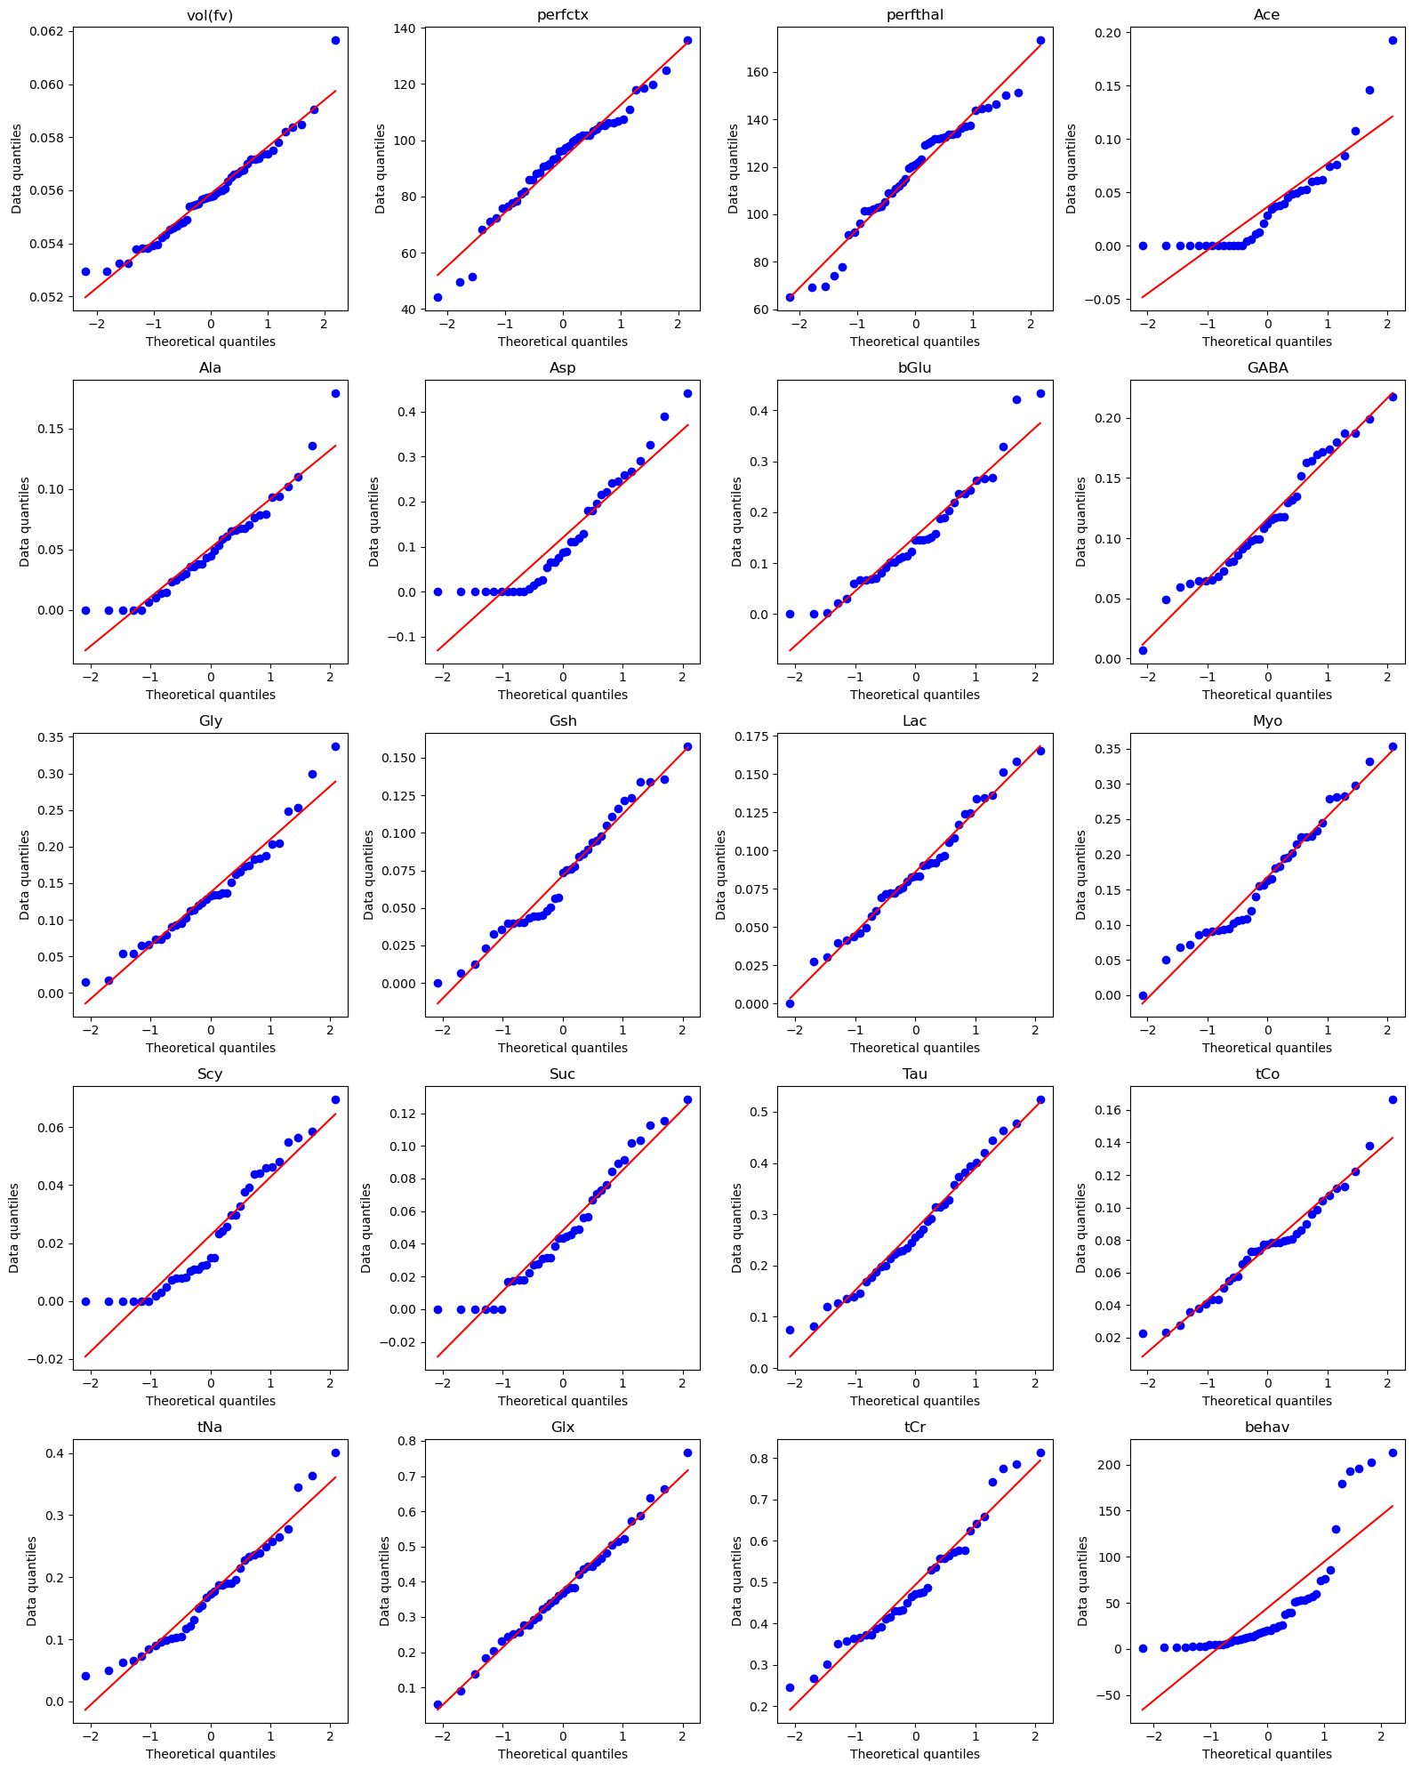

Slide 2
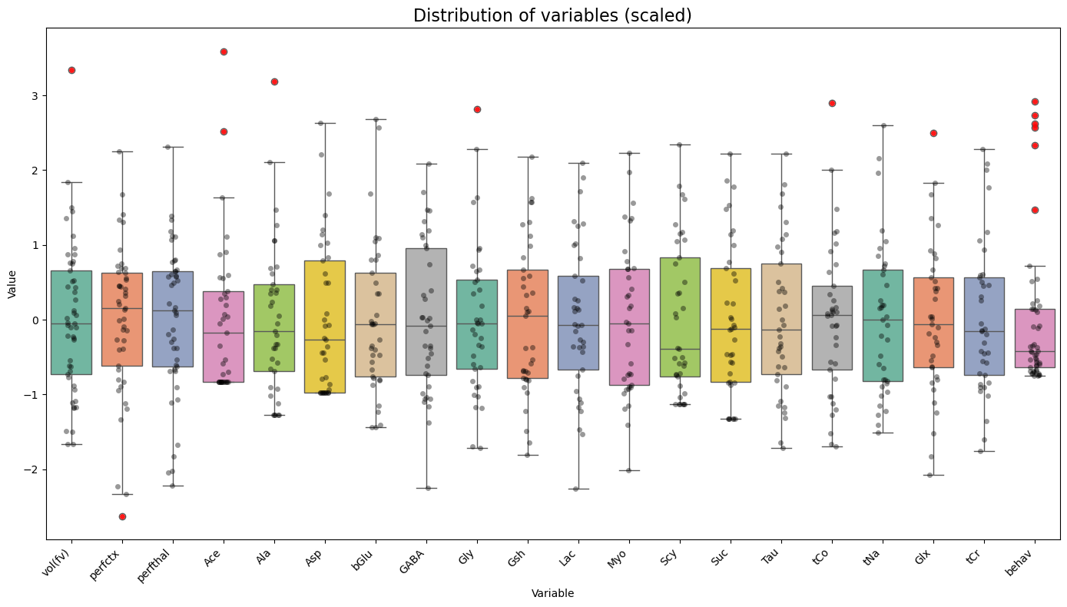

Slide 3
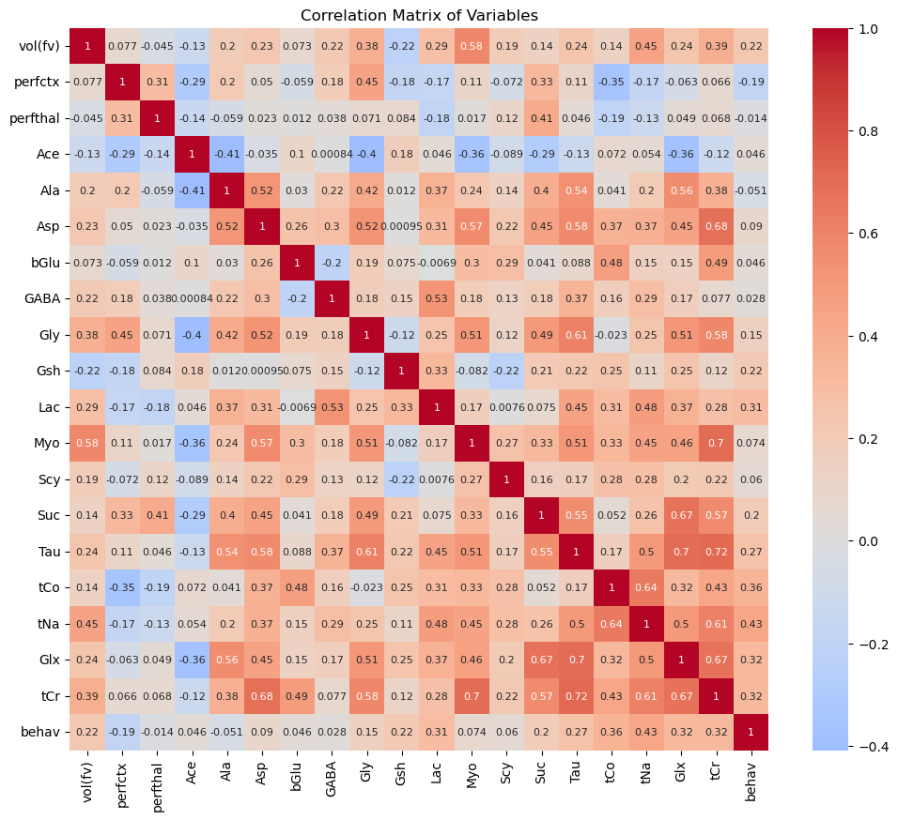
tNa | 0.429376
tCo | 0.356757
tCr | 0.318772
Perfctx | - 0.188244
Ala | - 0.050969
perfthal | - 0.014098

Slide 4
Regression models
Using the behavioral variable as it is (continuous)

Slide 5
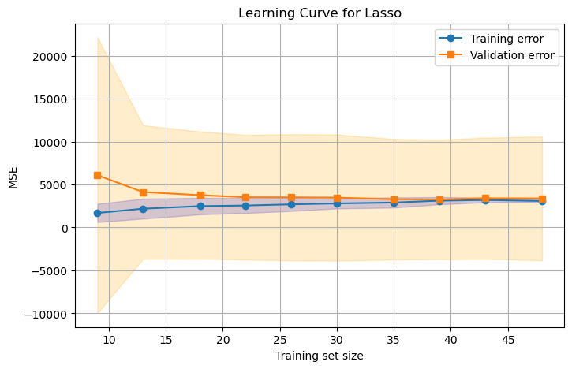
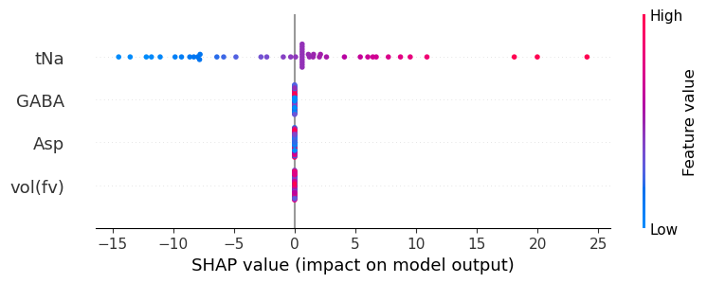
Lasso regression
MSE=3383.768, R²=-0.011
Notes:
Really close lines because the training size is very small

Slide 6
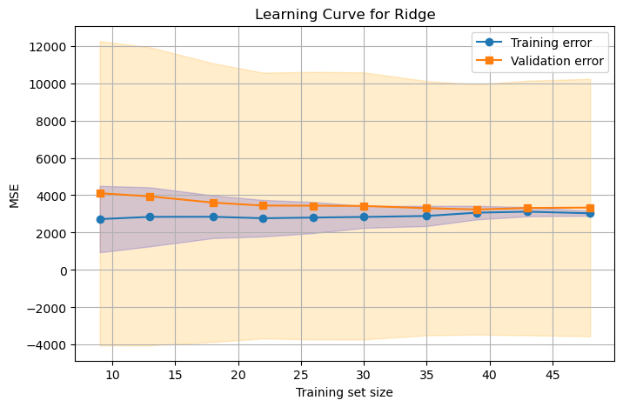
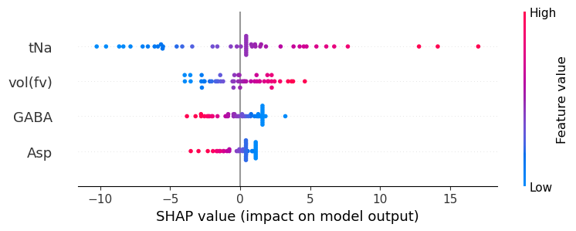
Ridge regression
MSE=3339.444, R²=0.002

Slide 7
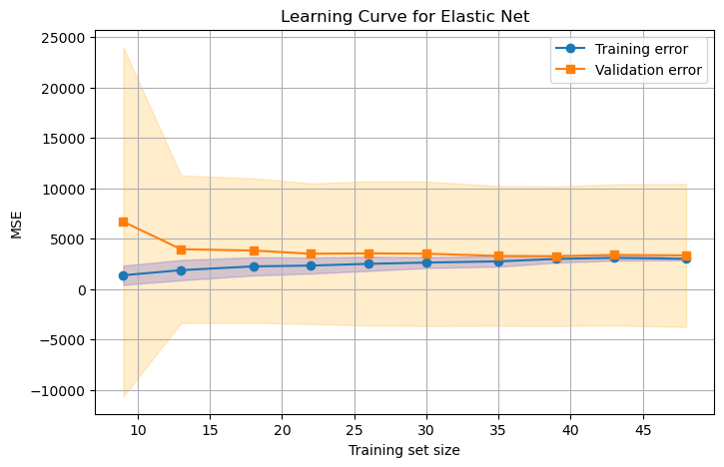
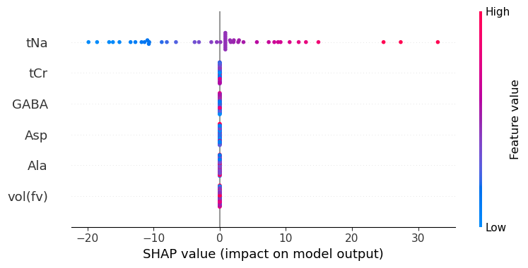
Elastic Net
MSE=3324.751, R²=0.006

Slide 8
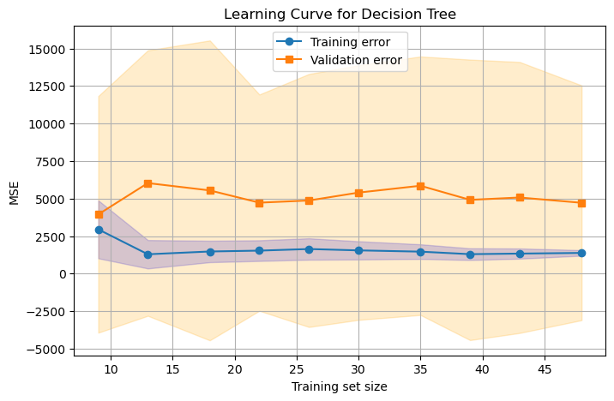
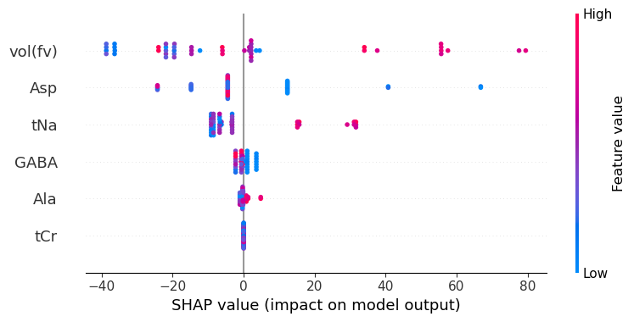
Decision Tree
MSE=4716.433, R²=-0.410

Slide 9
Model | Alpha | MSE | R2 | Predictors
Lasso R | 12.74 | 3383.768 | - 0.011 | Vol, tNa, GABA
Ridge R | 112.88 | 3339.444 | 0.002 | Vol, tNa, GABA
Elastic Net | 10 Best L1: 1 (so basically a Lasso) | 3324.751 | 0.006 | Vol, tNa, GABA
Decision Tree |  | 4716.433 | -0.41 | Vol, GABA, tNa

Slide 10
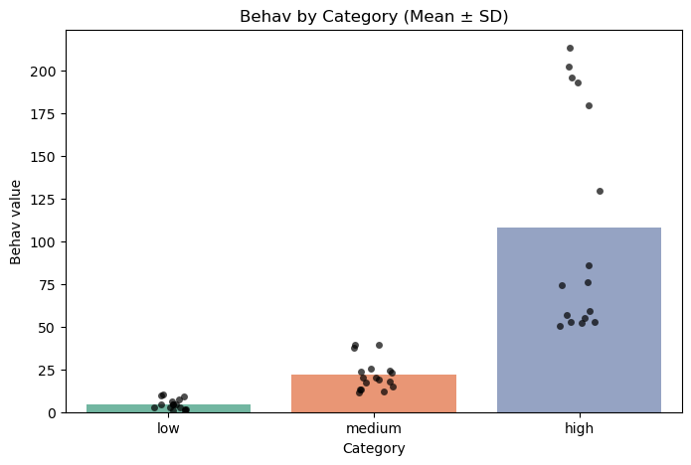
Classifier
Low = 1
Medium = 2
High = 0

Slide 11
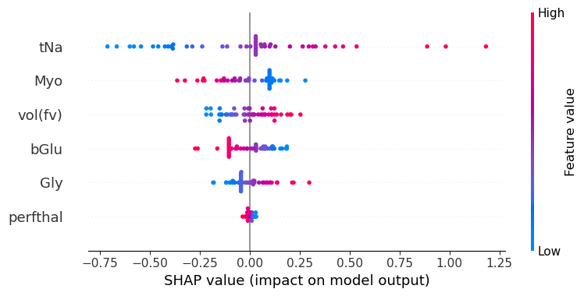
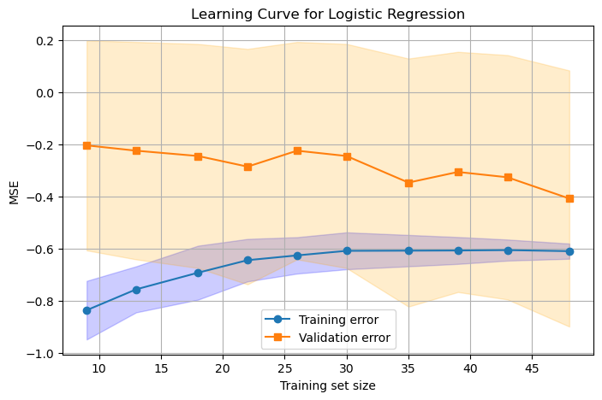
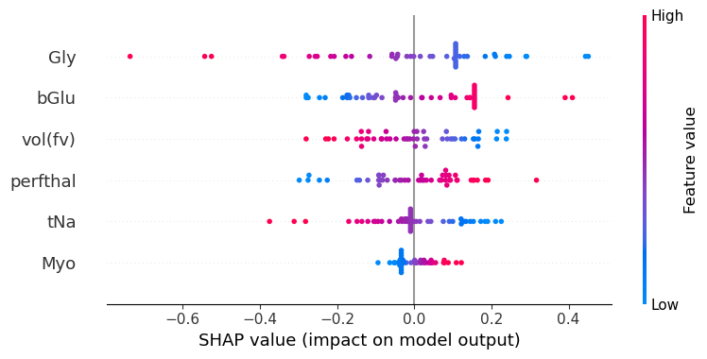
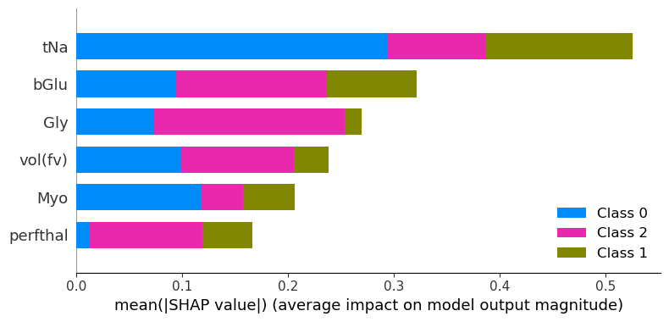
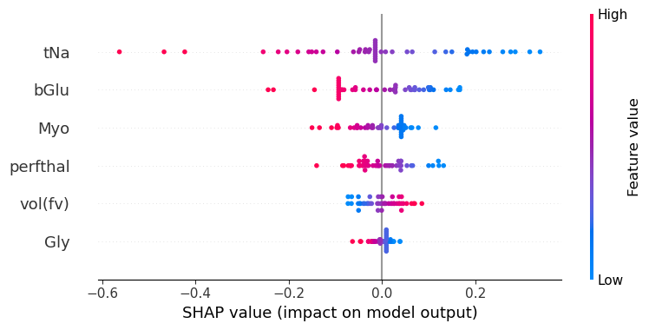
Logistic regression
High latency time
Medium latency time
Low latency time

Slide 12
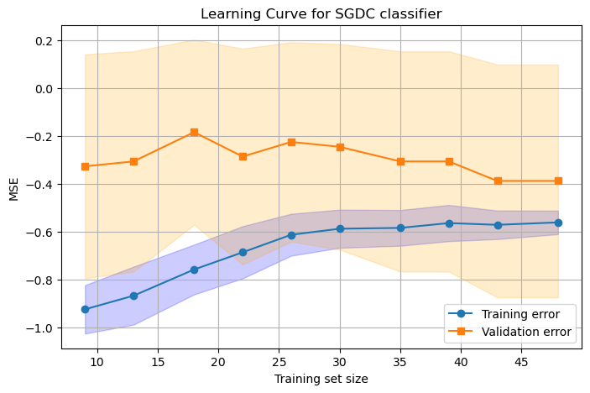
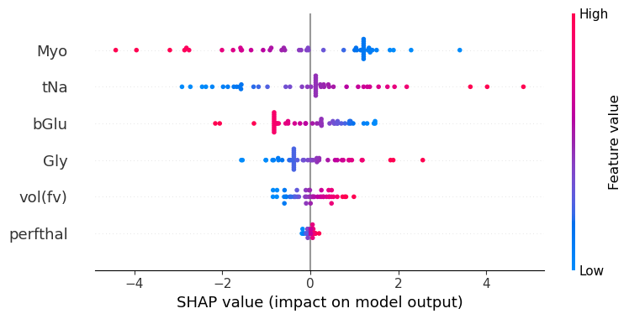
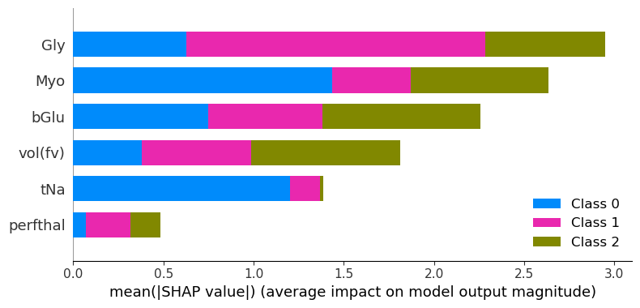
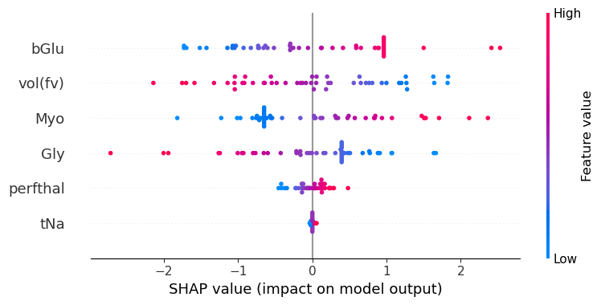
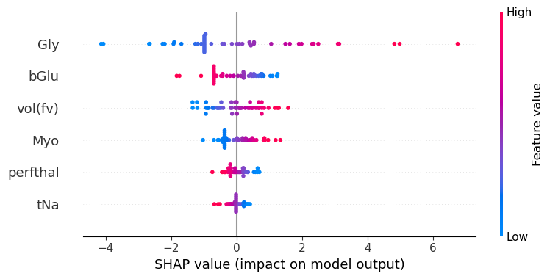
SGD classifier with elastic net penalty
High latency time
Medium latency time
Low latency time

Slide 13
Model | accuracy | features
Logistic regression | 0.408 | vol(fv) bGlu tNa
SGDC classifier | 0.510 | vol(fv) bGlu tNa

