Slide 1
Pattern Recognition and Machine Learning
(Fuzzy Sets in Pattern Recognition)
Debrup Chakraborty
CINVESTAV

Slide 2
Fuzzy Logic
When did you come to the class?
How do you teach driving to your friend
Linguistic Imprecision, Vagueness, Fuzziness – Unavoidable
It is beyond that: What is your height ?
5 ft. 8.25 in. !!
Subject to precision of the measuring instrument – Close to 5ft. 8.25 in.

Slide 3
Fuzzy Sets
Membership functions:
crisp set μ_{A} : X → {0,1}
Fuzzy set μ_{A} : X → [0,1]
S-type and Π-type membership functions
Degree of possessing some property – Membership value
Tall ( S – type)
1.0
Handsome ( Π -- type)
5.0
5.9
6.2
7.0

Slide 4
Basic Operations : Union, Intersection and Complement
Tall ( S – type)
1.0
Handsome ( Π -- type)
5.0
5.9
6.2
7.0
Tall ∪ Handsome ⇒ Tall OR Handsome
Tall ( S – type)
1.0
0.8
0.6
Handsome ( Π -- type)
5.0
5.9
6.2
7.0
Tall ∩ Handsome ⇒ Tall AND Handsome

Slide 5
Not Tall
Tall ( S – type)
1.0
5.0
5.9
6.2
7.0
Not Tall (Not = SHORT)
There are a family of operators which can be used for union and intersection for fuzzy sets, they are called S- Norms and T- Norms respectively

Slide 6
T- Norm
For all x,y,z,u,v ∈ [0,1]
Identity : T(x,1) = x
Commutativity: T(x,y) = T(y,x)
Associativity : T(x,T(y,z)) = T(T(x,y),x)
Monotonicity: x ≤ y, y ≤ v, T(x,y) ≤T(u,v)
S- Norm
Identity : S(x,0) = x
Commutativity: S(x,y) = S(y,x)
Associativity : S(x,S(y,z)) = S(S(x,y),x)
Monotonicity: x ≤ y, y ≤ v, S(x,y) ≤S(u,v)

Slide 7
Some examples of (T,S) pairs
T(x,y) = min(x,y); S(x,y) = max(x,y)
T(x,y) = x.y ; S(x,y) = x+y –xy;
T(x,y) = max{x+y-1,0}; S(x,y) = min{x+y,1}

Slide 8
Basic Configuration of a Fuzzy Logic System
Knowledge
Base
Fuzzification
Defuzzification
Inferencing
Output
Input

Slide 9
Types of Rules
Mamdani Assilian Model
R1: If x is A₁ and y is B₁ then z is C₁
R2: If x is A₂ and y is B₂ then z is C₂
A_{i} , B_{i} and C_{i,} are fuzzy sets defined on the universes of x, y, z respectively
Takagi-Sugeno Model
R1: If x is A₁ and y is B₁ then z =f₁(x,y)
R1: If x is A₂ and y is B₂ then z =f₂(x,y)
For example: f_{i}(x,y)=a_{i}x+b_{i}y+c_{i}

Slide 10
Types of Rules (Contd)
Classifier Model
R1: If x is A₁ and y is B₁ then class is 1
R2: If x is A₂ and y is B₂ then class is 2
What to do with these rules!!

Slide 11
Inverted pendulum balancing problem
θ
Force
Rules:
If θ is PM and θ is PM then Force is PM
If θ is PB and θ is PB then Force is PB

Slide 12
Approximate Reasoning
PM
PM
PB
θ
θ
Force
PM
PB
PM
PB
PM
PB
If θ is PM and θ is PM then Force is PM
If θ is PB and θ is PB then Force is PB

Slide 13
Pattern Recognition (Recapitulation)
Data
Object Data
Relational Data
Pattern Recognition Tasks
Clustering: Finding groups in data
Classification: Partitioning the feature space
Feature Analysis: Feature selection, Feature ranking, Dimentionality Reduction

Slide 14

Fuzzy Clustering
Why?
Mixed Pixels

Slide 15
Fuzzy Clustering
Suppose we have a data set X = {x₁, x₂…., x_{n}}⊂R^{p}.
A c-partition of X is a c × n matrix U = [U₁U₂ …U_{n}] = [u_{ik}], where U_{n} denotes the k-th column of U.
There can be three types of c-partitions whose columns corresponds to three types of label vectors
Three sets of label vectors in R^{c} :
N_{pc} = { y ∈R^{c} : y_{i} ∈ [0 1] ∀ i, y_{i} > 0 ∃i} Possibilistic Label
N_{fc} = {y ∈ N_{pc} : Σy_{i} =1} Fuzzy Label
N_{hc}={y ∈ N_{fc} : y_{i} ∈ {0 ,1} ∀ i } Hard Label

Slide 16
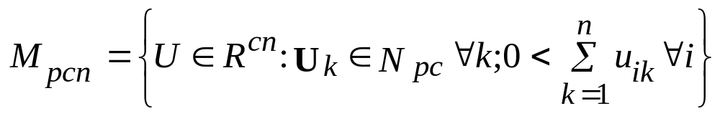
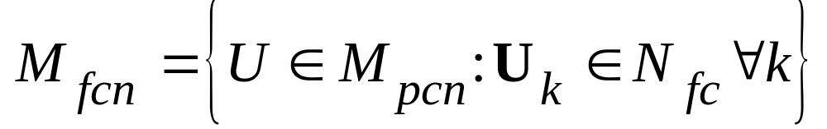
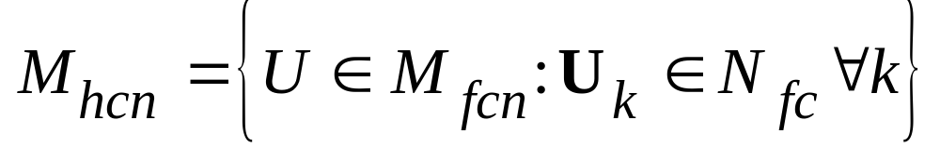
The three corresponding types of c-partitions are:
These are the Possibilistic, Fuzzy and Hard c-partitions respectively

Slide 17
An Example
Let X = {x1 = peach, x2 = plum, x3 = nectarine}
Nectarine is a peach plum hybrid.
Typical c=2 partitions of these objects are:
U₁∈ M_{h23}
U₂∈ M_{f23}
U₃∈ M_{p23}
x₁ | x₂ | x₃
1.0 | 0.0 | 0.0
0.0 | 1.0 | 1.0
x₁ | x₂ | x₃
1.0 | 0.2 | 0.4
0.0 | 0.8 | 0.6
x₁ | x₂ | x₃
1.0 | 0.2 | 0.5
0.0 | 0.8 | 0.6

Slide 18
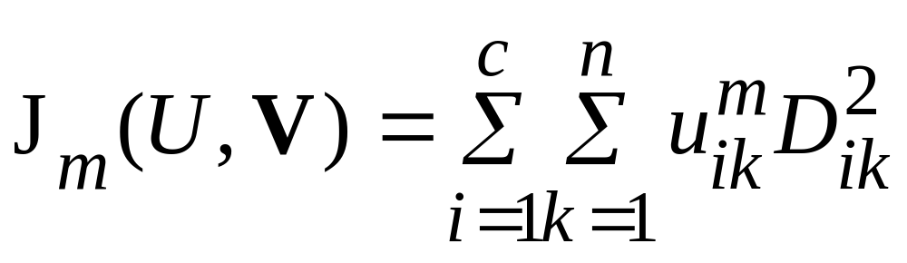
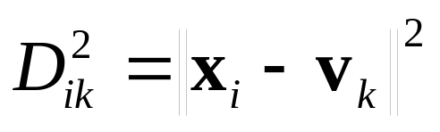
The Fuzzy c-means algorithm
The objective function:
Where, U∈M_{fcn,}, V = (v₁,v₂,…,v_{c}), v_{i} ∈ R^{p} is the i^{th} prototype
m>1 is the fuzzifier and
The objective is to find that U and V which minimize J_{m}

Slide 19
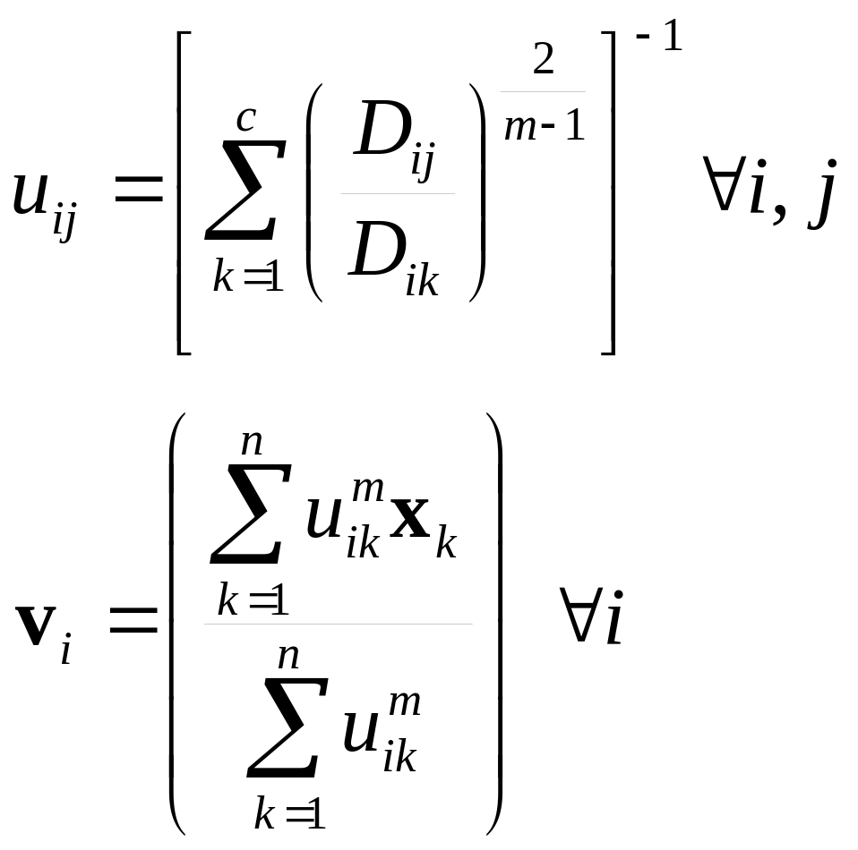
Using Lagrange Multiplier technique, one can derive the following update equations for the partition matrix and the prototype vectors
1)
2)

Slide 20
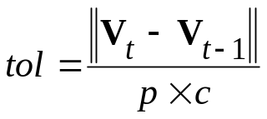
Algorithm
Input: X⊂R^{p}
Choose: 1 < c < n, 1 < m < ∝, ∈ = tolerance, max iteration = N
Guess : V₀
Begin
t → 1
tol → high value
Repeat while (t ≤ N and tol > ∈)
Compute U_{t} with V_{t-1} using (1)
Compute V_{t} with U_{t} using (2)
Compute
t → t+1
End Repeat
Output: V_{t}, U_{t}
(The initialization can also be done on U)

Slide 21
Discussions
A batch mode algorithm
Local Minima of J_{m}
m→1⁺, u_{ik} → {0,1}, FCM → HCM
m → ∝, u_{ik} → 1/c, ∀i and k
Choice of m

Slide 22



Fuzzy Classification
K- nearest neighbor algorithm: Voting on crisp labels
Class 1
Class 2
Class 3
z

Slide 23
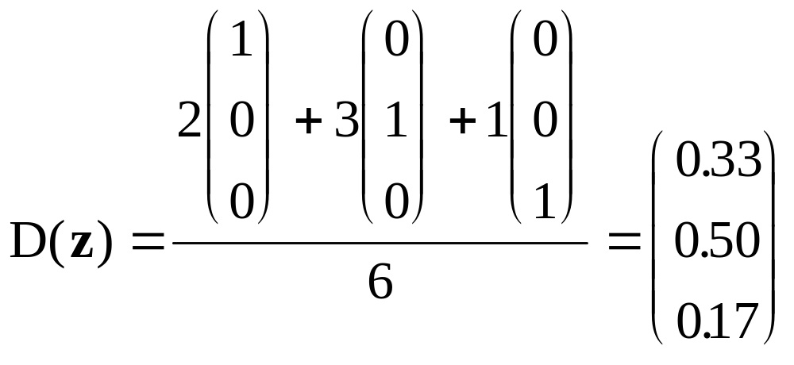
K-nn Classification (continued)
The crisp K-nn rule can be generalized to generate fuzzy labels.
Take the average of the class labels of each neighbor:
This method can be used in case the vectors have fuzzy or possibilistic labels also.

Slide 24
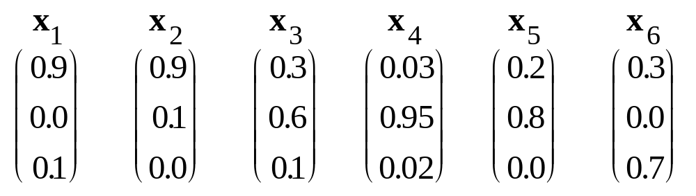
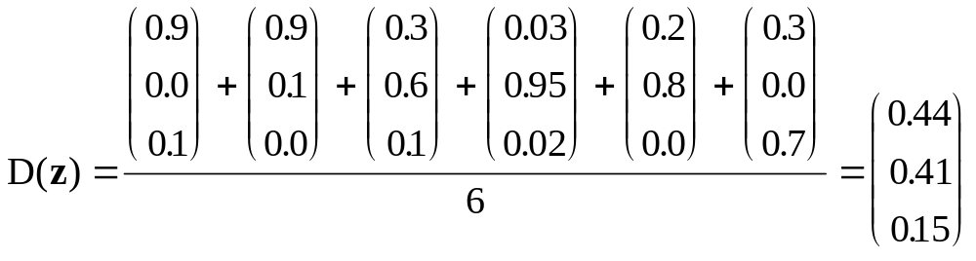
K-nn Classification (continued)
Suppose the six neighbors of z have fuzzy labels as:

Slide 25
Fuzzy Rule Based Classifiers
Rule1:
If x is CLOSE to a₁ and y is CLOSE to b₁ then (x,y) is in class is 1
Rule 2:
If x is CLOSE to a₂ and y is CLOSE to b₂ then (x,y) is in class is 2
How to get such rules!!

Slide 26
An expert may provide us with classification rules.
We may extract rules from training data.
Clustering in the input space may be a possible way to extract initial rules.
If x is CLOSE TO A_{x} & y is CLOSE TO A_{y} Then Class is
If x is CLOSE TO B_{x} & y is CLOSE TO B_{y} Then Class is
A_{y}
B_{y}
A_{x}
B_{x}

Slide 27
Why not make a system which learns linguistic rules from input output data.
A neural network can learn from data.
But we cannot extract linguistic (or other easily interpretable) rules from a trained network.
Can we combine these to paradigms?
YES!!

Slide 28
Neuro-Fuzzy Systems

Slide 29
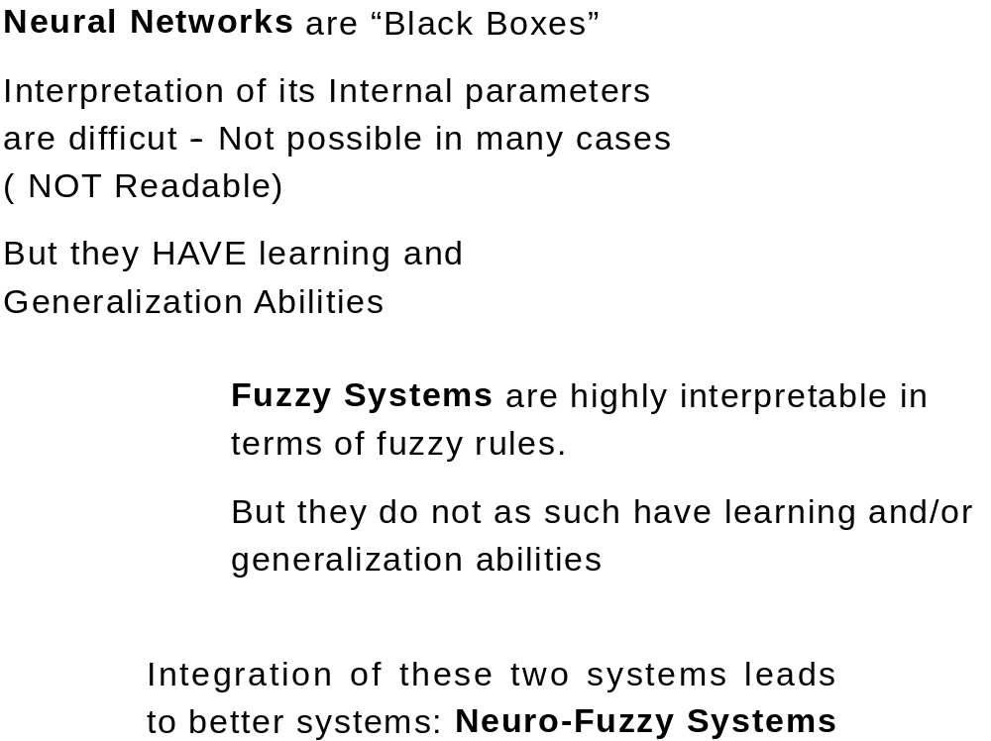

Slide 30
Types of Neuro-Fuzzy Systems
Neural Fuzzy Systems
Fuzzy Neural Systems
Cooperative Systems

Slide 31
A neural fuzzy system for Classification
Output Nodes
Antecedent Nodes
Fuzzification Nodes
x
y

Slide 32
Fuzzification Nodes
Represents the term sets of the features.
If we have two features x and y and two linguistic variables defined on both of it say BIG and SMALL. Then we have 4 fuzzification nodes.
BIG
SMALL
BIG
SMALL
x
y
We use Gaussian Membership functions for fuzzification ---
They are differentiable, triangular and trapezoidal membership functions are NOT differentiable.

Slide 33
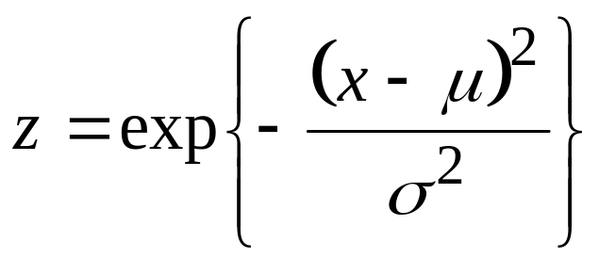
Fuzzification Nodes (Contd.)
μ and σ are two free parameters of the membership functions which needs to be determined
How to determine μ and σ
Two strategies:
1) Fixed μ and σ
2) Update μ and σ , through any tuning algorithm

Slide 34
Antecedent nodes
If x is BIG & y is Small
BIG
SMALL
BIG
SMALL
x
y

Slide 35
Class 1
Class 2
x
y

Slide 36
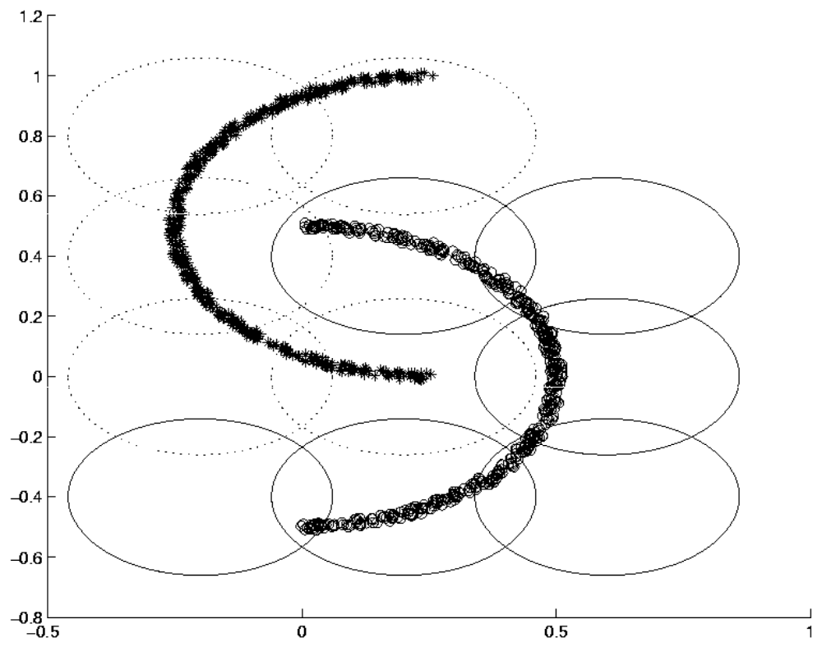

Slide 37
Further Readings
Neural Networks, a comprehensive foundation, Simon Haykin, 2nd ed. Prentice Hall
Introduction to the theory of neural computation, Hertz, Krog and Palmer, Addision Wesley
Introduction to Artificial Neural Systems, J. M. Zurada, West Publishing Company
Fuzzy Models and Algorithms for Pattern Recognition and Image Processing, Bezdek, Keller, Krishnapuram, Pal, Kluwer Academic Publishers
Fuzzy Sets and Fuzzy Systems, Klir and Yuan
Pattern Classification, Duda, Hart and Stork

Slide 38
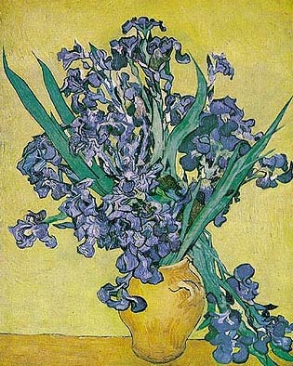
Thank You

