Slide 1


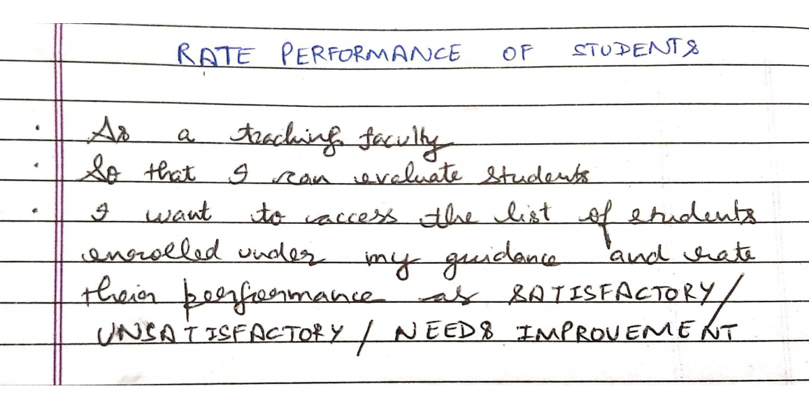
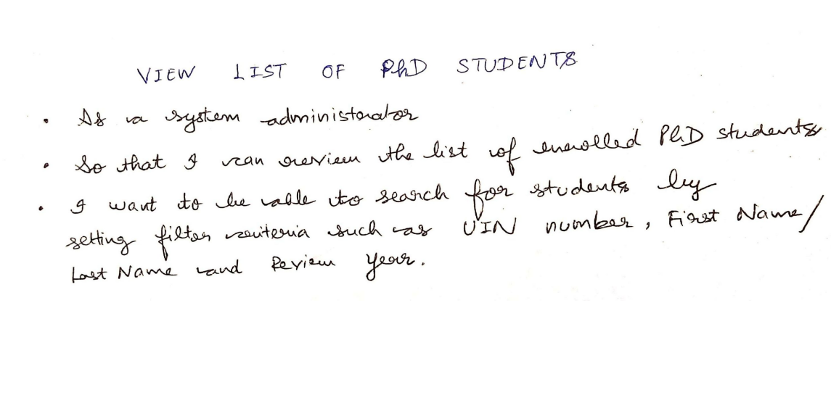
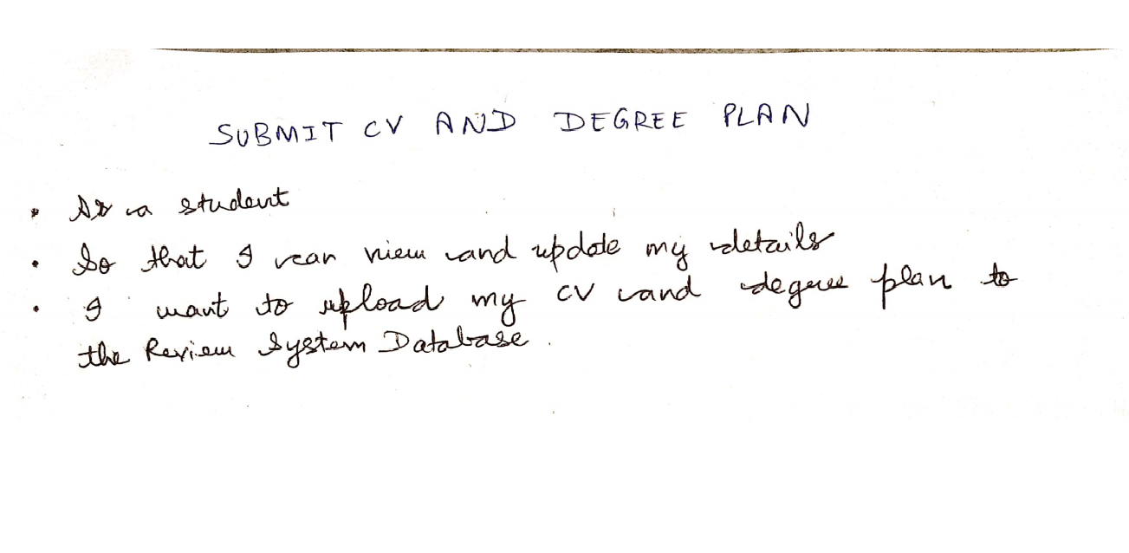
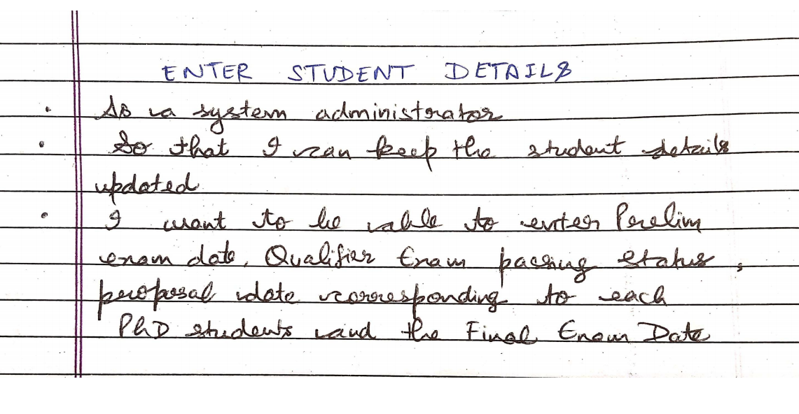





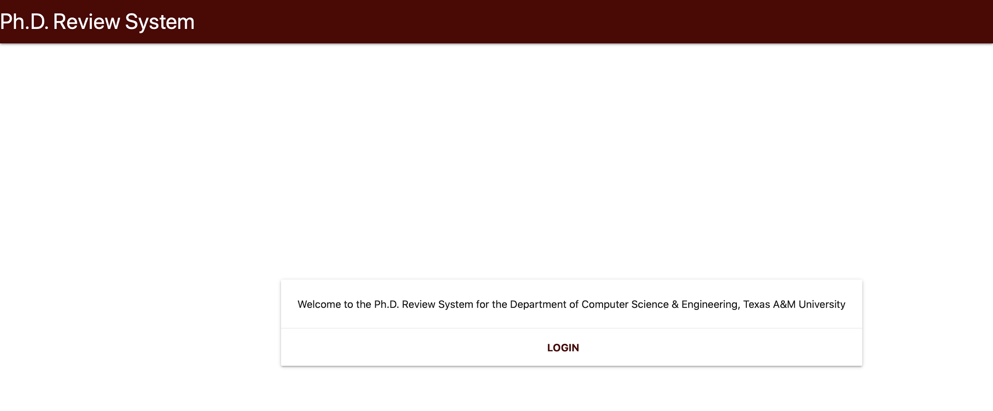
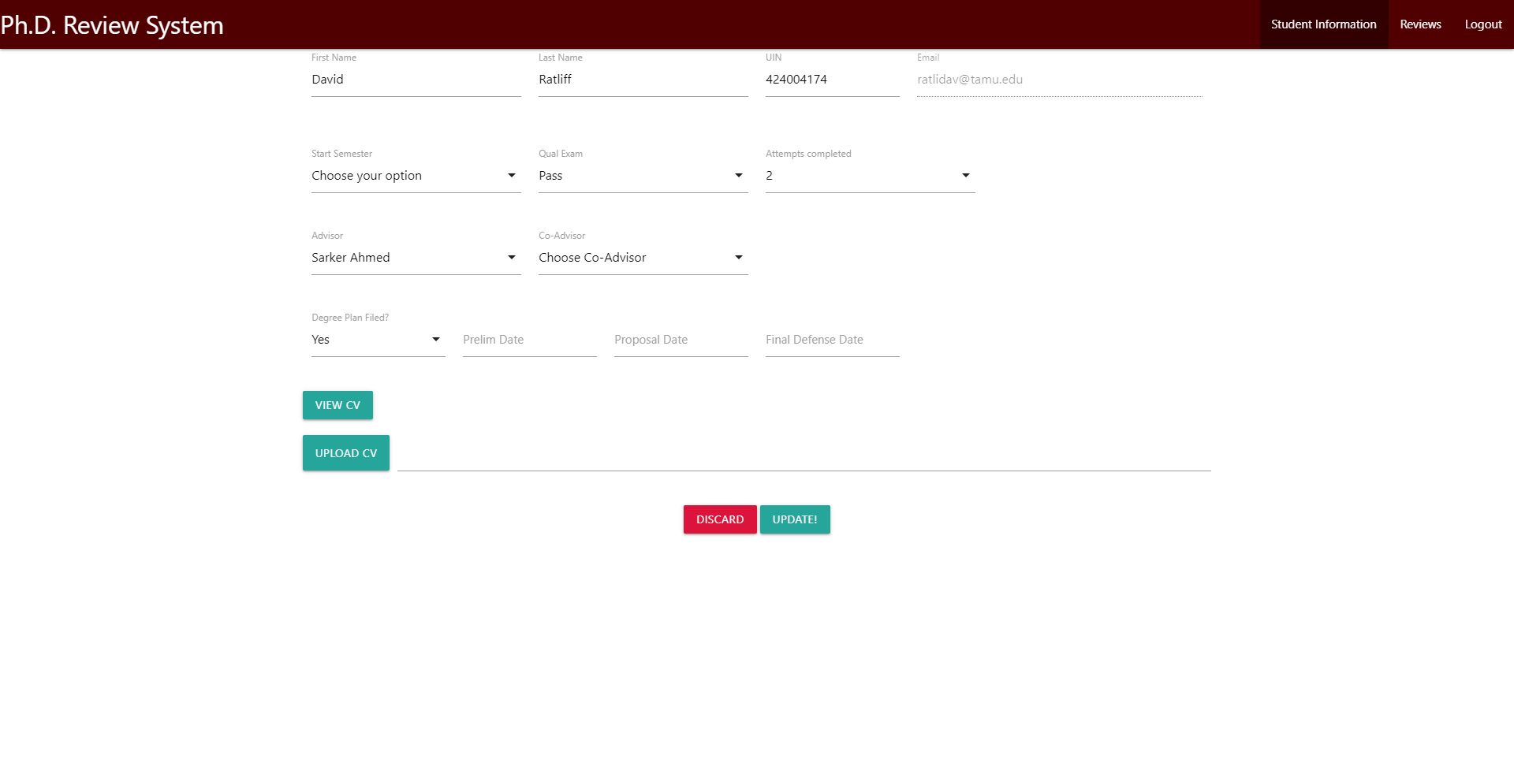
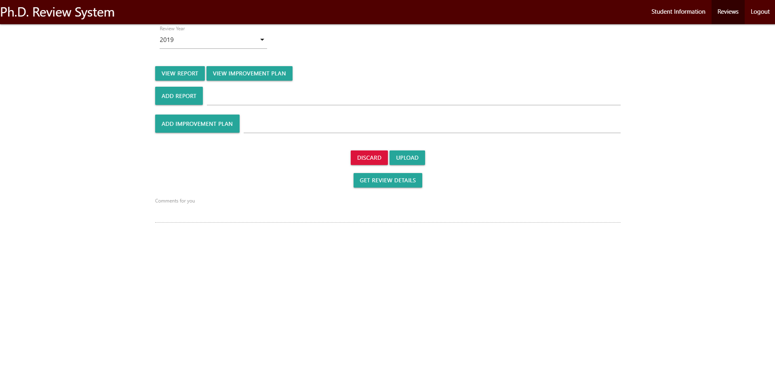
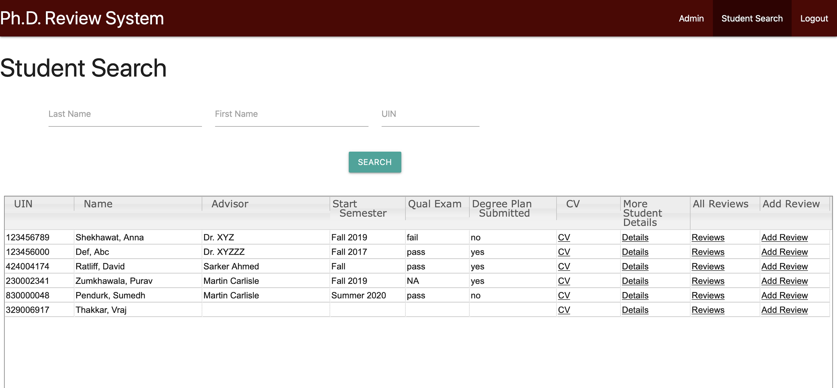
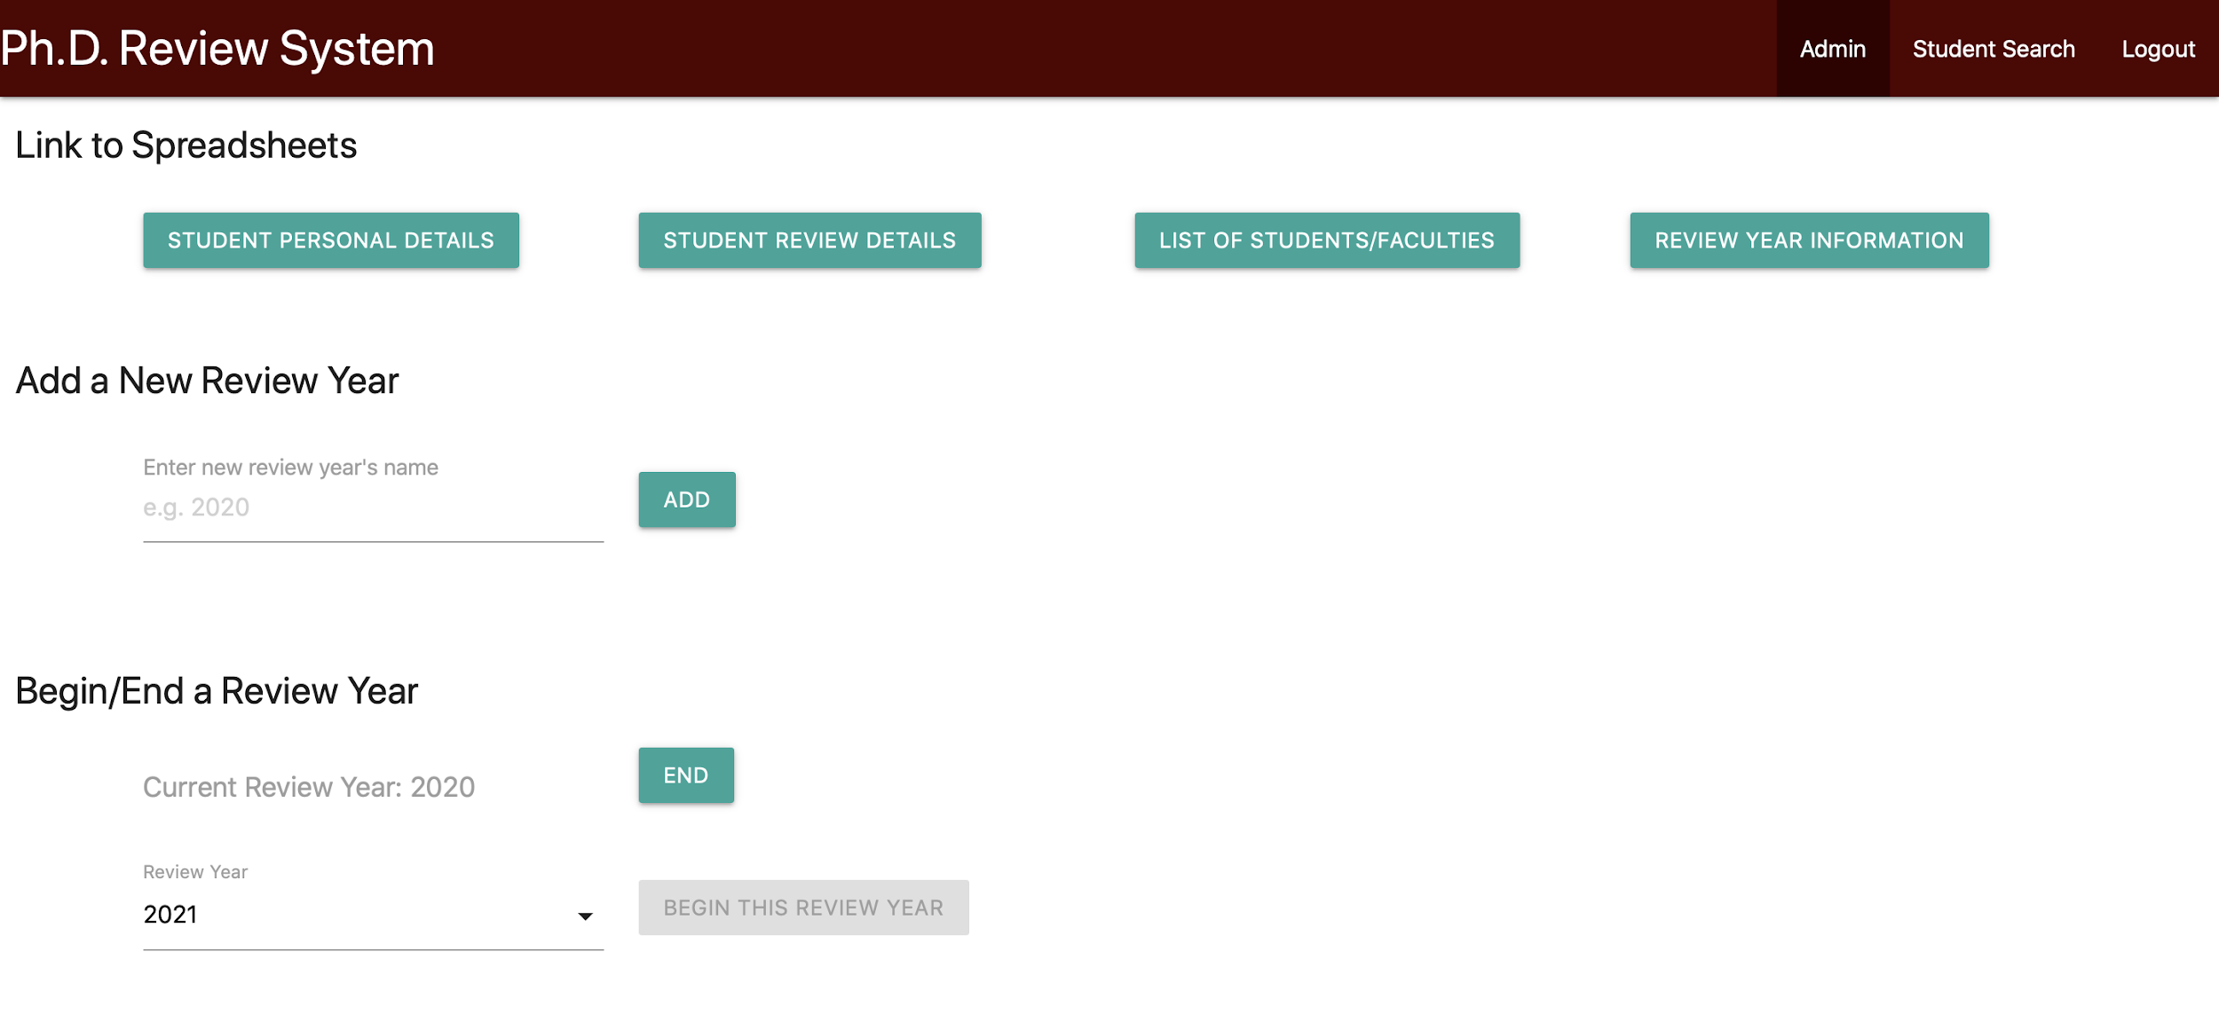
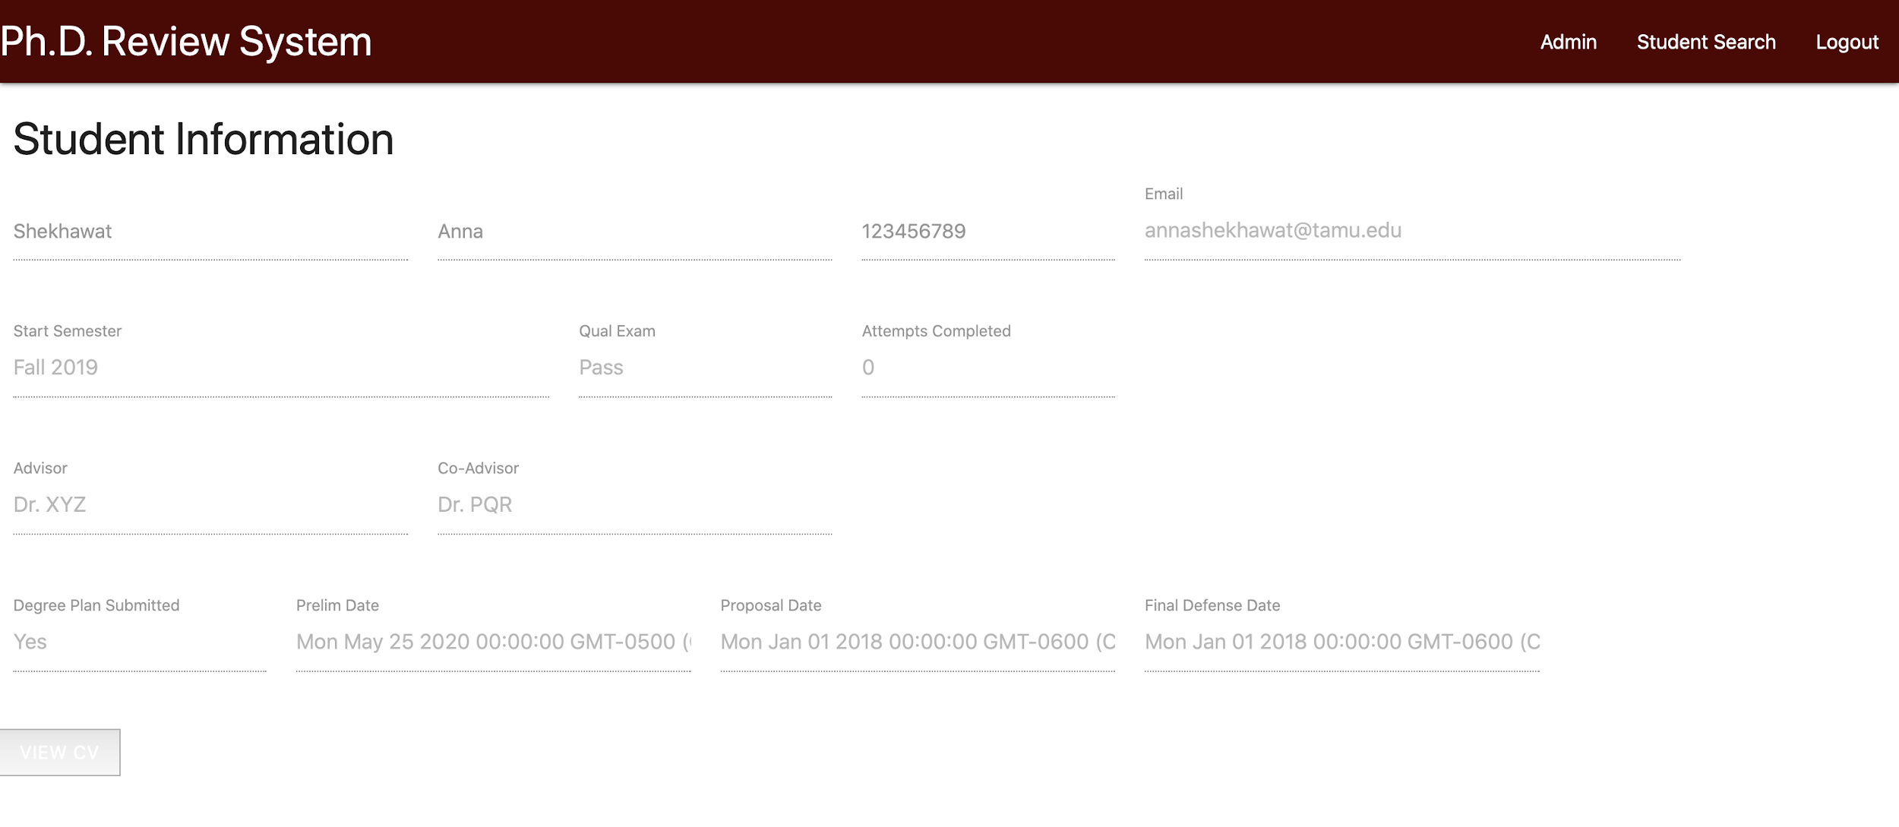
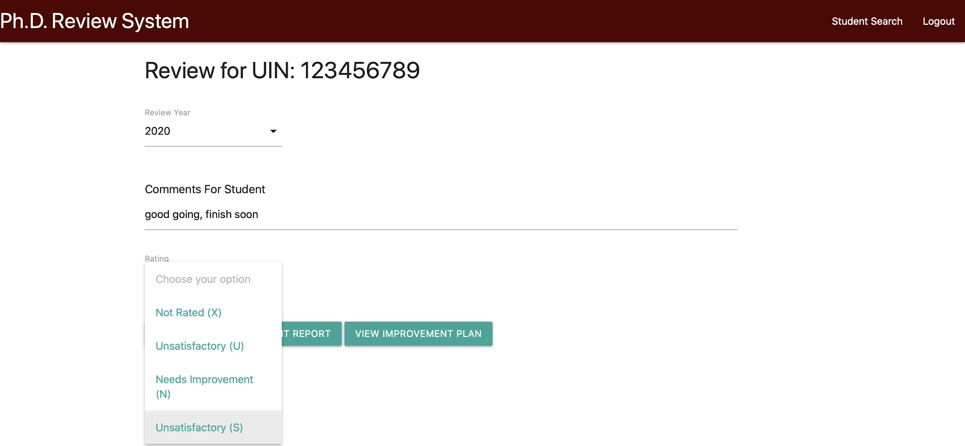
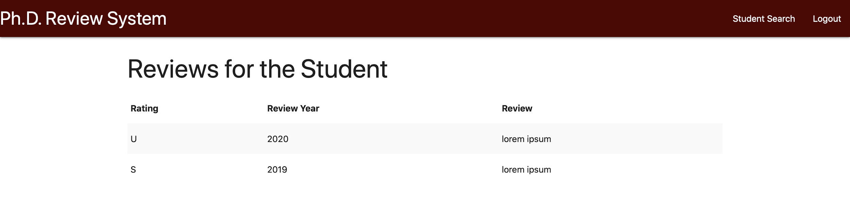
PhD Review System
Suresh Gandhi, Ankur Kunder, Sumedh Pendurkar, David Ratliff, Anna Shekhawat, Purav Zumkhawala
Department of Computer Science and Engineering, Texas A&M University
Introduction
Flow Diagram
The customer needed a PhD Review System to facilitate the reviews for PhD Students in the Department of Computer Science & Engineering at Texas A&M University.
The review system shall be accessible to students, their faculty advisors and to the Program Specialist and Graduate Advisor.
Login Page
Redirect to TAMU Engineering CAS
Application Goals
Valid Login
Authentication through CAS
Program Specialist and Graduate Advisor: Can add new students to the system, administrate review years, and modify student info
Faculty Advisor: Can view student details and create reviews
PhD Students: Can view personal details including professor evaluation and upload their resume and improvement plan if needed.
Student
User Role
Advisor
Administrator
Search for a student
View and upload personal details
No
Student available in the database?
Add new student / faculty
Search for a student
User Stories
Yes
View Date related details
View Review details
Modify Data for Students
Start and End a Review Year
Upload Department Letter
Edit Student Review
Figure 3: Schematic flow diagram of the PhD Review System
Technologies & Tools Used
Figure 1: Initial User Stories
Figure 2: Tools and technologies used (left to right):
Google Apps Script, Google Drive/Sheets API, jQuery, Materialize, GitHub
PhD Review Web Page Illustrations
Login Page
Review Pages
Admin Pages
Student View Pages

