Slide 1
SmartCard Reader Tarjetas con Chip
Estructura del Proyecto

Slide 2
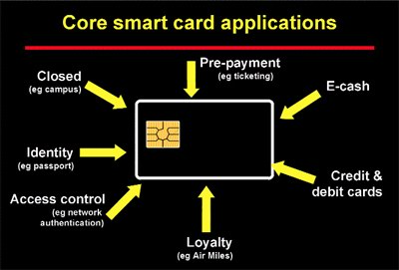
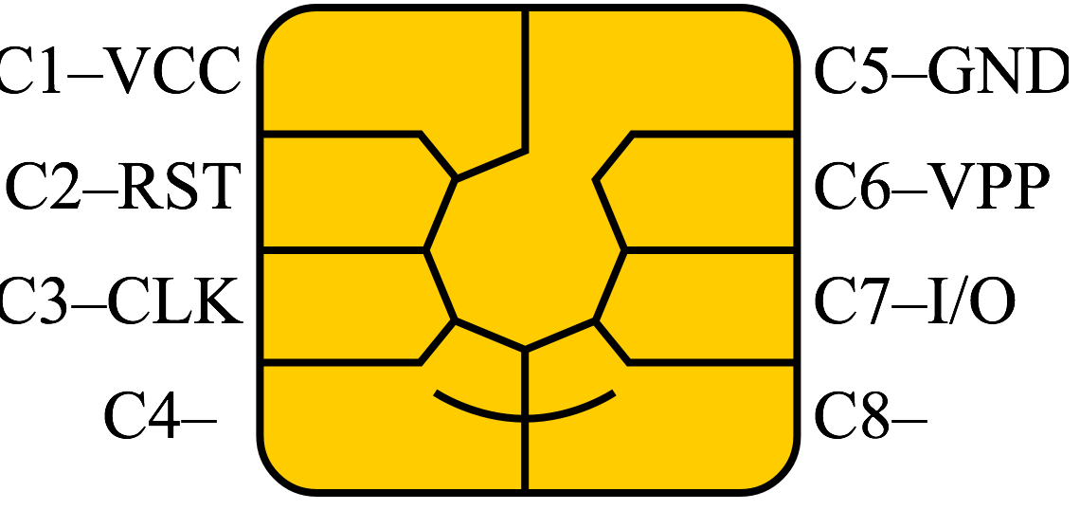
SmartCards

Slide 3



EMV

Slide 4
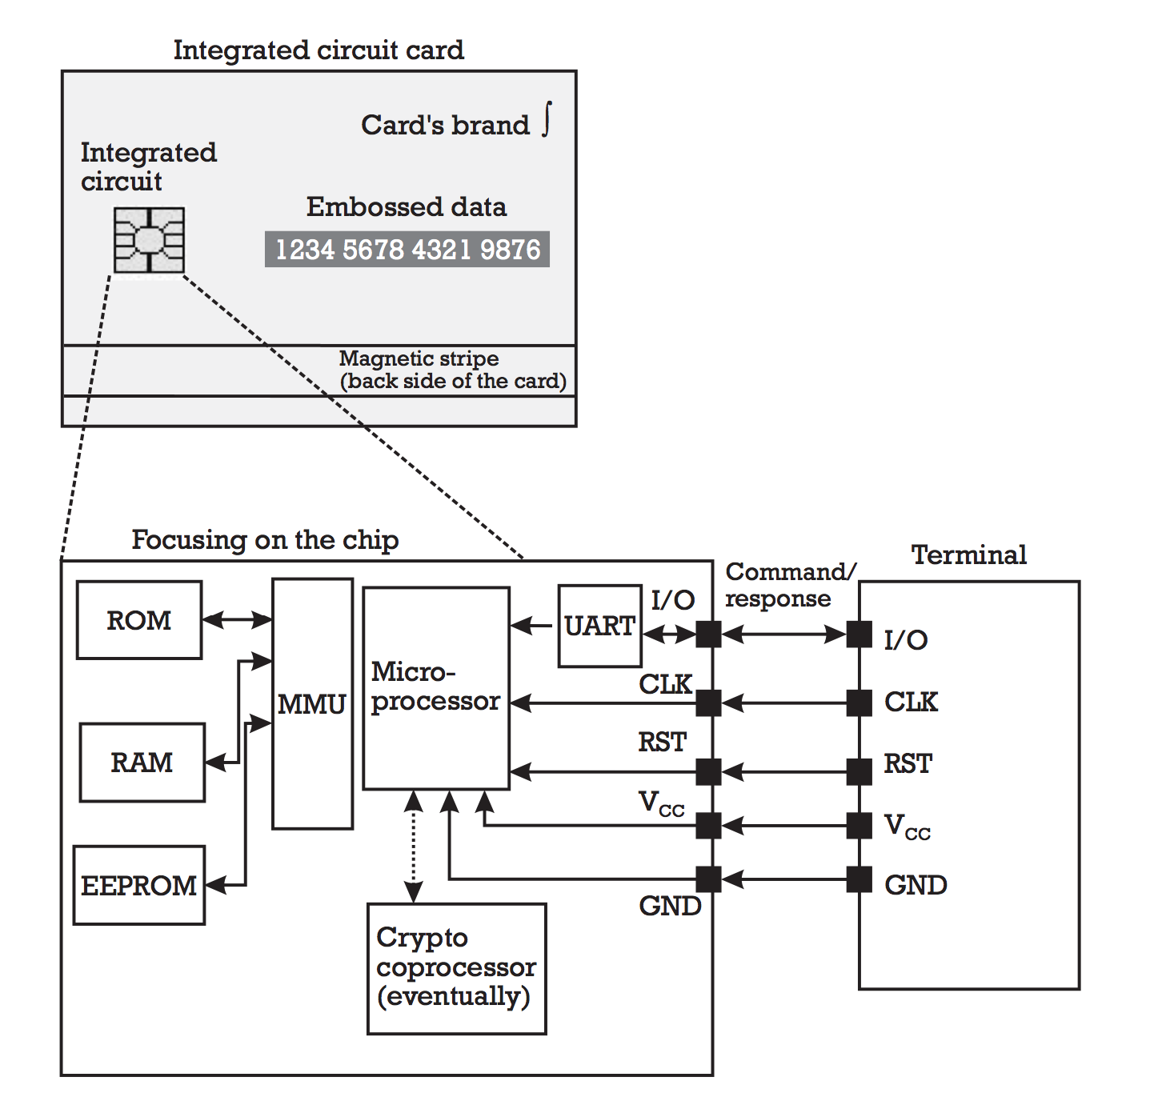
Estructura

Slide 5
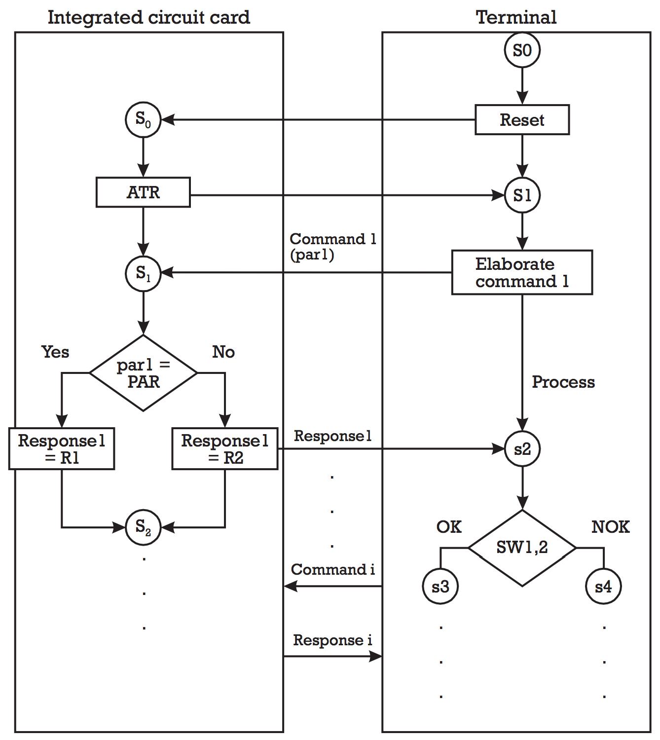
Comunicación

Slide 6
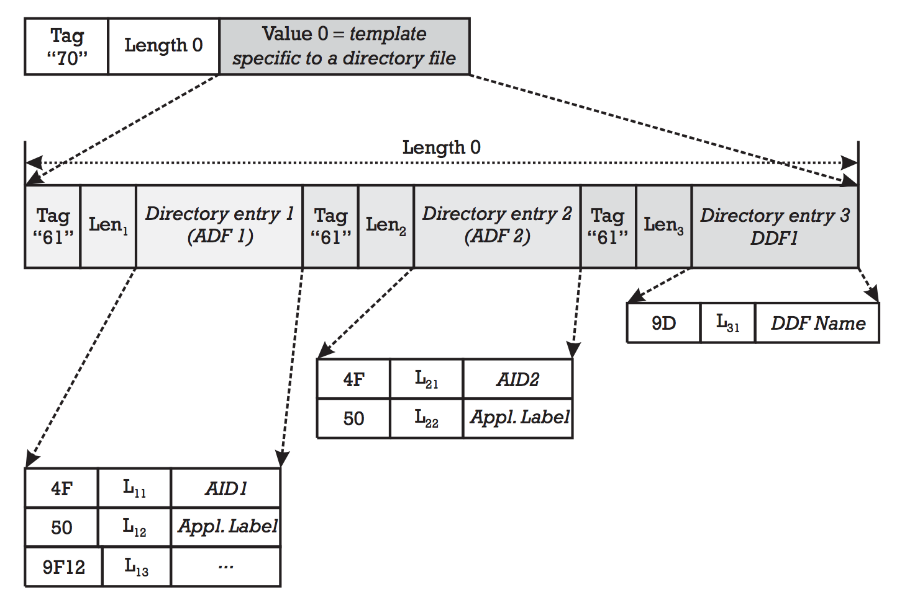
TLV – Tag, Lenght, Value

Slide 7
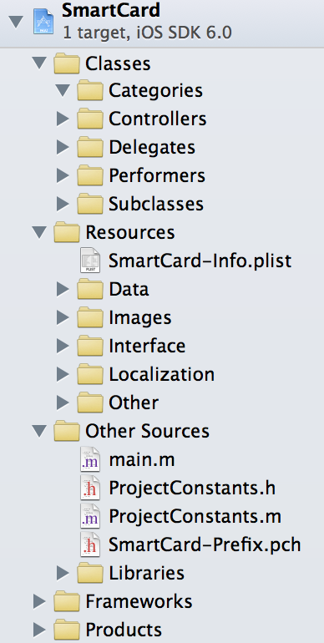
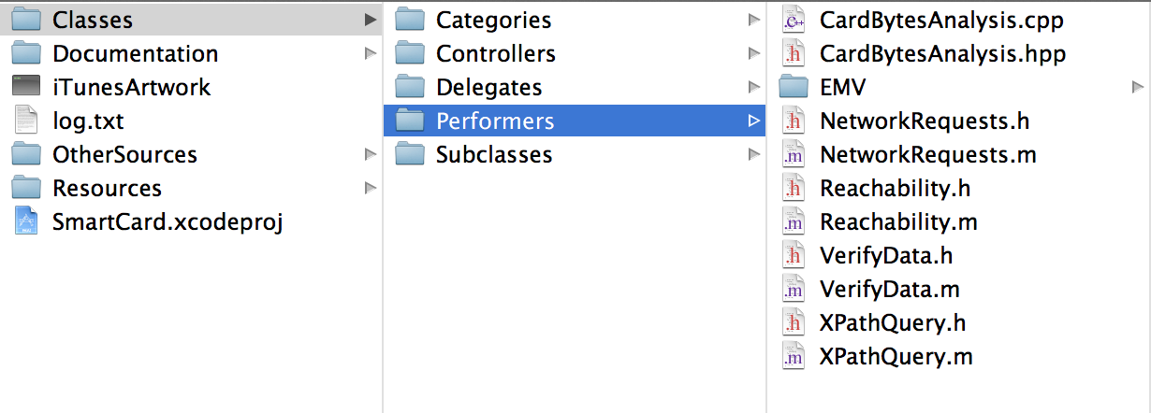
Xcode: SmartCard project
º
Demo

Slide 8
Referencias
http://www.openscdp.org/scripts/tutorial/emv/tlv.html
http://blog.saush.com/2006/09/08/getting-information-from-an-emv-chip-card/
Implementing Electronic Card Payment Systems, Christian Randu
Artech House 2003
EMV: Integrated Circuit Card Specifications for Payment Systems Book 1, 2, 3, 4
EMVCo 2011

