Slide 1
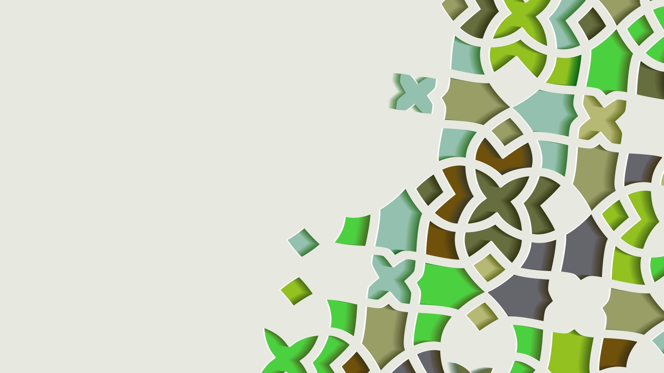
DiamondBack Insights
Group 10:
Asheer Mogal
Rohit Abbireddi
Pranay Reddy Anthareddy
Aniket Chafekar
Date: 12/03/2023
Last Updated: 12/10/2023

Slide 2
Sources & Users
Users :
Potential Incoming students
Current Students
University Management & Marketing team
Sources :
https://www.rhsmith.umd.edu/programs
https://www.forbes.com/top-colleges/
https://www.usnews.com/best-colleges
https://www.timeshighereducation.com/world-university-rankings

Slide 3

Mission Statement
"To develop a detailed database that captures the historical rankings of UMD's graduate programs from a variety of sources. This database aims to facilitate thorough trend analysis and usage by various members of the university and also assist in benchmarking, providing insightful, data-based perspectives that enhance and promote the prestige of the school."

Slide 4

Mission Objectives
To create a comprehensive database of historical rankings for UMD graduate programs from
multiple sources, enabling in-depth analysis of trends and benchmarking to provide data-driven
insights that strengthen the school's reputation.

Slide 5
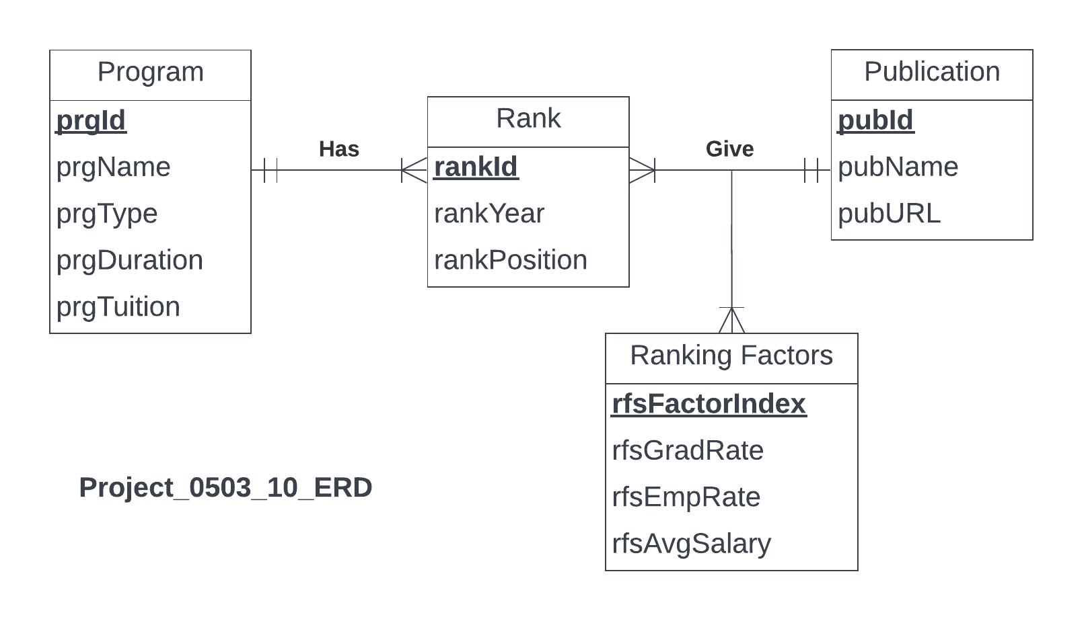
ER Diagram

Slide 6
Relational Schema
Program (prgId, prgName, prgType, prgDuration, prgTuition)
Publication (pubId, pubName, pubURL)
RankingFactors (rfsFactorIndex, rfsGradRate, rfsEmpRate, rfsAvgSalary)
Rank(rankId, prgId, rankYear, rankPosition)
Give(pubId, rfsFactorIndex, rankId)

Slide 7
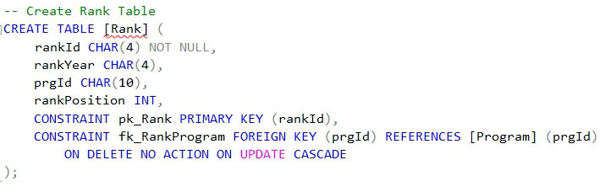
Table Creation – Rank Table

Slide 8
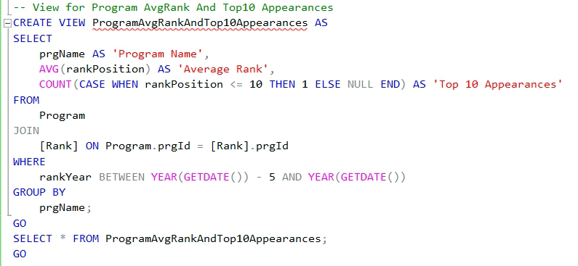
Business Transaction: 1. View for Program Average Rank and Top10 Appearances

Slide 9
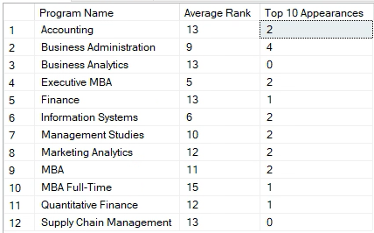
Business Transaction: 1. View for Program Average Rank and Top10 Appearances Output

Slide 10
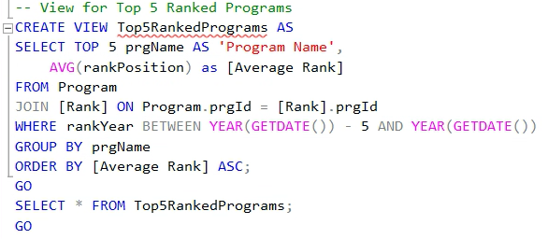
Business Transaction: 2. View for Top 5 Ranked Programs

Slide 11
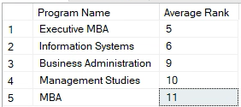
Business Transaction: 2. View for Top 5 Ranked Programs Output

Slide 12

Thank You

