Slide 1
dataElementName
numeratorDenom
resultTarget
HTC_TST (N, TA, Age/Sex/Result) TARGET: HTC received results
indicator
type
disaggregate
label

Slide 2
Typical Reference
= SUM(X1:X439)
Not clear what is being summed in formula
Structured Reference (using a table)
= SUM(data[Value])
Column name from table
Table name

Slide 3
2015 OR Ethiopia
2015 AND Ethiopia
2015
Ethiopia
2015
Ethiopia
NOT 2015
2015
Ethiopia

Slide 4
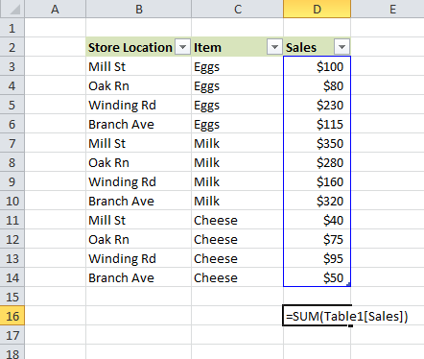
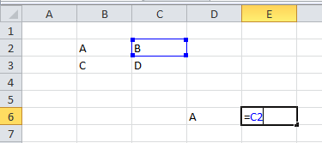
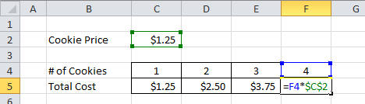
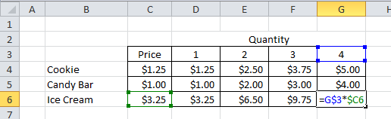

Slide 5
standard
Value if TRUE
LOGIC
Value if FALSE
nested
Value if TRUE
LOGIC
Value if TRUE
Logic if FALSE
Value if FALSE

Slide 6
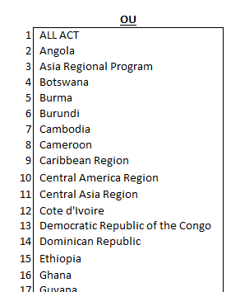
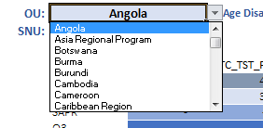
front end dropdown selection
list/named range on backend

Slide 7
SUMIFS Structure
=SUMIFS(sum_range, criteria_range1, criteria1, [criteria_range2, criteria2], ...)]
Easy SUMIFS
sum_range
= SUMIFS(data[Value], data[orgLevel3Name], “Ethiopia”))
Table name
criteria_range1
criteria1
Column name from table

Slide 8
sum_range
Table name
criteria_range1
criteria1
Column name from table
Moderate SUMIFS
= SUMIFS(data[Value], data[orgLevel3Name], “Ethiopia”), data[categoryOptionComboName, “*Positive*”, data[disaggregate], “Age/Sex/Result”))
wild card
Difficult SUMIFS
sums the SUMIFS formula for each criteria group
= SUM(SUMIFS(data[Value], data[orgLevel3Name], “Ethiopia”), data[categoryOptionComboName, “*Positive*”, data[disaggregate], “Age/Sex/Result”), data[categoryOptionComboName], {“*<1*”, “*1-4*”, “*5-9*”, “*10-14*”}))
multiple criteria surrounded by brackets

Slide 9
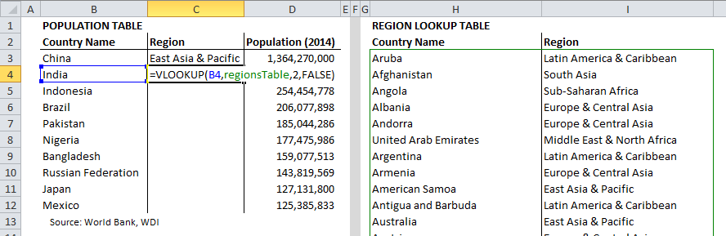
VLOOKUP
exact match only
= VLOOKUP(B4, regionsTable, 2, FALSE)
item to lookup
column # in table
named range for the table on the right

Slide 10
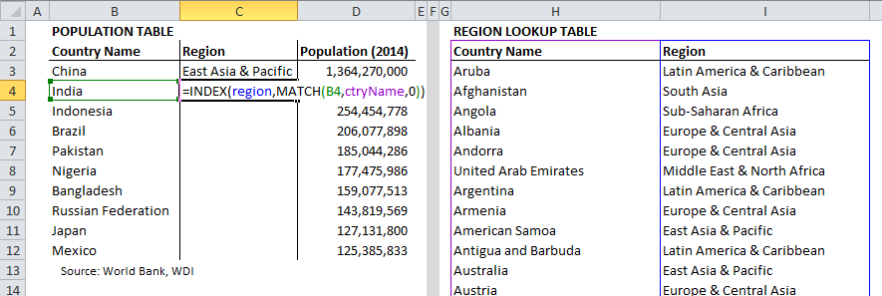
INDEX-MATCH
exact match only
= INDEX(region, MATCH(B4, ctryName, 0))
named range where region values are
named range in lookup table with country values
named range for the table on the right

Slide 11
INDEX & MATCH Structures
=INDEX(array, row_num, [column_num])
=MATCH(lookup_value, lookup_array, [match_type])

