Slide 1
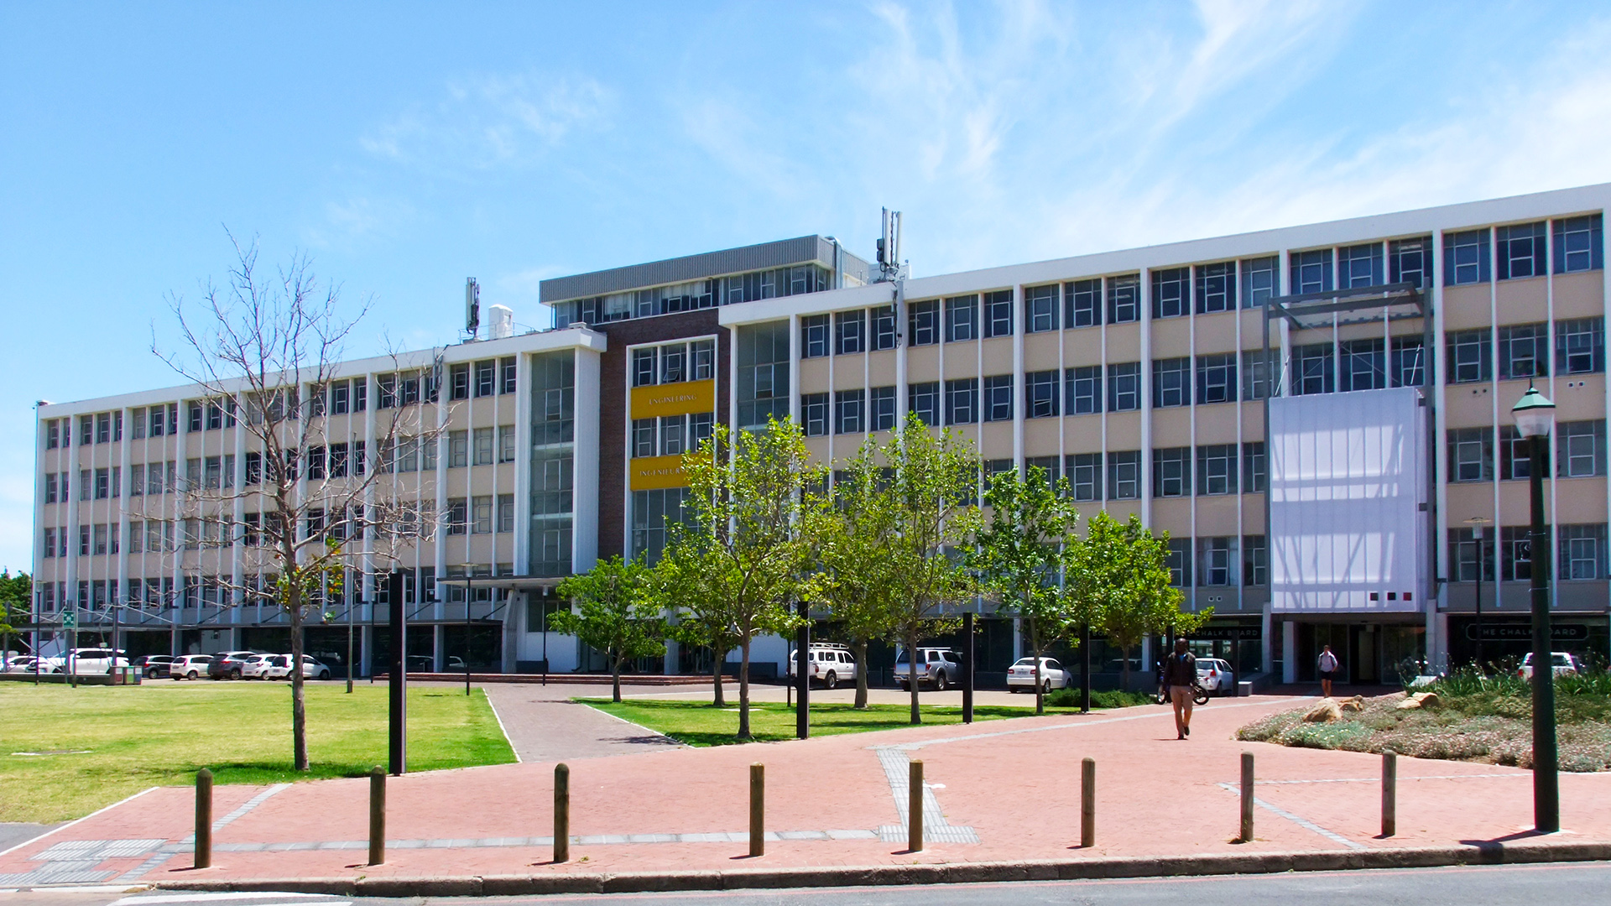
Compression of a Deep Reinforcement Learning Agent onto an Embedded Microcontroller
Achaia Beukes
Photo by Stefan Els
Notes:
Cover & End Slide Option
Replace the background image: Right-click on the slide, then choose Format Background and select Picture or texture fill. Select a new picture of your choice.
Remember to add an image attribution for e.g., Photo by Stefan Els.

Slide 2
Outline
Progress Presentation Overview
Background & Motivation
Project Objectives
Reinforcement Learning Algorithm
Deep Reinforcement Learning Algorithm
Hyperparameter Tuning using Optuna
Safety Concerns
Planned Activities
Conclusion

Slide 3
Background & Motivation
Why compress DRL for embedded devices?
Growing demand for autonomous on-device AI Systems
Systems are often resource-constrained
High memory & computing costs limit deployment
Compression research centres on supervised learning
This project targets a Deep Q-Network Agent

Slide 4
Project Objectives
Implement DRL Algorithm on Desktop PC
Train Agent to a Baseline Performance
Compress Policy Network for Deployment
Deploy Compressed Agent onto Embedded Device
Add Camera for Real-World Image Input

Slide 5
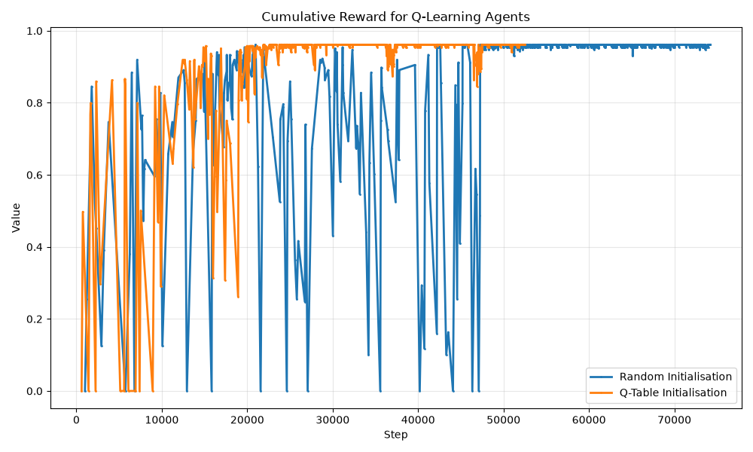

Reinforcement Learning Algorithm
Tabular Q-Learning Agent
Learns from Experience
Builds Q-Table with Q-Values
Bellman Equation
$Q\left(s,a\right)=R\left(s,a\right)+ γmax_{a}Q(s^{′},a)$
Epsilon Greedy Action Selection
Exploration
Exploitation
Decay Epsilon

Slide 6
Deep Reinforcement Learning Agent
Deep Q-Network Architecture
Neural Network as a Function Approximator
Policy Network Training
Epsilon Greedy Exploration Strategy
Experience Replay Buffer
Periodic Update of the Target Network

Slide 7
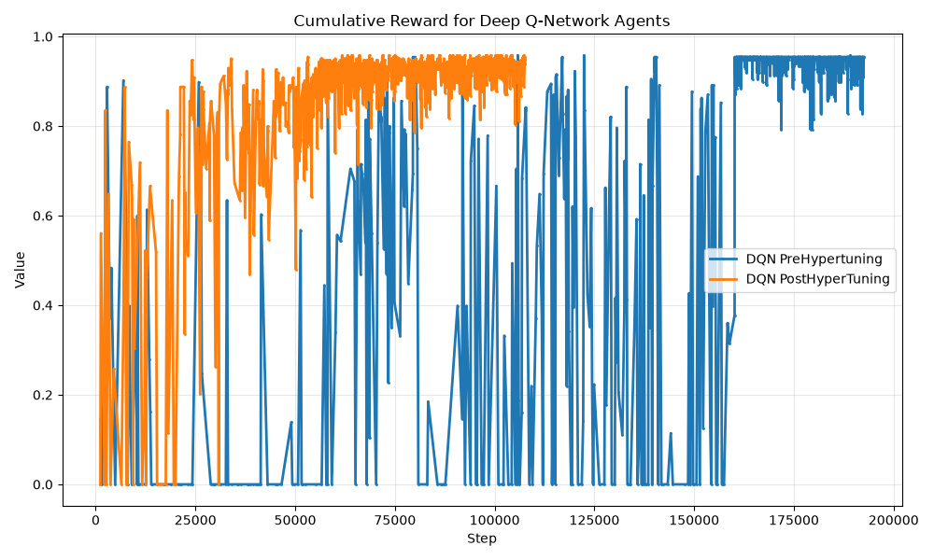
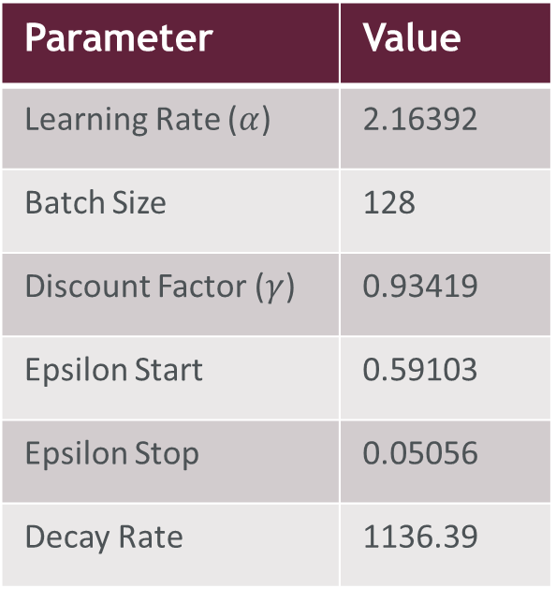
Hyperparameter Tuning using Optuna
Final Model Parameters
Parameter | Value
Learning Rate ($α$) | 2.16392
Batch Size | 128
Discount Factor ($γ$) | 0.93419
Epsilon Start | 0.59103
Epsilon Stop | 0.05056
Decay Rate | 1136.39

Slide 8
Safety Concerns
Risk: Data Corruption or Loss
Mitigation: Implementing Version Control with GitHub

Slide 9
Planned Activities
Remaining Milestones
21 Aug.
Implement Network Compression
28 Aug.
Evaluate Compression Performance
4 Sep.
Deployment onto Raspberry Pico 2W
18 Sep.
Model Performance Evaluation
25 Sep.
Camera Integration & Robustness Testing
16 Oct.
Final Report

Slide 10
Conclusion
Progress to Date
Working DQN Agent Trained on the MiniGrid
Hyperparameters Optimised via Optuna
Literature Reviewed: Pruning & Quantization Strategies
Remaining Work: Compress, Deploy, and Test On-Device
On track for Final Hand-In

Slide 11
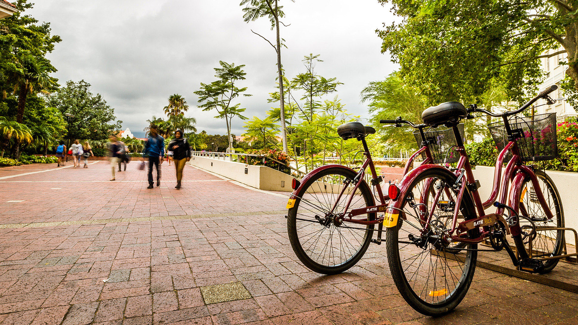
Thank you
Enkosi
Dankie
Photo by Stefan Els
Notes:
Cover & End Slide Option
Replace the background image: Right-click on the slide, then choose Format Background and select Picture or texture fill. Select a new picture of your choice.
Remember to add an image attribution for e.g., Photo by Stefan Els.

