Slide 1


Lassa fever
Situation overview
WHO working group on Lassa fever clinical management
10 May 2024 – Viral Haemorrhagic Fevers team

Slide 2
Lassa fever in endemic countries

Slide 3
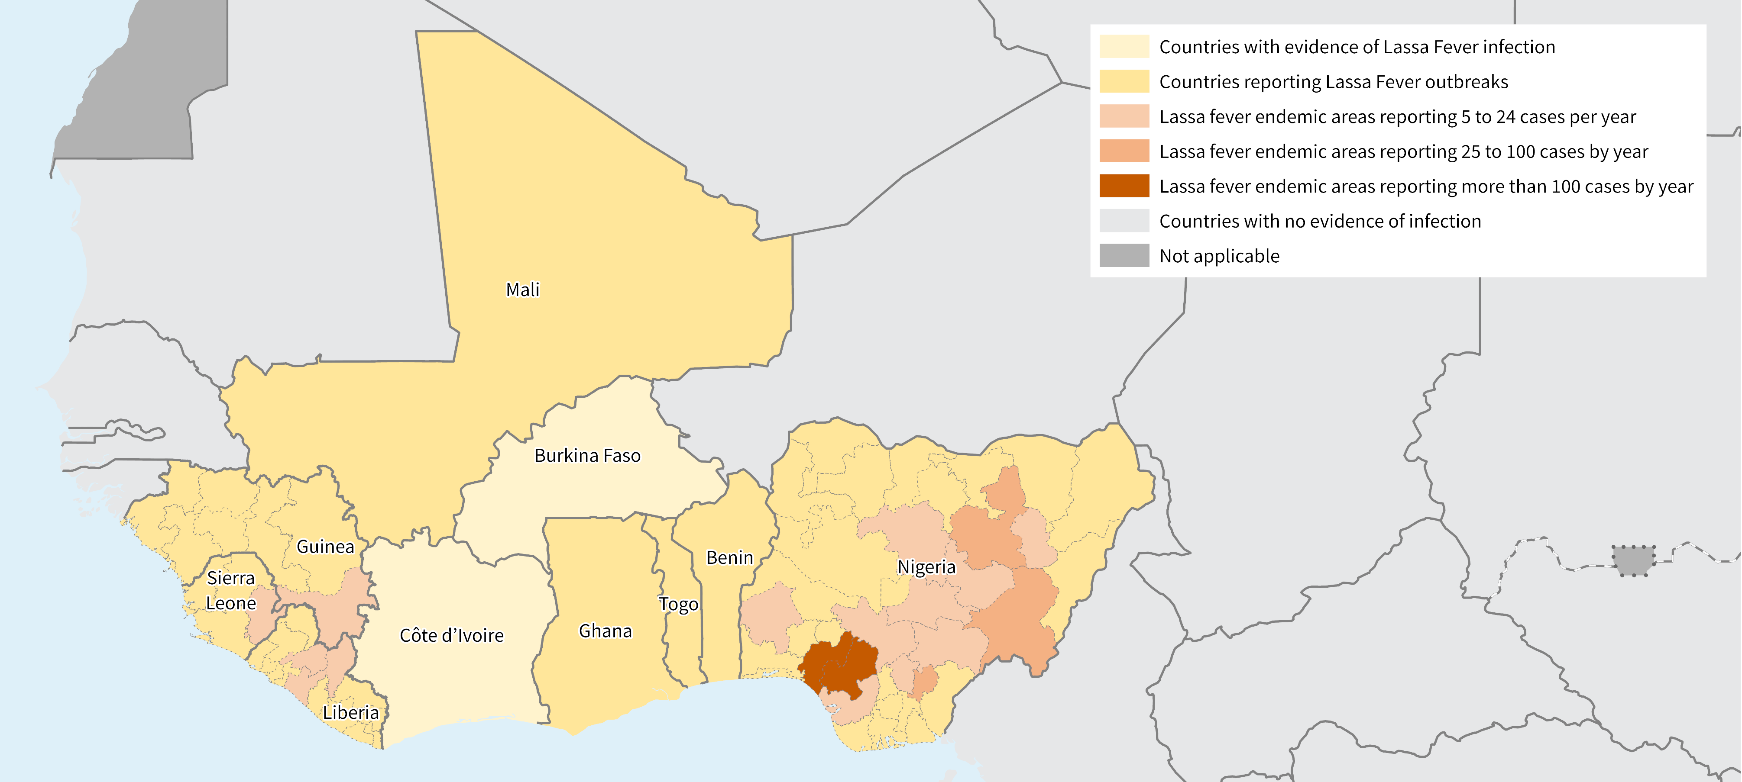
Geographic distribution of Lassa fever in West Africa (1969-2023)
Map available at https://www.who.int/health-topics/lassa-fever#tab=tab_1
Notes:
Updated map of Lf distribution in West Africa with average number of confirmed cases reported per year.
Important points : hyperendemic areas vs sporadic cases report -> critical to target interventions including for clinical trials.

Slide 4
Lassa fever confirmed cases by Admin 2 level, West Africa 2018-2023.
Source: Nigeria Centre for Disease Control (NCDC), MoH Sierra Leone, MoH Liberia, MoH Guinea.
Lassa confirmed Cases per year
Lassa confirmed Cases per year
Sokoto
Nigeria
Katsina
Jigawa
Kebbi
Zamfara
Yobe
Kano
Borno
Kaduna
Bauchi
Gombe
Guinea
Niger
Adamawa
Plateau
Kwara
FCT
Eastern
N'Zérékoré
Nasarawa
Taraba
Sierra
Leone
Southern
Oyo
Osun
Ekiti
Kogi
Benue
Bong
Nimba
Ogun
Ondo
Enugu
Grand
Bassa
Lagos
Edo
Anambra
Ebonyi
Delta
Imo
Abia
Cross
River
Liberia
State reporting more than 200 Lassa fever confirmed cases per year
Akwa Ibom
Bayelsa
Rivers
25 to 100 Lassa fever confirmed cases per year
5 to 24 Lassa fever confirmed cases per year
5 to 1 Lassa fever confirmed cases per year
Less than 1 Lassa confirmed cases per year
Notes:
Focus on (hyper) endemic areas within most affected countries.

Slide 5
Lassa fever – Africa laboratory network
Laboratory performing Lassa fever diagnostic
Dakar
Bamako
Redeemer
Kano
Guéckédou
Owo
Bauchi
Conakry
Irrua
N'Zérékoré
Abuja
Kenema
Monrovia
Lagos
Yaoundé
Bong
Abakaliki
Abidjan
Accra
Lomé
Cotonou
Map available at https://www.who.int/health-topics/lassa-fever#tab=tab_1
Notes:
Improved and increased lab capacity at national and subnational levels. Supports early detection & patient management.

Slide 6


Lassa fever - Africa clinician network
Lassa fever health care facility
Tanguieta
Bauchi
N'Zérékoré
Mango
Kenema
Borgou
Owo
Irrua
Abakaliki
Phebe
Map available at https://www.who.int/health-topics/lassa-fever#tab=tab_1
Notes:
Designated Lassa fever wards with established capacities – to continue support in hyper endemic areas.

Slide 7
Lassa fever confirmed cases and CFR by State, Nigeria 2018-2023.
Source: Nigeria Centre for Disease Control (NCDC)
Lassa confirmed Cases per year
Case Fatality Ratio
Sokoto
Sokoto
Katsina
Jigawa
Katsina
Jigawa
Kebbi
Zamfara
Yobe
Kebbi
Zamfara
Yobe
Kano
Borno
Kano
Borno
Bauchi
Gombe
Kaduna
Bauchi
Gombe
Kaduna
Niger
Adamawa
Niger
Adamawa
Plateau
Plateau
Kwara
FCT
Kwara
FCT
Nasarawa
Taraba
Nasarawa
Taraba
Oyo
Kogi
Oyo
Ekiti
Kogi
Osun
Ekiti
Osun
Benue
Benue
Ogun
Ondo
Enugu
Ogun
Ondo
Enugu
Lagos
Edo
Anambra
Ebonyi
Lagos
Edo
Anambra
Ebonyi
Delta
Imo
Abia
Cross
River
State reporting more than 200 Lassa fever confirmed cases per year
Delta
Imo
Abia
Cross
River
Akwa Ibom
Bayelsa
Akwa Ibom
State reporting CFR 12-19%
Bayelsa
Rivers
25 to 100 Lassa fever confirmed cases per year
Rivers
20 to 25 CFR for Lassa fever
5 to 24 Lassa fever confirmed cases per year
26 to 34 CFR for Lassa fever
5 to 1 Lassa fever confirmed cases per year
More than 35% CFR for Lassa fever
Less than 1 Lassa confirmed cases per year
Not applicable
Notes:
CFR higher in areas reporting less cases. Several factors to explain but supporting early case recognition (at peripheral health centers); earlier admission to designated ward (importance of patient’s referral system) and training of healthcare worker to deliver adequate level of care likely to impact CFR.

Slide 8
Update on
Lassa fever clinical care training package

Slide 9
Standardized Lassa fever clinical training package for healthcare staff
Development of a standardized Lassa fever training package for health care staff (with focus on clinicians and nurses).
Train healthcare workers and equip them with adequate knowledge and skills,
Improve expertise and confidence of health workers managing the disease,
Standardise and improve patients’ standard of care,
Highlight challenging situations and care for specific populations (children, pregnant women).
Notes:
Improve expertise: equip with necessary and adequate knowledge and skills for timely identification of patients and to deliver appropriate and safe quality care.
Standardise and improve patients’ standard of care: according to best practice standard
Highlight and advise/address?
Lessons learnt from EVD training, to identify issues as early as possible; to make development process smooth and efficient. That we have it at least once in a written format.
challenging situation : Kidney actute failure ( dialysis)

Slide 10
Lassa fever clinical case management training package
Introduction to Lassa fever
Module 01. Introduction to Lassa fever
Health Operations
Module 02. Lassa fever outbreak preparedness and control
Module 03. Laboratory diagnostics for Lassa fever
Module 04. Sample collection and management for Lassa fever
Module 05. Infection prevention and control measures for Lassa fever
Module 06. Mental health and psychosocial support during Lassa fever care
Module 07. Assessment of Lassa wards in existing facilities
Innovations for Lassa fever: therapeutics and vaccines
Module 08. Lassa fever therapeutics and vaccines under development
Optimized supportive care for Lassa fever
Module 09. Screening, triage and initial management
Module 10. Overall patient management and supportive care
Module 11. Co-infections management
Module 12. Other supportive therapies
Module 13. Considerations for Lassa fever survivor programme
Optimized supportive care for Lassa fever: complications
Module 14. Management of sepsis and septic shock
Module 15. Management of severe dehydration and hypovolemic shock
Module 16. Renal complications
Module 17. Management of acid-base and electrolyte disorders
Module 18. Neurological complications
Module 19. Respiratory complications
Module 20. Management of severe bleeding and anaemia
Optimized supportive care for Lassa fever:
care for special populations
Module 21. Women’s health, pregnancy and puerperium
Module 22. Infant and children

Slide 11


Where do healthcare workers play a (major) role?
Risk communication
Data and information sharing
Advocacy and awareness
Media engagement
Community engagement
Engagement with key influencers
Stimulating behavioural changes
Addressing concerns
Patient’s management
Triage and case isolation
Barrier nursing
Treatment and care
Infection prevention and control
Psychosocial support
Clinical trials
Ethics committee
Research
Health information
Patient’s care
Joint response plan
Effective communication
Partnership coordination
Laboratory
Specimen collection
Laboratory testing
Operations support and logistics
Investigation & surveillance
Outbreak response teams (epi, social)
Resource mobilisation and budgeting
Commodities
Transportation
Human resources
Security
Environment
Case investigation
Recording, reporting and data analysis
Active case finding
Rodent control
Community hygiene
Notes:
Overview of key pillars of Lf control activities – in blue all major areas where healthcare workers play a major role – of course should be involved also in all pillars at some levels.

Slide 12
Status update on training package
Training developed in close collaboration with clinicians and other experts from Nigeria and other countries and partners institutions.
Two meetings organized in Nigeria to present draft and subsequent versions.
Last round of revision completed in February 2024.
Pilot testing planned in Nigeria (possibly Ebonyi State), probably in June to refine, fit to needs, adapt and improve.
Finalization of first version by October 2024 and translation in French. Training to be then proposed in interested countries / partners.
Notes:
Very grateful to all of you that provided extensive comments and revision. Most up-to-date version to be shared soon (by email) – final editing work on-going.

Slide 13
Lassa fever priorities

Slide 14
Lassa fever priorities (1/2) – Not exhaustive !
Decrease morbidity and mortality of Lassa fever
Support clinicians (especially at peripheral health centers) to suspect Lassa fever and build patients’ pathway for early referral to Lassa fever wards.
Ensure standardized, safe and adequate oSOC care to Lassa fever (severe/vulnerable) patients.
Clinical trials to establish efficacy (as possible) of possible therapeutics.
Address sequelae of Lassa fever survivors (cf. hearing loss).
Early detection / confirmation of patients
Support establishment of either decentralized and/or close to patient RT-PCR testing and/or adequate sample transportation system.
Evaluate existing commercial assays (RT-PCR, serology).

Slide 15
Lassa fever priorities (2/2)
Prevent transmission in healthcare facilities and/or to medical personnel
Systematic investigation of healthcare worker infection to identify at-risk practices.
Support early recognition in peripheral health centers.
Ensure adequate infrastructure, flow of patients and IPC measures in health facilities.
Better understanding of rodent-to-human transmission in various contexts to try and establish potential control measures at community level
In-depth joint-investigation of context of transmission (epi, rodent specialist, social sciences, …).
Studies on rodent ecology in different sites.
Evaluate efficacy of rodent control measures & adapt preventive messaging & RCCE.

Slide 16
Few conclusion points
Global public health and moral imperative to alleviate impact of the disease on vulnerable populations.
Country capacity is essential to mitigate Lassa fever impact. Key points remain high level governments commitment and international collaboration.
Availability of new diagnostics, therapeutics and vaccines should improve medical intervention in areas of the world where access to care is challenging.
Regional surveillance, lab and clinician networks are vital for outbreaks prevention and response, together with the development of new R&D products and a one Health approach.

Slide 17




















Lassa fever partners
Including our colleagues in Benin, Guinea, Liberia and Sierra Leone and all other individual experts
For more information http://www.who.int/emergencies/diseases/lassa-fever/en/

Slide 18
Viral Haemorrhagic Fevers team
Pierre Formenty Anaïs Legand Alejandro Costa Alex Almuedo
formentyp@who.int leganda@who.int costaa@who.int almuedoa@who.int
Health Emergency Interventions Department
World Health Organization
Avenue Appia 20 | CH-1211 Geneva 27
Lassa Fever
www.who.int/health-topics/lassafever
Thank you!

