Slide 1

K.L.E’s
C. B. Kore Polytechnic, Chikkodi Karnataka 2022-23
A Presentation on
“ SMART PIGMY COLLECTION”
SUBMITTED BY
Achal patil 339CS20001
Ahmed Peerzade 339CS20002
Pratibha Jadhav 339CS20018
Soundarya Bommanhalli 339CS20030

Slide 2
INTRODUCTION
In this project we are going to create smart pigmy collection in this the admin /bank can add the pigmy collector and the pigmy collector add the customer using their valid details. Here the customer add the daily amount to the pigmy collector and he can view payment details. To implement this project we’re going to use full stack development languages like HTML, CSS, JavaScript, Bootstrap, PHP, MYSQL database.

Slide 3
Abstract
The purpose of this project is to create smart pigmy collection system in this project pigmy collector can login using username and password after login pigmy collector can add the customer and add the daily pigmy payment in system customer can login to this system and check the deposited payment history in bank login banks also see the all customer deposit payment details to implement this project we’re going to use full stack development languages like HTML, CSS, JavaScript, Bootstrap, PHP, MYSQL database.

Slide 4
Literature survey
Existing system:- As per my survey in current market to collect the payment pigmy collector are used small machine or manually to take the machine more payment is required and wastage of printout pages.
Proposed System:- we are going to develop smart pigmy collection can login using username and password after login pigmy collector can add the customer and add the daily pigmy payment in system customer can login to this system and check the deposited payment history in bank login banks also see the all customer deposit payment details to implement this project we’re going to use full stack development languages like HTML, CSS, JavaScript, Bootstrap, PHP, MYSQL database.

Slide 5
Requirements
Requirements for developing:-
Average I3 processor.
Average 4GB RAM.
Average 512GB hard disk.
Hardware requirement for deployment:-
Average I3 processor.
Average 2GB RAM.
Average 256GB storage.
Software requirement for development:-
OS (Window’s, MAC , Linux).
XAMP Server.
VS Code.
Chrome.
Software requirement for deployment:-
OS.
Chrome.
Language used or technology:-
Content language (client side language)(HTML,
CSS, bootstrap).
Backend (server side language) (PHP).
Database (MY SQL).

Slide 6
Advantages:-
Save time.
Reduce manual work.
Reduce machine cost.
Get easy report to customer.

Slide 7
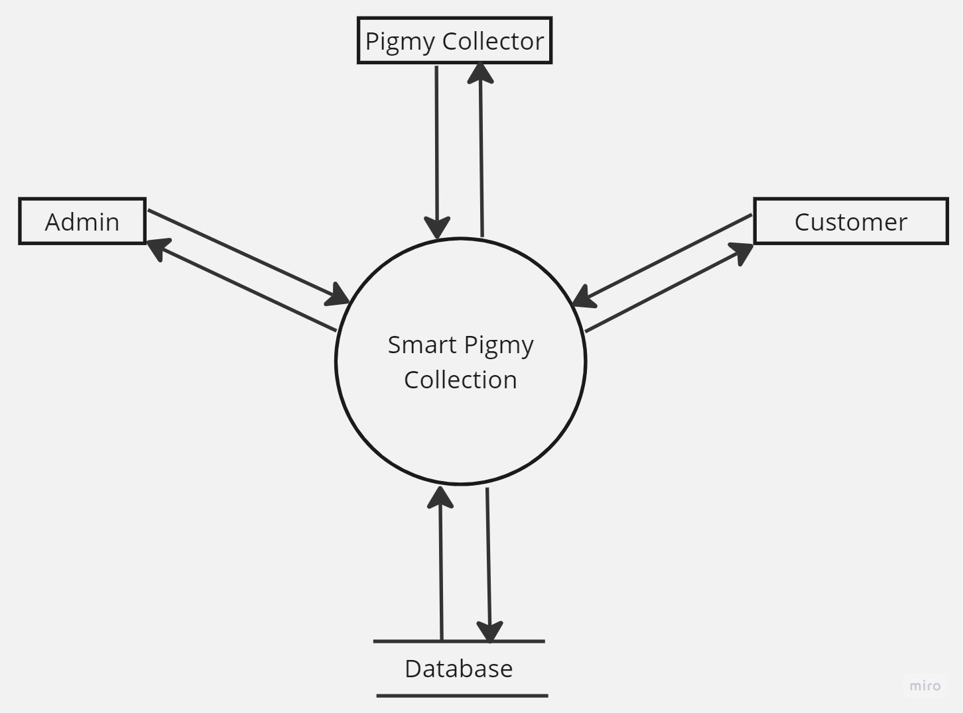
Data flow Diagram Level-0

Slide 8
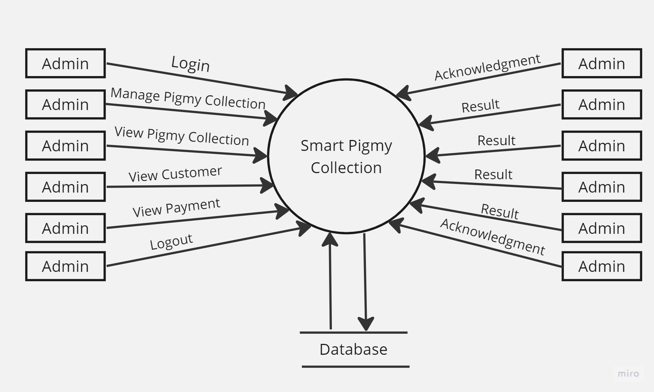
Data flow Diagram Level-1

Slide 9
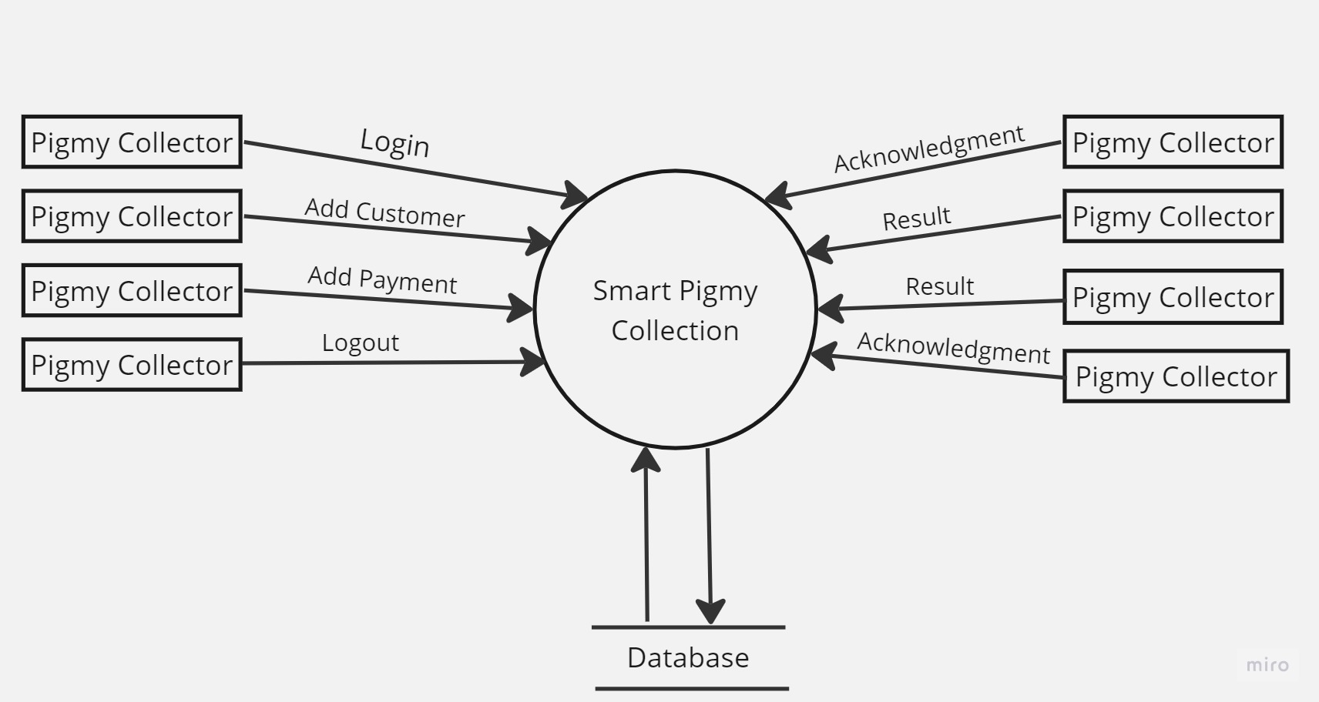
Data flow Diagram Level-1

Slide 10
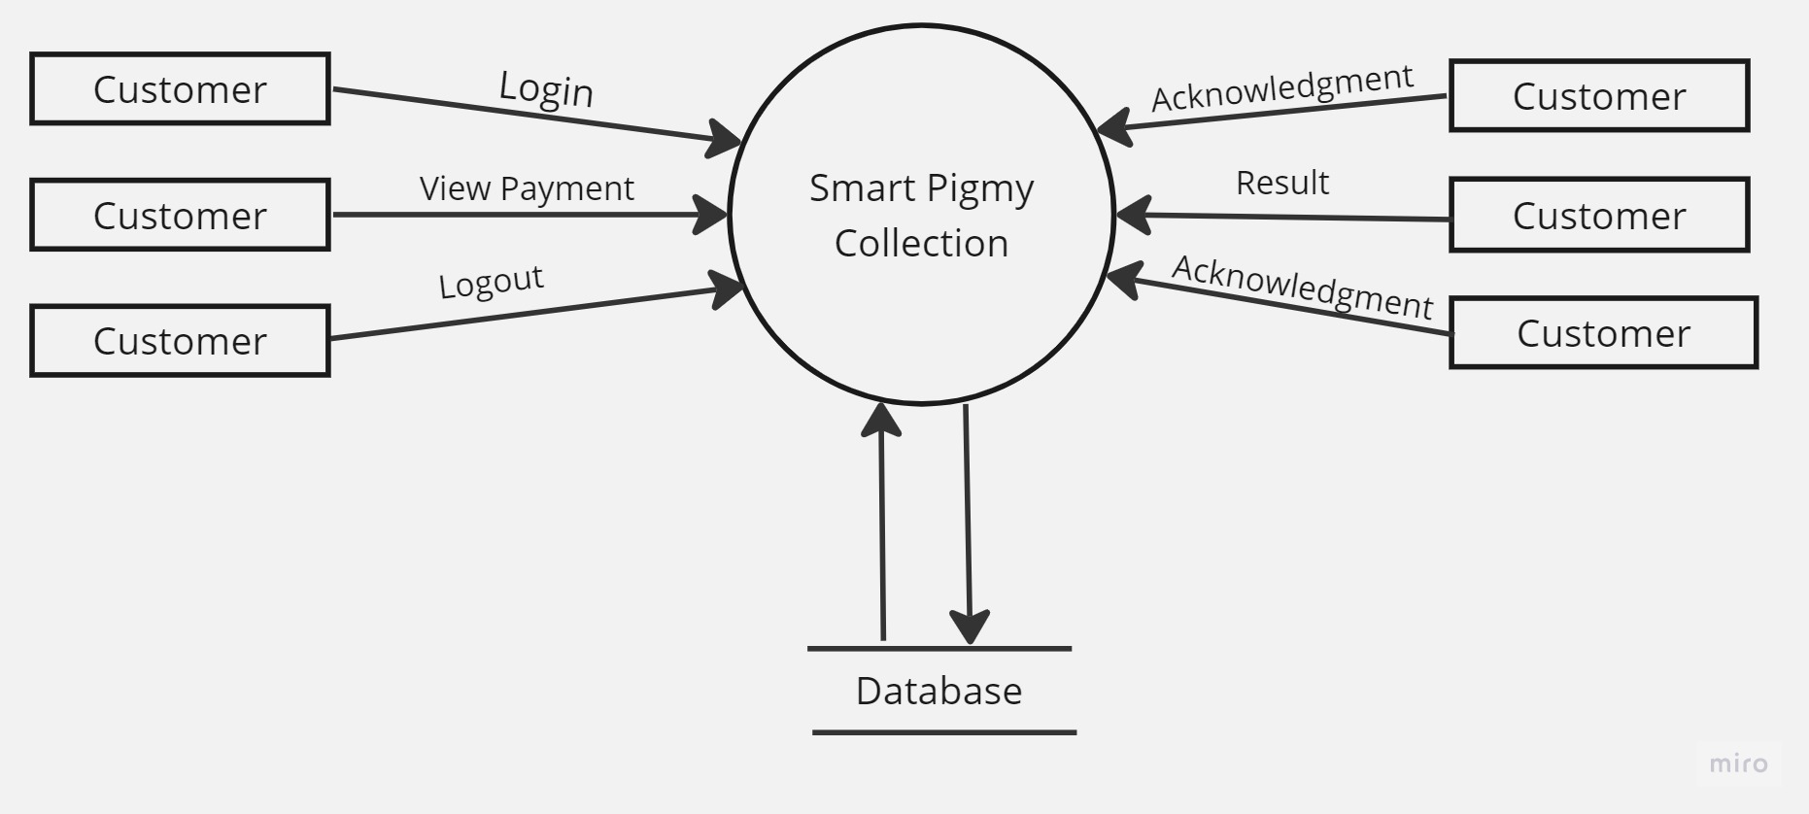
Data flow Diagram Level-1

Slide 11
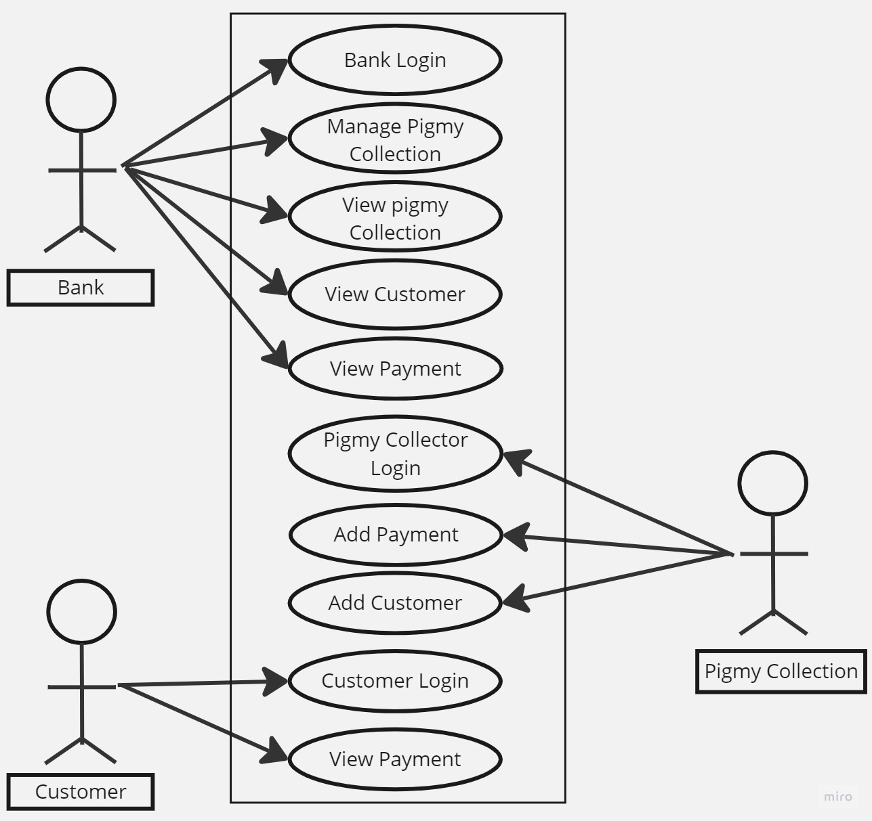
Use case Diagram

Slide 12
Methodologies Used
Agile methodology is a process for managing a project that involves constant collaboration and working in iterations. Agile project management works off the basis that a project can be continuously improved upon throughout its life cycle, with changes being made quickly and responsively. Agile is one of the most popular approach to project Management due to it's flexible, adaptability to change, and high level of customer input.
Phases of Agile model
Requirement Gathering
Design the requirements
Construction or Iterations
Testing and Quality assurance
Deployment
Feedback

Slide 13
Implementation Part
Bank Modules =>
Bank/Admin Login
Manage Pigmy Collection
View Pigmy Collection
View Customer
View Payment
Pigmy Collection Modules =>
Pigmy Collector Login
Add Payment
Add Customer
Customer Modules =>
Customer Login
View Payment

Slide 14
Future Scope
We can implement this project in live market.
In future we can develop in mobile application.

Slide 15
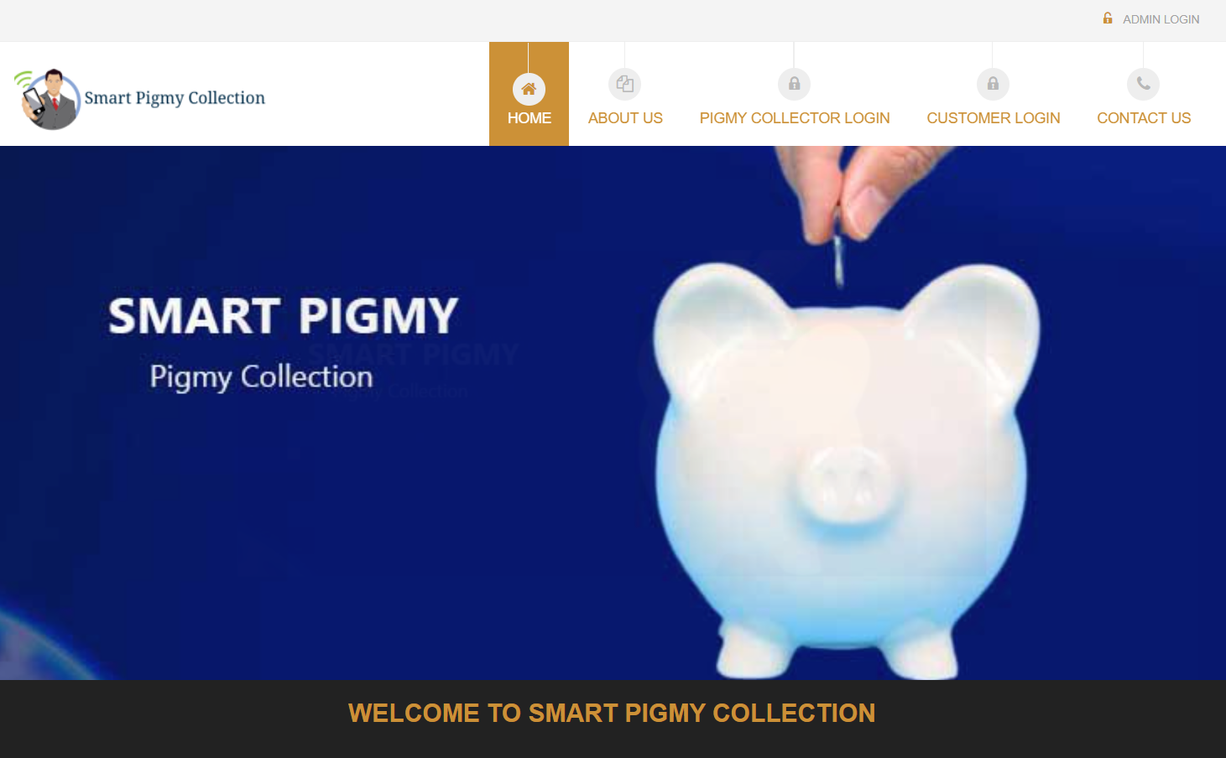
Screen shorts and Designed Website

Slide 16
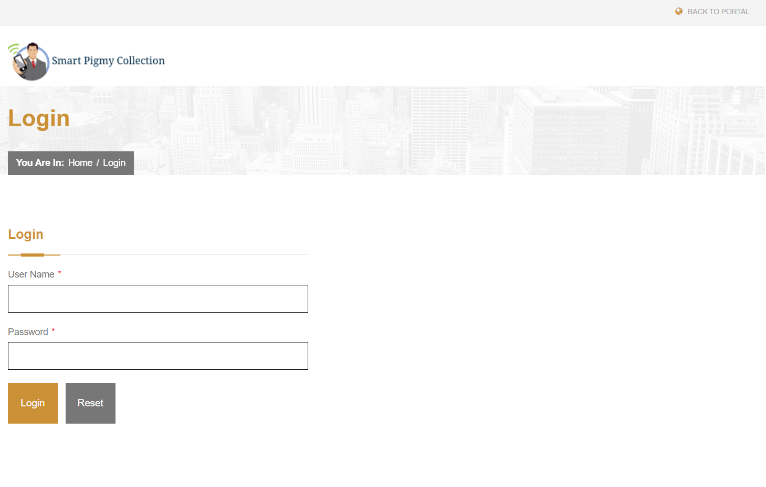

Slide 17
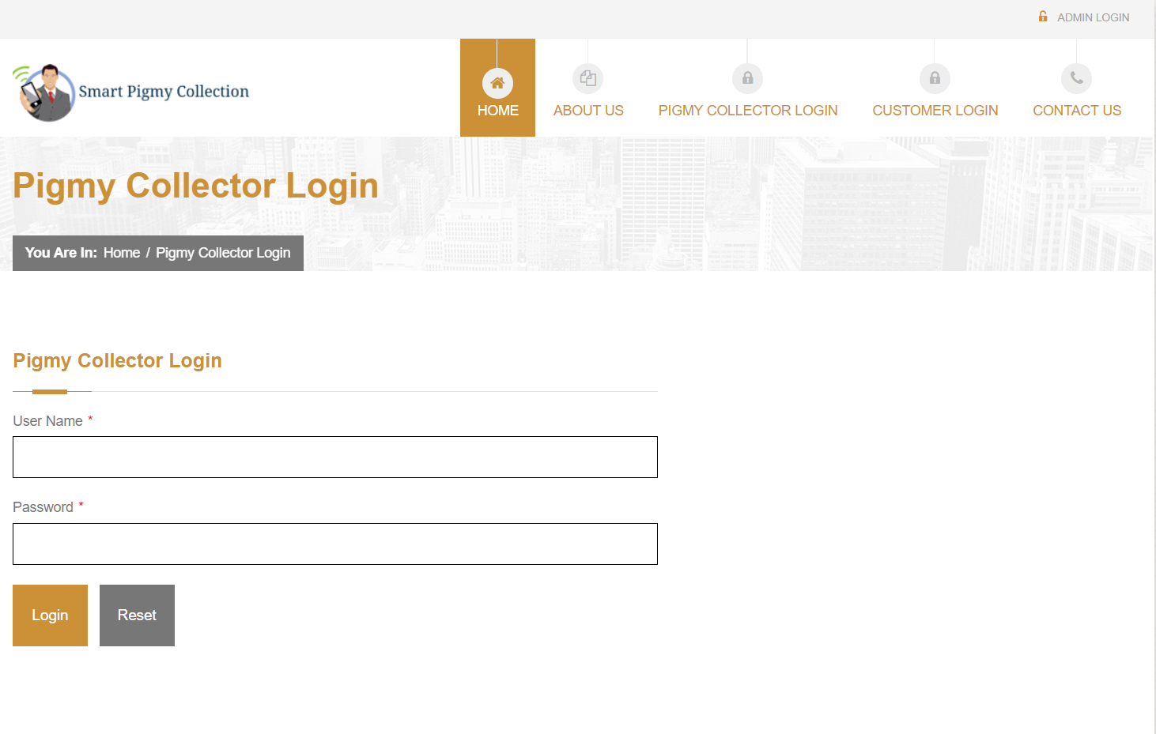

Slide 18
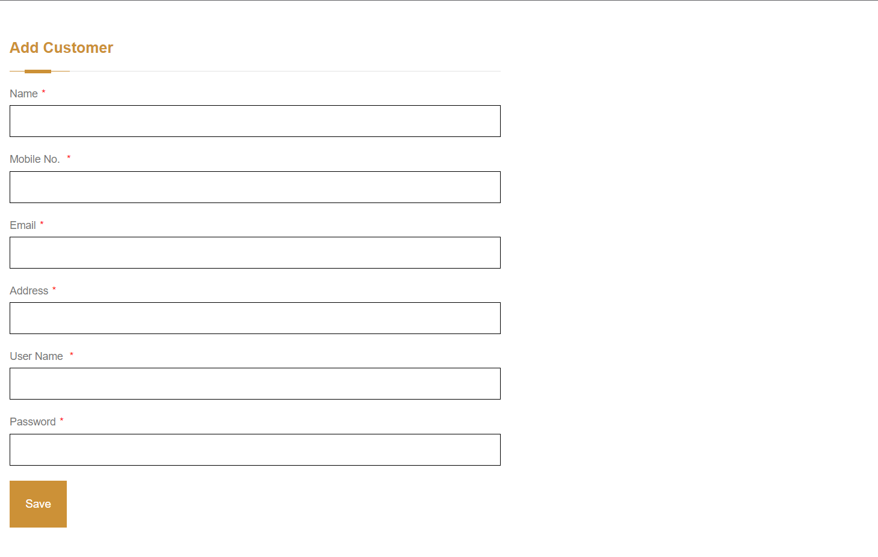

Slide 19
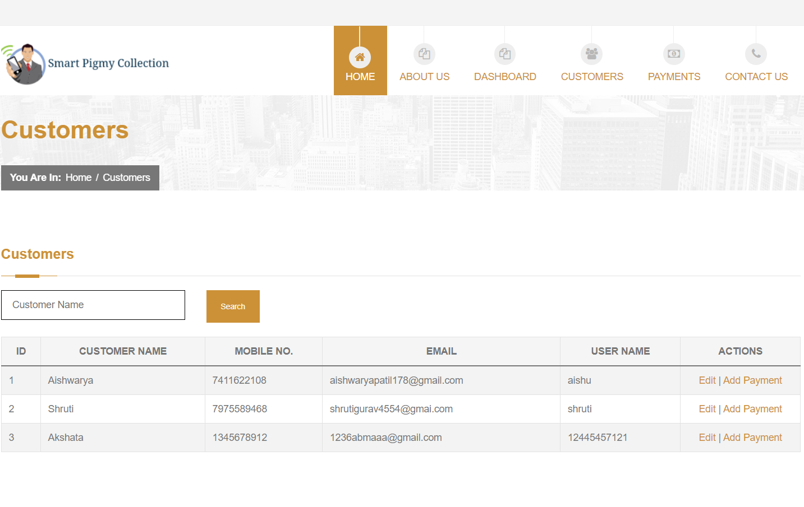

Slide 20
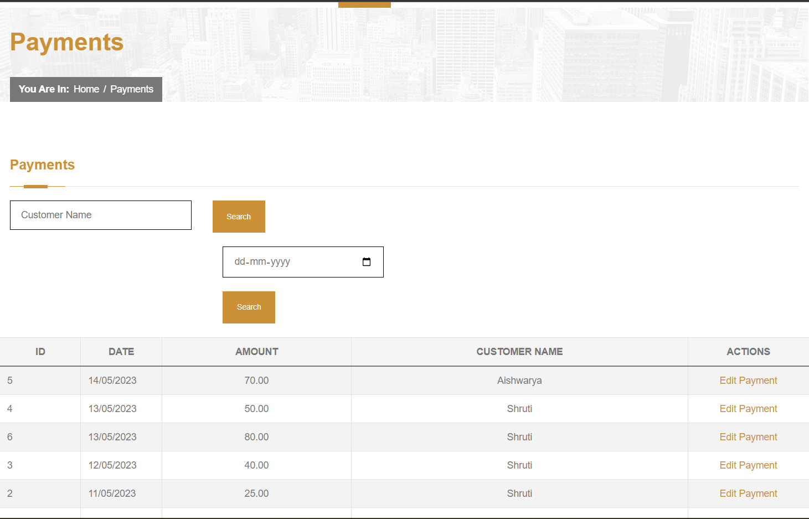

Slide 21
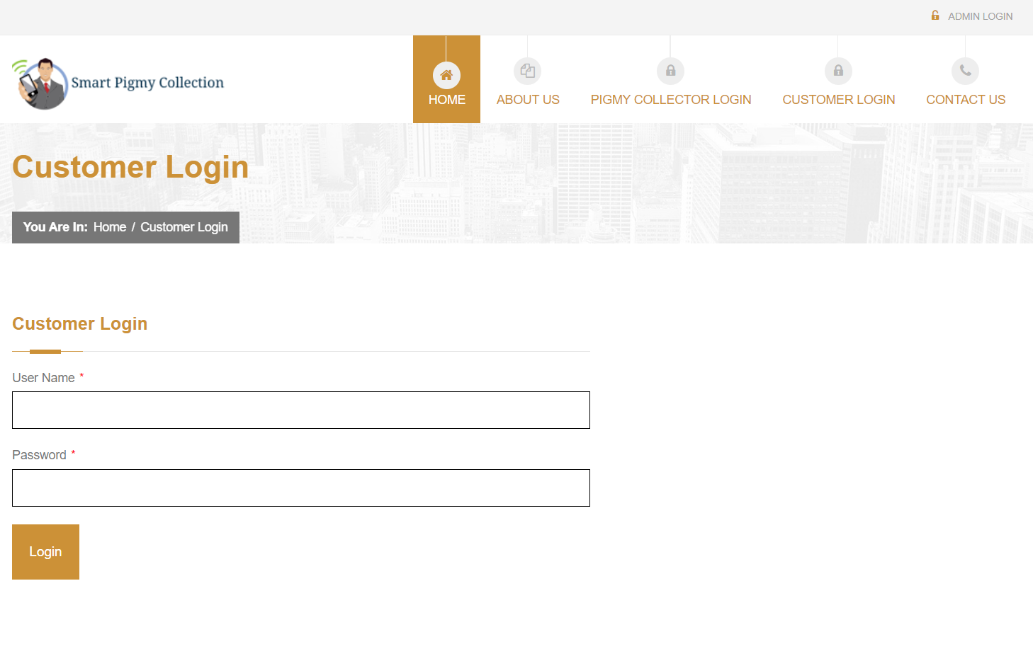

Slide 22
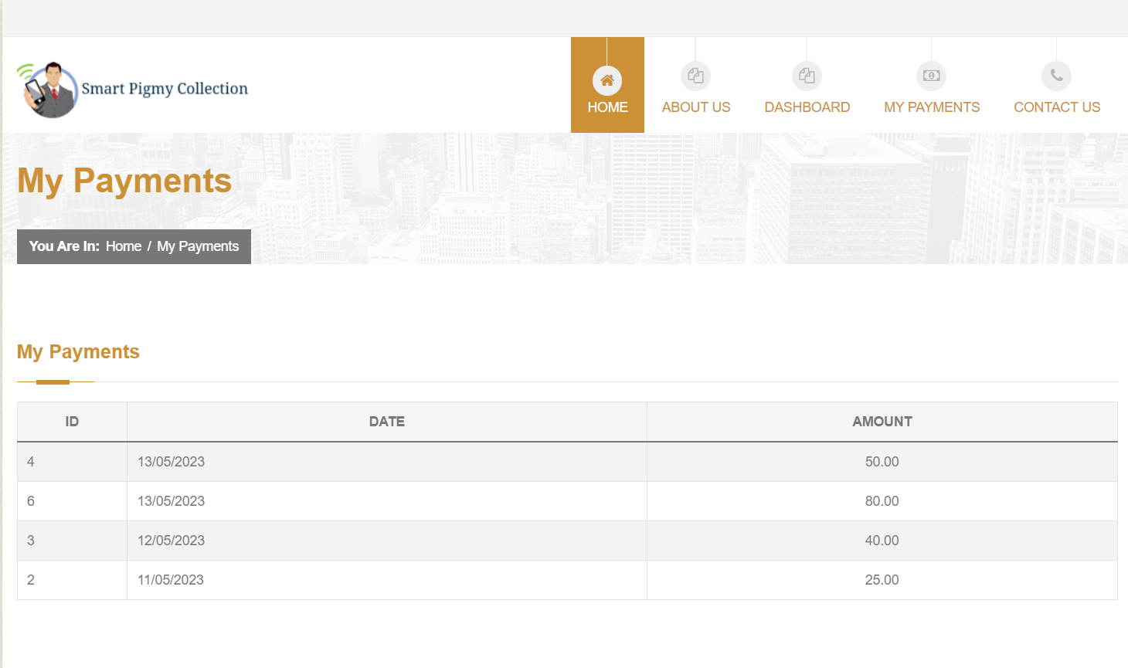

Slide 23
Conclusion
As per the project we will implement the “Smart Pigmy Collection” portal we will implement all the modules like Bank login , Pigmy Collector Login, Customer login, Add payment ,Add customer, View payment history with successfully error free user friendly.

Slide 24
BIBLIOGRAPHY:-
Books:-
[1] “Web Programming”, by ‘Chris Bates’ Wiley Dream tech India, 2nd Edition.
[2] “Software Engineering”, Ian Somerville, Sixth Edition, Pearson Education Ltd.
[3] “HTML Complete References” Easy steps to develop web pages.
[4] “PHP Complete Reference”
Websites:-
[1] http://en.wikipedia.org/wiki/PHP for PHP.
[2] http://www.hotscripts.com/category/php/ for PHP.
[3] http://www.mysql.com/click.php?e=35050 for MYSQL.
[4] http://www.w3schools.com for information on HTML.

Slide 25


