Slide 1
CS 683 Data Mining Default Final Project Achal Verma av438

Slide 2
Problem Statements
Trends of Poll over time by month
Build 2 different models M1 and M2
5 fold cross validation for M1 and M2
Problems faced:
: Null/Empty values in dataset
: Which parameters to use for classification

Slide 3
Solution Approach: Trends of Poll over time
Removed Null values
Sorted the CSV data with time period using end date.
Plotted the trends of polls for: Polls-plus, Now-cast, Polls-only and Combined data

Slide 4
Solution Approach: M1 and M2/ Cross Validation
M1: Mixing Gaussian and Bernoulli Naïve Bayes
M2: Rules Based classification: Used adjusted polls value as a classifier.
Cross Validation:
: Used grades A and A+ as test set.
: Used other grades as training set

Slide 5
Programming Environment
Python 2.7.2
Libraries: numpy, csv, sklearn.naive_bayes, matplotlib, datetime

Slide 6
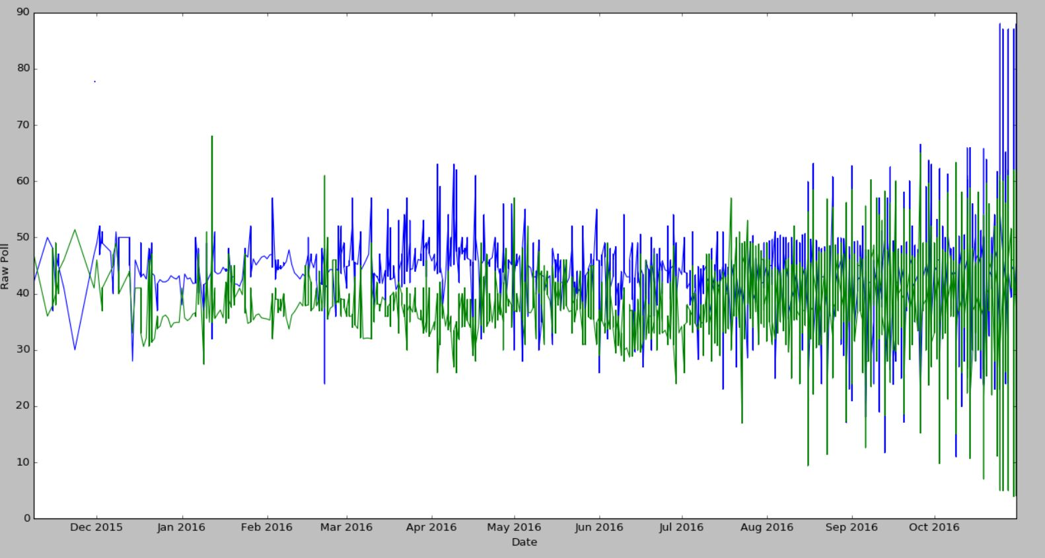
Results

Slide 7
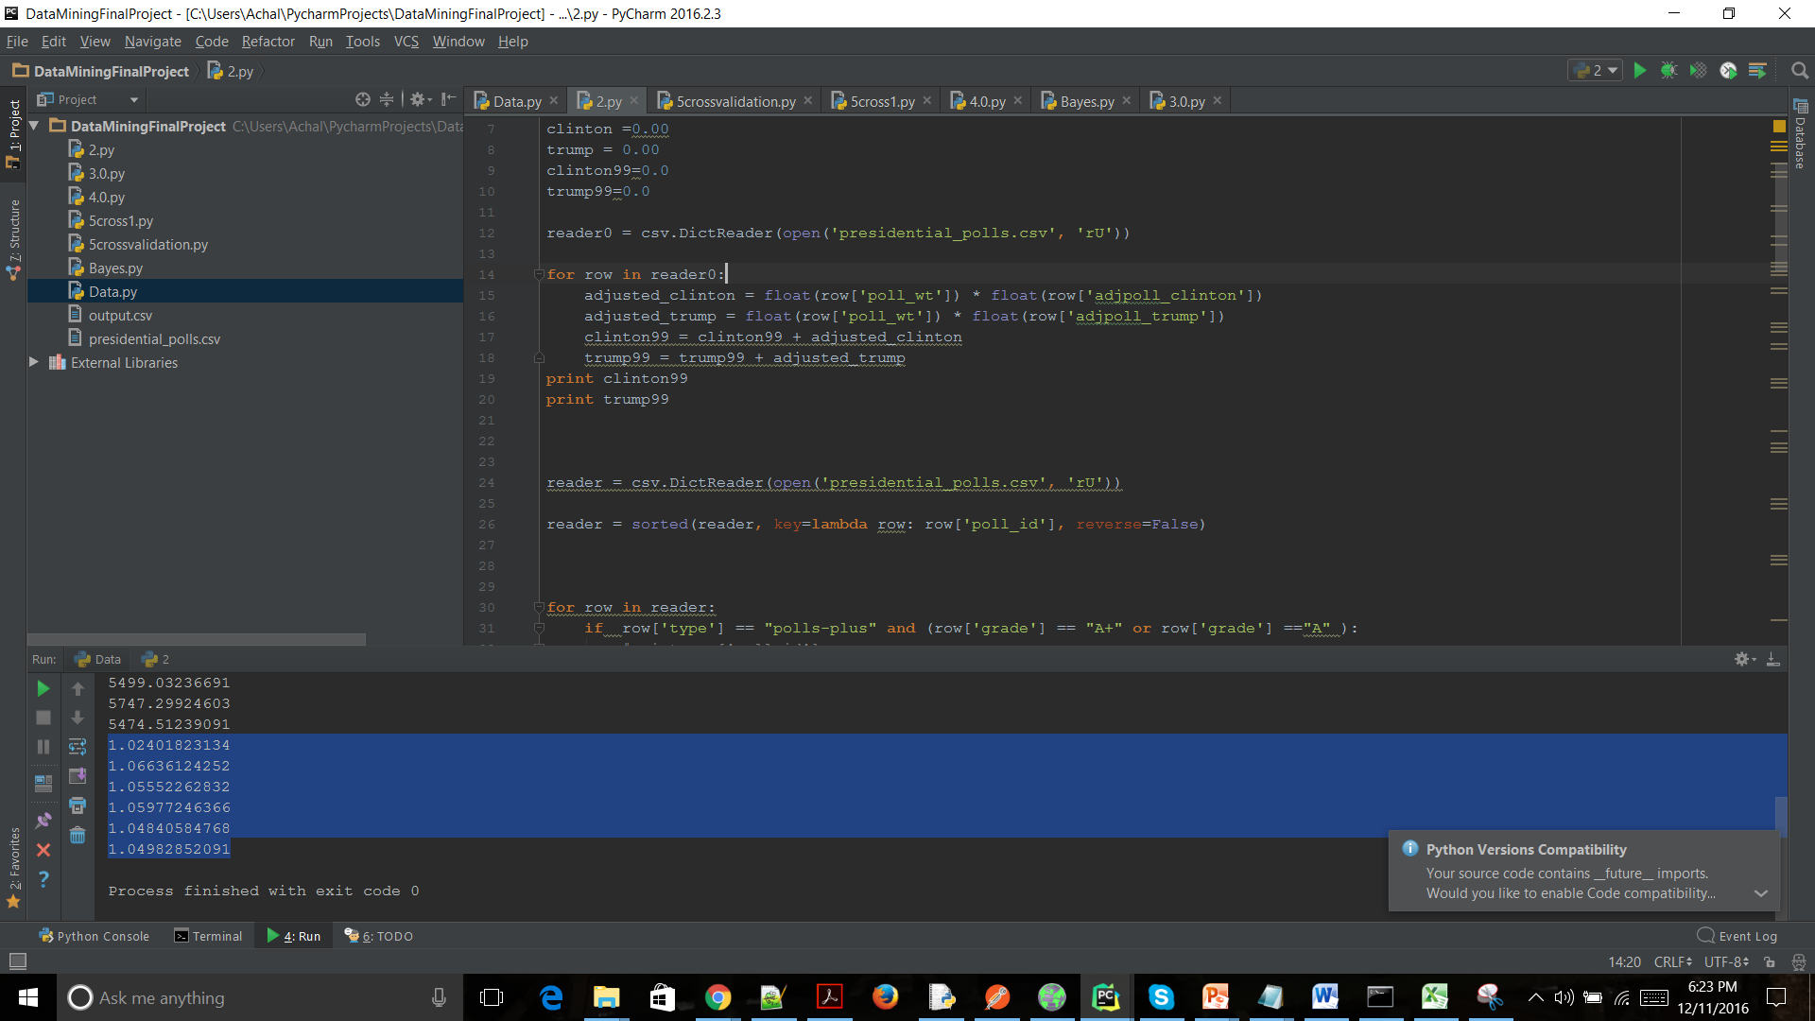
M2 Results

Slide 8
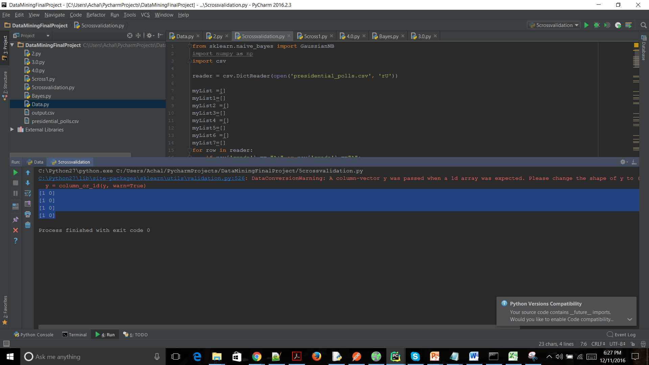
M1 Cross-Validation

Slide 9
Thank You

