Slide 1
ASSIGNMENT Name: Achal Tyagi
Problem Statement
Bank of Corporate conducted a telemarketing campaign for one of its financial products ‘Term deposits’ to build a long-term relationship with the existing customers. These campaigns need to be cost efficient such that the bank not only increases their overall revenues but also the total profit.
Assignment Objective
To identify the target customers and the driving factors behind the successful conversion of a customer and optimize future marketing campaigns.
Notes:
Problem Statement

Slide 2
Data Cleaning
Remove duplicates from “Account no” column.
Age has some negative values so remove those negative signs from them.
In job column in some cells has "admin." while other as "admin" so make all "admin." as "admin".
Loan default, housing Loan , Personal loan and subscription has "yes and no" in it so convert those yes to 1 and no to 0.
In date text column put it in date format and exclude day and month from it to another new columns.
Convert call duration from HH:MM:SS to seconds.
“Loan Default” and “Subscription” has some blanks so remove them so that analyzing dataset can become easier.
Remove Outlier in “previous” column.

Slide 3
PART I : Univariate Analysis
Variable under consideration: Age.
Notes:
Note : Majority of customers lies in the range of 24 to 60, as they are working folks. After the age group of 60 there is steep decline in count of Customers.

Slide 4
PART I : Univariate Analysis
Variable under consideration: Job.
Notes:
Note : Majority of peoples are from blue-collar and management segments.

Slide 5
PART I : Univariate Analysis
Variable under consideration: Loans.
Notes:
Note : 1. Figure 1: The persons who defaulted the loans were very less as of 2%.
2. Figure 2: Majority of peoples taken housing loan as compared to personal loans due to many reasons maybe due to investment purposes etc.

Slide 6
PART I : Univariate Analysis
Variable under consideration: Month.
Notes:
Note : Majority share of call is in month May i.e., 30.51%.

Slide 7
PART I : Univariate Analysis
Variables under consideration: Day.
Notes:
Note : Bank reaches to customer on weekends ( i.e., on Sunday and Saturday ) over weekdays as majority of peoples were working.

Slide 8
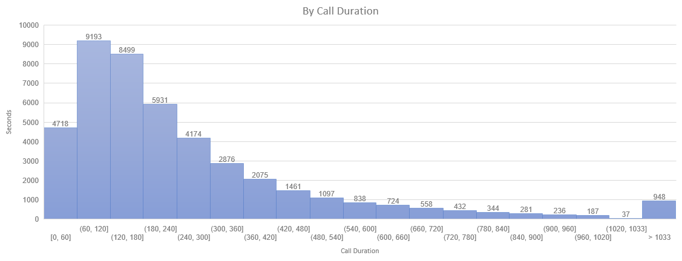
PART I : Univariate Analysis
Variables under consideration: By call Duration.
Notes:
Note : It is observed that the call duration with most of the customers lies between 1 – 3 minutes (i.e., (60-180)).

Slide 9
PART I : Segmented Univariate Analysis
Variables under consideration: Marital Status & Education.
Notes:
Note : 1. Graph 1: Majority of the customers are either married or single.
2. Graph 2: 51 % of peoples holding a master degree.

Slide 10
PART I : Segmented Univariate Analysis
Variables under consideration: Poutcome & Subscription.
Notes:
Note : 1. Graph 1 : 82% of the customers are not reached earlier and reached out for the first time regarding a product/service now by the bank.
2. Graph 2 : The overall conversion rate of the customers is 12% for the subscription of term deposit.

Slide 11
PART II : Bivariate Analysis
Variables under consideration: Call Duration & Subscription.
Notes:
Note : Average Call Duration of Subscribed Peoples in More than the unsubscribed ones.

Slide 12
PART II : Bivariate Analysis
Variables under consideration: Poutcome & Subscription.
Notes:
Note : The conversion rate of the people who have already subscribed for other products/services has shown interest again in opening the term deposit. So it is recommended to target the customers who has already subscribed to other products.

Slide 13
PART II : Bivariate Analysis
Variables under consideration: Months & Subscription.
Notes:
Note : The conversion rate during the month of march is higher than any other month, reason could be that the end of financial year as people are looking to invest long term. Hence, the customers need to be reached out more during March month.

Slide 14
PART II : Bivariate Analysis
Variables under consideration: previous & Subscription.
Notes:
Note : majority of the people who have subscribed for the term deposit are called for the first time and the conversion decreases as the no of previous calls increases. And it is Adviced From this graph, that not to reach customers after 7 or more calls.

Slide 15
PART II : Bivariate Analysis
Notes:
Note : 1. Graph 1 : The subscription conversion rate of unmarried is better than the married and divorced. So, it is better to target unmarried customers relatively more.
2. Graph 2 : The subscription conversion rate of doctorate customers is better than the bachelors or master. So, it is better to target the doctorate customers relatively more.

Slide 16
PART III: Optimization Results
Notes:
Note : Following results were obtained

Slide 17
PART III: Optimization Results
Notes:
Notes : Married marital status segmented by Education.

Slide 18
PART III: Optimization Results
Notes:
Notes : Single marital status segmented by Education.

Slide 19
PART III: Optimization Results
Notes:
Note : Divorced marital status segmented by Education.

Slide 20
PART III: Optimization Results

Slide 21
PART IV: Major Insight
Notes:
Notes : The optimized number of calls to be made for each customer segment in order to maximize the total number of conversions within the given constraints is given above.

