Slide 1

Analysis on Analytical/BI tools
Achal Gupta
Tom Westman
Oriyomi Waya

Slide 2
Agenda
Introduction
Critical Capabilities for BI and Analytical Tools
Return On Investments
Comparison Study
Scenario study
Conclusion

Slide 3
Critical Capabilities for BI and Analytical Tools
BI/Analytical Tools
Infrastructure
Security and Administration
Data Source Connectivity
Data Management
Ease of use
Reporting Capabilities
Sharing or Deploying
Ease of Use
Metadata Management
Self Service Data preparation
Dashboards and Reports
Advanced Analytics
Publishing tools
Cloud Deployment
Mobile Deployment
Ease of Admin
Ease of Setup

Slide 4
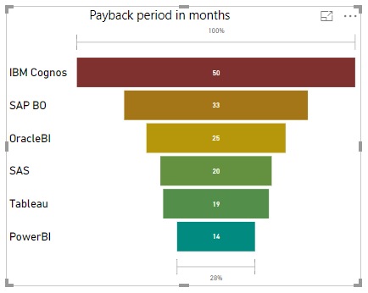
Return on Investments

Slide 5
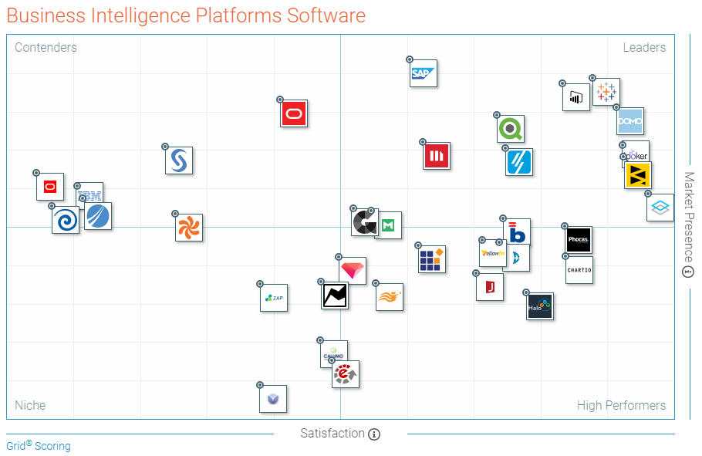
Comparison Study
Power BI
Oracle BI
SAS
IBM Cognos
SAP Business Objects
Tableau
-Grid® Report for Business Intelligence Platforms | Spring 2018
-Industry-wide survey by G2Crowd

Slide 6
Power BI
Business Analytics Service Provided By Microsoft
Strengths
Low Cost - $9.99 per user per month
Very good Data Visualisation
Weaknesses
Limited Use -
Lacking in Predictive Analytics
59% only use for reports

Slide 7
Oracle BI
Business Intelligence Server Developed By Oracle
Strengths
Flexible Cloud Service Integration
Ad hoc Queries and Analysis
Weaknesses
Oracle-Centric Appeal
Collaboration/Workflow

Slide 8
SAS
Statistical Analysis Software Developed By SAS Institute
Strengths
Wide range of statistical methods and algorithms
Highly customisable output options
Weaknesses
High initial cost – starting $8,700
Can be $100,000s per year
Licence fees per user per year

Slide 9
IBM Cognos
Web-Based Business Intelligence Suite By IBM
Strengths
Simple, intuitive environment
Good data protection, with layers of permissions and authorisation
Weaknesses
Difficult to setup and use without prior experience
Reports can take too long

Slide 10
SAP Business Objects
Business Intelligence Software Company Owned By SAP AG
Strengths
Includes pre-packaged content; data models, templates
Weaknesses
Sandbox/Test Environments
Poor Predictive Analytics
Cloud-centred vision, good integration

Slide 11
Tableau
Software Company Producing Interactive Data Visualisation Tools
Strengths
Exceptional data visualisation
Flexible deployment options
Weaknesses
Quite expensive, especially for smaller organisations
Great customer support

Slide 12
Tableau: The Chosen One!
Scenario
Large Enterprise
Matured and Stable
High quality
Inexperienced Analysts
Low Volume of Data
Daily standard reporting
Ease of use, setup and admin
Dedicated high quality customer support
No major restrictions
Focus on Mode 1 Analytics rather than Mode 2
Comparatively high budget
Security
Availability of learning opportunities
Matured Online Community
Availability of connectors

Slide 13

Summary
No perfect tool, pros and cons will be there
Understand requirements, budget and other factors and choose!
We believe that for our scenario, Tableau is the best fit

Slide 14
THANK YOU!!

