Slide 1

KNIME ANALYTICS
Achal Gupta(A00258772)
Pranay Kekre(A00267401)

Slide 2


What is KNIME?
Operations:
IO
Manipulation
Viewing
Analytics
Scripting etc.

Slide 3
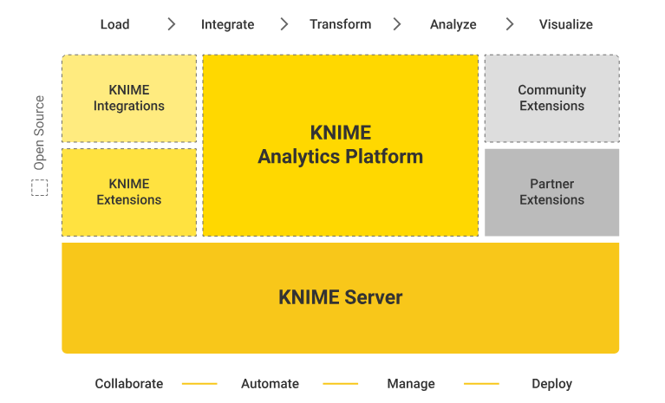
KNIME Ecosystem

Slide 4
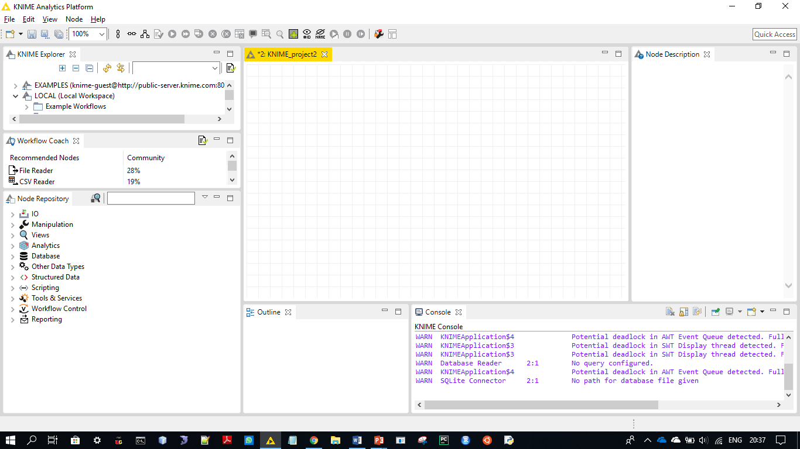
KNIME Platform

Slide 5
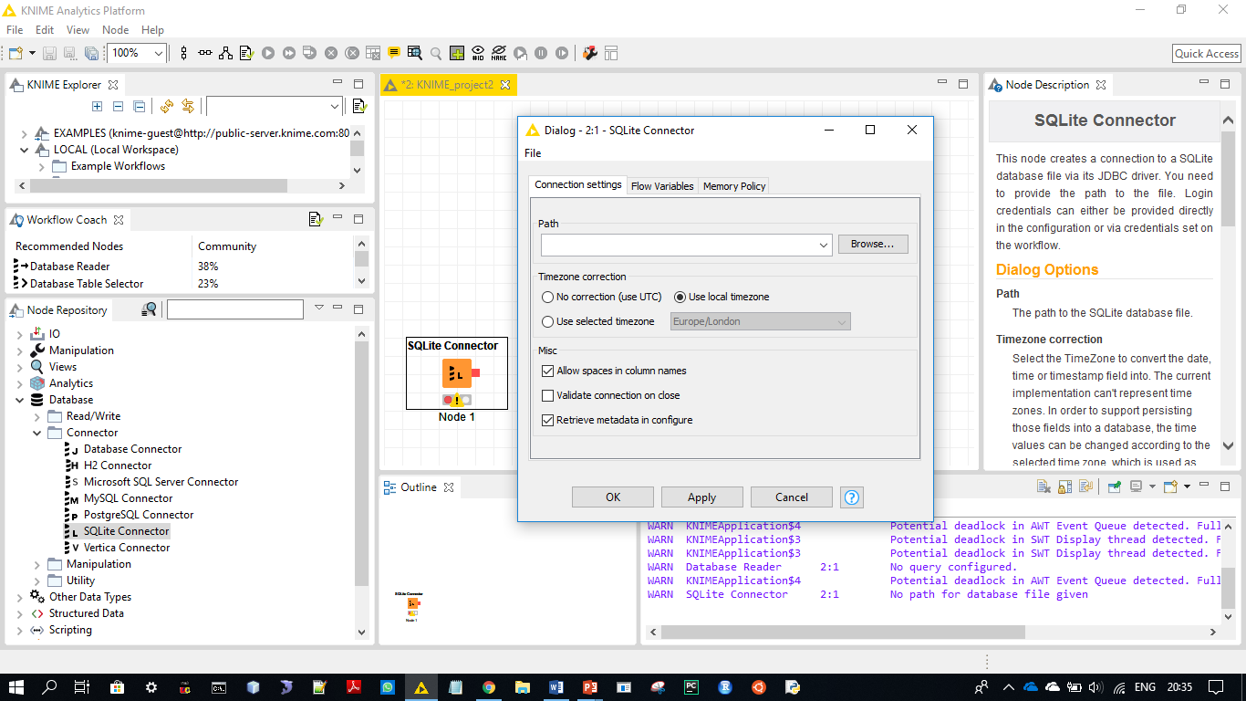
Adding Dataset for Use…..

Slide 6
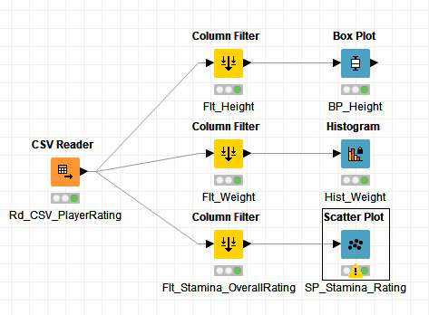
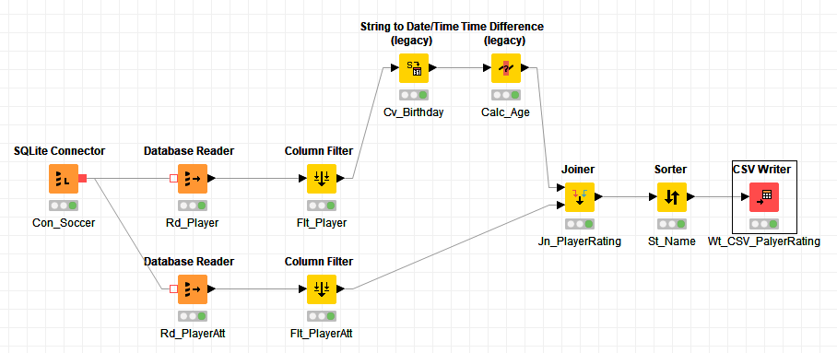
Distribution of Player Attributes

Slide 7
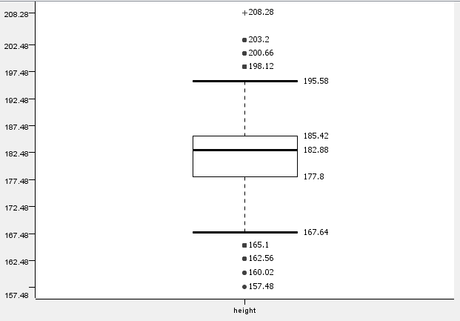
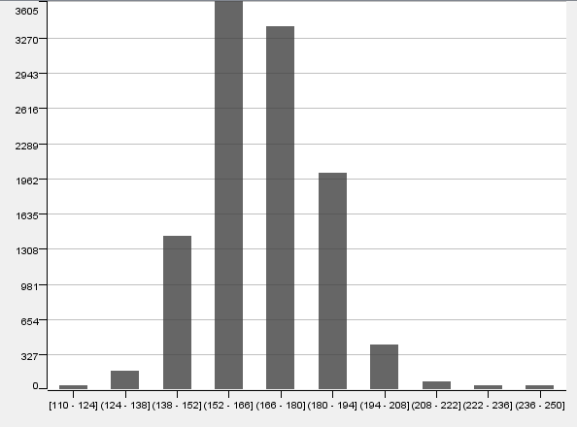
Distribution of Player Attributes
Distribution of Height of Soccer Players (Box-Plot)
Distribution of Weight of Soccer Players (Histogram)

Slide 8
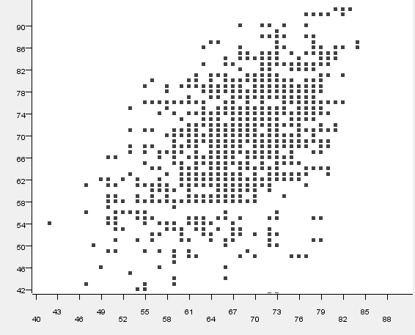
Output: Scatterplot Overall-Rating Vs Stamina
Overall Rating →
Stamina →

Slide 9
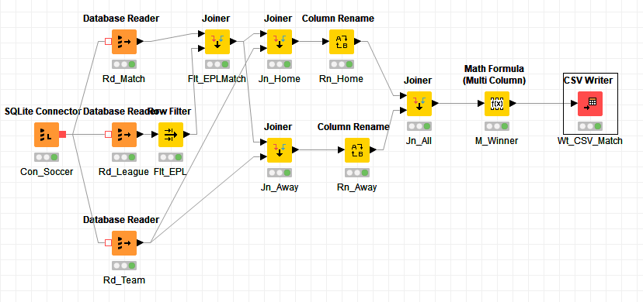
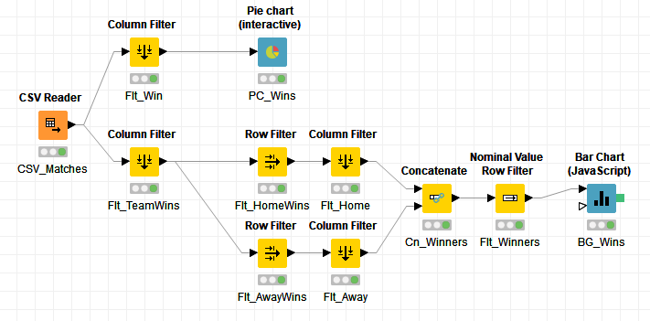
Win Statistics of EPL Teams

Slide 10
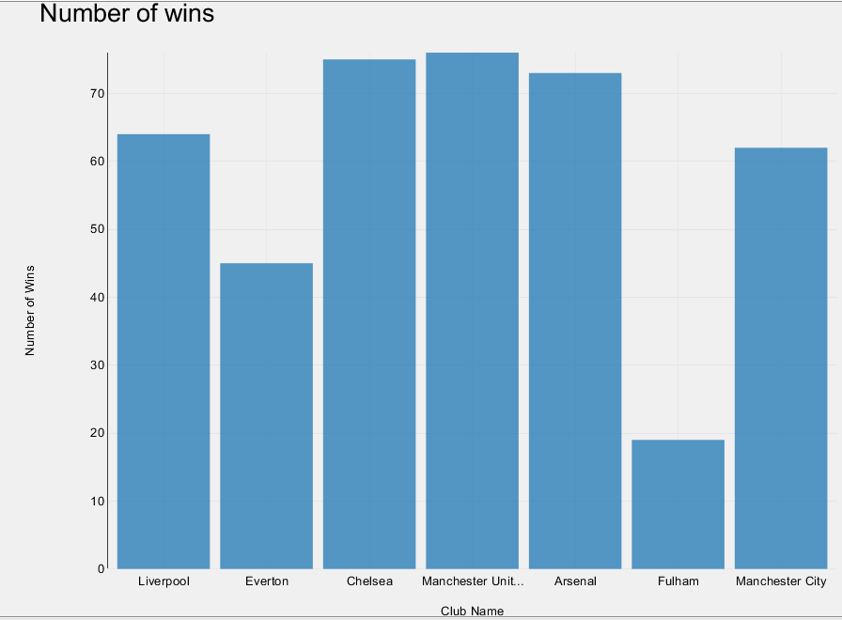
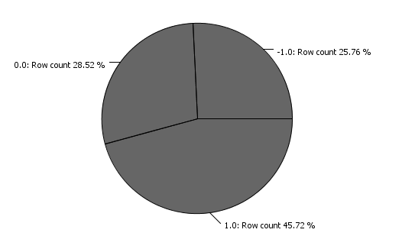
Output:
Win Count of 7 major EPL Teams (Bar Graph)
Home Team Vs Away Team Wins of EPL Teams
(Pie Chart)
Away Wins
Draws
Home Wins

