Slide 1

AN INVESTIGATION ON INTEGRATED ANALYSIS OF NEWS FEED, HISTORICAL PRICES AND TECHNICAL RATIOS IN PREDICTING STOCK MOVEMENT
Achal Gupta
Athlone Institute of Technology
MSc. in Data Analytics

Slide 2
Agenda
Introduction
Literature Review
Methodology
Results
Challenges and Future scope
Conclusion

Slide 3

Introduction
Aim and Objectives
Literature Review
Behavioral Decision Theory (Kahneman and Tversky, 1979)

Slide 4
Research Questions
Investigate prediction capability of Integrated Scale
Investigate capability of technical indicators to predict stock prices.
Investigate if the stock prices can be predicted using text mining of news feed.
Compare performance of classification models.
Investigate capabilities of time series analysis in predicting stock prices.

Slide 5
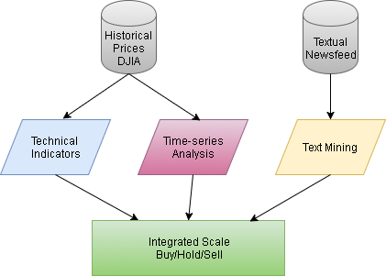
Methodology
Datasets
Analysis 1: Technical Indicators
Analysis 2: Text Mining
Analysis 3: Time Series Analysis
Integrated Scale

Slide 6
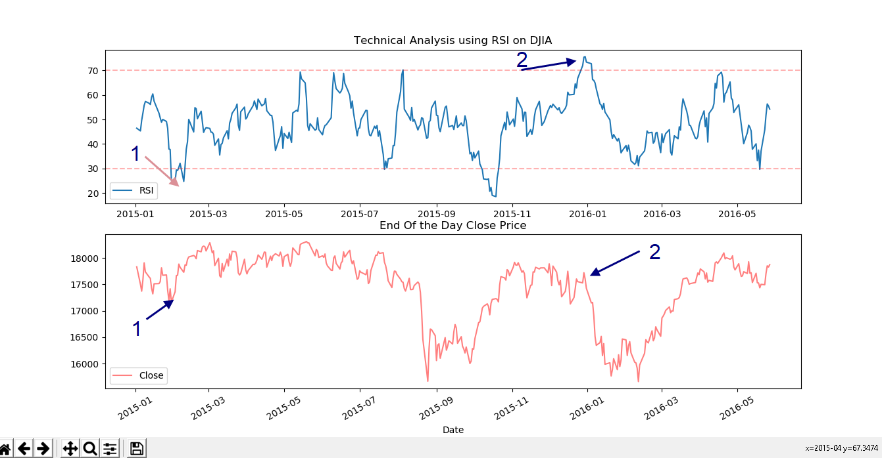
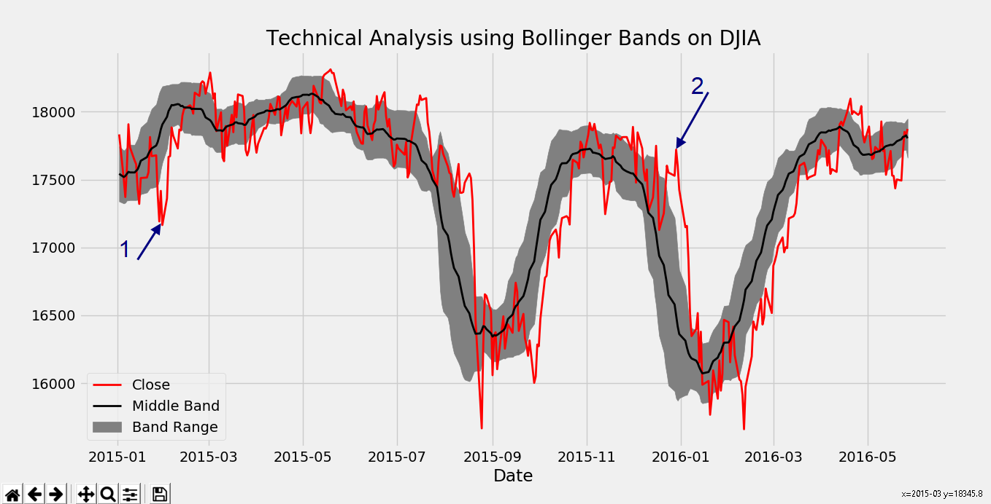
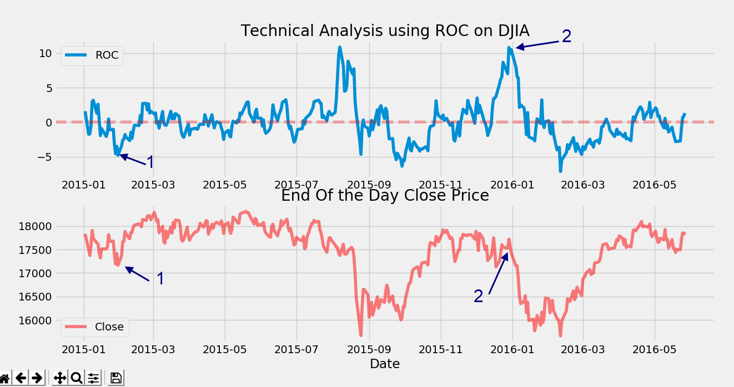
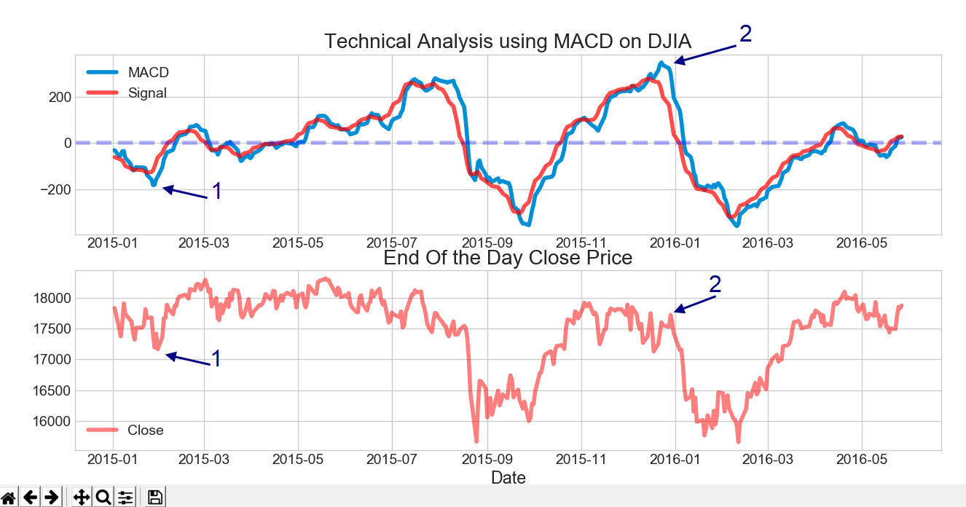
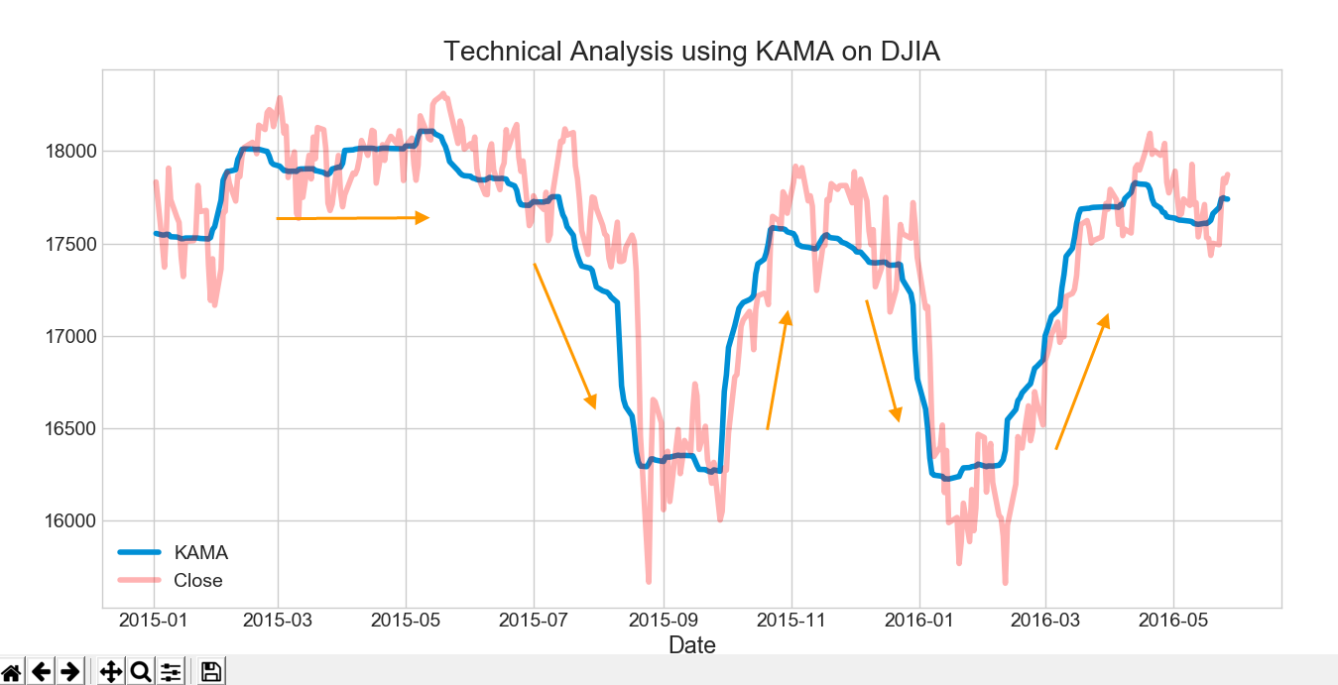
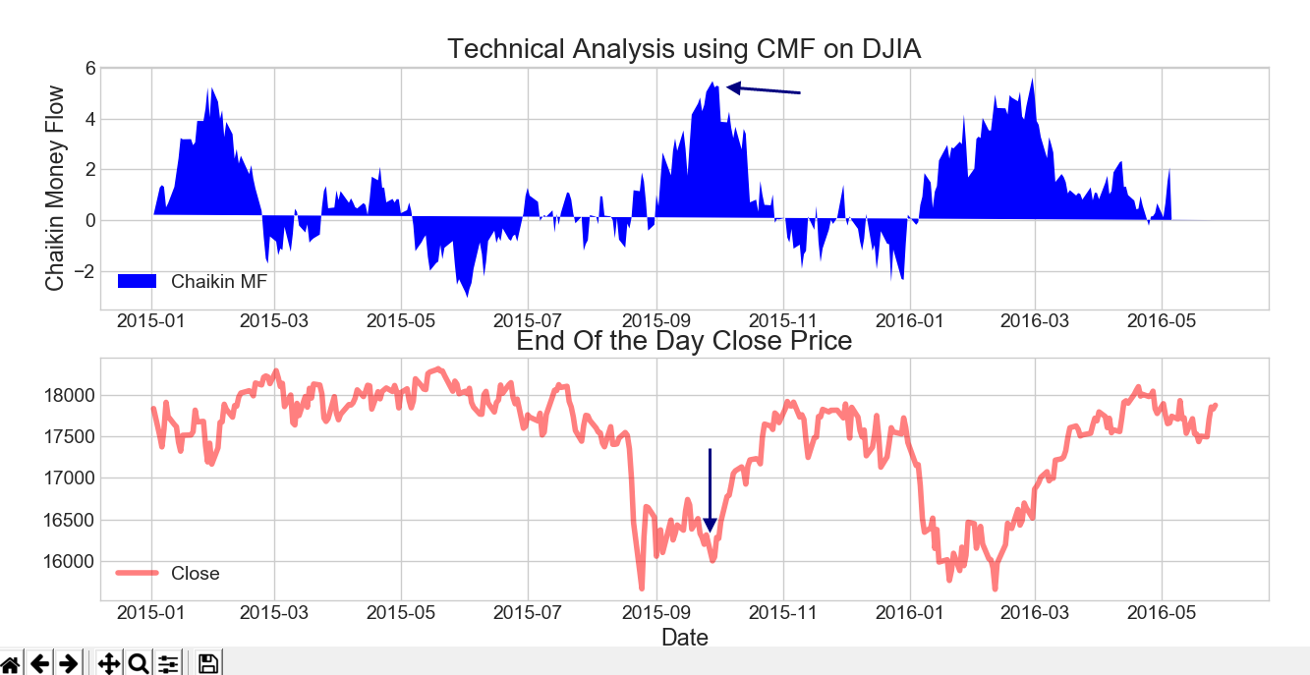
Results: Technical Indicators

Slide 7
Results: Text Mining

Slide 8
Results: Time Series Analysis
Performance Evaluations | MAE | RMSE
ARIMA | 143.2535 | 361.6687
LSTM | 0.00288 | 0.003342

Slide 9
Results: Integrated Scale
Date | 27/06/2016 | 28/06/2016 | 29/06/2016 | 30/06/2016 | 01/07/2016
Original Value | 17140.24023 | 17409.7207 | 17694.67969 | 17929.99023 | 17949.36914
Original Movement | NA | 1 | 1 | 1 | 1
Predicted Price MLR | 26356.57075 | 26147.66991 | 26369.50771 | 26598.71272 | 26848.83222
Predicted Price ARIMA | 17422.52934 | 17705.62792 | 17930.96527 | 17311.42275 | 11734.67517
Predicted Price LSTM | 0.03 | 0.02 | 0.00 | -0.02 | -0.01
Predicted Movement LR1 | 1 | 1 | 1 | 0 | 1
Predicted Movement LR2 | 1 | 1 | 1 | 0 | 1
Predicted Movement LR3 | 1 | 1 | 1 | 1 | 1
Predicted Movement SVM1 | 1 | 1 | 1 | 0 | 1
Predicted Movement SVM2 | 1 | 1 | 1 | 0 | 1
Predicted Movement SVM3 | 1 | 1 | 1 | 1 | 1
Predicted Movement NLSVM1 | 1 | 1 | 1 | 1 | 1
Predicted Movement NLSVM2 | 1 | 1 | 1 | 1 | 1
Predicted Movement NLSVM3 | 1 | 1 | 1 | 1 | 1
Overall Score | NA | 10 | 11 | 6 | 12
Final Decision | NA | Buy | Buy | Hold | Buy

Slide 10
Challenges and Future Scope
Challenges
Data collection
Data cleaning
Hardware requirements
Technical expertise
Future Scope
Optimization of individual algorithms
Better selection strategies for technical indicators
Adding more data sources like Twitter

Slide 11
Conclusion

