Slide 1
Cyclistic Bike-Share Analysis Report (2025-2026)
(Google Data Analytics Capstone Project)
Achala Jain
26.06.2026
Prepared By

Slide 2
Table of contents:-
Business Task
Data Sources
Data Cleaning and Preparation
Data Analysis
Ride Count Analysis
Average Ride Duration Analysis
Weekly Usage Analysis
Monthly Usage Analysis
Hourly Usage Analysis
Bike Type Analysis
Top Casual Station Analysis
Member vs Casual Comparison
Key Findings
Recommendations
Conclusion
References

Slide 3
Business Problem
Annual members are more profitable than casual riders.
Cyclistic wants to increase annual memberships.
The company needs to understand differences in rider behavior before designing marketing campaigns.
Business Objective
Identify behavioral differences between casual riders and annual members.
Provide data-driven recommendations to help convert casual riders into annual members.

Slide 4
Data Source
Cyclistic historical bike trip data provided as part of the Google Data Analytics Professional Certificate Case Study.
Data Contents
Ride Id
Ride start and end times
Rider type (member/casual)
Bike type
Station information
Tools Used
Tableau Desktop
R Programming
Microsoft PowerPoint

Slide 5
Data Cleaning and Preparation
Imported and combined trip data files
Removed duplicate records
Created ride duration
Checking Null Values
Converted date columns
Removed invalid ride durations
Removed 2024 records
Created Weekday and monthly variables
Created year column

Slide 6
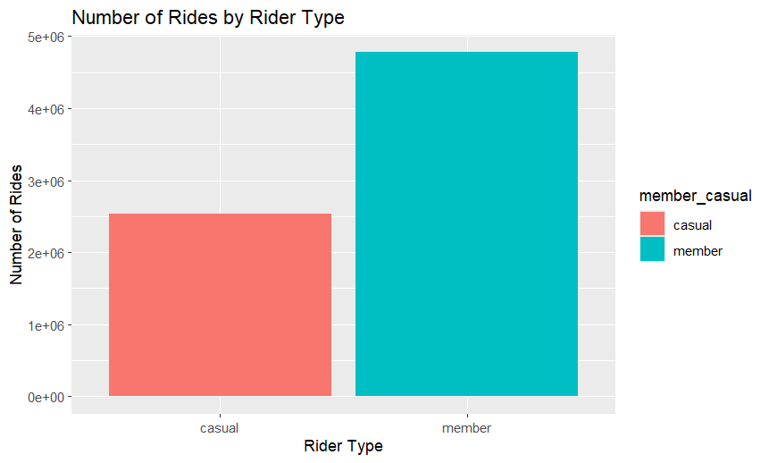
Ride Count Analysis
2025-May 2026
Insight:
Annual members generated more rides than casual riders.
Business Interpretation:
Members use Cyclistic as a regular transportation option.

Slide 7
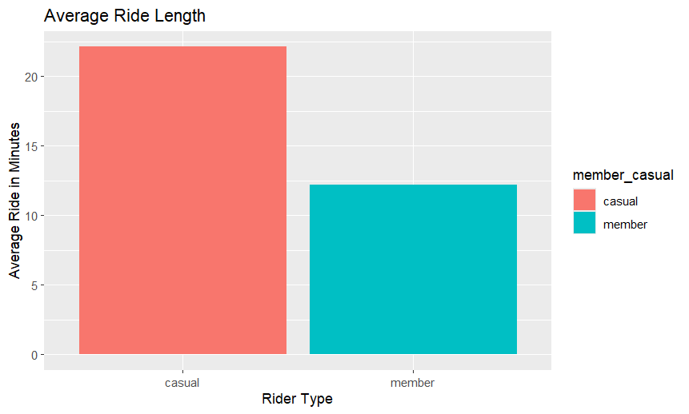
Average Ride Length Analysis
2025-May 2026
Insight:
Casual riders recorded longer average ride durations.
Business Interpretation:
Casual riders primarily use bikes for leisure and recreational activities.

Slide 8
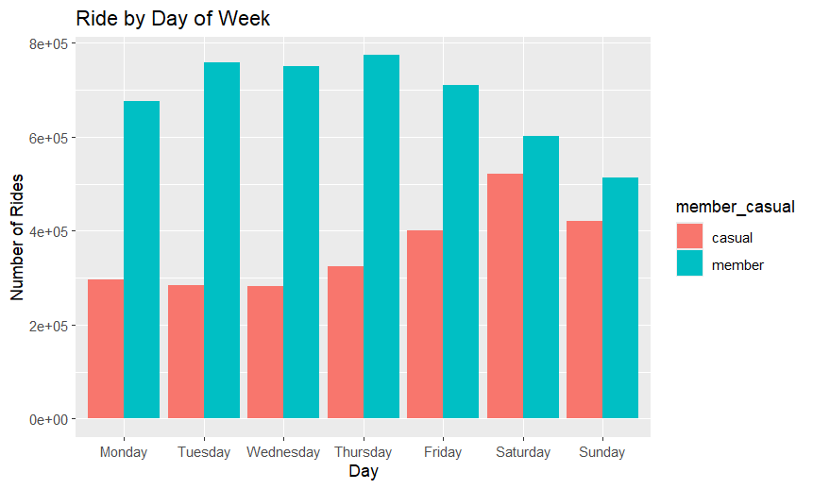
Weekly Usage Analysis
2025-May 2026
Insight:
Annual members show higher ride activity during weekdays.
Casual riders show increased usage during weekends, especially Saturday and Sunday.
Business Interpretation:
Members primarily use Cyclistic bikes for commuting and daily transportation.
Casual riders are more likely to use bikes for leisure and recreational activities.

Slide 9
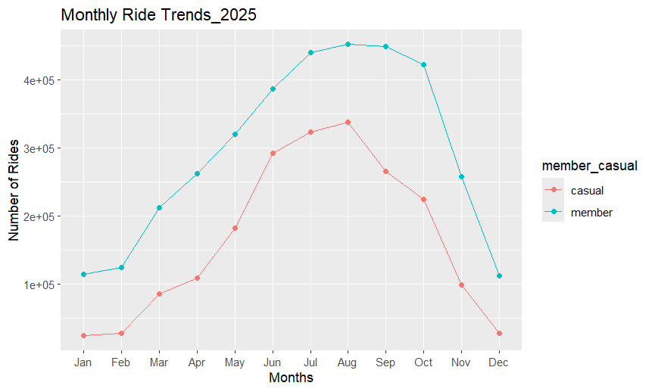
Monthly Usage Analysis
Insight:
Ridership increases during warmer months.
Usage declines during winter months.
Business Interpretation:
Weather and seasonal conditions strongly influence bike-share usage.

Slide 10
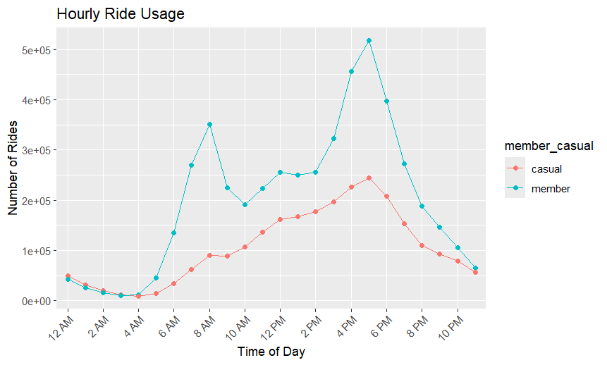
Hourly Usage Analysis
2025-May 2026
Insight:
Member rides peak during morning and evening hours.
Casual riders are more active during afternoon and leisure hours.
Business Interpretation:
Members use bikes to travel to and from work.
Casual riders tend to ride during free time and recreational periods.

Slide 11
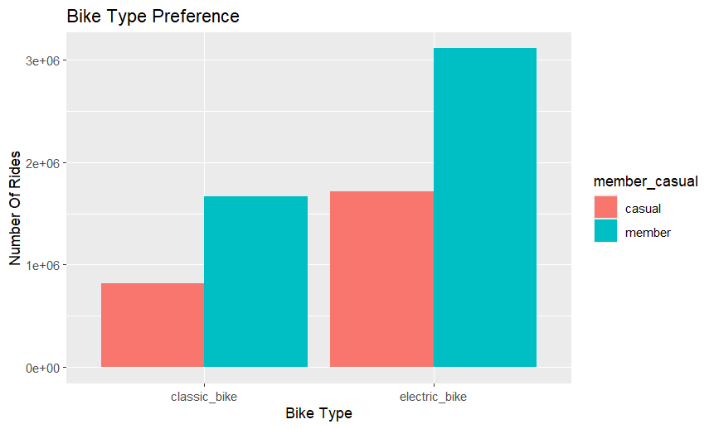
Bike Type Preference Analysis
2025-May 2026
Insight:
Electric bikes are the most popular bike type among both casual riders and members.
Business Interpretation:
Convenience and ease of use make electric bikes attractive to riders.

Slide 12
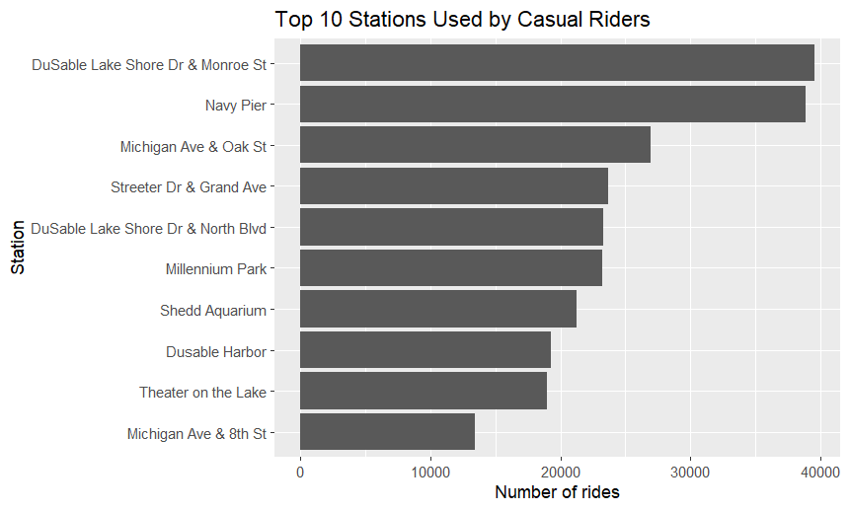
Top Casual Stations
2025-May 2026
Insight:
Casual riders frequently start or end trips at a few popular stations.
These stations are likely located near tourist and recreational areas.
Business Interpretation:
Casual riders mainly use Cyclistic for leisure and sightseeing purposes.

Slide 13
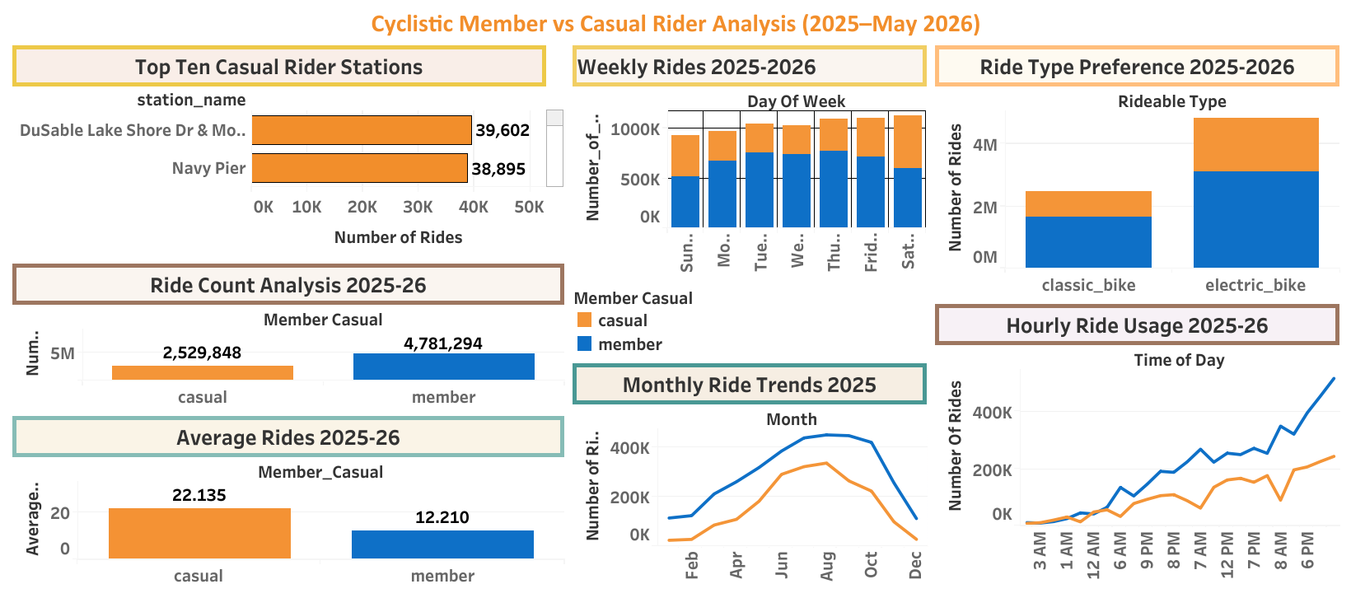
Member vs. Casual Comparison
Higher ride frequency among members.
Longer ride duration among casual riders.
Different weekday and weekend riding patterns.
Members use bikes for daily transportation and commuting.
Casual riders primarily use bikes for leisure and recreational trips.

Slide 14
Key Findings
Members take more rides.
Casual riders ride longer.
Ridership peaks in summer
Members prefer weekdays.
Casual riders prefer weekends.
Electric bikes are most preferred.

Slide 15
Recommendations
1. Target Weekend Casual Riders
Launch weekend promotions and membership trials, as casual riders are most active during leisure periods.
2. Promote Membership Value
Highlight cost savings, convenience, and unlimited access benefits through digital marketing campaigns.
3. Focus on Peak Riding Seasons
Run membership conversion campaigns during spring and summer when rider activity is highest.

Slide 16
Members drive ride frequency, while casual riders drive ride duration. By targeting casual riders with membership-focused campaigns, Cyclistic can increase annual memberships and enhance long-term profitability.
Conclusion

Slide 17
References
Cyclistic Historical Bike Trip Data.
Google Data Analytics Professional Certificate Case Study, Coursera.
R Programming Language.
Tableau Desktop

Slide 18
Thank You

