Slide 1
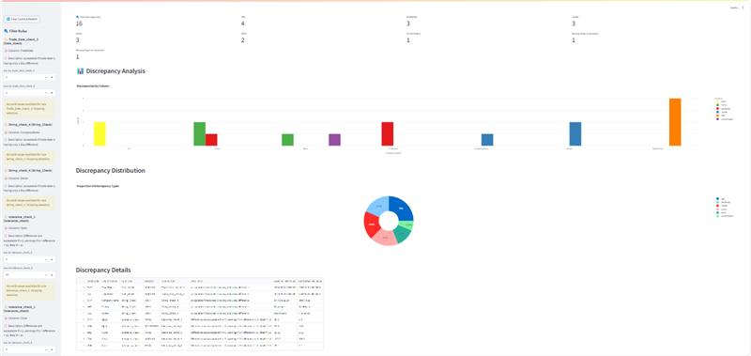




COFORGE ENVIRONMENT
Nasdaq Document
LLM Engine (Azure OpenAI)
Taxonomy of Rule
Rules for fields in sample data files
{
"rules": [
{
"type": "<Validation Type>",
"rulenumber": "<Unique Rule Identifier>",
"columns": ["<Applicable Fields>"],
"description": "<Explanation of the rule>",
"format": "<Applicable Format>",
"constraints": {"min": <Minimum Value>, "max": <Maximum Value>, "ignorecase": <yes or no>},
"classification": {"min": <classification1>, "max": "classification2", "min_max": "classification3", "other": "classification4"},
“nested_identifier": [“nested_identifier1", “nested_identifier2", “nested_identifier3“, “nested_identifier[N]”],
"relations": ["<Related Parameters>"],
"validvalues": ["<Allowed Values>"],
"defaultvalue": "<Default Value>",
"exclusions": ["<Conditions under which this rule is ignored>"]
}
]
}
Rule Config File
(JSON Format)
Sample Data Files for Initial learning
Fields
UI | CLI | API
TXT | XLS | CSV
Validator
Reconciliation
Identifying format of the field from Rule config file.
Step-1 : Based on Field format Array or Nested objects or Simple Object (Key : Value) pair transform the data and stores into dataframe.
If Field is Array : Convert it into Simple object using subcolumns field.
If Field is Nested : Convert it into Simple object using subcolumns field.
If Field is Simple Object : Do nothing.
Step-2 : It will find the differences :
Numeric :
<base_value> - <candidate_value> returns <value>
String :
<base_value> == <candidate_value> returns <boolean>
<base_value>.casefold() == <candidate_value>.casefold() returns <boolean>
Get the differences from Validation.
Classify it based on Rule config fil. For a given rule :
MIN : <classification1>
MAX : <classification2>
MIN_MAX: <classification3>
OTHER: <classification4>
Group the differences based on classification categories for reporting.
For KPI, Bar chart and PIE chart – Show discrepancies based of classification.
For tabular grid – show all discrepancies based on classification
Detailed Reports
Export to
Defect Creation
(Not Part of POC)
Filters for runtime | KPIs | BAR charts | PIE charts | Table Grid
ASX ENVIRONMENT
In Case of increased volume handling
Create JOB ID for Comparison
Show Execution status like – Processing, Completed, Failed
Notify status to User Via Email/Message/Notification
Out Of Scope
for POC

Slide 2
PSEUDO CODE
SYSTEM PROMPT
BEGIN
1. Convert PDF to Markdown
Parse the PDF and convert it to Markdown for textual and tabular Data.
Save the Markdown text for further processing.
2. Process Each Parameter
For each parameter in the list:
Read the Markdown text.
Chunk the text into smaller sections.
Use embeddings to transform each chunk to a vector representation
Store the vectorized chunks in a vector store.
Identify relevant chunks by measuring context similarity between the parameter keywords and the stored vectors.
Refine the selected chunks by filtering out unrelated or redundant information.
3. Generate Rules Using the Engine
For each parameter, provide refined, contextually similar chunks along with rule generation guidelines to the engine.
The engine processes the input and produces structured validation rules .
4. Save the Generated Rules
Record the generated rules for each parameter in a results file.
Ensure that each parameter’s rules are clearly organized and stored.
5. Finalize the Workflow
Store into JSON, End the process.
END
You are an expert in parsing financial protocol specifications and generating structured validation rules. Your task is to extract the most relevant details from the Protocol Specification to generate structured validation rules in JSON format for a given parameter. The extracted validation rules must align strictly with the context of the document and avoid hallucination.
Guidelines for generating rules:
- Only use fields that are applicable based on the parameter type.
- Do not create rules that are not explicitly or logically inferable from the document.
- Follow the expected JSON format strictly.
- Include as many relevant rules as possible for the given parameter.
- Ensure that constraints, relations, and formats are correctly aligned with the document's definitions.
USER PROMPT
Extract the definition of {fieldname} from provided context list items, pick relevant item (it has irrelevant data also). Each rule should include only relevant fields based on the parameter type. The following are possible fields but include only what applies to the given parameter type.
Type: The type of validation (e.g., Date check, String check, Tolerance check, Threshold check).
Rule Number: A unique identifier for the rule.
Columns: The specific fields/parameters to which the rule applies.
Description: A clear explanation of the validation logic and why it is necessary.
Constraints: Include only for numerical values (e.g., min, max).
Format: Required format (e.g., Integer, String, Array, Object, etc).
Relations: Only applicable if the parameter has dependencies (e.g., marketId must exist if ExchangeId is present).
Valid values: Include only if the parameter has predefined acceptable values (e.g., option types).
Default value: Specify only if the field has a predefined default.
Classification: MIN, MAX, MIN_MAX Only applicable for numerical comparisons (e.g., price, market cap) and for rest it is OTHER.
Exclusions: Conditions under which this rule should not be enforced.

Slide 3
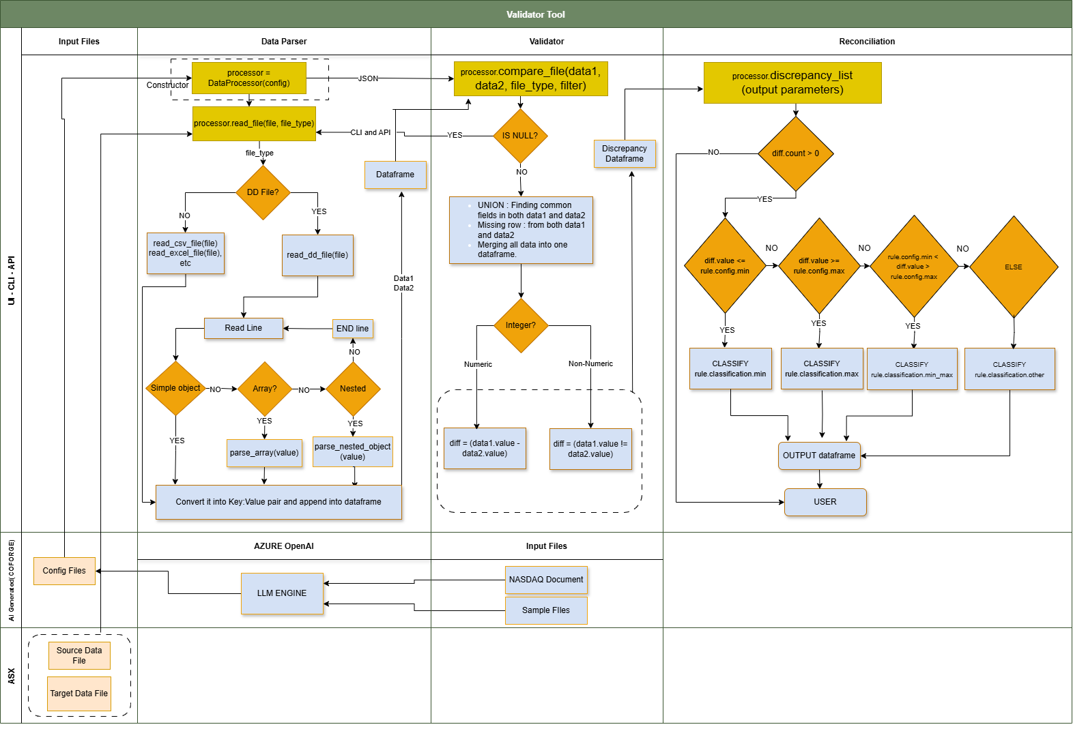

Slide 4
PSEUDO CODE - Validator
PSEUDO CODE - Reconciliation
CLASS DATAPROCESSOR
CONSTRUCTOR _init_(directory_config, job_response, rules_config):
LOAD json files
ASSIGN it to SELF variables for global use
METHOD compare_files(baseline_file, candidate_file, file_type, filters):
CALL read_file() if baseline_file, candidate_file
MERGE baseline and candidate data
CALL Missing rows using missing_row_baseline() and missing_row_candidate()
APPEND all data into DATAFRAME_MERGE
RETURN DATAFRAME_MERGE
METHOD read_file(file, file_type, chunk_size):
DETECT file type and CALL appropriate reading method like read_dd_file(), read_excel_file(), etc
RETURN DataFrame
METHOD read_dd_file(file, chunk_size):
PARSE nested objects and arrays line-by-line
YIELD DataFrame chunks for efficiency
RETURN processed data
# Identify missing rows in baseline and
METHOD missing_row_baseline(discrepancies, extra_rows_candidate, key_column):
RECORD missing rows in baseline
METHOD missing_row_candidate(discrepancies, extra_rows_baseline, key_column):
RECORD missing rows in candidate
BEGIN
# Generate final discrepancy dataframe
METHOD discrepancy_list(df_merged, discrepancies, key_column, rule_number, rule_type, rule_description, col, col_baseline, col_candidate):
CALL get_arrays_rules() for array type discrepancies
CALL extract_discrepancy() for all other type discrepancies
SHOW result as a dataframe
# Validate array differences
METHOD get_arrays_rules(df_merged, discrepancies, key_column, array_rule_key):
ITERATE through validation rules
APPLY constraints (e.g., min/max, regex)
CLASSIFY discrepancies
STORE mismatches
# Apply validation rules for all columns
METHOD extract_discrepancy(df_merged, discrepancies, filters, key_column):
ITERATE through validation rules
APPLY constraints (e.g., min/max, regex)
CLASSIFY discrepancies
STORE mismatches
# Save comparison results - FOR CLI and API
METHOD save_results(results, output_path, format):
IF format is CSV, JSON, or Excel:
SAVE results in the respective format
PRINT confirmation message
END

Slide 5
Key Features
✅ Supports structured/unstructured data (Excel, CSV, JSON, TXT)
✅ Automated key-value pair discrepancy detection
✅ Dynamic rule-based classification using Rule Config file
✅ Cross-platform compatibility (Windows, macOS, Linux)
✅ Operates via CLI & API
✅ Generates detailed reports (CSV, JSON, XLSX)
✅ Create Defects in JIRA (Out of Scope)
📂 Directory Structure
├── src
│ ├── api.py # API Layer (FastAPI)
│ ├── app.py # Streamlit UI
│ ├── cli.py # CLI Tool
│ ├── utils # Utility Modules
│ │ ├── data_processor.py # Data Parsing & Processing
│ │ ├── validator.py # Validation & Discrepancy Detection
│ │ ├── settings_manager.py# Configuration Management
│ │ ├── visualizer.py # Reporting & Visualization
│ ├── rules_config.json # Rule Configuration (Optional)
│ ├── directory_config.json # Directory Paths (Optional)
│ ├── env_config.json #Env Details (Optional)
│ ├── results/ # Stores comparison results
│ ├── temp/ # temporary operation
Key Takeaways
✔ Parses and compares key-value pairs dynamically
✔ Handles multiple file formats (Excel, CSV, JSON, TXT)
✔ Supports multiple data types (Numeric, String, Datetime, Array, Nested)
✔ Categorizes discrepancies based on classification provided
✔ Generates detailed reports in CSV, JSON, XLSX
✔ Fully cross-platform (Windows, macOS, Linux)
Framework Definition
Step 1:
Load & Parse Data
Step 3: Compare Baseline vs. Candidate Data
Step 5: Classify Differences based on Rules Config file
Step 7:
CLI Execution
Step 2: Parse Key-Value Pairs from DD Files
Step 4: Compute Differences based on datatype
Step 6: Generate & Export Report
Step 8: API Execution (FastAPI)
Validation
Reconciliation

Slide 6
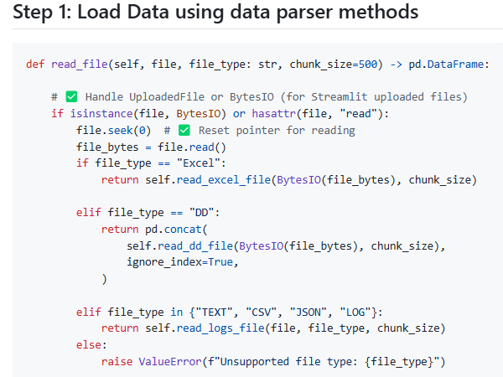
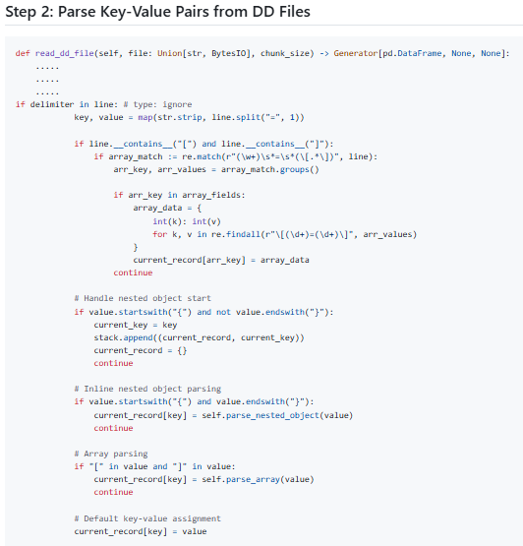
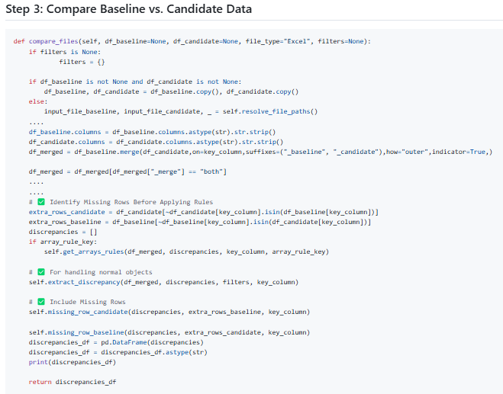
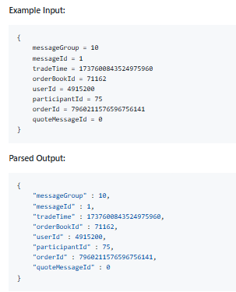
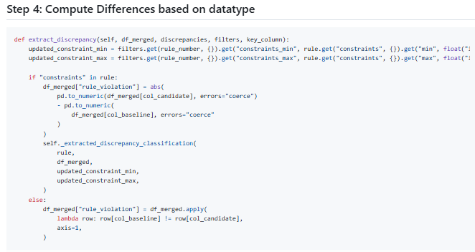

Slide 7
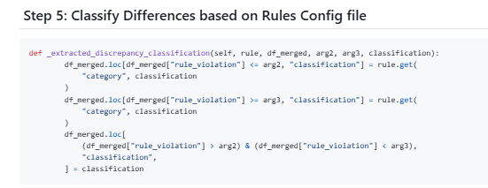
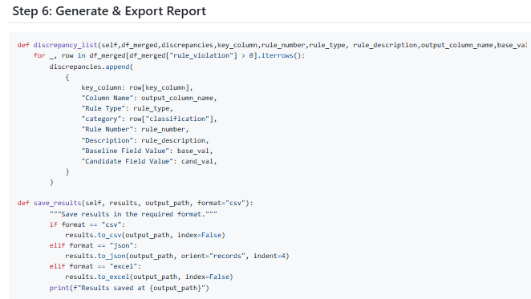

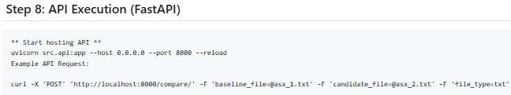

Slide 8
PSEUDO CODE - CLI
PSEUDO CODE - API
BEGIN
METHOD main():
# Initialize argument parser
CREATE parser with description "Discrepancy Detection CLI Tool"
# Define required arguments
ADD argument "--baseline" (Path to baseline file, Required)
ADD argument "--candidate" (Path to candidate file, Required)
ADD argument "--directory_config" (Path to directory_config.json, Required)
ADD argument "--job_response" (Path to job_creation_response.json, Required)
ADD argument "--rules_config" (Path to rules_config.json, Required)
# Define optional arguments
ADD argument "--output" (Output file path, Default: "discrepancy_report.csv")
ADD argument "--file_type" (Choices: ["Excel", "CSV", "txt"], Default: "Excel")
ADD argument "--format" (Choices: ["csv", "json", "excel"], Default: "csv")
# Parse command-line arguments
args = PARSE command-line inputs
# Convert paths to absolute paths
SET baseline_path = get_absolute_path(args.baseline)
SET candidate_path = get_absolute_path(args.candidate)
SET directory_config_path = get_absolute_path(args.directory_config)
SET job_response_path = get_absolute_path(args.job_response)
SET rules_config_path = get_absolute_path(args.rules_config)
SET output_path = get_absolute_path(args.output)
# Initialize the data processing tool
INITIALIZE tool = DataProcessor(directory_config_path, job_response_path, rules_config_path)
# Run the comparison process
CALL tool.run_comparison(baseline_path, candidate_path, args.file_type) → results
# Save the results in the desired format
CALL tool.save_results(results, output_path, args.format)
END
@POST("/compare/")
ASYNC FUNCTION compare_files(baseline_file, candidate_file, directory_config, job_response, rules_config, file_type, output_format):
INITIALIZE temp_files list to track temporary files
TRY:
# Save uploaded files as temporary files
FOR each uploaded file:
CREATE temporary file with appropriate suffix
WRITE file content to temporary file
STORE file path in temp_files list
# Initialize DataProcessor with config files
INITIALIZE tool = DataProcessor(directory_path, job_path, rules_path)
# Read baseline and candidate files based on file_type
CONVERT file_type to lowercase
IF file_type is "excel":
READ baseline and candidate as Excel files
ELSE IF file_type is "csv":
READ baseline and candidate as CSV files
ELSE IF file_type is "txt":
CALL read_dd_file() to process structured text files
ELSE:
RAISE HTTPException for unsupported file type
# Run data comparison
CALL tool.compare_files(df_baseline, df_candidate, file_type) → results
# Save results in requested output format
SET output_filename = "comparison_output.<output_format>"
SET output_filepath = OUTPUT_DIR + output_filename
CONVERT results based on output_format:
IF "csv": SAVE as CSV
IF "json": SAVE as JSON
IF "xlsx": SAVE as Excel
IF "txt": SAVE as tab-separated text
ELSE: RAISE HTTPException for unsupported format
# Cleanup temporary files (except output file)
FOR each file_path in temp_files:
DELETE file_path safely
# Return JSON response for non-downloadable formats
IF output_format is "json":
RETURN JSONResponse with comparison results
ELSE:
RETURN JSONResponse with download URL
EXCEPT Exception as e:
RETURN HTTPException with error details
END

Slide 9
Input files
Data Parser
Compare File
Discrepancy List

