Slide 1
Ecommerce Capstone Project: Market Mix Modelling, Final Submission Report
Objective: To Model the impact of different Levers on the Revenue/GMV(Gross Merchandise Value) of Company Eleckart
Submitted by Achal Kagwad on 31st December 2021
Email id: achal.kagwad@gmail.com Phone No:+91-9108302174
Linkedin Profile: https://www.linkedin.com/in/achalkagwad/

Slide 2
Business Objective
Performance Driver Analysis: Which KPIs Drive the Top Line Performance?
Impact Analysis of marketing ROI: What is the quantitative impact of each commercial lever on revenue?
Optimizing Marketing Spends: How to best allocate the marketing budget to gain the highest outcome or return on investment?

Slide 3
Problem Solving Methodology: CRISP DM
Understanding the Business Data
Data Preparation and Feature Engineering
Exploratory Data Analysis and Visualizations
Preparing Regression Models For Prediction and Determining Important KPIs
Model Evaluation and Model Selection
Model Deployment(Out of Scope For the Project)

Slide 4
Understanding Data
Main Consumer File with Order Details at a daily basis
Media Investment File with amount invested in each advertising medium for the past year.
Sale Calendar File showing the dates from the past year where there was a promotional offer
NPS Score showing Net Promoter Score(Voice of Customer) and company stock value for last year
Weather File having detail of weather Reports from last year in the state of ‘Ontario Canada’

Slide 5
Understanding Data: 4Ps of Marketing
Product:
Number of Units Sold
Delivery Days and SLAs
Categories/Sub Categories
Verticals
Procurement SLAs
Price:
GMV: Gross Merchandise Value
Product MRP
Place:
Pincode | Order Payment Type | Week of the Year(Seasonality) | Holiday Events | Sale Calendar
Promotion:
Marketing Channel Investments | NPS-Customer Sentiment | Discounts | Adstocks

Slide 6
Data Preparation and Clean Up
Handling Incorrect values in some columns
Imputing "\N" value in deliverybdays & deliverycdays by 0
Treating incorrect GMV values (where gmv > product_mrp * units) by imputing the faulty MRP values with GMV/units
Handling Negative values for product_procurement_sla, deliverybdays & deliverycdays by dropping them
Handling large values(0.3%) for product_procurement_sla by dropping them
De-Duplication Of Data:
After converting all column values to lowercase, we see that there are around 99283 (6.33%) rows that are duplicates. We went ahead and dropped them
Treating Null Values and Whitespaces:
Initially there weren’t any NULL values in the dataframe. However, there were quite a few Whitespaces present in some of the columns in the dataframe
We first converted these whitespaces to NaNs and the dropped these values.
Dropping Insignificant Columns
Dropping Columns with Single Unique Value (as it doesn’t add any information to the analysis)
Dropping some of the ‘Id’ Columns which are insignificant to the analysis

Slide 7
Data Preparation and Clean Up Continued..
Outlier Treatment:
Since we have already deleted some records on erroneous grounds, in order that we don't lose any further data, we chose not to delete outlier values
For the variables - 'SLA', 'deliverybdays', 'deliverybdays', 'gmv', 'product_mrp', 'list_price' where outliers are present, we CAPPED the values above 99 percentile to the value corresponding to 99 percentile
Thus the outliers couldn’t affect the predictive model while at the same time there was enough data to build a generalizable model.
Selecting One Year Data:
Selecting 1 Year Data from July, 2015 – June, 2016. In the process, 592 records were dropped.
Converting Categorical Features to Numerical Form:
Binary encoding for categorical variable with 2 levels
One Hot Encoding for categorical variable with multiple levels by creating dummy variables
Additional Data Preparation For Model Building:
Merging Order dataset with all other secondary dataframes
Extracting 3 separate dataframes for 3 product subcategories - camera accessory, home audio and gaming accessory
Roll Up daily Order Data to Weekly Level by aggregating the numeric variables based on Week#
Train Test Split -Dividing the master data frames into train and test datasets for all 3 product subcategories followed by Scaling(we used standard scaler) of values for appropriate interpretation of features.

Slide 8
Feature Engineering: Creation of New KPIs
Week#: Generating Week Column from Order Date
List Price: List Price= GMV*Units
Payday Week: If Payday falls within the week then payday week=1 else 0
Holiday Week: If Holiday falls within the week then payday week=1 else 0
Product Type (Luxury/Mass Market): Is GMV value is greater than 80 percentile, then luxury else mass market
Discount%: Discount%= 100*(product_mrp-listprice)/product_mrp
SMA(Simple Moving Average): 3 and 5 Week SMA for all Advertising Media Channels, NPS and Stock Exchange
EMA(Exponential Moving Average): 8 Week EMA for all Advertising Media Channels
Ad Stock Values: for all Advertising Media Channels(assuming adstock rate as 60%)

Slide 9
Visualizations: An Insight into Data

Slide 10
Analyzing number of Items Sold & Revenue across the 3 Product Sub Categories

Slide 11
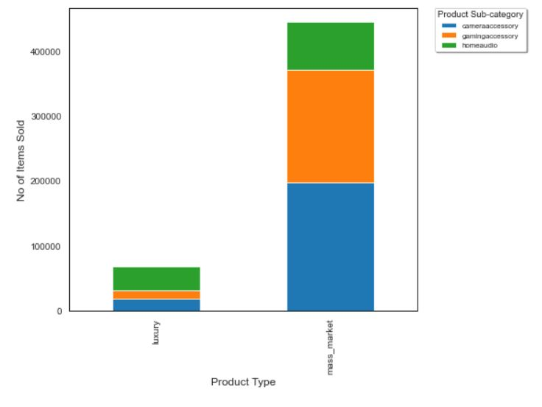
Units Sold Across 3 categories
- Most of the units sold belonged to the mass market category.
- Among mass market products sold, Camera and Gaming Accessories related products were sold the most.
- Home Audio products were the most popular among the luxury products sold

Slide 12
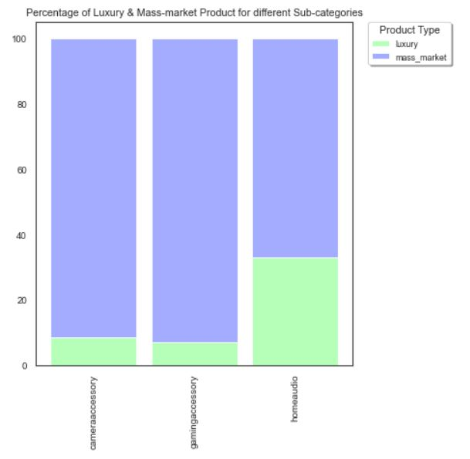
Percentage of Units Sold across 3 categories
-The percentage of number of orders tagged `mass market` is higher compared to orders tagged `luxury`.
- Percentage of luxury products under `HomeAudio` is higher compared to the other sub categories. This implies people are willing to buy more of luxury items for HomeAudio category.

Slide 13
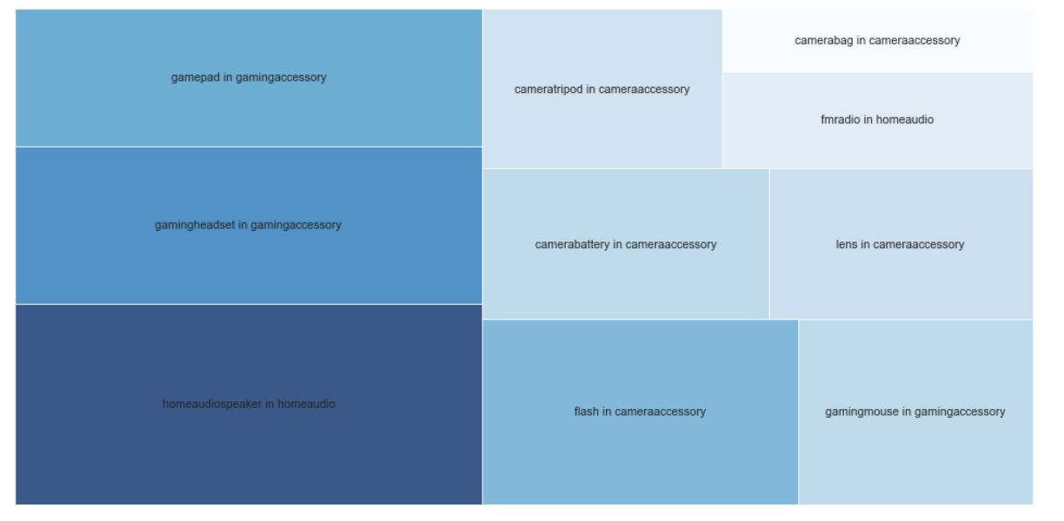
Insights: Above Plot shows top 10 product verticals with highest ORDERS across product categories. We can see `homeaudiospeaker in homeaudio` had the most no of sales followed by `gamingheadset & gamepad in gamingaccessory`

Slide 14
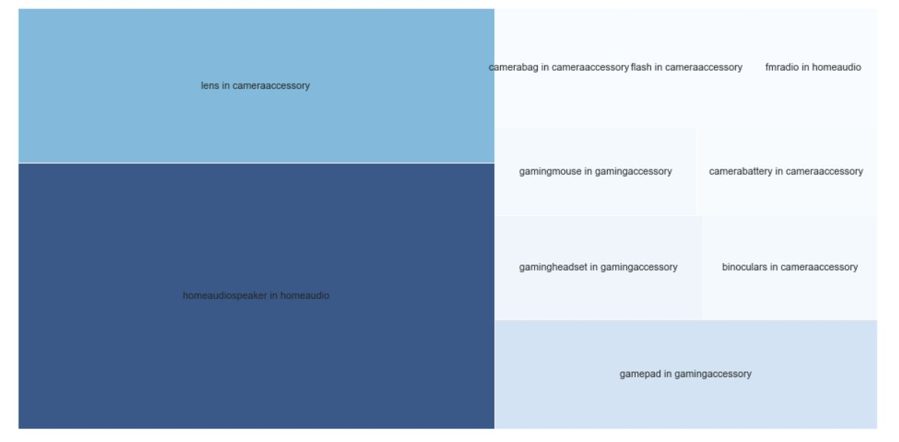
Insights: Above Plot shows top 10 product verticals with highest REVENUE across product categories. `homeaudiospeaker in homeaudio` brought the largest revenue followed by `lens in cameraaccessory` & `gamepad in gamingaccessory`.

Slide 15
Analyzing how Revenue and Orders/Sales vary based on discount%

Slide 16
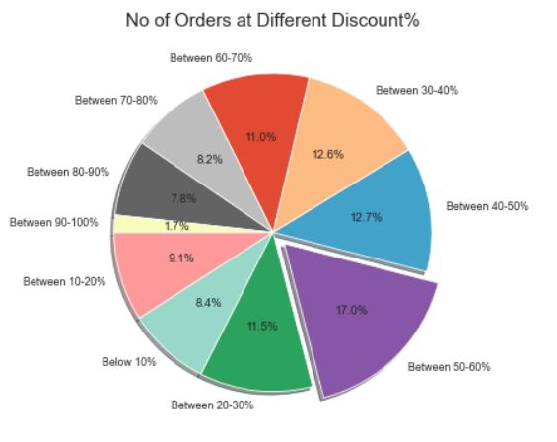
Impact of Discount% on No of Orders/Sales
Most of the sales takes place when the discount is between 50-60%

Slide 17
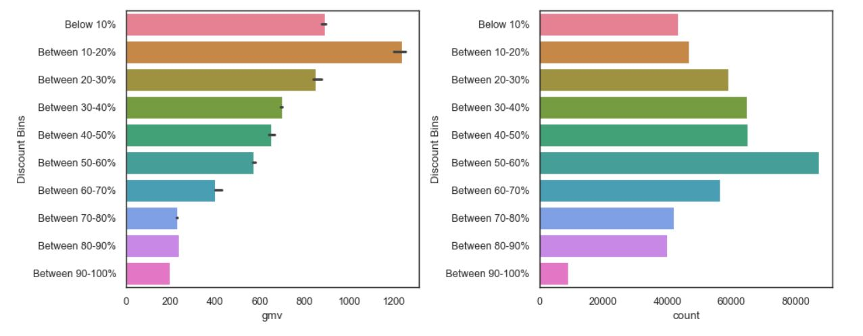
Insights: -Median Revenue is maximum when Average discount% is between 10-20%. But beyond that, average revenue slowly starts to decline.
- The Sales on the other hand shows a steady increase with increase in Discount percentage till it peaks at 50-60% after which it starts to fall again.
- This shows that at higher discount, although the sales are good, the revenue collapses signifying a loss for the company. An average discount of 10-20% is the most profitable for the company.¶

Slide 18
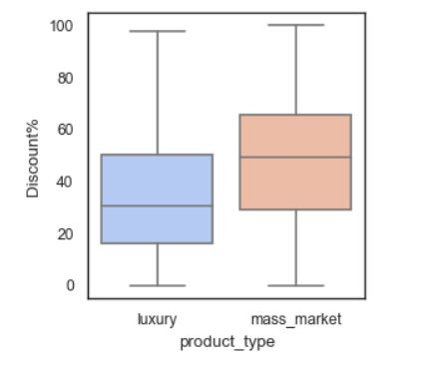
Impact of Discount% on Revenue
- The median discount percentage offered for luxury items is less compared to that of Mass Market Products.
- This is a known trend among luxury products or luxury brands to offer limited or no discounts to retain the exclusivity of their products.

Slide 19
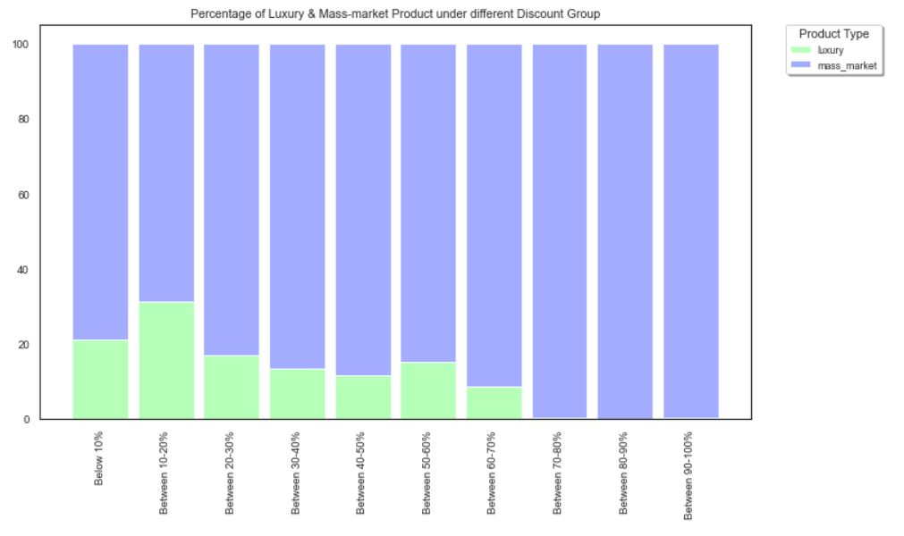
Insights:
We will find around 35% of products where a discount given between 10-20% are luxury products. This is bin which has the highest amount of products where luxury items are sold which implies a discount of 10 to 20% for luxury items usually works and gets sold and thus maintains its premiumness.

Slide 20
General Strategy to Optimize
Companies usually optimize on metrics : Market Share, Revenue and Profit.
Ecommerce companies prioritize optimizing on first Market Share, than Revenue and later on Profit in their long term business plan and success.
Here for Eleckart, if it is in the phase of optimizing on sales rather than profit it can continue to offer discounts in the range of 50 to 60% for mass market products to ensure high orders and sales.
In later years if Eleckart wants to optimize on Revenue and Profit it can offer discounts in the range of 10 to 20% to ensure high revenue as inferred from our visualizations above.

Slide 21
Analyzing how Revenue and Orders/Sales vary based on Payment Types

Slide 22
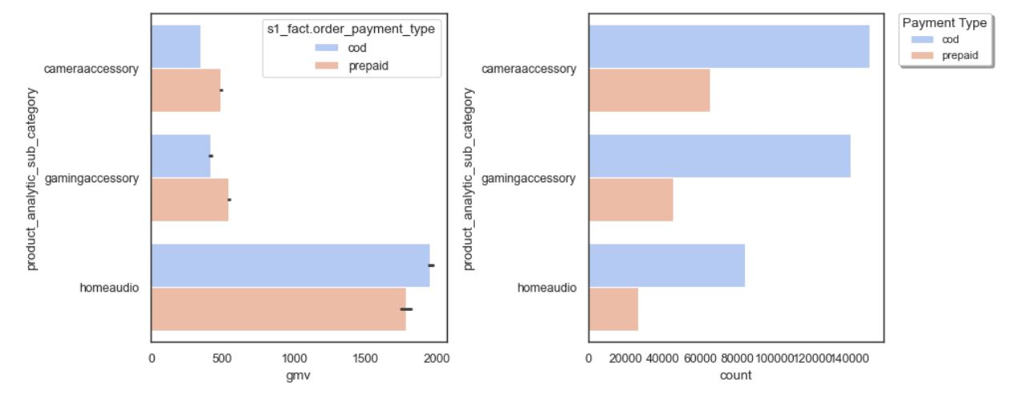
Insights:
- Clearly the Revenue/gmv for homeaudio category is greater compared to others categories
- The Number of Orders/sales is highest in Cameraaccessory category
- The Number of Orders/sales when ‘cod(cash on delivery) is almost twice as much more than ‘’prepaid’ in all categories.

Slide 23
Analyzing Trends of various media channel investments by week

Slide 24
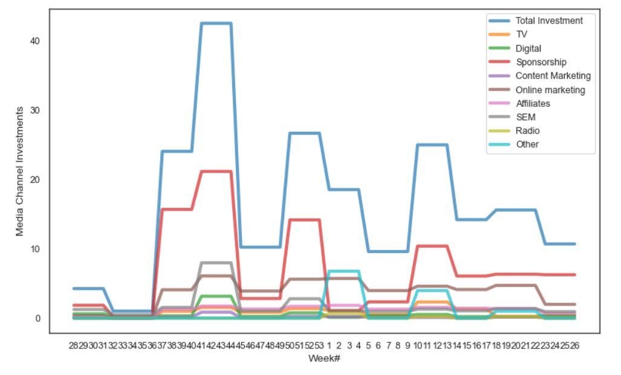
Insights:
- Over the past year, bulk of the Ad Investment has been made in Sponsorships followed by Online Marketing & Search Engine Marketing.

Slide 25
Effect of Media Investment and Discount% on Revenue

Slide 26
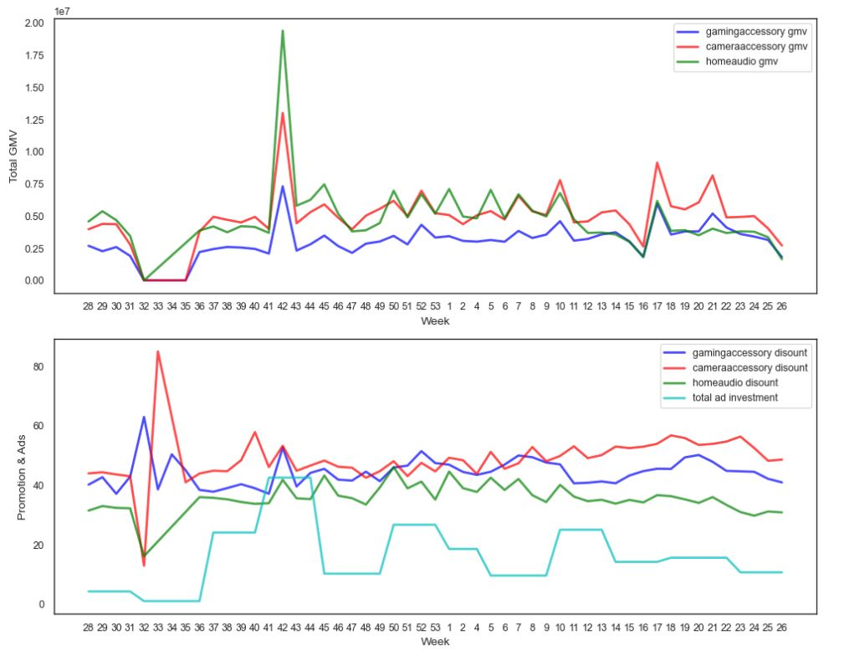

Slide 27
Insights of Effect of Media Investment and Discount% on Revenue
For the `week# 42 (during Thanksgiving)`, all the graphs show a steep rise. Revenue increased because of both higher discount% and increased Ad Investment.
For the `week 32(August)`, Revenue generated was the lowest from all 3 product subcategories. This can be observed as a direct relation to minimum amount of total investment in Ads. Discount was also lowest for all products apart from camera accessories. Post this dip in revenue, discount% was increased to bring about higher sales. This increase in Discount% was observed most in the case of gaming accessories. However, barring home audio products, the revenue from other products was seen to be constant for the next 3 weeks after which, the revenue started to pick up.
In general the average discount% offered for home audio products is lesser compared to that of the other product subcategories.

Slide 28
Brief Description of Linear Regression Models Built

Slide 29
Additive Linear Regression Model
Linear model is used to capture the current effect of several KPIs.
This model assumes an additive relationship between the different KPIs. Hence their impacts are also additive towards the dependent Y variable.
The equation can be represented as:
•Y = α + β1At + β2Pt + β3Dt + β4Qt + β5Tt + ϵ

Slide 30
Multiplicative Linear Regression Model
Multiplicative model is used when there are interactions between the KPIs.
To fit a multiplicative model, take logarithms of the data(on both sides of the model), then analyse the log data as before.
The equation can be represented as:
Y = e^α .X1^β1 . X2^β2 . X3^β3 . X4^β4 . X5^β5 + ϵ
lnY = α + β1ln(X1) + β2ln(X2) + β3ln(X3) + β4ln(X4) + β5ln(X5) + ϵ'

Slide 31
Metrics Impacting Revenue in LR Equations
- `A` stands for Advertising Impact on Revenue/GMV
- `P` stands for Pricing Impact on Revenue/GMV
- `D` stands for Discounts or Promotion Impact on Revenue/GMV
- `Q` stands for Quality or Product Assortment Impact on Revenue/GMV
- `T` stands for Industry Trend and Seasonality Impact on Revenue/GMV

Slide 32
Model Dashboard and Model Selection
All Values are on Test Data, as we are interested how models perform on test data; we choose model which has high R2 and low MSE
 | R2 Add | R2 Mul | MSE Add | MSE Mul | Model Chosen | Top Features
Camera Accessory | 0.772 | 0.974 | 1255947.4 | 0.311 | Mul | 10
Gaming Accessory | 0.753 | 0.990 | 630689.24 | 0.257 | Mul | 5
Home Audio | 0.958 | 0.993 | 351391.67 | 0.149 | Mul | 5

Slide 33
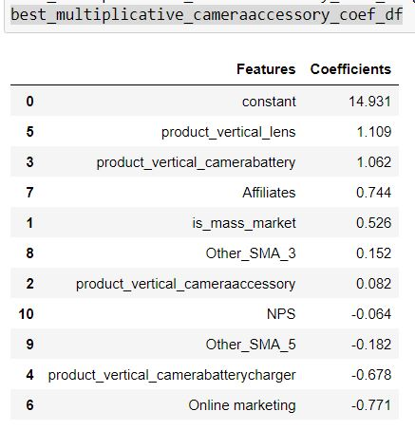
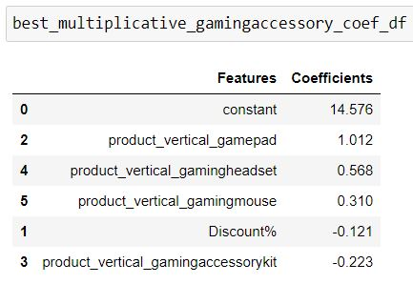
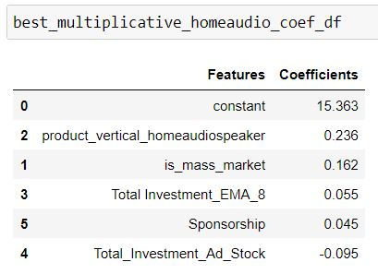
Top Features suggested by Multiplicative Model for the 3 product categories-Coefficient Values

Slide 34
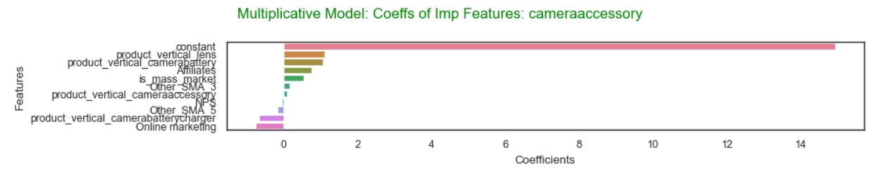
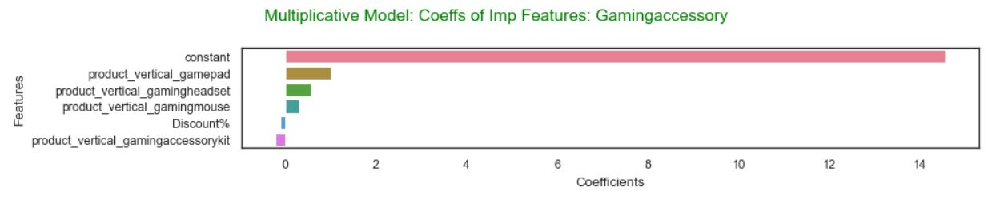
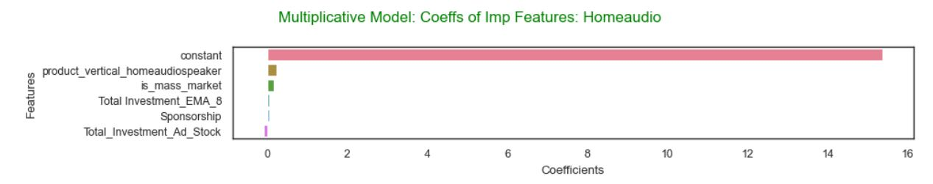
Top Features suggested by Multiplicative Model for 3 product categories-Coefficient Value Plots

Slide 35
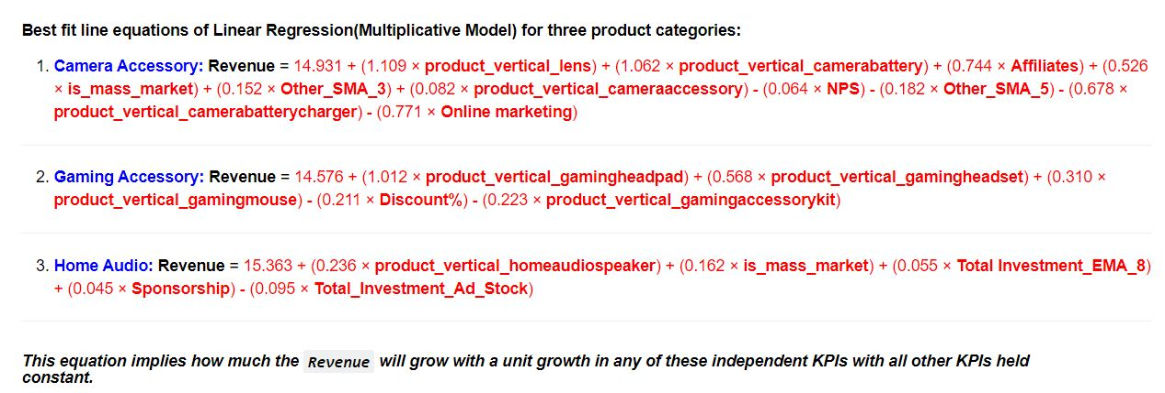
Equation of Best Fit Lines for 3 product categories

Slide 36
Recommendations: Major Features to look out for:
For each product category of “Camera Accessory”, “Gaming Accessory” and “Home Audio” we need to look out for these features:
Which product verticals contribute positively towards increasing the revenue and which product verticals affect adversely to revenue?
Which media investment channels contribute positively towards increasing the revenue and which channels affect adversely to revenue?
For the given product category whether promotion of “Mass market” products or “Luxury” Products lead to increased revenue?

Slide 37
Recommendations- Camera accessory
Company should promote “Lens” and “Camera Battery” as they contribute in increasing revenue.
Out of the various Media Investment Channels company should focus more on “Affiliates” channels by introducing well researched and known to bring high revenue schemes. “Online Marketing” Channel on the other hand impact negatively and thus investment in that channel should be reduced.
“Mass market” products are better contributors to increased revenue in comparison to luxury products.

Slide 38
Recommendations- Gaming accessory
“Gamepad”, “Gamingheadset”, “Gaming Mouse” should be promoted as they contribute in increasing revenue. On the contrary “gamingaccessorykit” results in loss.
Advertising spends on “Affiliates” and “TV” are known to bring positive impact on revenue.
“Mass market” products are better contributors to increased revenue in comparison to luxury products.
Higher percentage of discounts for this Gaming accessory category works adversely towards bringing down the revenue.

Slide 39
Recommendations- Home Audio
“Homeaudiospeaker”, and “fmradio” should be promoted as they contribute in increasing revenue.
Advertising spends on “Sponsorship” is seen to bring positive impact on revenue, while Investment in AdStock is seen to bring negative impact on revenue
“Mass market” products are better contributors to increased revenue in comparison to luxury products.

Slide 40
Appendix:Other Visualizations

Slide 41
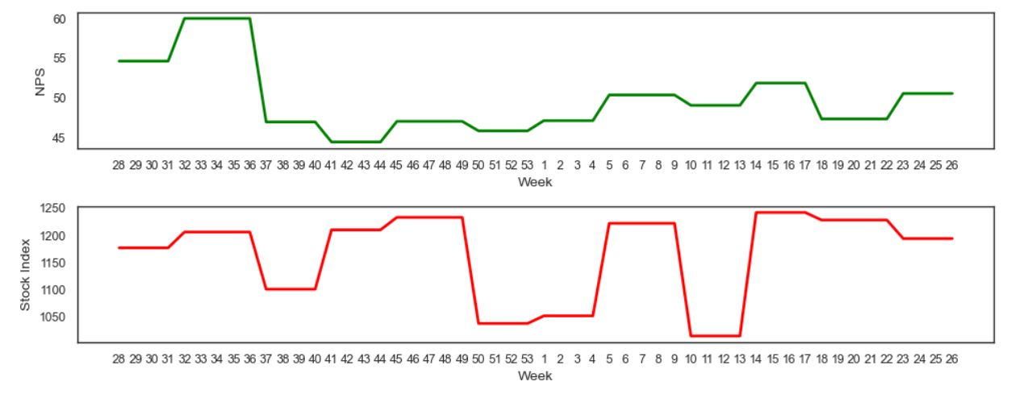
Trends in Nps and Stock Exchange Over the weeks
Consumer NPS score is highest in weeks 32-35, which coincides with the time when maximum discounts were offered.
Company Stock Index has seasonal ups and downs over the span of 1 year

Slide 42
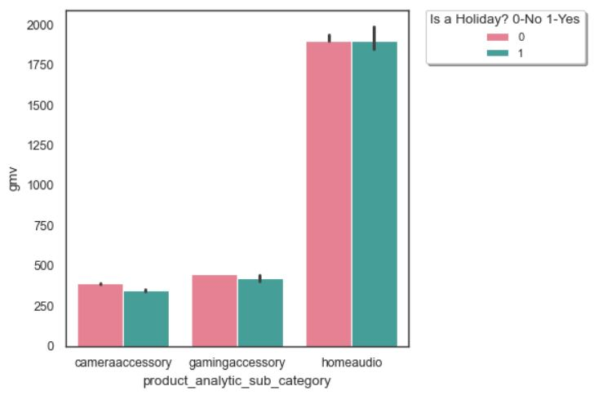
Impact of Holiday on Revenue
Presence of a Holiday does not impact revenue much!

Slide 43
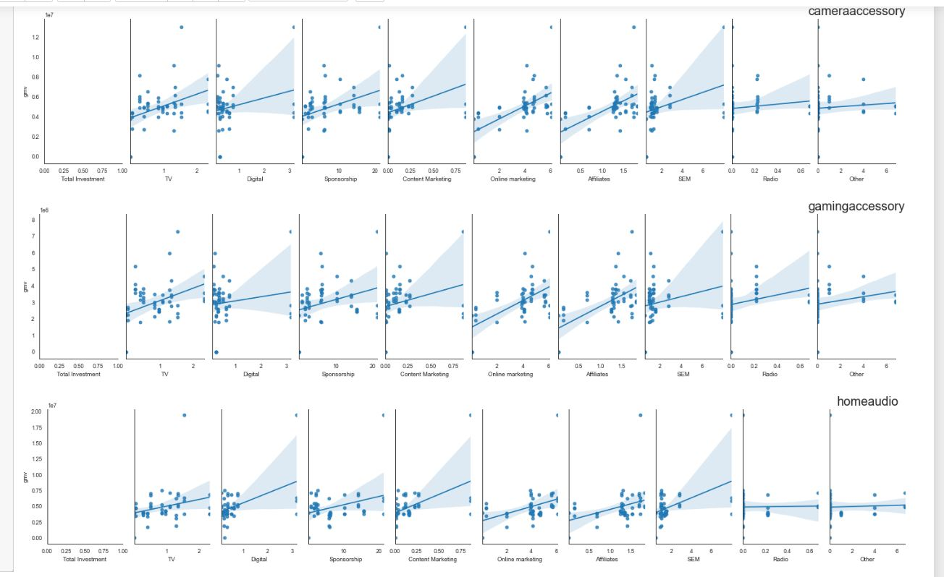
Insights: - ‘Affiliates’ and ‘Online Marketing’ seem to have relatively positive correlation with GMV(Revenue).
‘Radio’ Seems to have least correlation with GMV(Revenue)

Slide 44
Model Validation:Visualizations

Slide 45
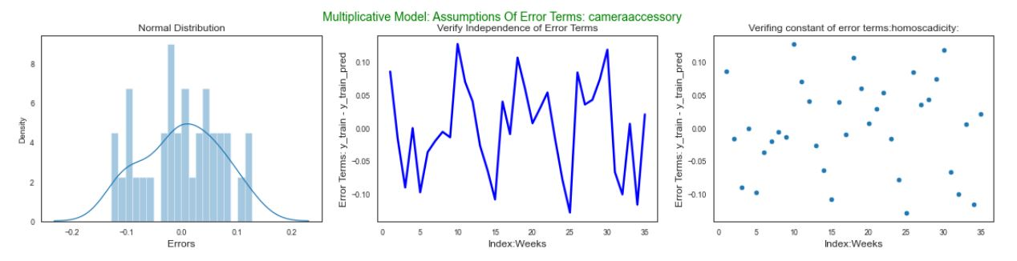
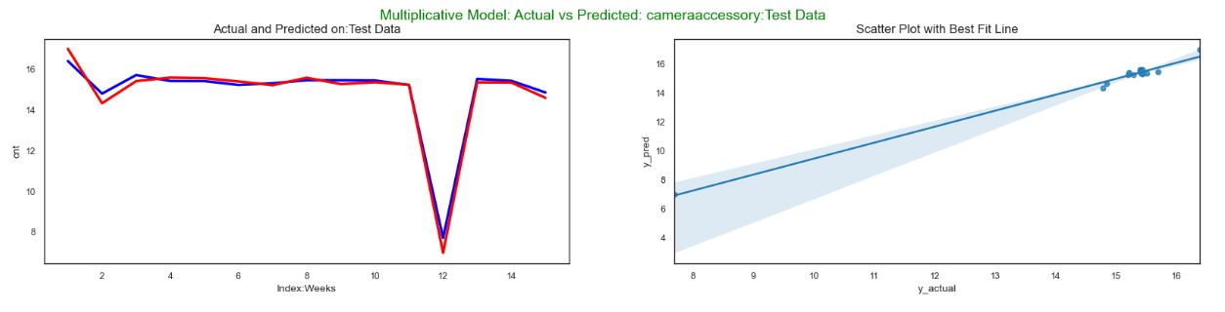
Error Terms & Actual vs Predicted Plots: Camera Accessory

Slide 46
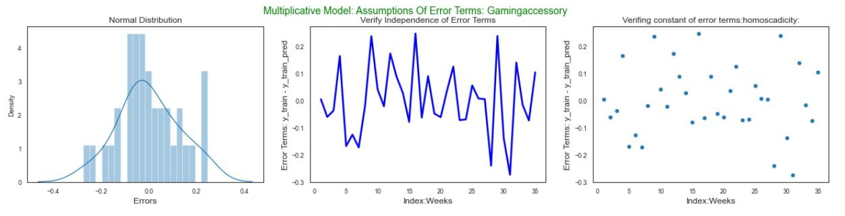
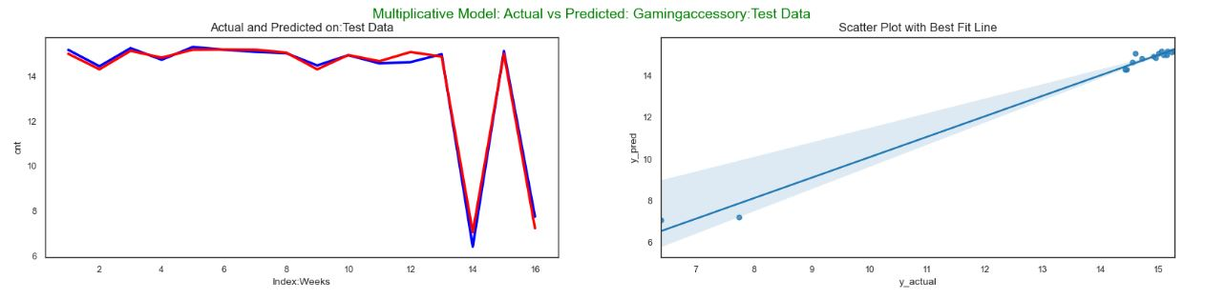
Error Terms & Actual vs Predicted Plots: Gaming Accessory

Slide 47
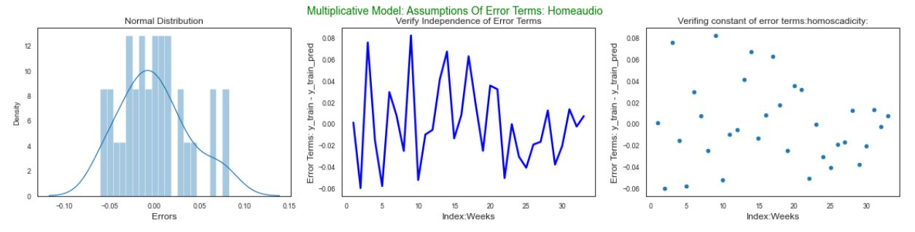
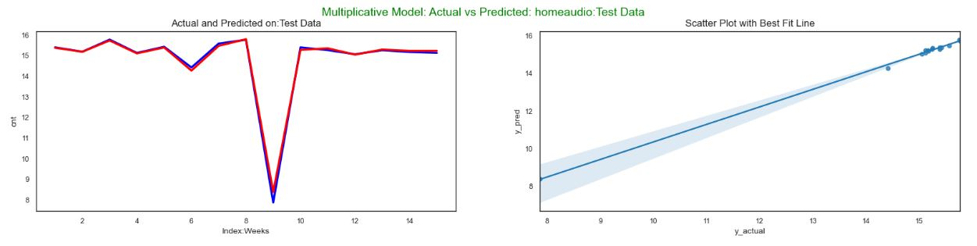
Error Terms & Actual vs Predicted Plots: Home Audio

Slide 48

Thank You!
Presenter: Achal Kagwad
Phone No: +91-9108302714
Email: achal.kagwad@gmail.com
Linked In: https://www.linkedin.com/in/achalkagwad/

