Slide 1

Product Management
Certification Program
Industry Project - I
Notes:
© Copyright UpGrad Education Pvt. Ltd. All rights reserved

Slide 2
Submission Guidelines
After completing all the parts of the project, you will have to submit your responses in the following manner.
Submit the following parts of the project in this “Presentation’’ file
Part 1 - Understanding the market
Part 2 - User research
Part 5 - MVP Creation
Part 6 - Sketching
Part 7 - Wireframing & Prototyping
Submit the following part of the project in the template document provided on the platform.
Part 3 - Business Model Canvas
Part 4 - Product Artifacts
User Persona
User Journey Map
Note: Finally you have to add this Presentation & other submission documents in a ZIP folder and upload it in the submission section on the platform. More details in slides to follow
Notes:
© Copyright UpGrad Education Pvt. Ltd. All rights reserved

Slide 3
Part 1: Understanding the Market
Notes:
© Copyright UpGrad Education Pvt. Ltd. All rights reserved

Slide 4
Target Market Identification
<Add more slides if required>
Notes:
© Copyright UpGrad Education Pvt. Ltd. All rights reserved

Slide 5
Porter's Five Forces Analysis
NOTE: You can provide a brief analysis of the five forces here, and then list down three bullet points for each of the five forces in the editable template provided in next slide.
<Add more slides if required>
Notes:
© Copyright UpGrad Education Pvt. Ltd. All rights reserved

Slide 6
Porter's Five Forces Template
Threat of Entry
<Add text here>
Bargaining Power of Buyers
<Add text here>
Competitive Rivalry
<Add text here>
Bargaining Power of Suppliers
<Add text here>
Threat of Substitutes
<Add text here>
Notes:
© Copyright UpGrad Education Pvt. Ltd. All rights reserved

Slide 7
Competitor Analysis
< Carry out the analysis as per the parameters mentioned in the problem statement >
<Add more slides if required>
Notes:
© Copyright UpGrad Education Pvt. Ltd. All rights reserved

Slide 8
Part 2: User Research
Notes:
© Copyright UpGrad Education Pvt. Ltd. All rights reserved

Slide 9
Objectives and Hypotheses
<Add more slides if required>
Notes:
© Copyright UpGrad Education Pvt. Ltd. All rights reserved

Slide 10
Surveys
< Use this space to write your survey information and insights>
< Attach your survey questionnaire link>
<Collected response should be submitted in excel format with other submission files in a zip folder>
<Add more slides if required>
Notes:
© Copyright UpGrad Education Pvt. Ltd. All rights reserved

Slide 11
Interviews
< Use this space to write your interview questions and insights>
<Collected response should be submitted in word document format with other submission files in a zip folder>
<Add more slides if required>
Notes:
© Copyright UpGrad Education Pvt. Ltd. All rights reserved

Slide 12
Part 3: Business Model Canvas
Notes:
© Copyright UpGrad Education Pvt. Ltd. All rights reserved

Slide 13
Business Model Analysis
<Create the Business Model Canvas using the template provided on the platform>
Notes:
© Copyright UpGrad Education Pvt. Ltd. All rights reserved

Slide 14
Part 4: Product Artefacts
Notes:
© Copyright UpGrad Education Pvt. Ltd. All rights reserved

Slide 15
User Persona
Create user personas using UXPressia. A sample persona created using UXPressia is attached here for your reference.
Export the image of user persona in png format.
Submit the user persona in the png format in the template provided on the platform
Notes:
© Copyright UpGrad Education Pvt. Ltd. All rights reserved

Slide 16
User Journey Map
Create a user journey map using UXPressia. A sample user journey map created using UXPressia is attached here for your reference.
Export the image of user journey map in png format.
Submit the user persona in the png format in the template provided on the platform
Notes:
© Copyright UpGrad Education Pvt. Ltd. All rights reserved

Slide 17
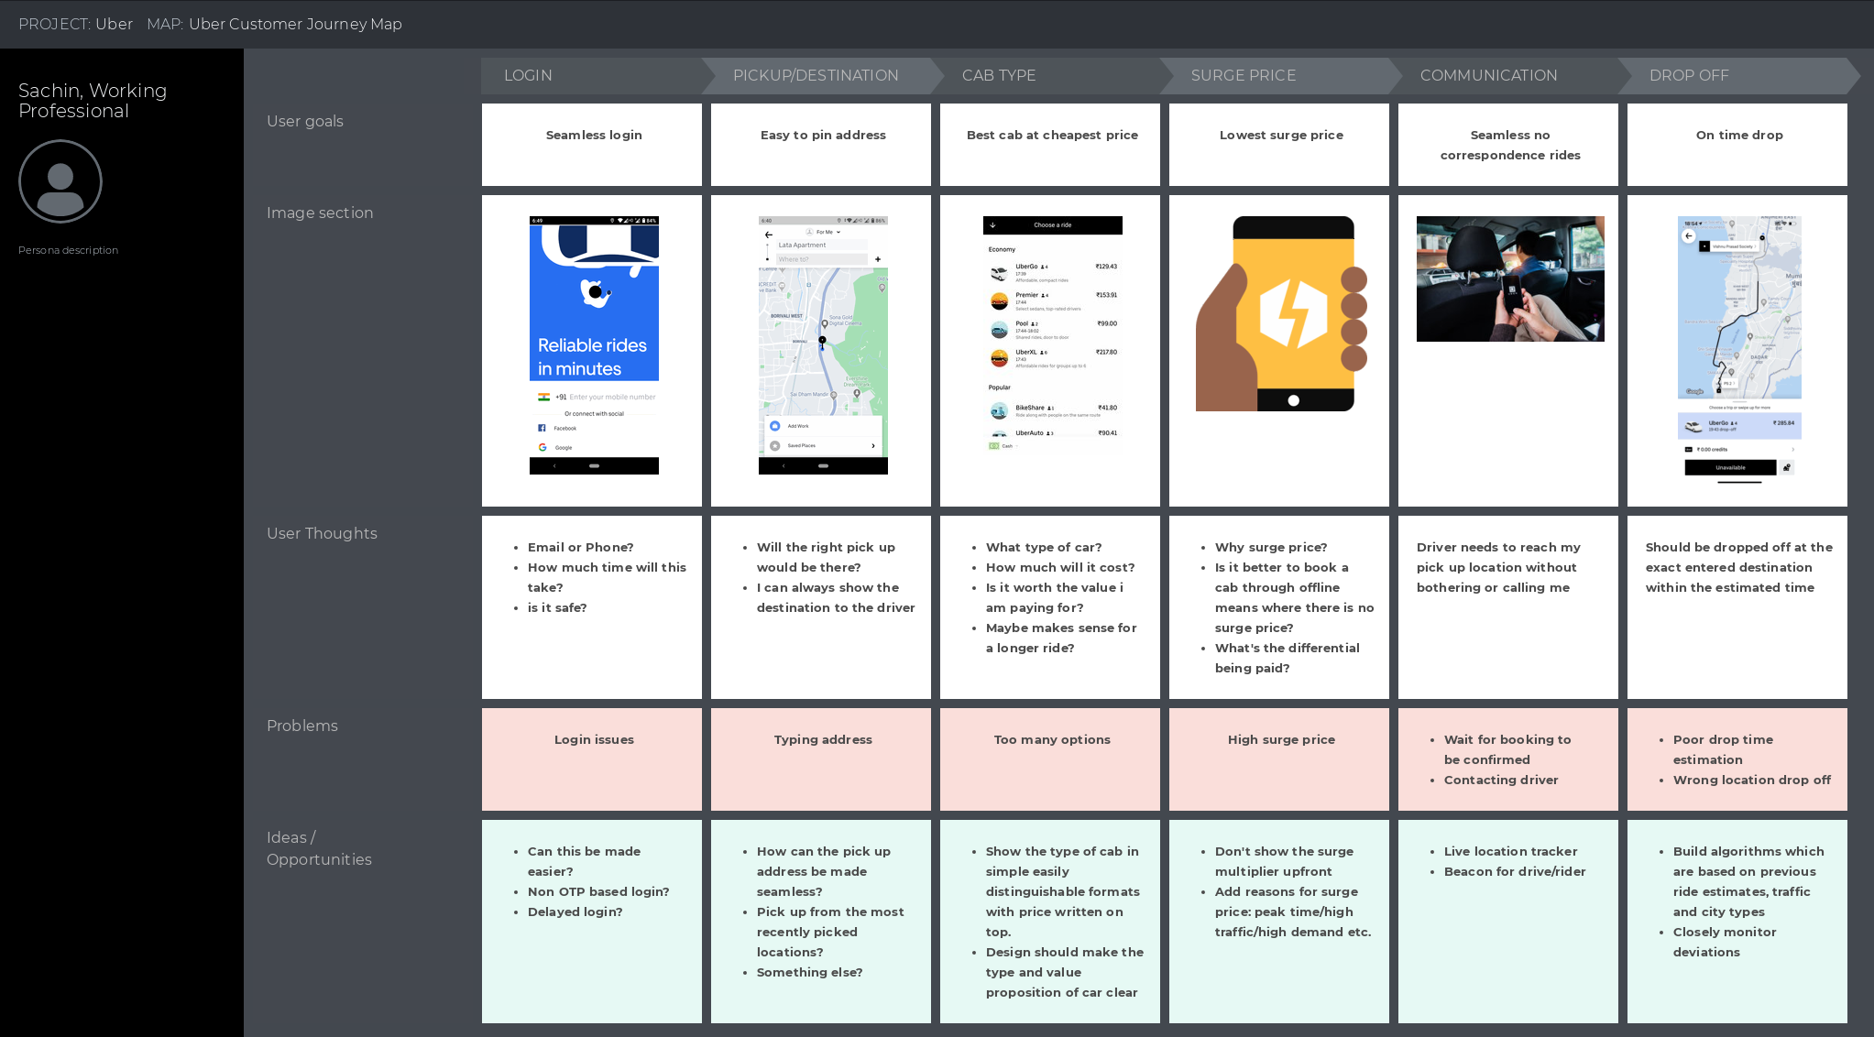
User Journey Map
Notes:
© Copyright UpGrad Education Pvt. Ltd. All rights reserved

Slide 18
Part 5: Minimum Viable Product Creation
Notes:
© Copyright UpGrad Education Pvt. Ltd. All rights reserved

Slide 19
Features/Functionalities
<List all the appropriate features/functionalities for the product.>
Notes:
© Copyright UpGrad Education Pvt. Ltd. All rights reserved

Slide 20
Must Have Features
Feature | Reason behind choosing this as a ‘Must Have Feature’
Note: Add rows in the above table as per the requirement
Notes:
© Copyright UpGrad Education Pvt. Ltd. All rights reserved

Slide 21
Nice to Have Features
<List all ‘Nice to Have Features’ for the product.>
Notes:
© Copyright UpGrad Education Pvt. Ltd. All rights reserved

Slide 22
Part 6: Sketching
Notes:
© Copyright UpGrad Education Pvt. Ltd. All rights reserved

Slide 23
Features
Page name | It’s Features/Functionalities
Note: Add a row in the above table for each page you will create
Notes:
© Copyright UpGrad Education Pvt. Ltd. All rights reserved

Slide 24
<Page Name>
Add a small description of the features/buttons/redirections of this page.
Note: Duplicate this slide for each of the pages you create
Notes:
© Copyright UpGrad Education Pvt. Ltd. All rights reserved

Slide 25
Part 7: Wireframing and Prototyping
Notes:
© Copyright UpGrad Education Pvt. Ltd. All rights reserved

Slide 26
<Page Name>
Add the screenshot of the wireframe for this page below.
Note: Duplicate this slide for each of the pages you create
Notes:
© Copyright UpGrad Education Pvt. Ltd. All rights reserved

Slide 27
Navigational Flow
Place the navigational flow structure here
Notes:
© Copyright UpGrad Education Pvt. Ltd. All rights reserved

Slide 28
Tools used
Wireframing | <Mention the tool used here>
Prototyping | <Mention the tool used here>
Notes:
© Copyright UpGrad Education Pvt. Ltd. All rights reserved

Slide 29
Prototyping
Prototyping | <Enter the link for your prototype here>
Notes:
© Copyright UpGrad Education Pvt. Ltd. All rights reserved

Slide 30
Disclaimer: All content and material on the UpGrad website is copyrighted material, either belonging to UpGrad or its bonafide contributors and is purely for the dissemination of education. You are permitted to access print and download extracts from this site purely for your own education only and on the following basis:
You can download this document from the website for self-use only.
Any copies of this document, in part or full, saved to disc or to any other storage medium may only be used for subsequent, self-viewing purposes or to print an individual extract or copy for non-commercial personal use only.
Any further dissemination, distribution, reproduction, copying of the content of the document herein or the uploading thereof on other websites or use of content for any other commercial/unauthorized purposes in any way which could infringe the intellectual property rights of UpGrad or its contributors, is strictly prohibited.
No graphics, images or photographs from any accompanying text in this document will be used separately for unauthorised purposes.
No material in this document will be modified, adapted or altered in any way.
No part of this document or UpGrad content may be reproduced or stored in any other web site or included in any public or private electronic retrieval system or service without UpGrad’s prior written permission.
Any rights not expressly granted in these terms are reserved.

