Slide 1

Industry Project
Part II
Chaitra Mahadevappa
Jyothi Kumari
Sameet Suryawanshi
Achal Kagwad
Date of Submission: 11th January 2023

Slide 2
Assignment Instructions
DELIVERABLES
Part-1 - Product Analytics
Part-2 - Growth Strategies
Part-3 - Product Roadmap
Part-4 - Product Backlog and Sprint Backlog
Part-5 - Product Requirements Document
Part-6 - Go-to-Market Strategy
SUBMISSION GUIDELINES
Part-1, 2 and 6 should be submitted in this PPT document.
Part-3 and 4 should be submitted in the excel document given on the platform.
Part- 5 should be submitted in the word document given on the platform.

Slide 3
Part 1
Product Analytics

Slide 4
Recap - AARRR Framework
Acquisition
Retention
Referral
A
A
R
R
R
Find the core
Concept
Activation
Revenue

Slide 5
Acquisition Metrics
1. Number of Signups: Metric which measures the number of users who have signed up with the Hungroo application. More number of signups better probability of them using the app in future and becoming paid users in future
2. Cost of Customer Acquisition(CAC): Total Spending on Sales and Marketing divided by the number of users acquired. This gives the cost of acquiring a new customer. This gives Hungroo to better allocate its marketing spends to various channels.
3. Bounce Rate: Percentage of Users who open the app and leave without any significant order. This metric shows what better(call to actions) can be done to make the user sign up with Hungroo.
4. Cost Per Install: Cost of getting the app installed by the user. This metric is a subset of Cost of Customer Acquisition and better gives detailed cost in having a user install the app.
5. Number of App downloads : Organic Traffic comes from organic search engines and paid traffic comes from sponsored ads. This metric gives understanding of the proportion and thus helps in investing wisely

Slide 6
Activation Metrics
1. Number of Signups: Metric which measures the number of users who have signed up with the Hungroo application. More number of signups better probability of them using the app in future and becoming paid users in future
2. Cost of Customer Acquisition(CAC): Total Spending on Sales and Marketing divided by the number of users acquired. This gives the cost of acquiring a new customer. This gives Hungroo to better allocate its marketing spends to various channels.
3. Bounce Rate: Percentage of Users who come on the website and leave without any significant interaction. This metric shows what better(call to actions) can be done to make the user sign up with Hungroo.
4. Cost Per Install: Cost of getting the app installed by the user. This metric is a subset of Cost of Customer Acquisition and better gives detailed cost in having a user install the app.
5. Number of App downloads : Organic Traffic comes from organic search engines and paid traffic comes from sponsored ads. This metric gives understanding of the proportion and thus helps in investing wisely

Slide 7
Retention Metrics
Number of Active Users(DAU/WAU/MAU): Daily, Weekly, Monthly Active Users: Number of Users placing at least one order per day, per week and per month respectively. A high number indicates customers are satisfied and hooked to the product which is bringing them back to it.
Churn Rate: Is the ratio of customers who cancel or don't renew their subscription to the total number of customers company had. For Hungroo it’s the number of users who have uninstalled the app or have not placed order in the past 30 days. A high churn rate is bad for business.
3. Engagement Metrics: Number of orders placed, Average No. of orders placed in month.

Slide 8
Revenue Metrics
Average Revenue Per User(ARPU): It’s the amount that Hungroo earns per user. It’s the measure of revenue generation capability of Hungroo. Higher the ARPU more cashflows to support all business activities and scale the business
Customer Lifetime Value(LTV): Revenue that Hungroo can expect to get from a customer over entire lifetime the customer is associated with the product. The gold standard is the ratio of LTV to CAC must be 3 or higher at any given time for the business to sustain and scale itself.
Annual Recurring Revenue and Monthly Recurring Revenue(ARR and MRR): The revenue that
will be generated from all its paying users on an annual and monthly basis. Higher the number the better.
Contraction MRR: Measure of the revenue which has been lost due to a customer downgrading from a
higher paid plan to a lower paid plan. Gives sense where the product is heading
5. Expansion MRR: Measure of surplus revenue generated due to a customer upgrading to a higher paid plan.
This also gives a sense that customers are willing to upgrade.

Slide 9
Referral Metrics
Net Promoter Score(NPS): It’s the measure of satisfaction among users and the likelihood of customers willing to refer the product to peers. Mathematically its percentage of promoters – percentage of detractors. An NPS greater than 30 is good.
Viral Coefficient: It’s the measure of how many customers, an existing customer is bringing in for the product. This metric calculates the exponential referral cycle. This metric will help us understand if our referral scheme is making an impact on not.
App Store Ratings: Measure of Ratings provided by users and customers in the App Store for Hungroo app. Higher the ratings the better

Slide 10
Wireframe - Analytics Dashboard
Below are Analytics Dashboard Wireframes for each of the AARRR framework metrics.
We have made Low Fidelity Wireframes here.

Slide 11
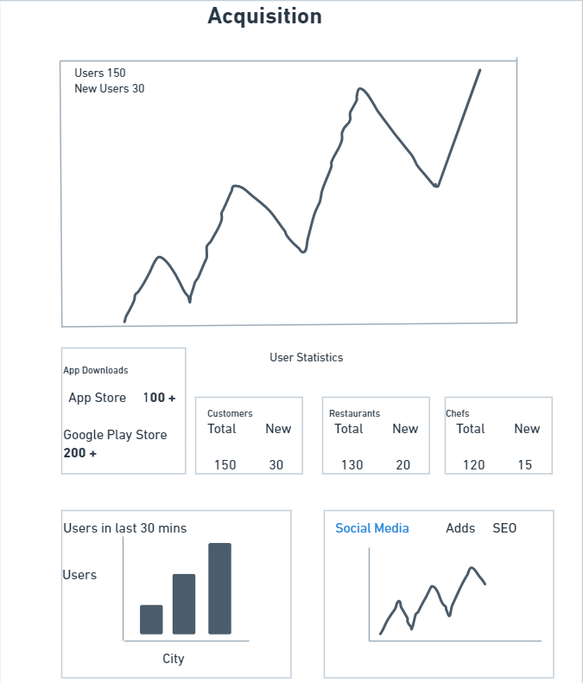

Slide 12
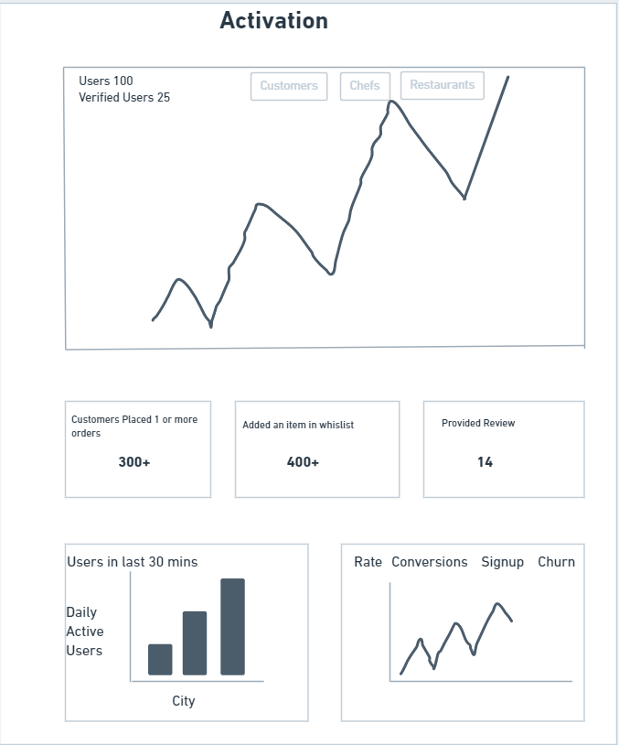

Slide 13
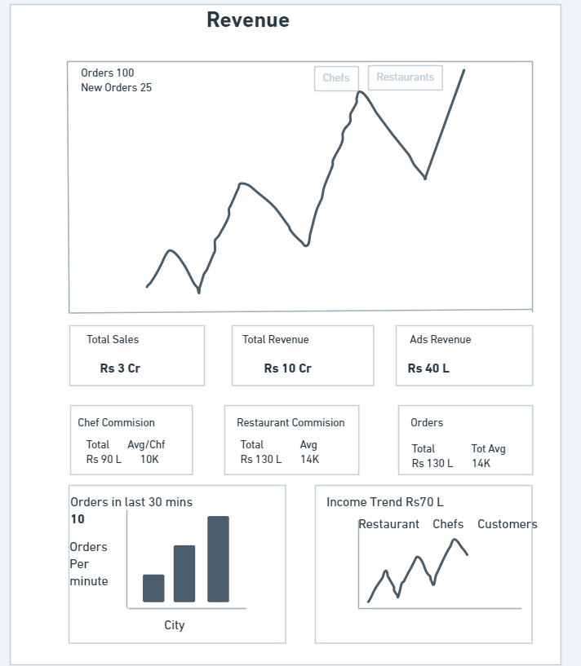

Slide 14
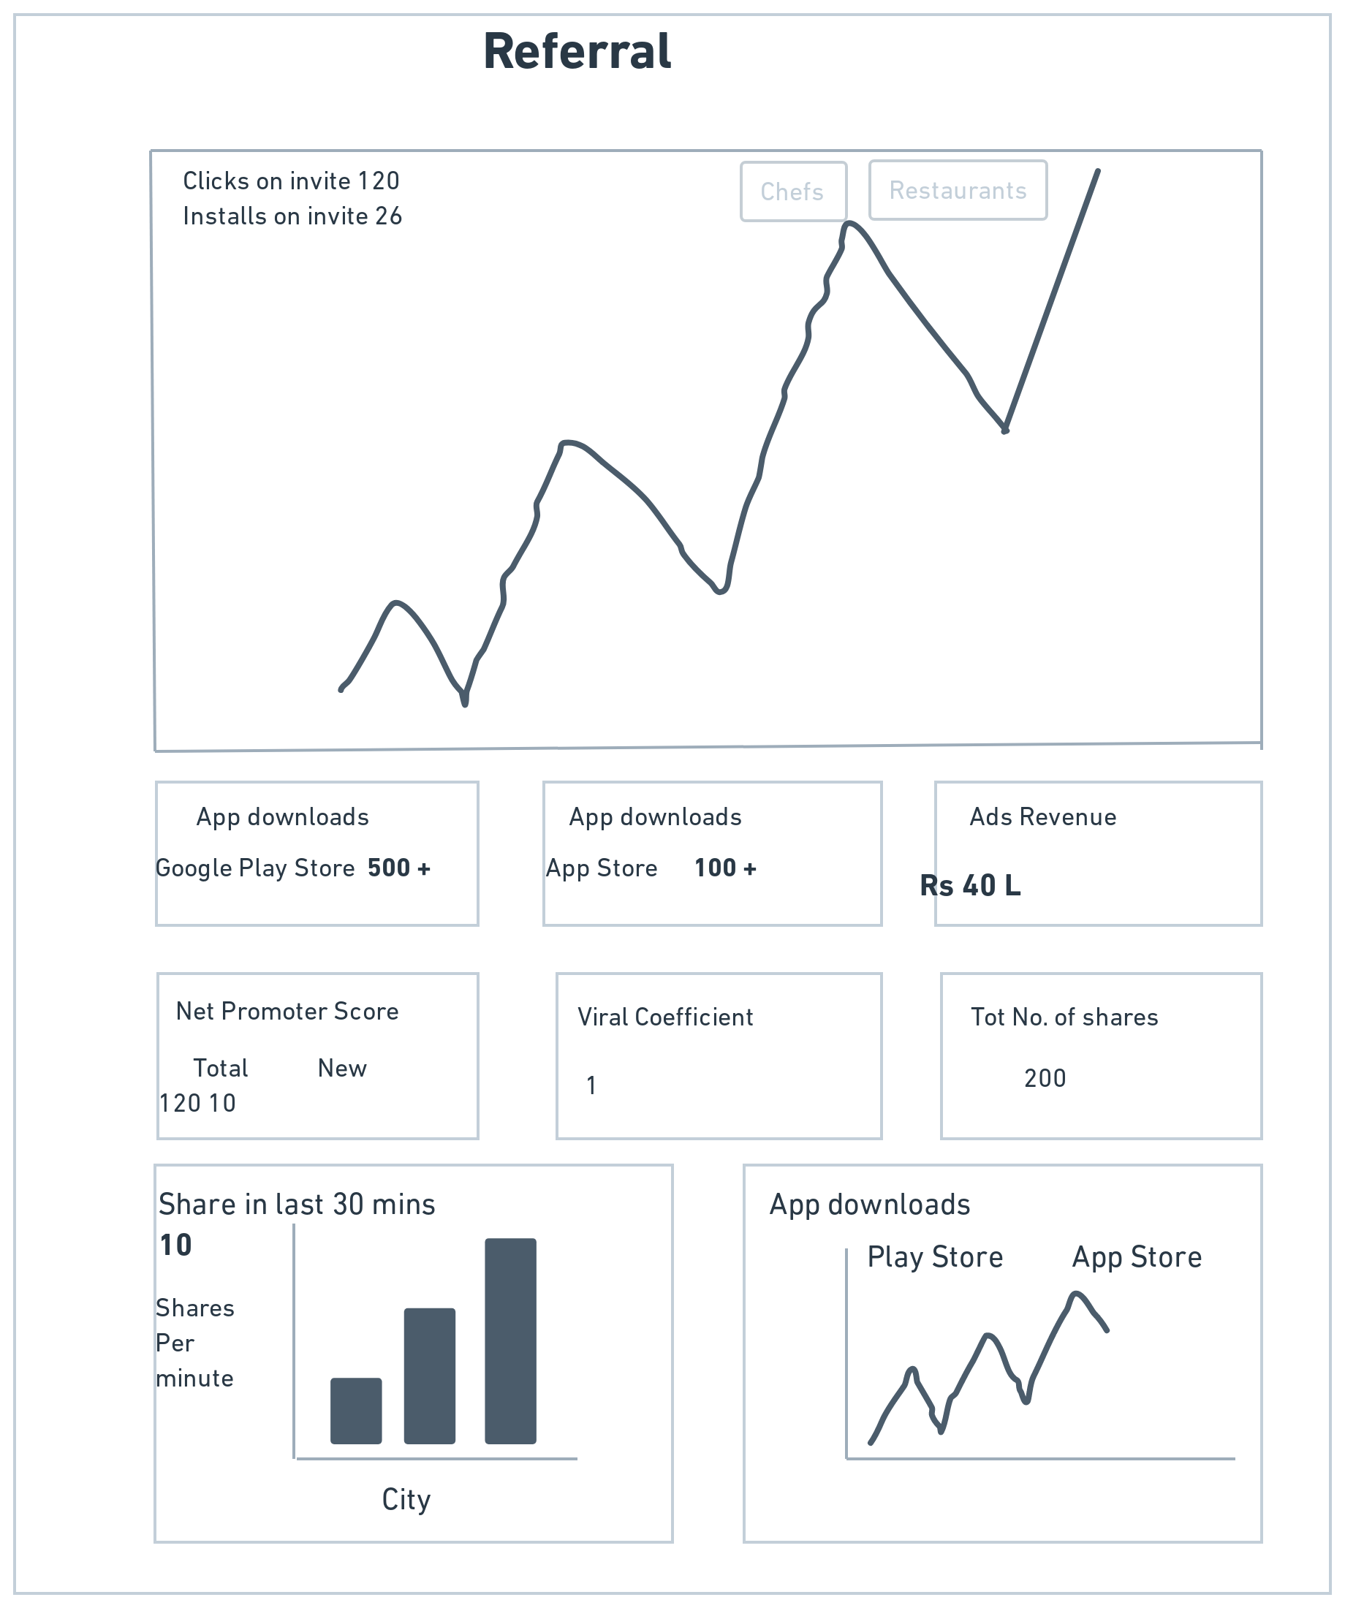

Slide 15
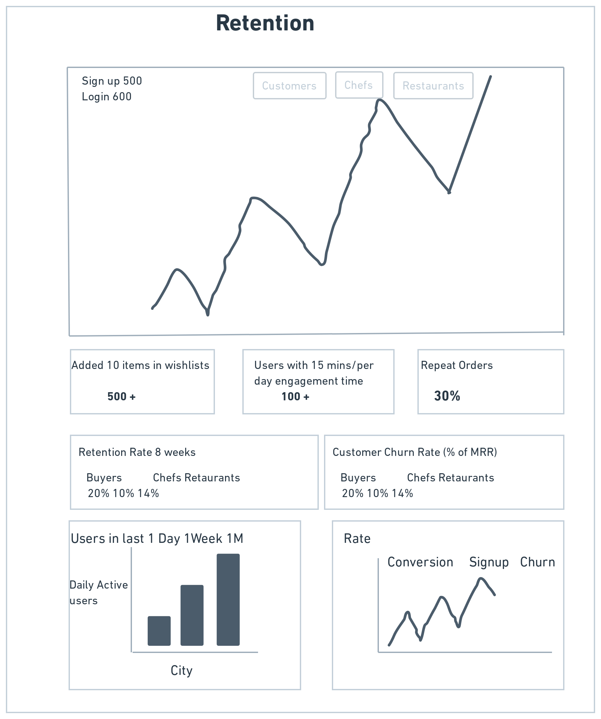

Slide 16
Part 2
Growth Strategies

Slide 17
Acquisition Channels
INORGANIC CHANNELS:
PAID SEARCH: PPC(Pay Per Click), PPI(Pay Per Impression):Allow business to customize their campaigns. These Paid ads can be placed via google ads and on other platforms.
ORGANIC CHANNELS:
SEO: Search Engine Optimization, SEO tactics can be used
Referral Users.
Direct Traffic.

Slide 18
Acquisition Strategy- Optimizing Paid Marketing Campaigns
Improving Landing Pages: To create different landing pages that are contextual to the paid ad.
Setting Up catalogue feeds: Run automated campaigns at scale by creating versatile product catalogue that targets users who are interested in them.
Optimizing Conversion Pixels: These are tags or pixels that are placed at specific events in product flow. This will help measuring how many users ended up converting to registered/paid users from the ad campaigns.
Creating Custom Audience: Create a custom audience of all transacted users to find out other users with similar traits.

Slide 19
Acquisition Strategy- SEO Tactics
Adopting Mobile First Approach: Since we have data that for food ordering users use mobiles rather than desktop we can adopt the “Mobile First Approach”. Mark the most frequently visited pages as Accelerated Mobile Pages(AMP).
Focusing on User Generated Content(UGC): Leverage User Generated Content on Apps. Google Crawlers give weightage to uniqueness and freshness of content on any page. More user generated content on app or website can improve page’s rank on search results. UGC helps brands collect visual product or company mentions from social media and other sources to influence discovery based ecommerce. Brand can easily gather UGC, secure approval to use it, and present it on-site to help boost conversion.

Slide 20
Activation Strategy- Activation Events
App Downloads: Successful app downloads mean acquisition strategies have led users to download the app.
Placing the first order using the food delivery app.
Placing the first ‘n’ order within a time duration of ‘x’ weeks.
Subscribing to a meal delivery plan.

Slide 21
Activation Strategy
Avoid the Cold Start Experience: The churn rate for most of the apps is 86% in first 2 weeks, which means most people don’t even experience our product. The First-Time experience of the users should take them to the core action of the product which is ordering food or meal online and getting it delivered within stipulated time frame. Avoid the empty dead end states, if at all such a such state is reached, users should be educated to take them back doing the core action.
Incentivise the first ‘n’ orders. Based on the data at hand and the budget we have, we can incentivise the first ‘n’ orders by giving discount. We can also run campaings where users is incentivised with either money or free meals if the referral he has referred gets activated. Main motto is to ensure the users make their first few transactions(core action) as soon as possible and help the users build a ‘habit’ around it.
Personalize First Time Experience: Recommend top restaurants and brands based on user persona, demography etc.

Slide 22
Retention and Engagement Strategy
Retention Measures the “breath” of the usage of a product by its users. It Measures the % of users active within a time period.
Engagement measure the “depth” of the usage of the product by its users. Depth of the engagement is the strongest indicator that the users are deriving the desired the value.
Improving the Product: In our case, experiment with pricing strategies. For e.g. offer discounts on longer subscription plans.
Improving Activation: Steepest drop in the retention curve is right at the beginning, if we can improve the activation rate than we can also shift the retention curve up to have long term retention.
Reward Loyalty: Reward most profitable customers with tailor made offers and packages. Knowing who brings more revenue allows us to allocate our time and resources efficiently.
Allow Users to Pause Subscription or Membership.
Show Users what they will miss: Give users an offer they cannot resist!

Slide 23
Engagement Strategy
Build Reinforcing Habits around the Core Value Proposition: In food delivery app the habit loop is Trigger-The user is hungry. Action- The user orders food from the app. Benefit- The user gets good food delivered to his location and satisfies the users hunger.
Generate and Deliver the External Trigger: Have Personalized Push Notifications/ In Product Notifications almost often right after meal times. Mao the external trigger(app notifications) to internal trigger(Hunger)
Expand the Value Proposition: Instead of just delivering food form restaurants, we can also deliver also other items that go along with food, such as groceries. This can be a long term plan and not an immediate plan.

Slide 24
Referral Strategy
Incentivise Referrals to friends and family: Using a personalized link both the referrer and the referee get a discount benefit when the link leads to a sign-up or a successful order placed. This will encourage the referrer to send out the invite link to more people and convince them to place an order so both people receive benefit.
Referral Leader boards: Time based Gamified Leader Board that rewards the top ‘n’ referrers with exclusive prizes. Weekly, Monthly based Leader Boards
Other Referral schemes may look like these in the food delivery app: 1) Refer 5 friends and when they place their first order you get a dish worth Rs300/- free. 2) Point based system on referral which can be redeemed on the next order which also drive engagement. 3) Cashbacks of referral orders.

Slide 25
Revenue Strategy
Repeat Purchase: Giving points on each order and an upper cap of points to be redeemed in the next frequency of orders. This cycle will continue and will increase the LTV of a customer.
Premium Providers: Another customer segment that is luxury driven and target customers that will pay higher price for a product that has a higher quality. Several premium and/or imported product providers in India. Provide a aggregator market place product.
Memberships and Subscriptions: Again based on the User Data, like Zomato Gold, we can come up with plans that gives customers tier-based benefits. Such as Basic- 10% of on orders above Rs750, Silver- 10% of on Orders above Rs600 and Gold- 10% of on orders above Rs500.

Slide 26
Part 3
Product Roadmap

Slide 27
Submission Template
Note:
Use the template provided on the platform to create a product roadmap
You are free to edit / add columns as needed to the template provided

Slide 28
Part 4
Product Backlog and Sprint Backlog

Slide 29
Submission Template
Note:
Use the template provided on the platform to create a product backlog and sprint backlog document.
You are free to edit / add columns as needed to the template provided

Slide 30
Part 5
Product Requirements Document

Slide 31
Submission Template
Note:
Use the template provided on the platform to create a well-structured, exhaustive and comprehensive PRD.
You are free to edit / add columns as needed to the template provided

Slide 32
Part 6
GTM Strategy

Slide 33
Achieving Product-Market Fit
KEY FEATURES FROM MVP AND KEY INDICATORS:
Weekly Menu and Subscription Page: Display of 7 day menu on Subscription Page. Our customers will be able to select their meals and subscribe to it weekly. Key Indicators: of achieving PMF(Product Market Fit): Ratio of Pay per order to subscriptions, Subscriptions Renewed, High Customer Retention Rates.
Preferences Page: To further streamline to subscribe to a meal plan, we have added a preference page where customers can add their dietary requirements , restrictions, allergies. This data is shared with Home Chefs so they can customize their meals accordingly. Key Indicators: No of Meal Plans Customized, Sales closing early, Value from Product, High Customer Retention Rates
Search Page: Search by Restaurants, Food Items and Chef. The Search is curated by Search Filters, by location, dishes, highly rated chefs. This makes search intuitive. Key Indicators: Number of Searches by various filters, No of Bookmarks on Search Pages, Value from Product in customizing meal plans.

Slide 34
Product Positioning
PRODUCT POSITIONING STATEMENT: “For 18-40 years old who need home cooked food, our platform provides customized meal plans, subscriptions and a range of home-chefs to choose from”
PRODUCT USP:
Homely hygienic food, preferred food by customers at affordable prices.
Customized Meals
Try meal before subscribe
Subscription plan based on frequency(Weekly, Monthly)

Slide 35
Pricing Strategy
EXTERNAL FACTORS:
Highly Price Sensitive Audience
Food Tech is into high volume, low margins pricing section.
Competitors : Offline tiffin aggregators.
INTERNAL FACTORS:
Product Cost
Investment Budget
Revenue and Profit Milestones
We will be using combination of pricing strategies for our product namely:
Penetration Pricing: Offering large discounts on newly launched locations
Cost Based Pricing: The price of the product is the summation of its production cost and the margins required over it.
Value Based Pricing: The price of the product is based on what the customers are willing to pay.

Slide 36
Sales & Marketing Strategy- Marketing Channels
Social Media: Food is surely appeals visually to most. We can use prominent social media such as Instagram and Facebook to post images and generate buzz. Every affiliate partner(Restaurants and Home Chefs) associated with us will post on their respective social media pages to drive awareness. Paid ads can be leveraged to boost content to relevant audiences
Email: Emails can be used to broadcast major feature change, price change. We will also use email for order confirmation and tracking. Emails are good way to let our users know how are product is evolving.
Word of Mouth: Most Home chefs manage their clients offline. We can leverage their existing network and encourage their client base online on our app. We can use referral links to restaurants, home chefs, subscription pages via instant messaging app such as WhatsApp.

Slide 37
Sales & Marketing Strategy- Sales Channels
Direct Selling: Selling Through App and Website will be our major sales channel. Post Marketing , the number of visits on the app/website will cause direct selling.
Affiliate Partnerships: Partnership with Restaurants and Home Chefs to promite each other on our platform. Our Partners will provide offers if ordered using our App and we will feature our partners.

Slide 38
Product Launch Plan: Pre-Launch
PRODUCT:
City wise reach is enabled and home chefs are ready to accept orders
Onboarding journeys in sales channels are in place
Setup reporting structures and metrics for the product
Ensure market place as at least “x” different products sourced specifically from prominent home chefs.
MARKETING:
Launch Social Media and Email CRM Campaigns to enable a complete holistic effort
Finalize and set on auto mode Ad Spends for Social Media and PPC Campaigns
TECHNOLOGY:
Ensure Platform readiness by checking if development and testing sprints are completed.
Ensure the servers are ready to handle to anticipated web traffic
Have back up plans if any show stoppers do arise during this phase.

Slide 39
Product Launch Plan: Launch
PRODUCT:
Track Everyone and corresponding metrics that interact with our product.
Qualify leads that are generated.
MARKETING:
Send our press releases to media outlets, Social Media Live can also be used.
Collaborate with identified micro-influencers to drive engagement on platforms.
TECHNOLOGY:
Monitor the web and app for performance issues and crashes.
Use Back Up Servers in case of performance issues and crashes.

Slide 40
Product Launch Plan: Post-Launch
PRODUCT:
Define and Measure Key Performance Indicators(KPIs)
Establish strong customer support.
Build Customer Testimonials
Define Long Term Referral and Retention Strategies
MARKETING:
Track launch campaigns and new users by channels.
Track metrics with micro influencers on platforms.
TECHNOLOGY:
Plan next important priority feature releases.
Build Human Capital to maintain IT Infrastructure for scaling and growth.

Slide 41
Disclaimer
All content and material on the upGrad website is copyrighted material, either belonging to upGrad or its bonafide contributors and is purely for the dissemination of education. You are permitted to access print and download extracts from this site purely for your own education only and on the following basis:-
● You can download this document from the website for self use only.
● Any copies of this document, in part or full, saved to disc or to any other storage medium may only be used for subsequent, self viewing purposes or to print an individual extract or copy for non commercial personal use only.
● Any further dissemination, distribution, reproduction, copying of the content of the document herein or the uploading thereof on other websites or use of content for any other commercial/unauthorized purposes in any way which could infringe the intellectual property rights of upGrad or its contributors, is strictly prohibited.
● No graphics, images or photographs from any accompanying text in this document will be used separately for unauthorised purposes.
● No material in this document will be modified, adapted or altered in any way.
● No part of this document or upGrad content may be reproduced or stored in any other web site or included in any public or private electronic retrieval system or service without upGrad’s prior written permission.
● Any rights not expressly granted in these terms are reserved.

