Slide 1

Growth Product Management Specialisation
Industry Project
By: ACHAL KAGWAD
COHORT-C14
Date: 2nd May 2023 achal.kagwad@gmail.com | 9108302174

Slide 2
About the Project
OBJECTIVE
You should be able to devise strategies to drive the growth of an existing product or service by leveraging insights from user data and also by applying your own knowledge.
KEY REQUIREMENTS
You will require a thorough understanding of all the topics covered in the base program and the first five modules of the specialisation track to perform the tasks in this project.
DESCRIPTION
Disney+ Hotstar is India’s leading online content streaming platform offering content ranging from sports, movies, news to TV shows. It has a user base of more than 300 million. Hotstar is the only online streaming platform in India to effectively bring sports content along with exclusive content from Disney. Hotstar is accessible across multiple devices, TV, mobile, Chromecast and other formats. Initially, Hotstar’s strategy was very different from those of Netflix and Amazon Prime Video. Hotstar first started as a free content platform with ads as a monetisation lever. It eventually decided to take up a model similar to those of Netflix and Amazon Prime and launched its subscription offering with a free tier that is ad-supported and the VIP and Premium subscription plans.

Slide 3
About the Project
KEY ELEMENTS TO CONSIDER
Riding high on the live streaming of the Indian Premier League, Hotstar expanded its base to more than 100 million monthly active users. The company built technology for live streaming of cricket matches and built products like ‘Watch N Play’ to engage the users. While cricket has been one area of strength for Hotstar, the platform also brought exclusive content from Indian content creators as well as from outside India, which is another reason for the rapid growth in the number of its active users. While Hotstar has a huge monthly active user base, a large portion (more than 70%) of users do not purchase any subscription plan and instead use the free tier of Disney+ Hotstar. Now, based on your understanding of the case, answer the questions in the document given below.
Note:
The entire project is divided into five different parts and you have to perform seven tasks in order to complete this project.
Kindly adhere to the submission guidelines to avoid any loss of marks.
You have to add this presentation and the Word document in a ZIP folder and upload it in the submission section on the platform.

Slide 4
Submission Guidelines
Task | Submission Guidelines
Market Sizing | Perform the market sizing, and add the calculations and all your analysis in this document.
Competitor Analysis | Perform the competitive analysis based on the parameters mentioned in the problem statement, and add your response to this document.
User Research | Submit the hypotheses, questionnaire and your insights from the user interviews in this document. Add the Google drive link for the interview video snippet in this document. You can conduct the interview over any video conferencing app and share the screen recording for the same. (Note: Kindly make sure you change the edit access of the video file to ‘Anyone on the Internet’ before you share the link. If you do not provide access to the file, you will not be awarded any marks for it) Add the data gathered during interviews to the word document provided on the platform.

Slide 5
Submission Guidelines
Task | Submission Guidelines
Building Product Artefacts | Add the responses for user segmentation and user beliefs directly in this document. Create user personas using UXPressia, then export the images of user personas in the PNG format and them to the Word document provided on the platform.
Product/Market Expansion Using Ansoff Matrix | Build the growth strategies for all the four quadrants of the Ansoff Matrix, and add all your analysis in this document.
Building Growth Strategies | Analyse the data set provided on the platform, and add responses to all the questions in this document.
Building Product Roadmap | Perform the entire analysis, and add your response to this document.

Slide 6
Industry Project Part 1

Slide 7
Task 1: Market Sizing
Notes:
© Copyright UpGrad Education Pvt. Ltd. All rights reserved

Slide 8
Task 1: Market Sizing & Target Market Identification
TAM(Total Available Market): Total Population of India is 1.4 Billion ie 140 Crores. Considering urban and rural population to be in the ration of 30: 70, Approximate urban population is 42 Cr and the rural population is 98 Cr.
SAM (Serviceable Addressable Market): HotStar wants to serve customers with access to fast internet who watch content in English and Local Languages. Assuming 90% of Urban population have access to fast internet and 70% of rural population have access to fast internet we have 0.9*42 Cr= 37.8 and 0.7*98=68.6 Cr. Total of 37.8+68.6=106.4 Cr
TARGET AUDIENCE: As per our business model, we filter on age group of 18 to 45 who have a smart phone or TV to watch OTT. Assuming 70% of Urban population who have access to fast internet and in the desired age group and 80% of Rural Population with similar filters: (0.7*37.8+0.8*68.6)=26.46+54.88=81.34 Cr.
Notes:
© Copyright UpGrad Education Pvt. Ltd. All rights reserved

Slide 9
Task 2: Competitive Analysis
Notes:
© Copyright UpGrad Education Pvt. Ltd. All rights reserved

Slide 10
Task 2: Competitor Analysis- Strengths and Weaknesses
CRITERIA | NETFLIX | AMAZON PRIME VIDEO
Strengths | Netflix has a vast library of original content that has won numerous awards and has a loyal subscriber base. Netflix's pricing is competitive and affordable compared to other streaming services. | Amazon Prime Video offers a vast selection of movies and TV shows, including exclusive content from Amazon Studios. Amazon Prime Video is bundled with other Amazon Prime services, such as free shipping, which adds value for customers.
Weaknesses | Netflix's library is heavily focused on TV shows and movies, while Disney+ Hotstar offers a wider variety of content, including sports and live events. Netflix has a limited selection of content for specific regions due to licensing restrictions. | Amazon Prime Video's user interface is often criticized for being cluttered and difficult to navigate. Amazon Prime Video has a limited selection of sports and live events compared to Disney+ Hotstar.
Notes:
© Copyright UpGrad Education Pvt. Ltd. All rights reserved

Slide 11
Competitor Analysis- Opportunities and Threats
CRITERIA | NETFLIX | AMAZON PRIME VIDEO
Opportunities | Netflix can expand its original content library to include more diverse and inclusive stories to appeal to a wider audience. Netflix can focus on expanding its presence in international markets where Disney+ Hotstar has a smaller footprint. | Amazon can leverage its extensive customer base to expand its video streaming service and offer more original content. Amazon can consider acquiring smaller streaming services or production companies to add to its content library and compete with Disney+ Hotstar's wider range of content.
Threats | Disney+ Hotstar's acquisition of Hotstar has given it a strong foothold in the Indian market, which could pose a threat to Netflix's growth in the region. Threat of New Entrants. | Disney+ Hotstar's exclusive sports and live events content could pose a threat to Amazon Prime Video's growth. Threat of New Entrants
Notes:
© Copyright UpGrad Education Pvt. Ltd. All rights reserved

Slide 12
Competitor Analysis- UI/UX Features-SignUp OnBoarding & Content Discovery
Disney HotStar | NETFLIX | AMAZON PRIME VIDEO
Users can sign up for Disney+ Hotstar using their email address or phone number. The process is similar to Netflix, but users are required to provide additional personal information, such as their date of birth and gender. | The sign-up process for Netflix is simple and straightforward. Users are required to enter their email address and create a password. Once they have entered their payment information, they can start browsing the content library. | Users are required to sign up for Amazon Prime membership to access Amazon Prime Video. The sign-up process is similar to Netflix, but users are required to provide more personal information, such as their name and address.
Disney+ Hotstar's homepage is designed to showcase a mix of popular and trending content. Users can browse the content library by genre or search for specific titles. It also has a dedicated sports section, which is a unique feature | Netflix's homepage is designed to showcase content based on a user's viewing history and preferences. Users can browse the content library by genre or search for specific titles. | Amazon Prime Video's homepage is similar to Netflix, but it also includes recommendations based on a user's purchase history on Amazon. Users can also browse the content library by genre or search for specific titles
Notes:
© Copyright UpGrad Education Pvt. Ltd. All rights reserved

Slide 13
Competitor Analysis- UI/UX Features-PlayBack Experience and Additional Features
Disney HotStar | NETFLIX | AMAZON PRIME VIDEO
Hotstar's playback experience is similar to Netflix and Amazon Prime Video, but it offers the option to change the video quality based on the device used to stream the content. It also offers a "skip intro" button, which is a unique feature. | Netflix's playback experience is seamless and offers users the option to change the video quality based on their internet connection. It also offers the option to download content for offline viewing. | Amazon Prime Video's playback experience is similar to Netflix, but it also offers the option to add subtitles and change the audio language.
Disney+ Hotstar's additional features include a live sports section, the ability to watch content in different languages, and the option to cast content to a TV using Chromecast. | Netflix's additional features include the ability to create multiple profiles, parental controls, and the option to set reminders for upcoming titles. | Amazon Prime Video's additional features include the option to rent or purchase movies and TV shows that are not included in the content library, and the ability to download content for offline viewing.
Notes:
© Copyright UpGrad Education Pvt. Ltd. All rights reserved

Slide 14
Competitor Analysis- Why users choose other products over Disney+HotStar
Because of the limited content library in certain regions.
The absence of some popular titles, or
The lack of original content compared to Netflix.
Users may also prefer Amazon Prime Video because it is bundled with other Amazon Prime services, such as free shipping.

Slide 15
Competitor Analysis- In Which UI Areas Disney+HotStar has competitive advantage
In terms of onboarding, Disney+ Hotstar has an advantage over Netflix and Amazon Prime Video as it offers users the option to sign up using their phone number, which is a popular method in India.
In terms of content discovery, all three services offer a similar experience, but Disney+ Hotstar has an advantage with its dedicated sports section.
In terms of playback experience, all three services offer a similar experience, but Disney+ Hotstar has an advantage with its "skip intro" button.
In terms of additional features, all three services offer unique features that cater to different user needs.

Slide 16
Competitor Analysis- Monetisation: Subscription Model
All three streaming services offer a subscription-based model, where users pay a monthly or annual fee to access their content libraries. Disney+ Hotstar and Netflix offer different subscription tiers with different pricing and features, while Amazon Prime Video is bundled with other Amazon Prime services and offers a flat fee for access to all its content.
Similarity: All three services rely heavily on their subscription-based model as the primary source of revenue.
Difference: Disney+ Hotstar and Netflix offer different subscription tiers with varying prices and features, while Amazon Prime Video is bundled with other Amazon Prime services and offers a flat fee for access to all its content.

Slide 17
Competitor Analysis- Monetisation: Advertising Based Model
Disney+ Hotstar and Amazon Prime Video offer an advertising-based model, where users can access some content for free with ads. This model is particularly popular in India, where the market for subscription-based services is still developing.
Similarity: Both Disney+ Hotstar and Amazon Prime Video offer an advertising-based model to monetize their users.
Difference: Disney+ Hotstar offers a hybrid model where some content is available for free with ads, while premium content is only available with a subscription. Amazon Prime Video's advertising-based model is limited to a small selection of movies and TV shows.

Slide 18
Task 3: User Research
Notes:
© Copyright UpGrad Education Pvt. Ltd. All rights reserved

Slide 19
Task 3: User Research-Hypothesis
Users are willing to pay a premium for exclusive content and features.
Users are more likely to choose a subscription plan that offers flexibility and choice- wide variety of content across different genres and languages.
Users are more likely to cancel their subscription if they have a poor user experience or encounter technical issues.
Users are more likely to choose a subscription plan that offers a free trial or a money-back guarantee.
Users are more likely to continue their subscription if they receive personalized content recommendations and notifications.
Users are likely to upgrade to a higher-tier subscription plan if they receive exclusive content and features that are not available in lower-tier plans.
Users are more likely to remain loyal to an OTT platform that offers a seamless user experience across different devices and platforms.

Slide 20
Task 3: User Research-Survey & Interview Questionnaire
What motivated you to subscribe to an OTT platform?
What types of content do you enjoy watching on OTT platforms?
What types of content are missing from the platform that you would like to see more of?
How do you typically decide which subscription plan to choose?
What factors are most important to you when choosing a subscription plan?
What would make you cancel your subscription to an OTT platform?
Have you ever upgraded or downgraded your subscription plan? If so, why?
How do you discover new content on the platform?
How do you prefer to receive notifications about new content or exclusive features?
What types of personalized content recommendations do you find most helpful?
What do you think the OTT platform could do to improve the user experience?
What other features or content would you like to see added to the platform in the future?

Slide 21
Task 3: User Research-Key Needs and Pain Points
Key Needs:
Access to a wide variety of content across different genres and languages.
A free trial or a money-back guarantee to try out the platform before committing to a subscription.
Personalized content recommendations based on their viewing history and preferences.
Exclusive content and features not available in lower-tier subscription plans.
A seamless user experience across different devices and platforms.
Pain Points:
Difficulty choosing the right subscription plan that meets their needs and budget.
Limited availability of content in their preferred language or genre.
Too many notifications or irrelevant content recommendations.
Technical issues or glitches with the platform's user interface or streaming quality.
Difficulty discovering new and relevant content on the platform.
Limited availability of subtitles or captions in certain languages.
Limited customer support or slow response times to user inquiries.

Slide 22
Task 4: Building Product Artefacts-Segments of Users
Sports Fans: This segment of users would be interested in subscribing to Disney+ Hotstar's sports-focused plans, which offer access to live sports events and match highlights across various sports leagues. The rationale behind this approach is that sports fans have a specific set of interests and preferences that can be targeted with a tailored subscription plan.
Movie and TV Show Enthusiasts: This segment of users would be interested in subscribing to Disney+ Hotstar's premium subscription plan, which offers access to a wide range of popular movies and TV shows. The rationale behind this approach is that users who are primarily interested in watching movies and TV shows are likely to be willing to pay a premium price for a comprehensive content library.
Family-Oriented Users: This segment of users would be interested in subscribing to Disney+ Hotstar's family plan, which offers multiple user profiles and access to a range of family-friendly content. The rationale behind this approach is that families have specific needs and preferences when it comes to entertainment, and a tailored subscription plan can help cater to those needs.
The rationale behind user segmentation is to divide the overall target audience into smaller groups based on similar needs, preferences, and behaviors. By segmenting the audience, it becomes easier to identify and understand the unique needs and pain points of each group, and develop targeted marketing strategies and product offerings that cater to those specific needs. This helps to improve customer satisfaction and retention, and ultimately drive business growth.

Slide 23
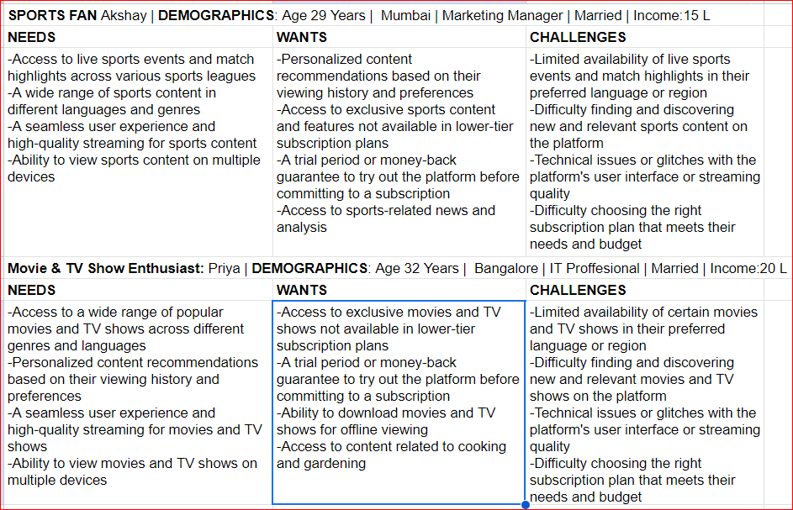
Task 4: Building Product Artefacts-Persona Sports Fan & Movie and TV Show Enthusiast

Slide 24
Task 4: Building Product Artefacts-Persona For Disney+HotStar: Sports Fan
PROFILE: SPORTS FAN Akshay | DEMOGRAPHICS: Age 29 Years | Mumbai | Marketing Manager | Married | Income:15 L
NEEDS:
Access to live sports events and match highlights across various sports leagues
A wide range of sports content in different languages and genres & Ability to view sports content on multiple devices
A seamless user experience and high-quality streaming for sports content
WANTS:
Personalized content recommendations based on their viewing history and preferences
Access to exclusive sports content and features not available in lower-tier subscription plans
A trial period or money-back guarantee to try out the platform before committing to a subscription
Access to sports-related news and analysis
CHALLENGES:
Limited availability of live sports events and match highlights in their preferred language or region
Difficulty finding and discovering new and relevant sports content on the platform
Technical issues or glitches with the platform's user interface or streaming quality
Difficulty choosing the right subscription plan that meets their needs and budget

Slide 25
Task 4: Building Product Artefacts-Persona For Disney+HotStar: Movie and TV Show Enthusiast
PROFILE: Movie & TV Show Enthusiast: Priya | DEMOGRAPHICS: Age 32 Years | Bangalore | IT Professional | Married | Income:20 L
NEEDS:
Access to a wide range of popular movies and TV shows across different genres and languages
Personalized content recommendations based on their viewing history and preferences
A seamless user experience and high-quality streaming for movies and TV shows
WANTS:
Access to exclusive movies and TV shows not available in lower-tier subscription plans
A trial period or money-back guarantee to try out the platform before committing to a subscription
Ability to download movies and TV shows for offline viewing
Access to content related to cooking and gardening
CHALLENGES:
Limited availability of certain movies and TV shows in their preferred language or region
Difficulty finding and discovering new and relevant movies and TV shows on the platform
Technical issues or glitches with the platform's user interface or streaming quality
Difficulty choosing the right subscription plan that meets their needs and budget

Slide 26
Task 4: Building Product Artefacts-Anti Persona For Disney-HotStar
PROFILE: Name: Avir | Age: 22 | Occupation: College student| Education: Pursuing Bachelor's degree in Arts| Location: Small town in India| Family Status: Single| Interests: Hanging out with friends, scrolling through social media, watching occasional movies and TV shows
NEEDS:
Access to basic and free entertainment content
Minimalistic interface with limited options to choose from
Low-cost subscription plans or ad-supported streaming options
WANTS:
Occasional access to popular movies and TV shows without having to commit to a subscription
Ability to customize their viewing experience with user preferences and settings
Access to social media sharing and community features to share their content preferences and reviews
CHALLENGES:
Limited budget for subscription plans or one-time purchases
Difficulty finding and discovering new and relevant content on the platform
Limited availability of certain content in their preferred language or region

Slide 27
Task 4: Building Product Artefacts-Accepted Consumer Beliefs
Accepted Consumer Beliefs based on research:
The price of subscription plans for OTT platforms is a key factor in deciding which platform to subscribe to.
The quality and variety of content available on an OTT platform is a key factor in deciding which platform to subscribe to.
Recommendations from friends and family are an important factor in deciding which OTT platform to subscribe to.
Desired Consumer Beliefs that we want the users to believe:
Disney+ Hotstar offers the best value for money among all the OTT platforms available.
Disney+ Hotstar has the most diverse and engaging content library with exclusive access to premium content.
Disney+ Hotstar provides a seamless and personalized viewing experience with advanced recommendation algorithms and features.

Slide 28
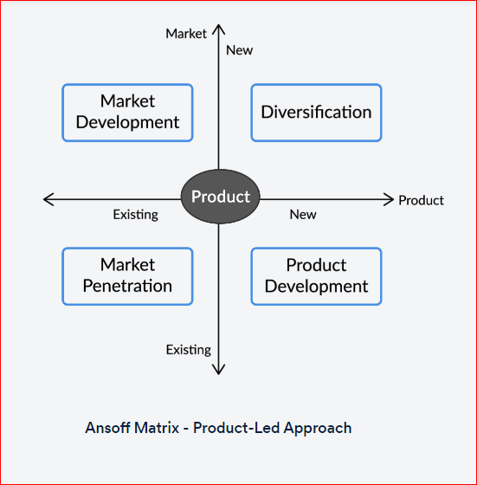
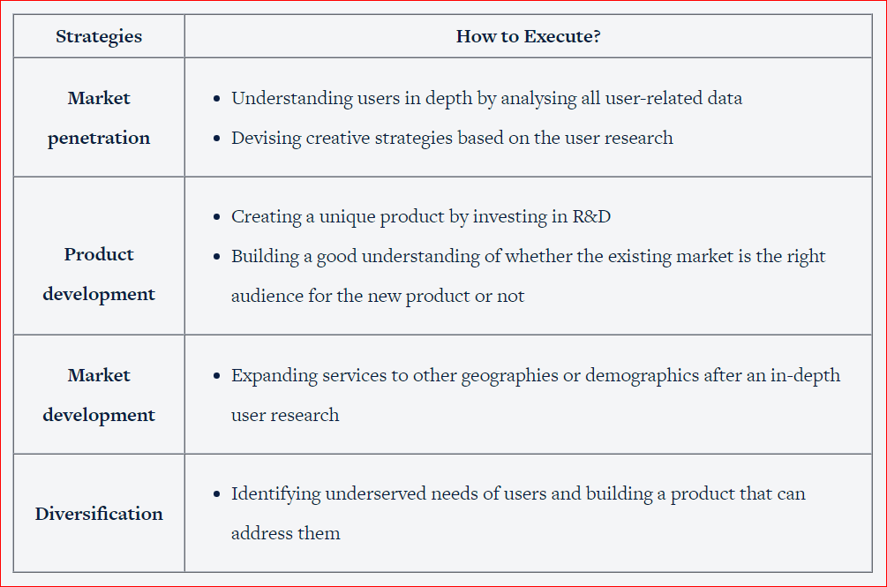
Task 5: Product/Market Expansion Using Ansoff Matrix

Slide 29
Task 5: Product/Market Expansion Using Ansoff Matrix
A. Market penetration: Disney+ Hotstar can grow by penetrating deeper into existing markets using the existing product by adopting the following strategy:
Offer discounts and promotions to existing subscribers: Disney+ Hotstar can offer attractive discounts and promotions to existing subscribers to encourage them to renew their subscriptions or upgrade to higher-tier plans. For example, they could offer a discount on a yearly subscription or provide additional benefits such as early access to premium content.
B. Product development: Disney+ Hotstar can grow by introducing a new product into the existing market by adopting the following strategy:
Introduce a new subscription plan: Disney+ Hotstar can introduce a new subscription plan targeting a specific segment of users with different preferences and needs. For example, they could introduce a plan that includes live sports events or a plan that offers exclusive access to regional language content. This would help to expand their customer base and increase revenue.

Slide 30
Task 5: Product/Market Expansion Using Ansoff Matrix
C. Market development: Disney+ Hotstar can grow by launching the existing product into new markets by adopting the following strategy:
Expand into new regions: Disney+ Hotstar can expand into new regions and countries where there is a demand for their content. They could also consider localizing their content to appeal to regional audiences. For example, they could introduce content in new languages or dub existing content into local languages. This would help to reach new customers and increase revenue.
D. Diversification: Disney+ Hotstar can grow by launching a new product into new markets by adopting the following strategy:
Launch a streaming device: Disney+ Hotstar could consider launching a streaming device that provides access to their content library as well as other streaming services. This would help them to diversify their product portfolio and reach a wider customer base. Additionally, they could bundle their streaming device with a subscription plan to attract new customers and increase revenue.

Slide 31
Industry Project Part 2

Slide 32
Task 6: Building Activation and Retention Strategies
A. Activation: Build a plan to activate users who have not subscribed to any of Disney+ Hotstar’s subscription plans.
i. Calculate the bounce rate to determine the percentage of total visitors who do not find any value in the product.
Bounce Rate is defined as percentage of users dropping without performing any action. More specifically in this context percentage who leave the app after visiting only a single page or screen, without performing any further actions or interactions. From data set provided we have total number of users as 1000.
No. of users visited only once in first 7 days = 347
Hence, Bounce rate = No. of users visited only once in first 7 days/ Total no. of users
= (347/1,000)*100 = 34.7%
Bounce rate of Disney + Hotstar is 34.7%

Slide 33
Task 6: Building Activation and Retention Strategies
ii. Determine the relationship between time spent on the Disney+ Hotstar app per visit and the users purchasing a subscription plan.
Total 60 out of 1000 have subscribed to a plan which is just 0.6%. However, the average time spent on the platform by the users who have bought the subscription is 3.25 sec; whereas it is 2.93 sec for those who haven’t purchased the subscription. The data shows that more the time spent by the user on the platform more likely is the conversion
Data also shows that users who have visited the website more than 11 times in the first 7 days have purchased the subscription where as users who have visited the website less than 11 times in the first 7 days have not purchased the subscription.

Slide 34
Task 6: Building Activation and Retention Strategies
iii. Highlight at least two key shortcomings of Disney+ Hotstar’s existing onboarding flow.
1. Users preferences to be captured: At the time of onboarding Disney+Hotstar may capture more information on users preferences in order to provide personalized content since beginning. Presently Users are not being asked to share their preferences or interest at the time of signing up. Resulting to a wide range of content where user might get lost and find difficulties in selecting content to watch.
2. Tedious sign-up process: Sign-up procedure is complex and time-consuming. Users are being asked number of information such as their name, email address, phone number, and payment information. Users must also choose a plan and provide their billing information, which can be challenging for some users. The difficult and drawn-out registration process may frustrate consumers and prompt some of them to give up completely.

Slide 35
Task 6: Building Activation and Retention Strategies
iv. Identify at least two core activation metrics that you should monitor to judge the effectiveness of the onboarding flow.
User Retention: A high user retention rate indicates that the app’s core value proposition has been clearly communicated during the onboarding process, which in turn encouraged consumers to utilize it again. It shows how involved users are and how effectively the onboarding process prepares customers for continuing use.
Activation Rate: The percentage of users who have watched the content on the app post completion of the onboarding process. It shows whether the onboarding procedure is successful in motivating users to act and interact with the app.

Slide 36
Task 6: Building Activation and Retention Strategies
b. A major problem that Disney+ Hotstar is facing is that a lot of users bounce and do not engage with the platform on the first visit? What can you do to engage them in the first visit?
Clear value proposition: During the onboarding process, it's critical to make the value proposition of Disney+ Hotstar clear to users. Emphasizing the advantages of using the site, such as getting access to exclusive material and watching live sporting events, is necessary.
Enhance onboarding experience: Provide an enhanced onboarding experience for first-time users. This can include a guided tour of the platform, tutorials on how to use the platform, and information on the platform's features and benefits.
Personalization: Provide personalized recommendations to users based on their viewing history or preferences. This will help users find relevant content quickly, increasing the chances of them staying on the platform.
Simplify the sign-up process: Make the sign-up process as simple and quick as possible. Asking for too much information upfront may deter users from signing up. Providing the option to sign up using social media accounts can also make the process easier for users.
Promotions and free trials: Offer promotions or free trials to new users to incentivize them to try out the platform. This will increase the chances of users engaging with the platform and returning for future visits.

Slide 37
Task 6: Building Activation and Retention Strategies
B. Retention: Build a plan to make the existing users re-subscribe to the subscription plans offered by Disney+ Hotstar.
i. Calculate the renewal rate of the subscription plans based on three parameters:
Overall renewal rate : Overall renewal rate =number of users who have renewed the subscription/the total number of users *100 = 428/1000*100 = 42.8%
Renewal rate based on the duration of the subscription plan:
Renewal rate of monthly subscription plan = no of renewed monthly subscription plans/total no of users*100
= 2/1000*100 = 0.2%
Renewal rate of yearly subscription plan = no of renewed yearly subscription plans/total no of users*100
= 426/1000*100 = 42.6%
Renewal rate based on the type of subscription plan:
Renewal rate based on type of subscription plan = price of the subscription plan/ total no of users*100
Renewal rate of 299Rs subscription plan= 2/1000*100 = 0.2%
Renewal rate of 399Rs subscription plan= 336/1000*100 = 33.6%
Renewal rate of 1499Rs subscription plan = 90/1000*100 = 9%

Slide 38
Task 6: Building Activation and Retention Strategies
ii. Identify which cohorts of users are not re-subscribing to the subscription plans and suggest strategies to improve the re-subscription rate of these users.
There are three cohorts in the given data which are monthly subscription, VIP subscription and the yearly premium subscription. The price of each subscription is as follows:
Monthly subscription = Rs.299/-
VIP subscription =Rs.399/-
Yearly premium subscription= Rs.1,499/-
Renewal rate (analyzed in the previous question) depending on the type of subscription plan, the renewal rates for the above mentioned subscriptions are 0.2%, 33.65, and 9%. The cohort of users that subscribe to monthly subscription plans is the least likely or not re-subscribing to do so among the above mentioned cohorts.
iii. Determine the relationship between the time spent by users per visit on the renewal rate of the subscription plans.
The time spent each visit and renewal rate are directly correlated, meaning that users who spend more time per visit are more likely to renew their subscription.
By applying the filter to the renewal column, we can understand that
The average time spent per visit by the users who renewed the subscription = 83.09 minutes
The average time spent per visit by the users who did not renew the subscription = 83.09 minutes

Slide 39
Task 6: Building Activation and Retention Strategies
b. A major problem that Disney+ Hotstar is currently facing is the very low re-subscription rate of its Premium plan. Devise a strategy to address this problem
Reducing the cost of monthly premium membership from Rs.299 to a lesser price and restricting the content to just one language would undoubtedly encourage consumers who initially chose monthly premium subscription to renew their subscriptions
Improve the user experience: One of the reasons for low resubscription rates could be the poor user experience. Therefore, it is essential to ensure that the user interface is user-friendly, easy to navigate, and provides relevant content suggestions. Conducting user testing and collecting feedback can help in identifying areas of improvement and provide a better experience to users.
Offer personalized recommendations: Personalized recommendations based on user preferences and viewing history can keep users engaged and make them feel valued. This can be achieved by leveraging machine learning algorithms to provide personalized recommendations and creating customized playlists based on user behavior.
Enhance content offerings: Providing new and exclusive content can be a significant driver for resubscription. Disney+ Hotstar can consider acquiring exclusive content rights, collaborating with content creators or investing in original content. They can also consider creating a "sneak peek" feature to give users a preview of upcoming content.
Focus on communication and engagement: To improve resubscription rates, it is essential to keep users engaged and informed. Disney+ Hotstar can leverage various communication channels such as email, push notifications, and in-app messaging to keep users informed about new content, updates, and promotional offers.

Slide 40
Industry Project Part 3

Slide 41
Task 7: Building Acquisiton and Monetisation Strategies
A. Acquisition: Build an exhaustive plan to acquire new users for Disney+ Hotstar’s subscription plans. a. Analyze the data in the ‘Data set 1’ tab of the excel sheet provided on the platform and answer the following:
Which acquisition channel is performing the best and why?
The In App(Organic) acquisition channel is performing the best according to data set 1.
These reasons demonstrate why it is the channel with the best performance:
The In app (Organic) has the largest average traffic source on the subscription page (1992322), followed by Google Advertising, Facebook Ads, and Push notifications.
In App(Organic) have the greatest average conversion rate which is 5.59 followed by Push notifications, Facebook Advertising, Google Ads.
Additionally, it shows that more users are discovering the app through word-of-mouth than through other forms of paid advertising, and they are prepared to subscribe once they realise the service is worth their money.

Slide 42
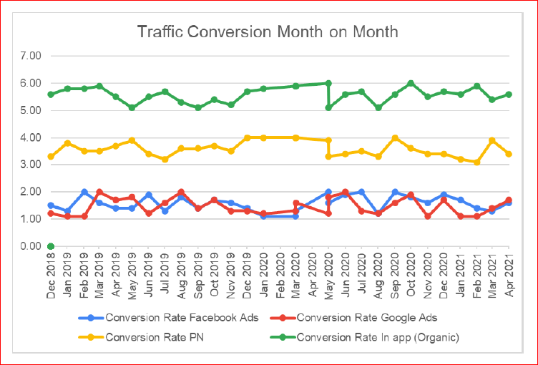
Task 7: Building Acquisiton and Monetisation Strategies
ii. How does traffic conversion vary month on month? Explain this by plotting a graph and analyzing its trend?

Slide 43
Task 7: Building Acquisiton and Monetisation Strategies
From the graph, we can see that traffic conversion varies month on month. There is a clear seasonal trend with higher traffic conversion rates during the months of March, April, May, and July, and lower rates during the months of January, February, and June. The conversion rate seems to have a moderate upward trend from January to May, followed by a downward trend from June to December.
Based on this trend, it might be useful to run targeted marketing campaigns during the months with higher traffic conversion rates

Slide 44
Task 7: Building Acquisiton and Monetisation Strategies
iii. Which paid acquisition channel is the most favourable?
From the above mentioned data, conversion rates are nearly identical, yet monthly spends on Facebook Ads is more than twice as much as Google Ads.
We can conclude that the Google Ads acquisition channel is the most advantageous one because less money is spent on Google Ads.
Channel | Avg Conversion Rate | Avg Marketing Spend
Facebook Ads | 1.579 | 2441574.103
Google Ads | 1.468 | 1060733.931

Slide 45
Task 7: Building Acquisiton and Monetisation Strategies
iv. Suggest an effective strategy to improve the traffic on the subscription page on a month-on-month basis?
To identify areas for improvement, we need to first understand the existing traffic patterns on the subscription page. We can use the data provided in the document to identify which months have the highest and lowest traffic and conversion rates.
Implement a targeted advertising campaign: During months with historically low traffic rates, we can build targeted advertising campaigns to increase traffic to the subscription page. To reach the right audiences, this can involve employing Google Ads, social network advertising, and other customized advertising platforms.
Give free trials: Disney+Hotstar might give new users a free trial period. They would have the opportunity to learn more about the website and its offerings without having to sign up for a subscription right away. As more individuals would be willing to check out the offer, this might assist increase traffic to the subscription page.
Personalized recommendations: Providing personalized recommendations based on user preferences and viewing history can encourage users to visit the subscription page to explore relevant content further. By leveraging machine learning algorithms and user data, Disney+ Hotstar can recommend personalized content to users, leading to increased engagement and traffic on the subscription page.

Slide 46
Task 7: Building Acquisiton and Monetisation Strategies
v. Identify atleast two core acquisition metrics that you should monitor throughout the acquisition campaigns.
Cost per Acquisition (CPA): This metric helps you measure the cost of acquiring a single customer through marketing campaigns. It is calculated by dividing the total marketing spend by the total number of new customers acquired. By tracking CPA, you can optimize your marketing efforts to ensure that you are acquiring new customers at an efficient cost.
Conversion Rate: This metric measures the percentage of users who visit the subscription page and actually sign up for the service. By tracking the conversion rate, you can identify any issues with the subscription flow and optimize it to improve the overall user experience and increase conversions.
Retention Rate: This metric helps you measure the percentage of users who continue to subscribe to the service after the initial sign-up. A high retention rate indicates that users are finding value in the service and are likely to continue using it. By tracking the retention rate, you can identify areas where the service may be lacking and make improvements to retain users over time.
Customer lifetime value (CLV): CLV is the estimated revenue a customer will generate over their lifetime with the business. It is an important metric to monitor as it helps to determine the long-term value of acquiring new customers through the campaign.

Slide 47
Task 7: Building Acquisiton and Monetisation Strategies
B. Strategy to convince the users to go for the yearly plan instead of the monthly plan.
State the benefits: Emphasize the benefits of an annual subscription over a monthly subscription. This can include exclusive content, access to all sports and more.
Trial offer: Let users try an annual subscription for a period of time before committing. It may take a week or a month for users to experience the benefits of an annual subscription before committing.
Highlight cost savings: Show users how much money they can save by choosing an annual subscription instead of a monthly subscription. You can also compare the total cost of two subscriptions over a year to show the savings.
Overall, the key to convincing users to go for the yearly subscription plan is to highlight the value proposition of the plan, such as cost-effectiveness, exclusive content, and convenience, and offer attractive incentives such as discounts, free trials, and money-back guarantees.

Slide 48
Task 7: Part B: Monetisation Strategies
B (a). Create at least three different monetisation plans for Disney+ Hotstar.
a. Monetisation Plans for Disney+ Hotstar:
Ad-Free Plan: Disney+ Hotstar can create an ad-free plan for users who do not want to see any ads while streaming. This plan could be offered at a premium price and could be an add-on to the existing VIP or Premium subscription plans.
Custom Plan: Disney+ Hotstar can let the user choose the channels/type of content they want and create a custom plan. This plan could be priced based on the user's selection of channels/content.
Live Events Plan: Disney+ Hotstar can create a separate plan for live events such as sports, concerts, and other live performances. This plan could be offered on a pay-per-view basis or as a part of the existing subscription plans.

Slide 49
Task 7: Part B: Monetisation Strategies
Ad-Free Plan:
Pros:
Increases revenue as users would pay a premium for an ad-free experience.
Enhances user experience by removing ads which might cause frustration.
May attract users who have a high disposable income and value an uninterrupted viewing experience.
Cons:
May not attract users who are not willing to pay for an ad-free experience.
Might impact revenue from advertisers who pay for ads on the free tier.
The cost of implementing an ad-free plan might be high.

Slide 50
Task 7: Part B: Monetisation Strategies
Custom Plan:
Pros:
Provides flexibility to users in choosing the content they want to watch.
Offers a personalised viewing experience, which could improve user engagement and retention.
Can be priced based on the user's selection, thereby increasing revenue.
Cons:
Might be difficult to manage from a content licensing perspective.
May lead to a fragmented user base, which could be challenging to manage.
Might lead to revenue cannibalisation if users opt for fewer channels/content.

Slide 51
Task 7: Part B: Monetisation Strategies
Live Events Plan:
Pros:
Provides an opportunity to monetise live events, which typically attract a large audience.
Can be priced at a premium, thereby increasing revenue.
May attract new users who are interested in live events.
Cons:
May not be as attractive to users who are not interested in live events.
May require additional infrastructure to support the streaming of live events.
The revenue from live events might be unpredictable.

Slide 52
Task 7: Part B: Monetisation Strategies
B (c). Two monetisation metrics that you should monitor.
Average revenue per user (ARPU): This metric measures the average revenue generated per user over a specific period of time. By monitoring ARPU, the product team can assess the effectiveness of the custom plan in increasing revenue and whether users are willing to pay more for the flexibility of choosing their own channels/content.
Customer lifetime value (CLTV): This metric measures the total revenue that a user is expected to generate throughout their lifetime as a customer. By monitoring CLTV, the product team can determine the long-term value of each user and whether the custom plan is effective in retaining users and increasing their lifetime value.

Slide 53
Task 7: Part B: Monetisation Strategies
B (d). Monetization plan that will be the most suitable one:
Based on the pros and cons listed for the three monetization plans, I believe that the most suitable one for Disney+ Hotstar would be the third option - creating a custom plan that allows users to choose the channels and type of content they want to subscribe to.
The reason why I think this plan would be the most suitable is that it provides the most flexibility to users, allowing them to choose what content they want to pay for instead of being locked into a fixed plan. This could appeal to a wider range of users with different preferences and budgets, making it a more inclusive and attractive option.
Furthermore, this plan could potentially increase revenue for Disney+ Hotstar as users who are willing to pay for premium content are likely to pay more for the specific channels or types of content they want to watch. It also allows Disney+ Hotstar to upsell and cross-sell content to users, which can lead to higher revenue per user.
However, there are also some potential drawbacks to this plan. One major con is that it could lead to a fragmented user base, with some users only paying for a few channels or types of content and others paying for a wide range. This could make it more difficult to market and promote the platform as a whole.
Another potential challenge would be developing and maintaining the technology infrastructure necessary to support such a custom plan. Disney+ Hotstar would need to invest in a robust and flexible platform that can handle user choices and provide a seamless viewing experience. This could be a significant investment for the company.
Overall, despite these potential challenges, I believe that the custom plan option would be the most suitable for Disney+ Hotstar, as it provides the most flexibility to users and the potential for increased revenue

Slide 54
Industry Project
Part 4

Slide 55
Task 8: Building Product Roadmap
A. List down at least three features that you would like to add/modify in the Disney+ Hotstar app
Augmented Reality (AR) Support: Adding AR support to the Disney+ Hotstarapp would allow users to experience immersive content and explore virtual worlds. Users had the option to explore virtual 3D environments, take pictures with fictional people, and more.
Voice-controlled Navigation: The app's addition of voice-controlled navigation would make it simpler and faster for users to access content. To explore and search for content, users may simply voice out their commands, greatly simplifying the process.
Support for Virtual Reality (VR): Adding VR compatibility to the Disney+ Hotstarapp would allow consumers to immerse themselves in content. Viewers may watch movies and television episodes in a virtual environment, which would make the experience much more interesting.
Adaptive Streaming: Introducing adaptive streaming to the app would allow users to watch material at the highest possible quality, depending on their device and internet connection. This ensures that all users have the best possible viewing experience.
Gamification: By including gaming elements into the app, users will be able to engage more fully with the material. The viewing experience could be made more enjoyable and exciting by users competing against one another in mini-games for points and prizes.

Slide 56
Task 8: Building Product Roadmap
B. Prioritise these features/improvements using the RICE framework, short form of Reach, Impact, Confidence and Effort framework.
RICE score= (Reach x Impact x Confidence)/Effort
In terms of infrastructure requirements, VR is generally considered to be more intensive than AR. VR requires a high-performance computer or gaming console to run, as well as a specialized VR headset. AR, on the other hand, can be run on a smartphone or tablet, although more advanced AR experiences may require specialized hardware
Feature | Reach | Impact | Confidence | Effort | Total
AR Support | 500 | 3 | 50% | 3 | 250
Voice Navigation | 600 | 4 | 70% | 3 | 940
VR Support | 900 | 5 | 90% | 5 | 810
Adaptive Streaming | 800 | 3 | 90% | 2 | 1080
Gamification | 900 | 4 | 90% | 5 | 648

Slide 57
Task 8: Building Product Roadmap
C. Pick the top feature/improvement you want to implement and build wireframes of how it will look:
1. Immersive Experience by using VR technologies:
Disney+ Hotstar features an immersive virtual reality arcade with a selection of content such as Sports Movies TV Shows WildLife etc. When exploring the virtual world, users can enjoy a realistic surroundings.
2. Multiple Players: The VR arcade on Disney+ Hotstarenables several players, allowing them to engage and work with one another. Gamers can band together to complete levels and solve riddles. They can watch Content together.
3. Realistic Environments: The VR arcade provides realistic environments that are intended to mimic real-life circumstances. To have a more realistic gaming experience, players can explore the virtual world and interact with its aspects

Slide 58

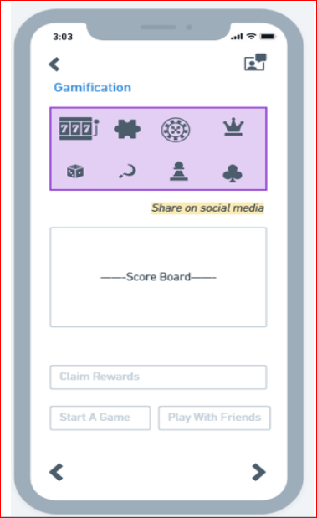
Task 8: Building Product Roadmap
Gamification

Slide 59
Task 8: Building Product Roadmap
1. Points:
The Disney+ Hotstarapp offers a point system that allows users to earn points for activities such as viewing shows, filling out questionnaires, and referring friends. The points can be redeemed for premium content or for special contests.
2. Badges:
The Disney+ Hotstarapp includes a badge system that awards users for accomplishing specific tasks or reaching certain milestones. Badges can be awarded for doing things like watching a specific number of movies or TV shows, filling out a survey, or introducing friends.
3. Leaderboards:
The Disney+ Hotstarapp contains a leaderboard that tells users how they rank in terms of points gained in comparison to other users. This motivates people to compete to see who can get the greatest score.

Slide 60
Disclaimer
All content and material on the upGrad website is copyrighted material, belonging to either upGrad or its bona fide contributors, and is purely for the dissemination of education. You are permitted to access, print, and download extracts from this site purely for your own education only and on the following basis:
You can download this document from the website for self-use only.
Any copies of this document, in part or full, saved to disc or to any other storage medium, may be used for subsequent, self-viewing purposes or to print an individual extract or copy for non-commercial personal use only.
Any further dissemination, distribution, reproduction, and copying of the content of the document herein, or the uploading thereof on other websites, or use of the content for any other commercial/unauthorized purposes in any way that could infringe the intellectual property rights of upGrad or its contributors is strictly prohibited.
No graphics, images, or photographs from any accompanying text in this document will be used separately for unauthorized purposes.
No material in this document will be modified, adapted, or altered in any way.
No part of this document or upGrad content may be reproduced or stored on any other website or included in any public or private electronic retrieval system or service without upGrad’s prior written permission.
Any rights not expressly granted in these terms are reserved.

