Slide 1
Reconciliation Tool
-Achal Kagwad
26th Jan 2015

Slide 2
Introduction
This Reconciliation tool helps you to compare any flat file which could be used for wide spread financial attribute reconciliations.
Used to test and validate the “data Integrity” of Data in the same system or the flow of data between systems.
Internally has support to set of configurations that are needed for comparisons and reconciliations of files.

Slide 3
List of features Implemented
Broadly classified under 2 Categories
Excel Recon Output features.
Configuration files and its validation

Slide 4
Excel Recon Output features.
Excel Output for further analysis if needed.
Classification of Data into 1)Summary Page 2)Source-Target Records. 3)Target-Source Records. 4)Source=Target Records. 5)Source!=Target Records.
Calculation of differences and deviances absolute and percentage.
Colour coding to highlight differences.

Slide 5
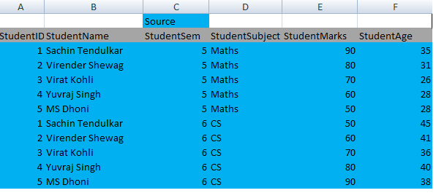
Sample Source File

Slide 6
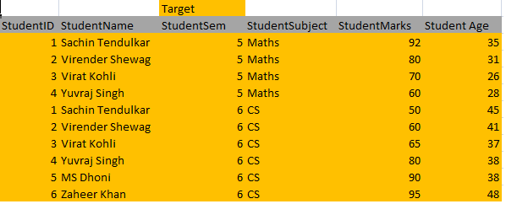
Sample Target File

Slide 7
Details of Config File
Delimiter character which can be comma(,) colon(: ) semicolon(;) etc
Name of Source File.
Name of Target File.
Filter Key: a key which displays the required column headers.

Slide 8
Details of Config File Contd
Composite Key: a special key which uniquely identifies rows. No two rows can have the same value of a composite Key.
CalculateDevianceOn Key: column header which have numeric values under them and deviance or absolute differences have to be calculated on them.
columnMappingFile: a file with mapping values of column headers of a new Target File which map back to the source headers.
valueMappingFile: a file with mapping values of a new Target File which map back to source values.

Slide 9
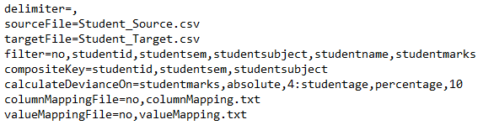
Sample Config File

Slide 10
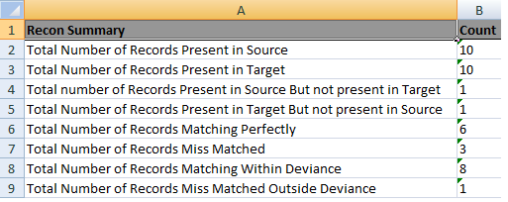
Summary Sheet In the Excel
Presents a brief overview of the Reconcialition

Slide 11

Source-Target Records
Records which are present in Source File but not present in Target File. Equal to the set operation (A-B)

Slide 12

Target-Source Records
Records which are present in Target File but not present in Source File. Equal to the set operation (B-A)

Slide 13
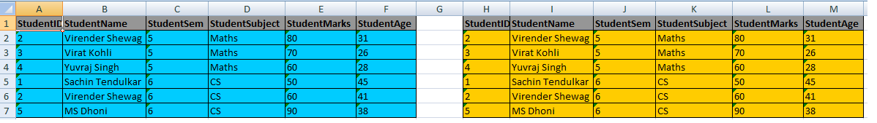
Source=Target Records
Records present in source which are also present in Target. These are perfectly matching records. Equal to the set operation (A INTERSECTION B)

Slide 14
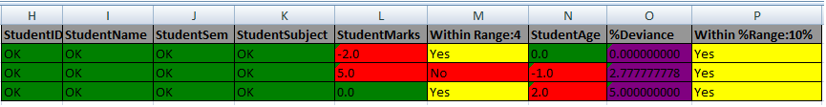
Source!=Target Records
These are not perfectly matching records, but closely matching records on which percentage deviance or absolute value comparisons are done based on the input given in config file.

Slide 15
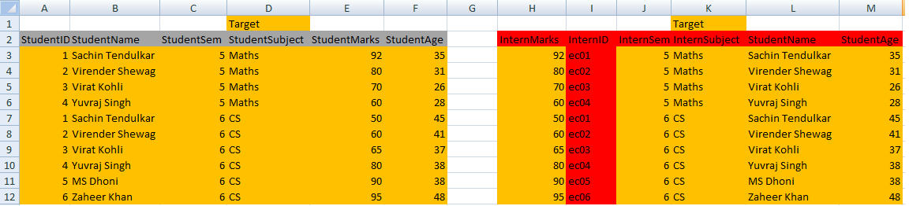
Change of Target File
A change of Target File to represent change in the names of column headers and change in the values of target file, highlighted in red.

Slide 16
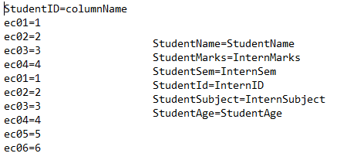
valueMapping and columnMapping files
Content of sample valueMappingFile(on the left) and sample columnMappingFile(on the right).These map data in Target File to the source file and bring the data in sync with the source file for comparisons.

Slide 17
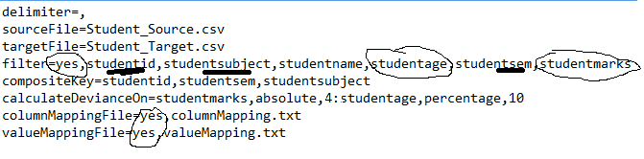
Config File changed to use mapping Files
Notice the flags changed from ‘no’ to ‘yes’ in the config file for filter key, columnMappingFile and valueMappingFile.

Slide 18
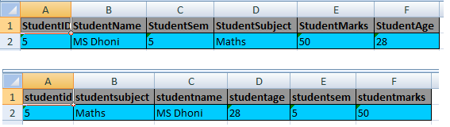
Source-Target Records with new config file
The image displays how ‘Source-Target’ Records representation in Excel sheet changes when config file is changed. Notice that the column headers are displayed in the order which is mentioned in the Config File.

Slide 19
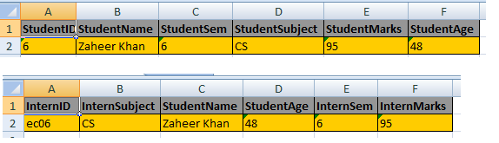
Target-Source Records with New Config File
The image displays how ‘Target-Source’ Records representation in Excel sheet changes when config file is changed.

Slide 20
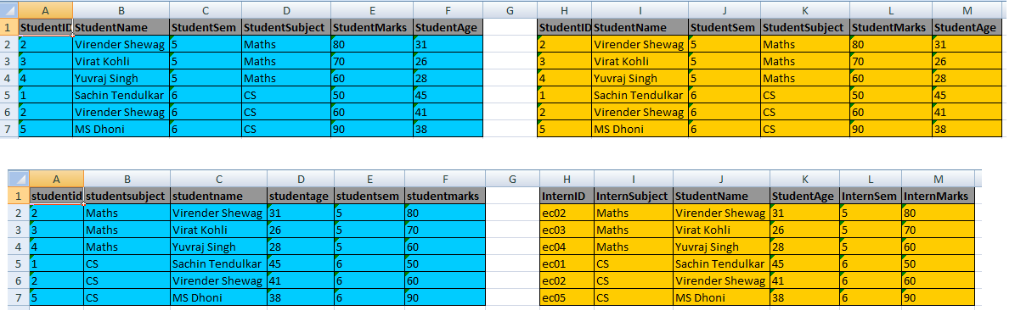
Source=Target Records with New Config File
The image displays how ‘Source=Target’ Records representation in Excel sheet changes when config file is changed.

Slide 21
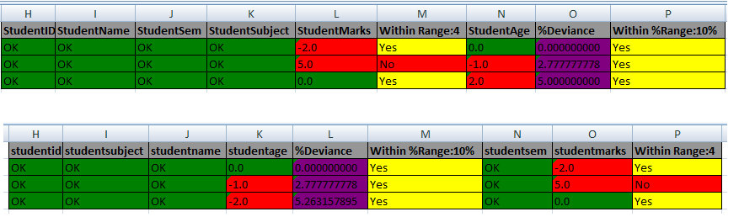
Source!=Target Records with New Config File
The image displays how ‘Source!=Target’ Records representation in Excel sheet changes when config file is changed.

Slide 22
Configuration File and its validation
Configuration file is the basic input file which helps to get data in required manner.
Its the basic file all you need to play with to run this tool.
The checks on this file are necessary to keep the “data integrity” of the files.
If the checks are not followed exceptions are thrown!

Slide 23
Revisit: Validation of Config File

Slide 24
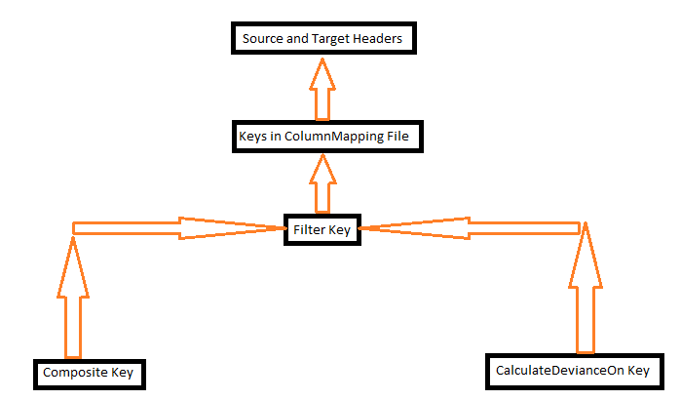
Checks and Validation of Config File
Image displaying Key Hierarchy

Slide 25
Checks and Validation of Config File
CalculateDevianceOn Key must be a subset of filter Key(if given) and must be a subset of source and target headers.
CompositeKey must be a subset of filter key(if given) and must be a subset of source and target headers.
Filter Key(if given) must be subset of source and target headers.
Filter Key(if given)key must be subset of columnMapping File key(if given).
columnMapping File (if given) has to give all the mapping of w.r.t to source header

Slide 26
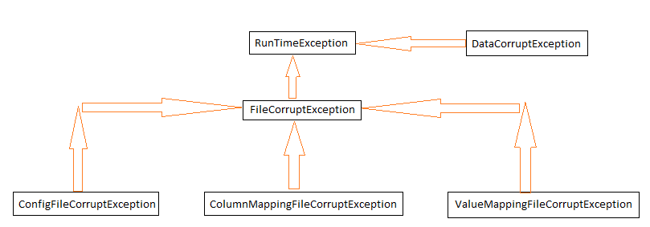
Exceptions thrown when Files or Data are improper

Slide 27
Package structure of the Project
.\src has all the source code well packaged into java packages and classes.
.\data is where you put all the Input source and Target files.
.\config is where you put your configFile and columnMapping and valueMapping files.
.\docs\gen gives the required generated XL sheet!
.\log gives a generated log file of the whole run of the project.

Slide 28
Future Enhancements
Database and XML comparisons.
Data Base, XML reading and connectivity could be added on top of this with ease.
Interactive UI
Basic Back End algorithms ready, could be ported on different UI systems like SWT,Swing even Android and IOS Tabs!

Slide 29
QUESTIONS??

Slide 30
Thank You. Have a good Day!☺

