Slide 1
Optimization Case Study : Staff Planning
By
Achal Kagwad | Himanka Das
IIIT-B Batch : DSC 026
Date : 25th October, 2021

Slide 2
Problem Statement
We have an insurance company that receives lots of claims
For claim approval and rejection process to be smooth it distributes among 2 types of staff/employees;
Full Time Employees(FTE)
Part Time Employees(PTE) also called as outsourced vendors.
Main problem statement is how we should the optimize the distribution of FTE vs. PTE so that we minimize the total cost on staff in such a way that FTE are given maximum amount of work(processing of applications) and if the work allocated to FTE is full, then we will outsource the remaining work to PTE or Outsourced Vendors.

Slide 3
MATHEMATICAL EXPRESSIONS/ MODEL
Formulating Mathematical Model which includes Index definitions, Parameters, Decision Variables, Objective Function and Constraints.

Slide 4
1. Index Definition
i = Bank Locations iterating over the three states A,B and C
j = Month-Iterates over the 12 months from Jan to Dec(1 to 12) across the three states

Slide 5
2. Parameters
Demand (i, j) = Demand of Number of Applications to be processed for given bank location(i) and month(j). Eg: Demand(‘A’, Jan etc.)
StaffAvailability (i, j) = Staff Availability for given (i, j)
FTESalary (i, j) = Monthly Salary for in house full time staff for given(i, j)
UnitOutsourcingCost (i, j) = Per application vendor outsourcing cost for given(i, j)
FTEAppServeRate = Number of applications serviced per month with staff working 100%. Value given here is ‘40’

Slide 6
3. Decision Variables
We have to distribute our application amongst Full Time Employees (FTE) and Outsourced vendors.
X(i, j) = FTE equivalent at any location in a month. This is a continuous variable.(NonNegativeReal).
Y(i, j) = Insurance application quantity which are Outsourced in a month. This is an Integer Variable(NonNegativeInteger)

Slide 7
4. Objective Function
Minimize(Annual Total Cost of FTE + Annual Total Cost of Outsourced Insurance Applications)
∑i ∑j X(i, j) * FTESalary(i, j) + ∑i ∑j Y(i, j) * UnitOutsourcingCost(i, j)

Slide 8
5.1. Constraints- Demand Constraint
No of FTE + No of Vendor Outsourced applications= Demand of applications for all bank states(i) and month(j).
X(i, j) * StaffAvailability(i, j) * FTEAppServeRate + Y(i, j)= Demand of applications for all bank states(i) and month(j).

Slide 9
5.2. Constraints- Regulatory Constraints
States ‘A’ and ‘B’ have regulatory constraints that the outsourced applications cannot be more than 30% and 40% of total number of applications.
Regulatory Constraint: y(i,j)<=Demand(i,j)*30 | For all i belongs to State 'A' and j belongs to all months(Jan to Dec)
Regulatory Constraint: y(i,j)<=Demand(i,j)*40 | For all i belongs to State 'B' and j belongs to all months(Jan to Dec)

Slide 10
5.3. Constraints – Other Constraints
X(i, j)=Continuous
Y(i, j)=Integer
These are nothing but our decision variables

Slide 11
DATAFRAME WITH ACTUAL, WORST & BEST CASE ANALYSIS
What is the optimal number of staff members for the worst and best cases ?
What are the percentages of outsourcing for the worst and best cases ?
What is the average cost per application for the worst and best cases ?

Slide 12
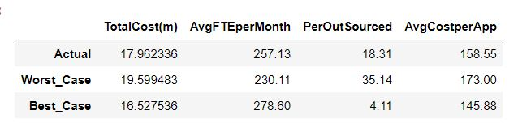
Summary of Dataframe Image output obtained from Python

Slide 13
Answering the questions for Worst and Best Case Analysis
Q1. What is the optimal number of staff members for the worst and best cases ?
Ans. : The Optimal Number of Staff members for worst and best cases are 230.11 and 278.60 respectively
Q2. What are the percentages of outsourcing for the worst and best cases?
Ans. : The Percentages of Outsourcing for the worst and best cases are 35.14% and 4.11% respectively.
Q3. What is the average cost per application for the worst and best cases?
Ans. : The Average Cost Per Application for the worst and best cases are 173 and 145.88 respectively

Slide 14
VISUALIZATIONS
Visualizations to infer Insights about the problem at hand

Slide 15
Stacked Column Charts
Using the solution of Q2 to create a stacked column chart that shows the percentage of applications processed by the staff and by the vendor for each month (%staff processed applications + %vendor processed applications should add up to 100%).

Slide 16
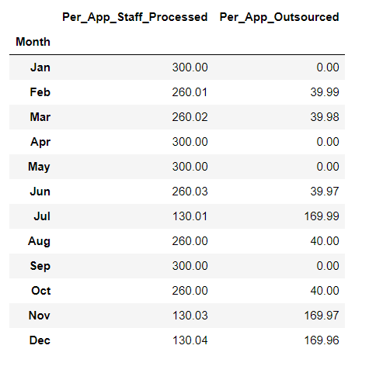
Dataframe of Percentage of Apps Processed by Staff and Vendor

Slide 17
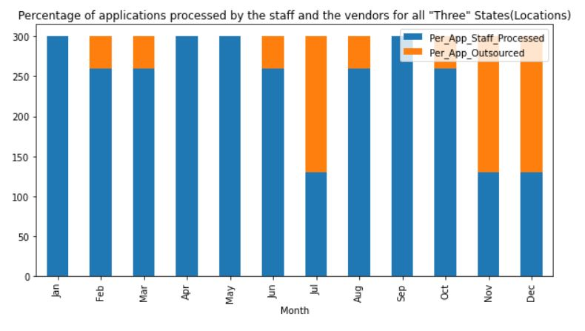
Stacked column chart showing percentage of applications processed by the staff and outsourced to vendors each month

Slide 18
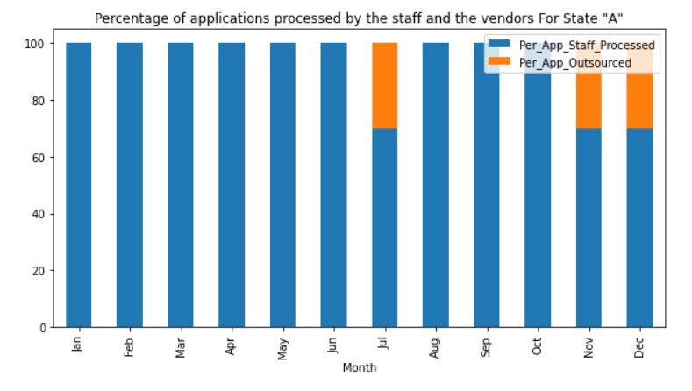
State ‘A’ breakdown of percentage applications - Staff Processed vs. Vendor Outsourced

Slide 19
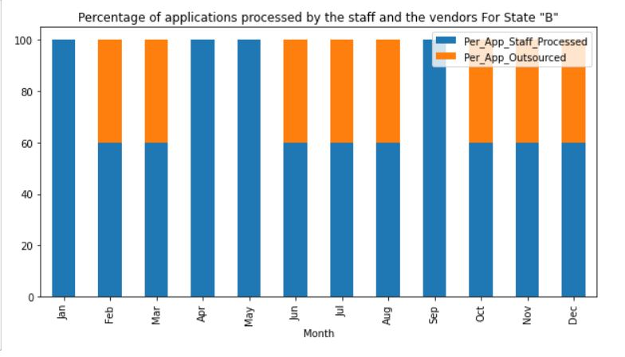
State ‘B’ breakdown of percentage of applications Staff Processed vs. Vendor Outsourced

Slide 20
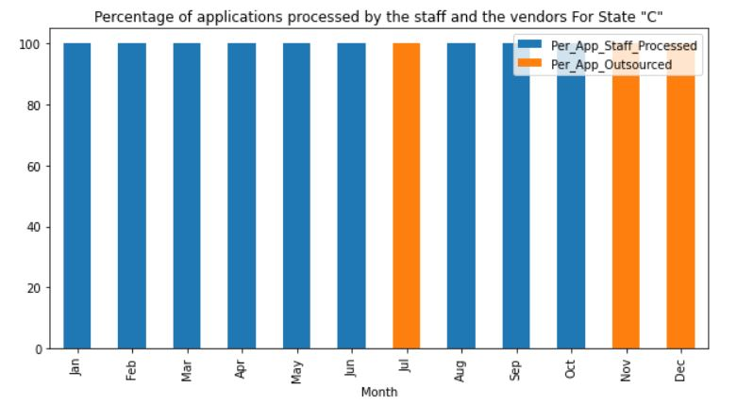
State ‘C’ breakdown of percentage of Applications Staff Processed vs. Vendor Outsourced

Slide 21
Line Graphs
Curating a line a graph to show how the cost per application increases with respect to any change in the parameters in your analysis. (Hint Given: We are to use the cost per application that we calculated in Questions 2 and 3, i.e., the actual scenario, best case, and worst case.)

Slide 22
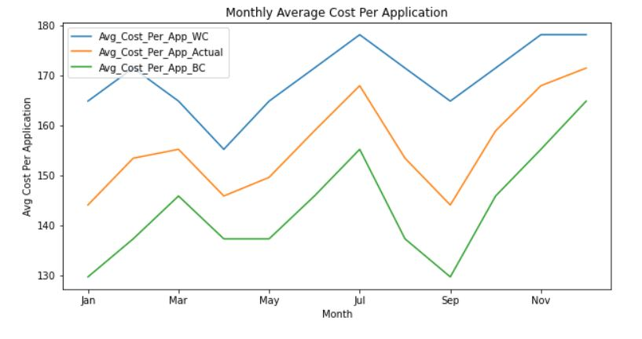
Variance in “Cost per Application” in Actual, Worst Case and Best Case Inference: We can infer from below graph that the cost/app is high during the month of March, July and also increases towards the end of year in months of November and December.

Slide 23
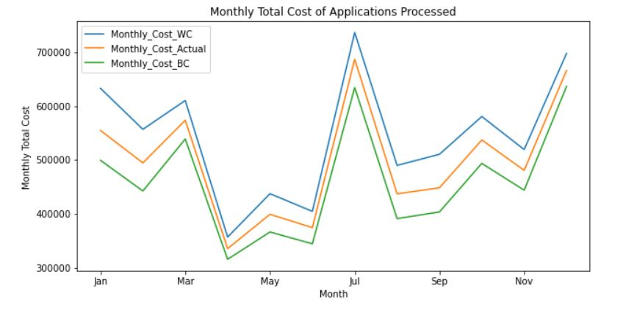
Variance in “Monthly Cost” in Actual, Worst Case and Best Case Inference: We can infer from below graph that the “Total Monthly Cost” is high during the month of March, July and also increases towards the end of year in months of November and December.

Slide 24
Thank you
For any other queries please feel free to reach us at;
achal.kagwad@gmail.com
himanka_p@hotmail.com

