Slide 1



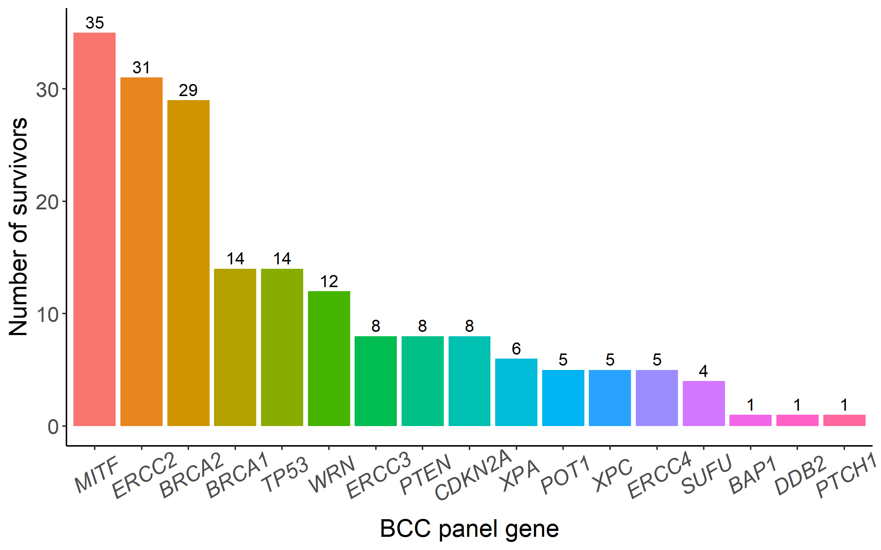
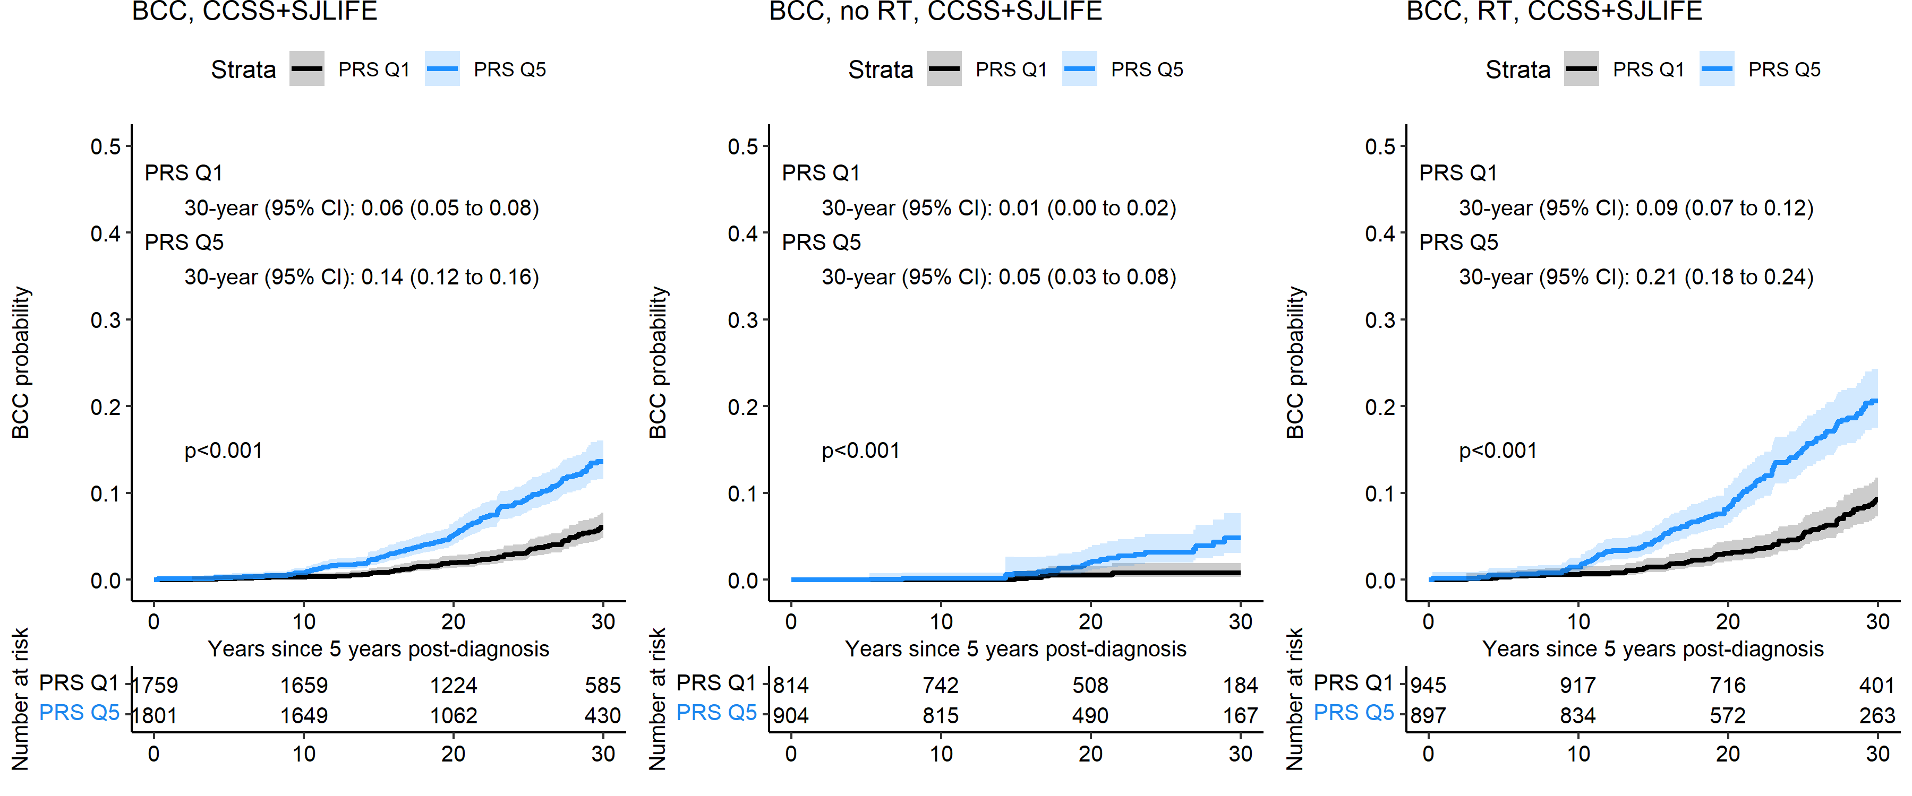
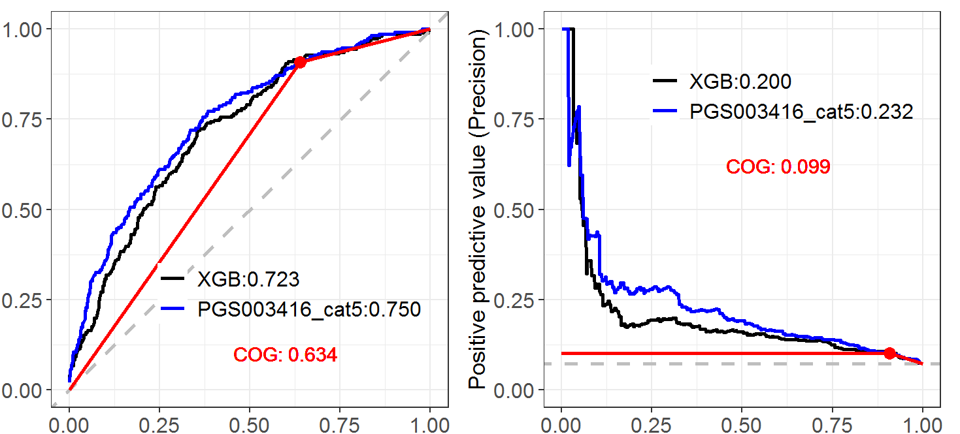
Inherited genetic susceptibility of basal cell carcinoma (BCC) and its contribution to risk prediction among long-term survivors of childhood cancer: a St. Jude Lifetime Cohort (SJLIFE) and Childhood Cancer Survivor Study (CCSS) report
Authors: Cindy Im,¹ Christina Boull,¹ Achal Neupane,² Zhe Lu,³ Hasibul Hasan,¹ Kirsten K. Ness,² Melissa M. Hudson,²
Gregory T. Armstrong,² Yutaka Yasui,² Michael A. Arnold,⁴ Joseph P. Neglia,¹ Yan Yuan,³ Lucie M. Turcotte¹, Yadav Sapkota²
¹University of Minnesota, ²St. Jude Children’s Research Hospital; ³University of Alberta; ⁴University of Colorado and Children’s Hospital Colorado
Background
Methods
Survivors of childhood cancer have greater risk of developing basal cell carcinoma (BCC) compared to the general population. Other critical aspects include:
Younger age at 1st skin cancer diagnosis (mean = 37y) and higher frequency of multiple BCCs (>25% of affected survivors); and
Treatment risk factors, including dose-response relationship between BCC risk and radiation therapy (RT) dose.
Genetic predisposition for BCC, especially related to BCC syndromes, should be considered
Aim: To assess whether genetic factors, e.g., pathogenic/ likely pathogenic (P/LP) variants or polygenic risk scores (PRSs), improve BCC clinical risk prediction
Analyses used whole-genome/-exome sequencing (WGS/WES) and imputed array-based genotype data from 5-year survivors in SJLIFE (completed campus visit) and CCSS (completed baseline survey)
Limited to European (EUR) ancestry survivors (>95% BCCs occur in Non-Hispanic White survivors)
BCCs reported ≥5y post-primary cancer diagnosis confirmed by pathologist/oncologist, with ICD-O behavior code 3
P/LP variants: Carriers identified using WES data, considering 18 genes evaluated in BCC clinical genetic testing panels (Blueprint, GeneDx, Invitae); all variant minor allele frequencies <1% in gnomAD v4 and sample
Classified as P/LP: per ClinVar database (accessed on December 10, 2023) or predicted high-confidence loss-of-function (LOFTEE)
PRS: Computed externally-validated general population keratinocyte cancer PRS (EUR GWASs, N>300,000)
462-variant multi-trait PRS (BCC, SCC, & 20 correlated traits, e.g., any cancer, pigmentation); PGS Catalog: PGS003416
Statistical analysis:
Prevalence of carrying rare P/LP variants in BCC panel genes evaluated in BCC unaffected/affected survivors
Cox proportional hazards regression using age as time scale evaluated PRS associations with genetic factors, adjusting for sex, age at childhood cancer diagnosis, genetic ancestry, and maximum RT dose (across 7 body regions)
Cross-validated prediction performance metrics for including PRS to model with BCC predicted risk from novel age-specific models developed in CCSS with good performance (“XGBoost”) compared using bootstrapped 2-sided p-values
Results
9,428 survivors in SJLIFE or CCSS with genotype data
Also broadly related to tumor suppression, DNA repair
No BCC (N=4954) | BCC (N=265)
Prevalence (95% CI)
3.4 (2.9-3.9) | 2.6 (1.2-5.6)
5,219 survivors in SJLIFE or CCSS with WES data
P/LP variants observed in 17 out of 18 panel genes
Low frequency of P/LPs in BCC syndrome genes
No association with carrying P/LP variants in BCC panel genes seen (HR = 0.8, 95% CI: 0.4-1.7)
51% female
Median age at follow-up: 38y (IQR: 30-45y)
52% treated with any RT
782 developed subsequent BCC
Keratinocyte cancer PRS differentiated BCC risk among survivors
Dose-response relationship between PRS quintiles and BCC hazard rate
More BCC risk differentiation by PRS among RT-exposed survivors
No RT
RT-exposed
More specific to basal cell nevus syndrome, Xeroderma pigmentosum
Figure 1: P/LP variant distribution in BCC genetic testing genes
CCSS only: Including keratinocyte cancer PRS improved BCC clinical risk prediction at younger and older age cutoffs, including among survivors treated with RT
Figure 2: BCC cumulative incidence by keratinocyte cancer PRS risk groups in SJLIFE and CCSS (top [Q5] vs. bottom [Q1] PRS quintile)
XGBoost AP: 0.20
+PRS AP: 0.23 (P=0.045)
COG AP: 0.10
Table 1: Keratinocyte PRS associations with BCC in SJLIFE/CCSS
True positive rate
Precision
 | SJLIFE (N=3195, 202 BCC) |  | CCSS (N=6233, 580 BCC) |  | Combined (N=9428, 782 BCC)
PRS | HR (95% CI) | P | HR (95% CI) | P | HR (95% CI) | P
Q1 | Ref. |  | Ref. |  | Ref.
Q2 | 1.5 (0.9-2.6) | 0.15 | 1.7 (1.3-2.3) | 2.4x10⁻⁴ | 1.6 (1.2-2.0) | 3.0x10⁻⁴
Q3 | 2.4 (1.4-4.1) | 1.2x10⁻³ | 1.5 (1.1-2.1) | 5.9x10⁻³ | 1.5 (1.1-1.9) | 3.2x10⁻³
Q4 | 2.4 (1.4-4.1) | 9.7x10⁻⁴ | 2.2 (1.7-3.0) | 4.6x10⁻⁸ | 2.2 (1.7-2.8) | 4.1x10⁻¹⁰
Q5 | 4.2 (2.6-6.9) | 1.5x10⁻⁸ | 2.7 (2.0-3.6) | 3.8x10⁻¹¹ | 2.8 (2.2-3.6) | 2.0x10⁻¹⁶
XGBoost AUC: 0.72
+PRS AUC: 0.75 (P<0.01)
COG AUC: 0.63
False positive rate
Recall
Figure 3: Cross-validated risk prediction performance with the inclusion of PRS to clinical XGBoost model (BCC by age 40y) in CCSS
Conclusions
Acknowledgements
Inherited genetic predisposition can inform subsequent BCC risk prediction, e.g., a keratinocyte cancer PRS exhibiting a strong dose-response relationship with BCC risk
Evaluating BCC gene panel P/LP variants showed limited utility among these high-risk survivors, likely because commercial testing panels include broader cancer susceptibility genes
Funding: US National Cancer Institute (R21 CA261833, MPI: C Im/Y Yuan; R01 CA216354, MPI: Y Yasui/J Zhang; U24 CA55727, PI: GT Armstrong; U01 CA195547, MPI: MM Hudson/K Ness); Children’s Cancer Research Fund (C Im, C Boull, LM Turcotte); UMN Foundation Pediatric Scholar Award (C Im).
The Childhood Cancer Survivor Study is an NCI-funded resource (U24 CA55727) to promote and facilitate research among long-term survivors of cancer diagnosed during childhood and adolescence. Investigators interested in potential uses of this resource are encouraged to visit http://ccss.stjude.org

