Slide 1

SCITT – COSE
Managing SCITT Statements as COSE Payloads
Attached | Detached | Hashed
Steve Lasker SteveLasker.blog Director of Ecosystem
DataTrails.ai
Reference: https://or13.github.io/draft-steele-cose-hash-envelope/draft-steele-cose-hash-envelope.html

Slide 2




SCITT records
Who made
an immutable Statement
about an Artifact
recorded “when”
SCITT
Identity
Statement
Artifact
Notes:
For a quick SCITT overview, we create statements about Artifacts. [CLICK]
An artifact can be anything from binary data (software, AI training data), digital media to physical goods. [CLICK]
A subject property is used to uniquely identify the artifact. [CLICK]

Slide 3


Who are the Who’s
People (Whoville who’s)
Services
Processes
Companies
Groups
Anything with any type of identity
SCITT uses x509 as an example
No intended limitation of identity types
It’s up to the SCITT Service to decide what types of identities they’ll support
SCITT
Identity
Statement
Artifact
CWT_Claims
issuer : tstr,
subject : tstr,
* : int => any
Notes:
For a quick SCITT overview, we create statements about Artifacts. [CLICK]
An artifact can be anything from binary data (software, AI training data), digital media to physical goods. [CLICK]
A subject property is used to uniquely identify the artifact. [CLICK]

Slide 4

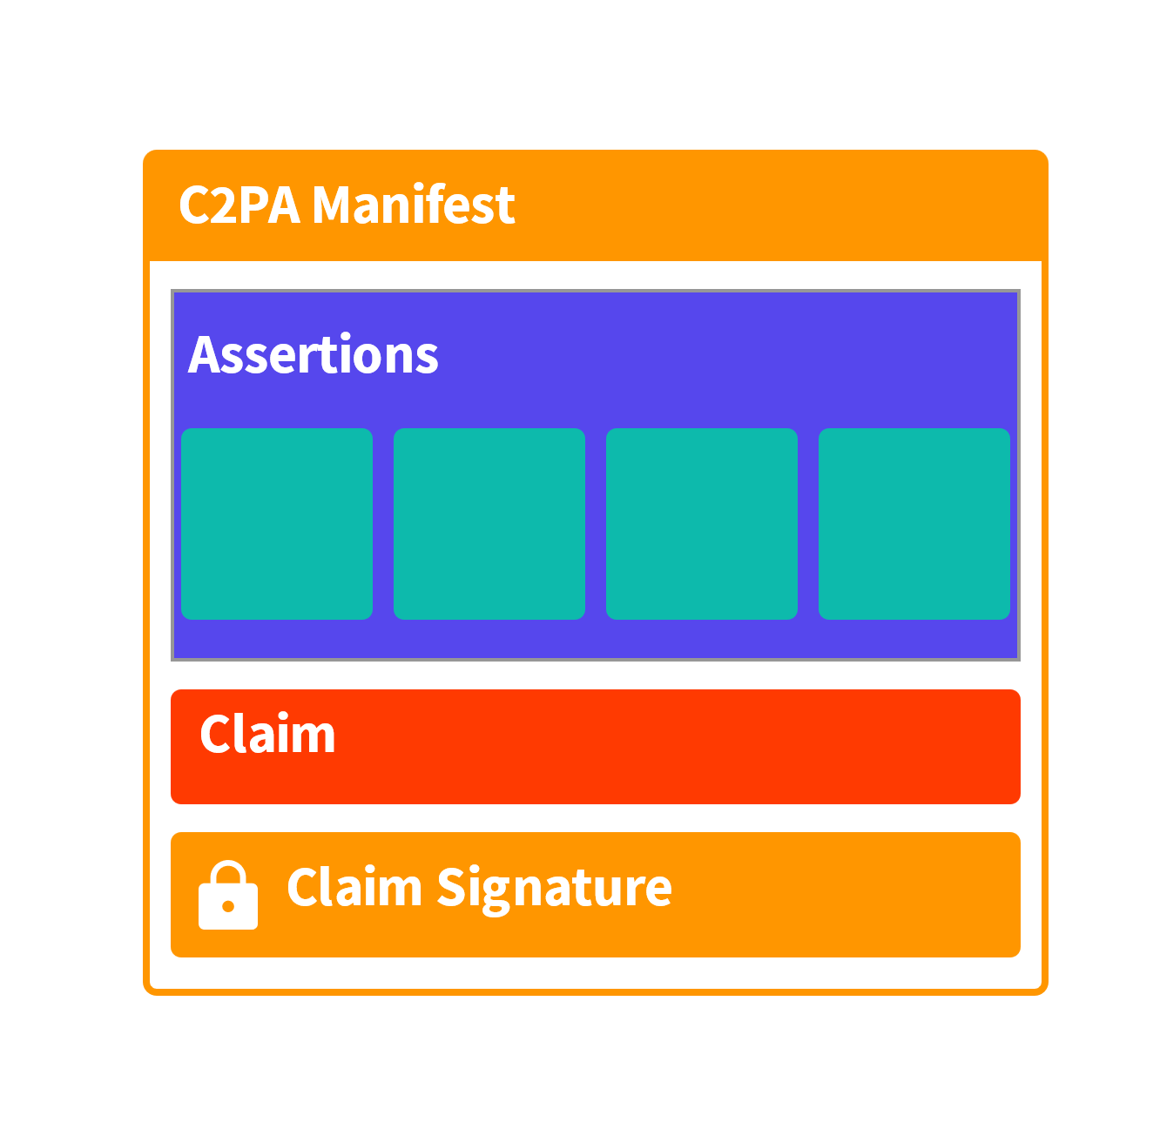






What are Statements?
SBOMs about binaries
Test results
Compliance to certifications
Security Scans
VEX Reports
Contracts about a deal
C2PA Manifests about digital media
Responsible AI Claims
Model Cards
SCITT
Identity
Subject: synsation-corp-net-monitor-v1
Statement
Artifact
Notes:
A Statement is simply information about the Artifact, including a Software Bill of Materials, [CLICK]
A statement for how your Machine Learning Model was trained, whether the product meets some compliance requirement, a contract, [CLICK]
or a C2PA Manifest, assuring the metadata can’t be stripped from the media.
A statement references the Artifact by setting a subject property, providing a feed of signed statements about the Artifact.

Slide 5
What is an Artifact?
Anything that needs a verifiable statement
Binary data (software, docker containers)
AI Models
vCons
Digital media (pictures, videos, contracts)
Physical goods (parts, nuclear waste)
Subject is the Artifact Identifier
SCITT
Identity
synsation-corp/net-monitor/v1
The format of Subject is not part of the SCITT Architecture. Likely industry specific, and poised for other IETF drafts
Statement
Artifact
CWT_Claims
issuer : tstr,
subject : tstr,
* : int => any
Notes:
A Statement is simply information about the Artifact, including a Software Bill of Materials, [CLICK]
A statement for how your Machine Learning Model was trained, whether the product meets some compliance requirement, a contract, [CLICK]
or a C2PA Manifest, assuring the metadata can’t be stripped from the media.
A statement references the Artifact by setting a subject property, providing a feed of signed statements about the Artifact.

Slide 6

To Be Signed Bytes
Issuer
COSE_SIGN1 (Envelope)
Statement
Artifact
protected : bstr .cbor Protected_Header
provenance.json
payload : bstr
Protected_Header
&(CWT_Claims : 15) => CWT_Claims
application/json
? &(content_type: 3) => tstr / uint
CWT_Claims
? &(alg : 1) => int
issuer : tstr,
? &(kid : 4) => bstr
synsation.io
synsation.io/product/v123
subject : tstr,
? &(x5t : 34) => COSE_CertHash
* : int => any
* int => any
Notes:
Lets look what goes into a SCITT Statement:
The issuer represents the identity making the statement about the artifact.
[CLICK]A set of CWT_Claims capture the issuer and the subject identifier of the artifact
[CLICK] A protected header captures the CWT_Claims, as the only required property
[CLICK] An unprotected header captures additional information, including receipts from previously registered signed statements
[CLICK] An envelope captures all the elements, including the statement, as the payload. However, the statement can be a detached payload, as a verifiable data structure for content stored in another location.
[CLICK] The Protected and Unprotected header are added to the envelope.
The envelope is now complete, and ready to be submitted to a SCITT Transparency Service, such as DataTrails

Slide 7

Signed Bytes
Issuer
COSE_SIGN1 (Envelope)
Statement
Artifact
COSE_SIGN1 (Envelope)
protected : bstr .cbor Protected_Header
provenance.json
protected : bstr .cbor Protected_Header
protected : bstr .cbor Protected_Header
payload : bstr
payload : bstr
payload : bstr
Notes:
Lets look what goes into a SCITT Statement:
The issuer represents the identity making the statement about the artifact.
[CLICK]A set of CWT_Claims capture the issuer and the subject identifier of the artifact
[CLICK] A protected header captures the CWT_Claims, as the only required property
[CLICK] An unprotected header captures additional information, including receipts from previously registered signed statements
[CLICK] An envelope captures all the elements, including the statement, as the payload. However, the statement can be a detached payload, as a verifiable data structure for content stored in another location.
[CLICK] The Protected and Unprotected header are added to the envelope.
The envelope is now complete, and ready to be submitted to a SCITT Transparency Service, such as DataTrails

Slide 8

SCITT Statement
Issuer
COSE_SIGN1 (Envelope)
Statement
Artifact
protected : bstr .cbor Protected_Header
payload : bstr
signature : bstr
unprotected : Unprotected_Header
Unprotected_Header
* int => any
Notes:
Lets look what goes into a SCITT Statement:
The issuer represents the identity making the statement about the artifact.
[CLICK]A set of CWT_Claims capture the issuer and the subject identifier of the artifact
[CLICK] A protected header captures the CWT_Claims, as the only required property
[CLICK] An unprotected header captures additional information, including receipts from previously registered signed statements
[CLICK] An envelope captures all the elements, including the statement, as the payload. However, the statement can be a detached payload, as a verifiable data structure for content stored in another location.
[CLICK] The Protected and Unprotected header are added to the envelope.
The envelope is now complete, and ready to be submitted to a SCITT Transparency Service, such as DataTrails

Slide 9




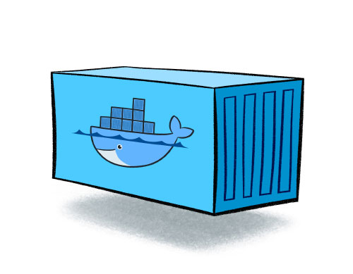





Registering
COSE_SIGN1 (Envelope)
protected : bstr .cbor Protected_Header
Transparency Service
payload : bstr
SCITT Ledger
Append-only Log
signature : bstr
unprotected : Unprotected_Header
How large is the COSE_Sign1 Envelope?
Protected Header ~1k
Unprotected Header 0
Signature ~1k
Payload ^{(Statement)} 1k-50gb
2k
~50.002gb
Is Size the constraint
Is the Statement already stored somewhere else?
Do we need to continually pass content for verification?
What value are we getting by storing the statement in the payload of the Signed Statement
External Storage
Notes:
Lets look what goes into a SCITT Statement:
The issuer represents the identity making the statement about the artifact.
[CLICK]A set of CWT_Claims capture the issuer and the subject identifier of the artifact
[CLICK] A protected header captures the CWT_Claims, as the only required property
[CLICK] An unprotected header captures additional information, including receipts from previously registered signed statements
[CLICK] An envelope captures all the elements, including the statement, as the payload. However, the statement can be a detached payload, as a verifiable data structure for content stored in another location.
[CLICK] The Protected and Unprotected header are added to the envelope.
The envelope is now complete, and ready to be submitted to a SCITT Transparency Service, such as DataTrails

Slide 10



Detached Payloads
COSE_SIGN1 (Envelope)
COSE_SIGN1 (Envelope)
protected : bstr .cbor Protected_Header
protected : bstr .cbor Protected_Header
Transparency Service
payload : bstr / nil
SCITT Ledger
Append-only Log
payload : bstr / nil
payload : bstr
signature : bstr
signature : bstr
unprotected : Unprotected_Header
unprotected : Unprotected_Header
Notary
COSE_SIGN1 (Envelope)
Verify
protected : bstr .cbor Protected_Header
payload : bstr / nil
signature : bstr
unprotected : Unprotected_Header
IF
External Storage
Unprotected_Header
? &statement_location => tstr "https://sbom.sh/retrieve/45c86..."
* int => any

Slide 11








Content of a SCITT Statement What is the size and makeup of the statement
Persistence Where is the Signed Statement, Metadata and Payload persisted
Inline content (binary)
Transparency Service
SCITT Ledger
Verifiable Data Structure
Small File
Define Small
COSE_SIGN1 (Envelope)
Large file
Define Large
MetaData
Indexable Structures (json)
protected : bstr .cbor Protected_Header
Collections of files large and/or small Likely packaged in another file (zip/tar) or referenced by a manifest
payload : bstr / nil
signature : bstr
unprotected : Unprotected_Header
Blob Storage
Raw Data
File by Reference: URI to the location: docker image, npm package, vcon, youtube video
Manifest: Collections of files, each referenced by a unique id (eg: docker image, npm package, vcon, youtube video)
External Storage

Slide 12

Content of a SCITT Statement What is the size and makeup of the statement
SCITT Envelope Payload Types How is the Statement represented within the Signed Statement
Persistence Where is the Signed Statement, Metadata and Payload persisted
Inline content (binary)
Transparency Service
Inline:
payload: <statement>
content-type: Type of the payload (application/json, application/bin, )
SCITT Ledger
Verifiable Data Structure
Small File
Large file
Hash:
payload: Hash of the content, minimizing the signed-statement size
content-type: Type of the hashed content (application/json, application/bin, )
detached-hash-algorityhm: sha-256 | SHA3-512
payload-location: added to resolve a possible location for the statement (payload)
MetaData
Indexable Structures (json)
Collections of files large and/or small Likely packaged in another file (zip/tar) or referenced by a manifest
Blob Storage
Raw Data
File by Reference: URI to the location: docker image, npm package, vcon, youtube video
Detached Payload:
payload: nil
content-type: the type of the detached content (application/json, application/bin, )
payload-location: added to resolve a possible location for the statement (payload)
Manifest: Collections of files, each referenced by a unique id (eg: docker image, npm package, vcon, youtube video)
External Storage
Legend
Most relevant
Possible
Least relevant
Least likely

Slide 13
Content of a SCITT Statement What is the size and makeup of the statement
SCITT Envelope Payload Types How is the Statement represented within the Signed Statement
Persistence Where is the Signed Statement, Metadata and Payload persisted
Inline content (binary)
Transparency Service
Inline:
payload: <statement>
content-type: Type of the payload (application/json, application/bin, )
SCITT Ledger
Verifiable Data Structure
Small File
Hash:
payload: Hash of the content, minimizing the signed-statement size
content-type: Type of the hashed content (application/json, application/bin, )
payload-hash-algorithm: sha-256 | SHA3-512
payload-location: added to resolve a possible location for the statement (payload)
Large file
MetaData
Indexable Structures (json)
Collections of files large and/or small Likely packaged in another file (zip/tar) or referenced by a manifest
Blob Storage
Raw Data
File by Reference: URI to the location: docker image, npm package, vcon, youtube video
Signed Statement Payload consistent across services
Never wonder what size constraint will fail
Builds upon existing storage services
Transparency Services can provide storage services, they just fill the payload-location with their storage url
Manifest: Collections of files, each referenced by a unique id (eg: docker image, npm package, vcon, youtube video)
External Storage
Legend
Most relevant
Possible
Least relevant
Least likely

Slide 14
SCITT Statement
Issuer
Envelope : COSE_SIGN1
Statement
Artifact
18( / COSE Sign 1 /
[
h'a4012603...6d706c65', / Protected /
h’ea478a4g…..a20abe28’, / Payload (hash) /
h'79ada558...3a28bae4’, / Signature /
h’a023b128…..210gbaeh’ / Unprotected /
)
hash
Protected_Header
{ / Protected /
1: -7, / Algorithm /
3: application/vcon+json, / Content type /
4: h'50685f55...50523255', / Key identifier /
-42, / payload-hash-algorithm /
15: { / CWT Claims /
1: software.vendor.example, / Issuer /
2: vendor.product.example, / Subject /
}
}
Unprotected_Header
{ / Unprotected /
?: vcon.service/2a0baefa…afaf2f9, / Statement Location /
}
Notes:
Lets look what goes into a SCITT Statement:
The issuer represents the identity making the statement about the artifact.
[CLICK]A set of CWT_Claims capture the issuer and the subject identifier of the artifact
[CLICK] A protected header captures the CWT_Claims, as the only required property
[CLICK] An unprotected header captures additional information, including receipts from previously registered signed statements
[CLICK] An envelope captures all the elements, including the statement, as the payload. However, the statement can be a detached payload, as a verifiable data structure for content stored in another location.
[CLICK] The Protected and Unprotected header are added to the envelope.
The envelope is now complete, and ready to be submitted to a SCITT Transparency Service, such as DataTrails

Slide 15
SCITT – COSE
Managing SCITT Statements as COSE Payloads
Hashed Payloads

