Slide 1



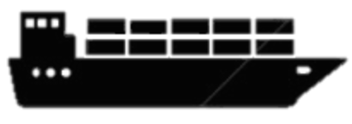

species | w_{industry} | w_{extinction}
sp₁ | # | #
sp₂ | # | #
sp₃ | # | #
1a. species: env + obs ➔ density
2. cumulative species risk
3. route by tradeoff
industry
species
1b. industry
Notes:
DF: Siting – “Decision Mapping”
DF: Routing – “Conservation Routing”
SDM: Boat + plane surveys – “Mixed Platform”
SDM: Expert range + presence pts – “Probabilistic Range Maps”
SDM: cloud cover ➔ gap fill – “Gap Filling”
Skipping:
Predicting Seasonal Migration
Original: ~/Documents/Meetings/2015-05-21 Dissertation MGEL Feedback/2015-05-21_dissertation-bbest_MGEL.pptx

