Slide 1
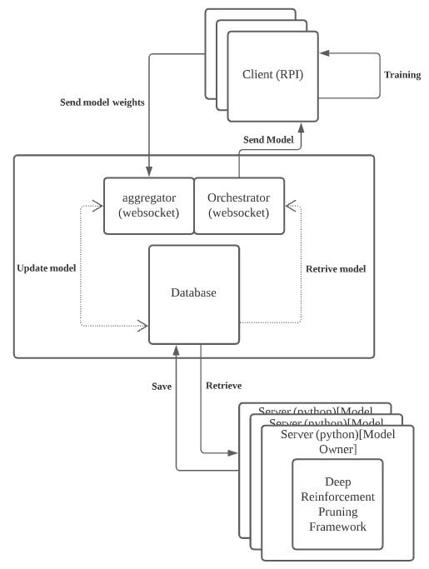
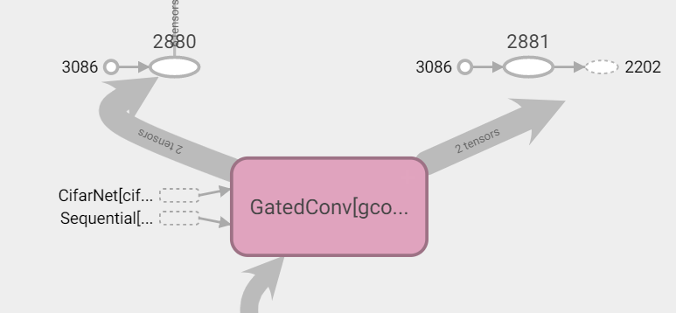
Federated Learning Study
Student: Aloysius Chan Zhen Wu Supervisor: Dr Jun Zhao
Project Objectives:
This Final Year project aims to create a federated learning framework to show the contrast between federated learning training and conventional model training. The results should show the difference in terms of training accuracy and training time. Additionally, state-of-the-art model pruning methodology is also applied on top of this framework for additional experimentation. To achieve model pruning, we will tap on a previous research methodology created that outperforms conventional pruning methods.
Federated Learning Framework
Deep Reinforcement Learning (DRL) pruning :
DRL pruning is used on top of the federated learning framework to perform model pruning. This methodology consist of both static and runtime pruning. Pruning is achieved by wrapping each layer with a gating module and training the runtime and static actor-critic agents on the desired sparsity ratio.
Gating module
www.scse.ntu.edu.sg

