Slide 1

Klf6 ROLe IN Beta-Cell Insulin Resistance-Induced Dedifferentiation
Angela Chan
Notes:
https://www.ncbi.nlm.nih.gov/geo/query/acc.cgi?acc=GSE137187
Article:
https://www.ncbi.nlm.nih.gov/pmc/articles/PMC7093812/

Slide 2
Introduction
Beta cells in the pancreatic islet of Langerhans are considered glucose sensors, adjusting the level of insulin based on the blood glucose level
Klf6(Kruppel-like factor 6) is known to control the expression of beta cells
Loss off B-cell function is due to insulin resistance associated with it’s cellular regression of function
Mechanisms relating to Beta cell dedifferentiation are not fully understood
Notes:
Transport of control islet to diabetic mice led to loss of Glu2 expression and GSIS but transport of diabetic islet led to restoration of both Glut2 and GSIS
Loss of beta cell function also based on genetic architecture

Slide 3
Background
In Type 2 diabetes, insulin resistance increases pancreatic beta-cell insulin secretion capacity and number of beta-cells
Utilize a mouse model with Klf6 KO to see if there is a relation between regulation of Beta cell adaptation with and without insulin resistance.
S961, a insulin receptor antagonist was used to downregulate insulin receptor expression
Mouse were fed on a high fat fructose high sucrose diet during different periods and a transcriptome analysis was done along with RNA-seq
Notes:
IS Klf6 responsible for protecting Betal cell from dedifferentiation?

Slide 4
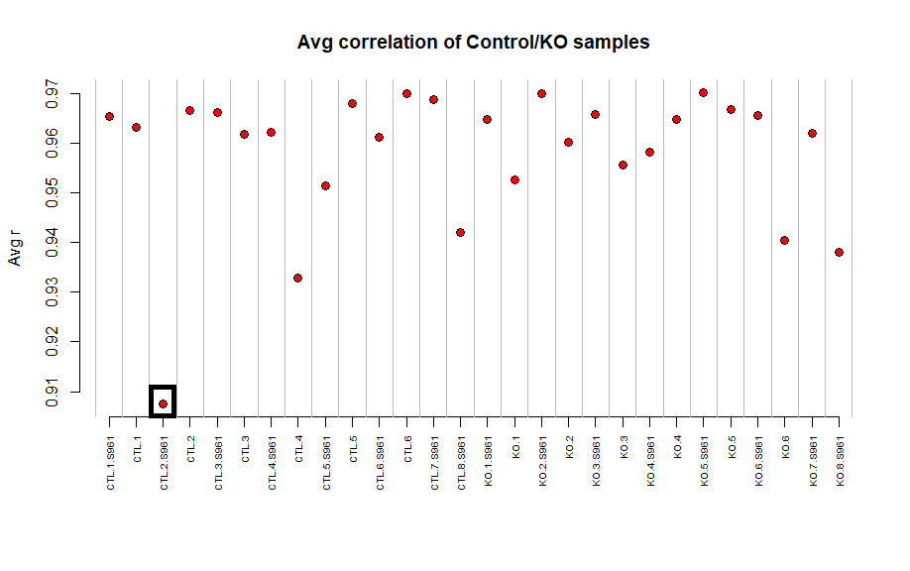
Data: Finding the outlier
CTL.2.S964 seems to be an outlier

Slide 5
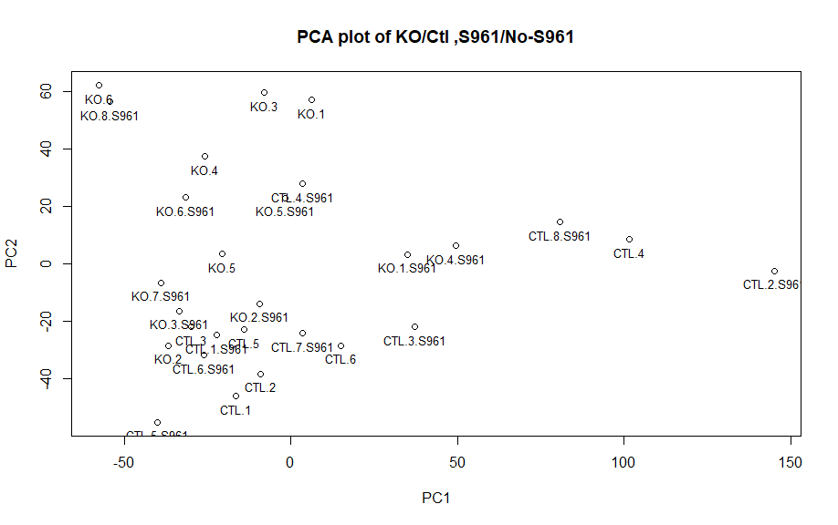
Data: Confirmation
Same results as the correlation plot

Slide 6
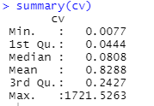
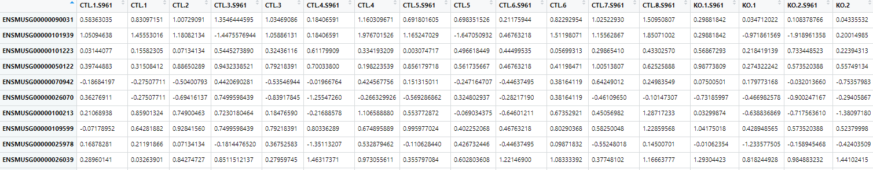
Data: Filtering Genes
Filtered through coefficient of variation; values below 0.82 were taken out.
This leaves us from 14219 observations to
1653.

Slide 7
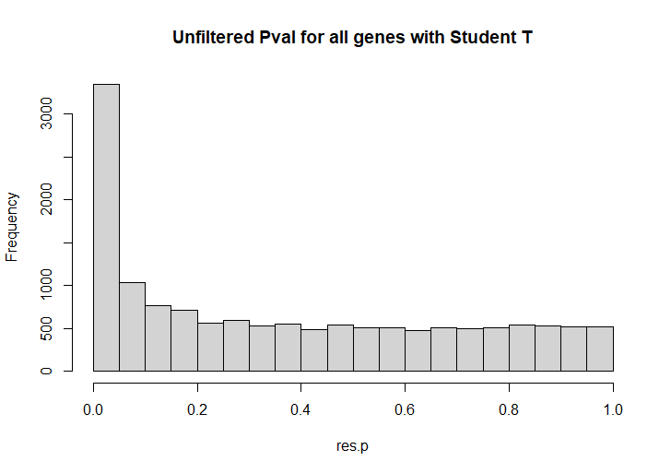
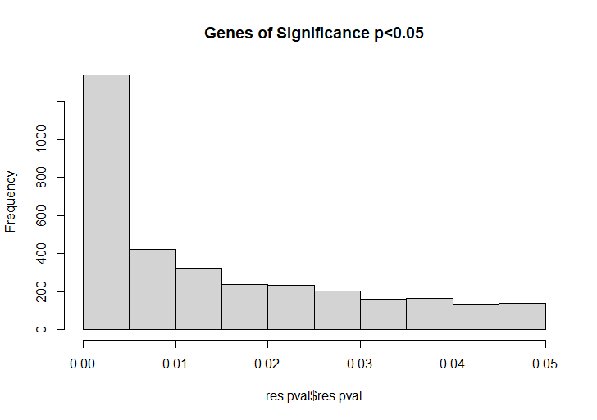
Data: Is there a significance?
Notes:
Student t-test unpaired - 684

Slide 8
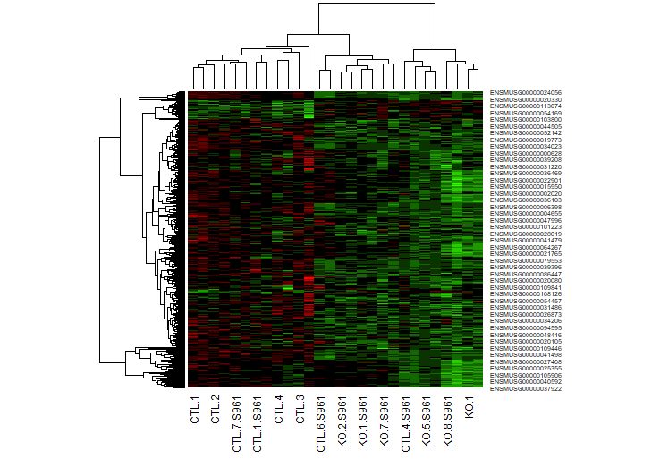
Heat map

Slide 9
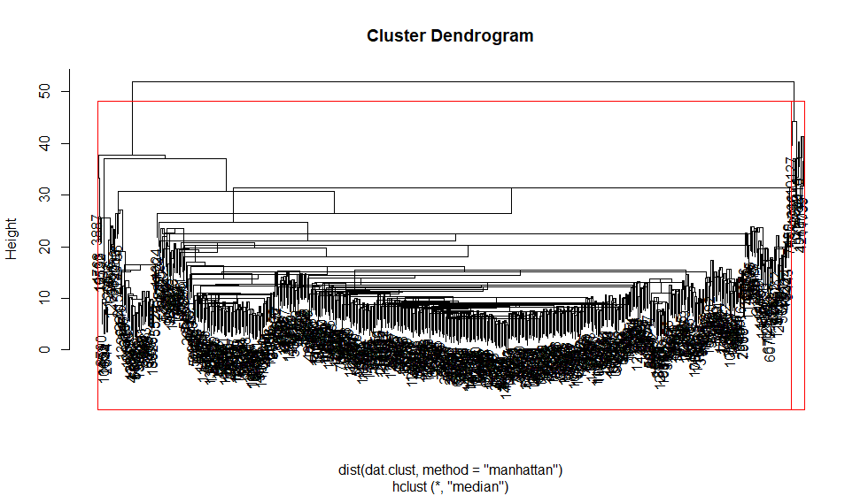
Dendrogram
Notes:
Too many genes present to see the dendrogram fully . Should use kmeans .

Slide 10
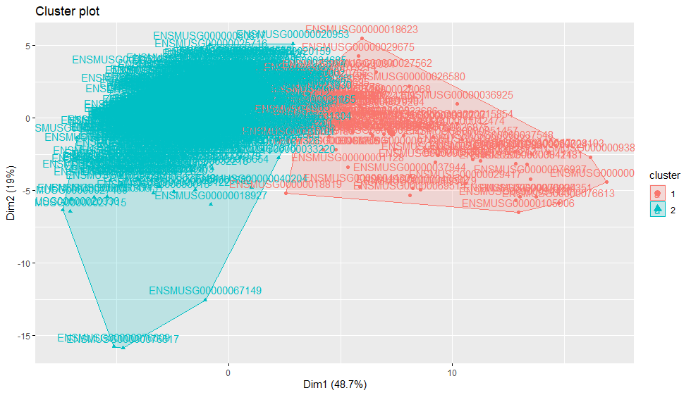
K-means
Notes:
Tried using facto extra

Slide 11
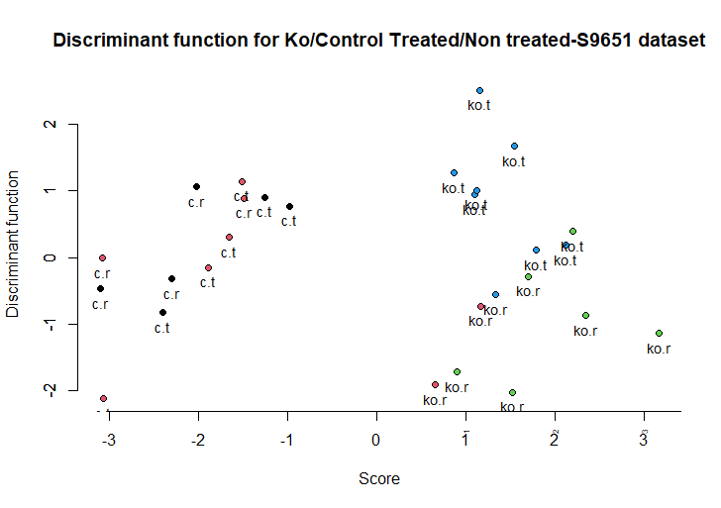

Discriminant analysis
c.r = untreated control
c.t = S961 treated control
ko.r = untreated Klf6 knockout
ko.t = S961 treated Klf6 knockout

Slide 12
Conclusion:
The knockout of Klf6 does have an effect on certain gene expression/functions. We can assume that Klf6 is necessary to help maintain the maturation of Beta cells and prevent dedifferentiation especially with S961 treatment.
There is a down regulation foxo1, slc2a2, Syt14, Igf1r , Atp2a2. Some of these genes are linked to beta cell survival and maintenance of beta cells.
There is an upregulation in Vim, oat, gast, Slc18a2, Igfbp4.

Slide 13
References
DAVID. Retrieved from https://david.ncifcrf.gov/home.jsp
Dumayne C, Tarussio D, Sanchez-Archidona AR, et al. Klf6 protects β-cells against insulin resistance-induced dedifferentiation. Mol Metab. 2020;35:100958. doi:10.1016/j.molmet.2020.02.001
Galili Tal .(2020) Hierarchical cluster analysis on famous data sets- enhanced with dendextend package. Retrieved from https://cran.r-project.org/web/packages/dendextend/vignettes/Cluster_Analysis.html.

Slide 14
Code:
#Load Data
setwd("D:\\JHU courses\\Gene Visiualization\\Final Project")
data <- read.table(file = "GSE137187_Count_normalized_matrix.txt" ,header =T, row.names = 1)
dat <- data[,2:29]
#link gene symbol to Ensembl_ID
symbol <- data[,1]
symbol <- as.data.frame(symbol)
symbol$ens <- rownames(dat)
#Find outliers
#cv mean
dat.pcat <- prcomp(t(dat))
plot(dat.pcat$x, main = "PCA plot of KO/Ctl ,S961/No-S961")
text(dat.pcat$x, label = dimnames(dat)[[2]],pos = 1, cex=0.8)
#Avg Corr of samples ; all samples
dat.cor <- cor(dat)
dat.avg <- apply(dat.cor,1,mean)
par(oma=c(3,0.1,0.1,0.1))
plot(c(1,length(dat.avg)),range(dat.avg),type="n",xlab="",ylab="Avg r",main="Avg correlation of Control/KO samples",axes=F)
points(dat.avg,bg="red",col=1,pch=21,cex=1.25)
axis(1,at=c(1:length(dat.avg)),labels=dimnames(dat)[[2]],las=2,cex.lab=0.4,cex.axis=0.6)
axis(2)
abline(v=seq(0.5,62.5,1),col="grey")

Slide 15
Code:
#filtering out genes
dat.rmeans <- apply(dat,1, mean)
dat.rmeans <- as.data.frame(dat.rmeans)
dat.sd <- apply(dat,1, sd)
dat.sd <-as.data.frame(dat.sd)
#cv = std/mean
cv = dat.sd/dat.rmeans
colnames(cv) <- "cv"
plot(1:nrow(cv),cv$cv)
cv = abs(cv)
new.cv <- subset(cv, cv > 0.82 )
#removing the genes based on average cv
n <- match(rownames(new.cv), symbol$ens )
dat.sub <- dat[n,]

Slide 16
Code:
#T-test
t.test.all.genes <-function(x, s1,s2){
x1 <- as.numeric(x[s1])
x2 <- as.numeric(x[s2])
res <- t.test(x1,x2, paired = FALSE)
value <- as.numeric(res$p.value)
scores <- as.numeric(res$score)
#return(res)
return (value)
}
res <- apply(dat.sub,1, t.test.all.genes, s1= c(1:14) , s2 = c(15:28))
res.p <- apply(dat.sub,1, t.test.all.genes, s1= c(1:14) , s2 = c(15:28))
#subsetting pvals less than 0.05
res.pval <- subset(res.p, res.p <0.05)
res.pval <- as.data.frame(res.pval)
#genes of significance
#matching rownames to columnnames
res.name <- rownames(res.pval)
index <- match(res.name, symbol$ens)
p.sym <- symbol[index,]

Slide 17
Code:
dat.clust <- filt.dat
filt.dat
#red = upreg green= downreg
hm.rg <- c("#FF0000","#CC0000","#990000","#660000","#330000","#000000","#000000","#0A3300","#146600","#1F9900","#29CC00","#33FF00")
names(dat.clust) <- ann
heatmap(as.matrix(dat.clust),col=hm.rg)
dat.hca <- hclust(dist(dat.clust, method = "manhattan"), method = "median")
plot(dat.hca)
library(MASS)
names(dat)
clas <- names(dat)
clas[grep("CTL.\\d.S961",clas)] <- rep("c.t",length(clas[grep("CTL.\\d.S961",clas)]))
clas[grep("CTL.\\d",clas)] <- rep("c.r",length(clas[grep("CTL.\\d",clas)]))
clas[grep("KO.\\d.S961",clas)] <- rep("ko.t",length(clas[grep("KO.\\d.S961",clas)]))
clas[grep("KO.\\d",clas)] <- rep("ko.r",length(clas[grep("KO.\\d",clas)]))
datx <- as.data.frame(t(dat))
datx <- data.frame(clas,datx)
dat.lda <- lda(clas~.,datx)
dat.pred <- predict(dat.lda,filt.dat)
plot(dat.pred$x,bg=as.numeric(factor(clas)),pch=21,col=1,ylab="Discriminant function",axes=F,xlab="Score",main="Discriminant function for Ko/Control Treated/Non treated-S9651 dataset")
axis(1)
axis(2)
text(dat.pred$x , label = dat.pred$class, pos = 1, cex = 0.9)
table(dat.pred$class, clas)

Slide 18
Code:
#kmeans with factoextra
install.packages('factoextra’)
Library(factoextra)
dat <- na.omit(dat)
dat <- scale(dat)
distance <- get_dist(dat)
k2 <- kmeans(dat, centers = 2, nstart = 25)
str(k2)
fviz_cluster(k2 , data= dat)
k2$centers

