Slide 1
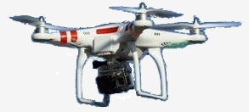
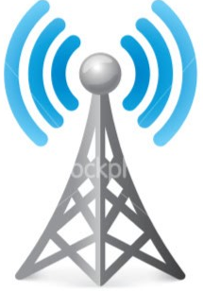

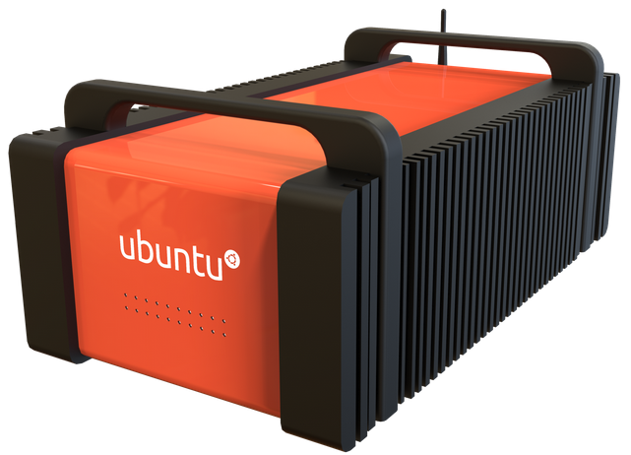
4G LTE
Drone Swarm
4G LTE
4G LTE
Fiber
Link
4G LTE
Fiber
Link
Mission
Personnel
Fiber
Link
Cloudlet
Cell
Tower

