Slide 1

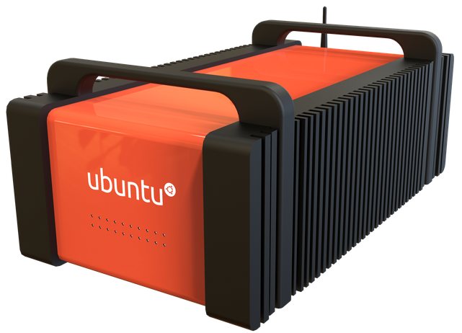

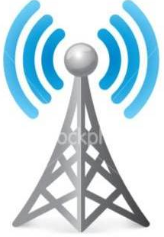
Cloudet
Samsung
Galaxy 4
Parrot
ANAFI
WiFi
Unix Time
Watch + Drone
LTE
LAN
Cell
Tower

