Slide 1
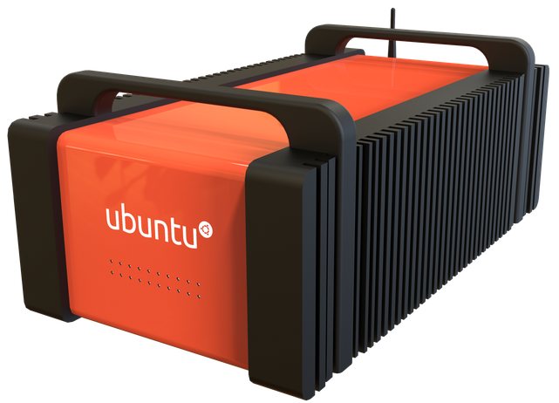

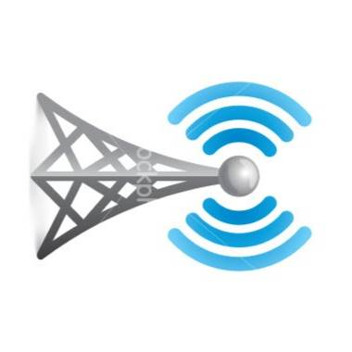

ES
LAN
Unix
Time
Cell
Tower
LTE
Samsung
Galaxy 4
WiFi
Drone + Watch
Parrot
ANAFI

