Slide 1
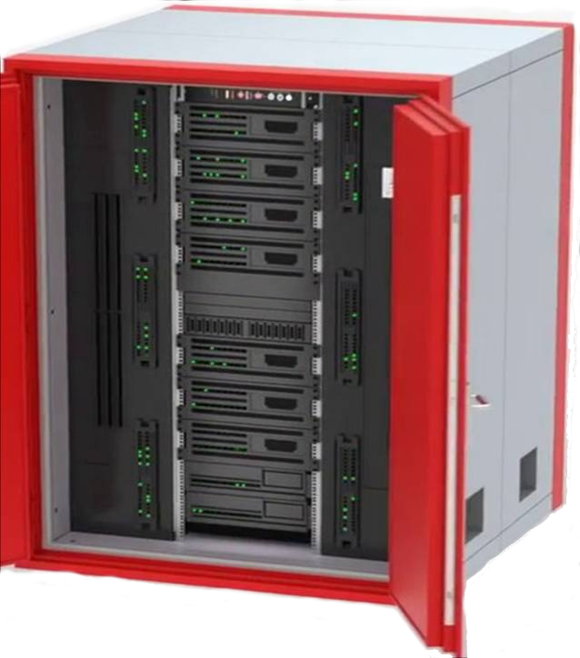
FreeZone-1
Live Pomme Session
Cloudlet-1
I
n
t
e
r
n
e
t
FreeZone-2
Master
Cloudlet
Cloudlet-2
Knowledge
Graph
FreeZone-N
Cloudlet-N

