Slide 1
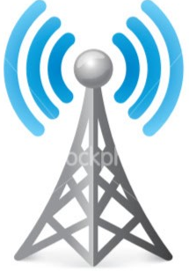
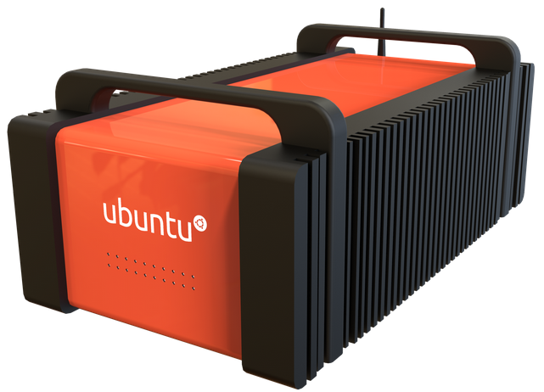
Parrot
ANAFI
Samsung
Galaxy 4
WiFi
Drone + Watch
LTE
Cloudlet
LAN
Cell
Tower

