Slide 1

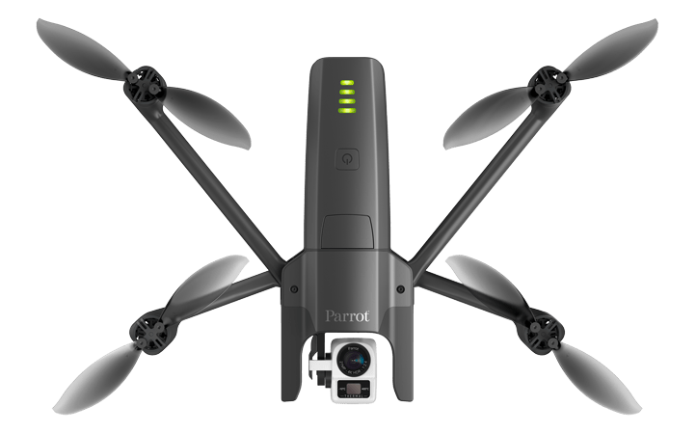
Format of AVFrame n
AVFrame n Slice
AVFrame n + 1 Slice
Watch
AVFrame n + 2 Slice
RTSP Stream
from WiFi
Hotspot
FFmpeg
WiFi
AVCodec
LTE
AVFrame n
(multiple
UDP
Packets)
ES
Decoded
Frames
Drone

