Slide 1
Mobile Apps in Azure App Service
Global Azure Bootcamp 2018

Slide 2




Thanks to our sponsors!

Slide 3
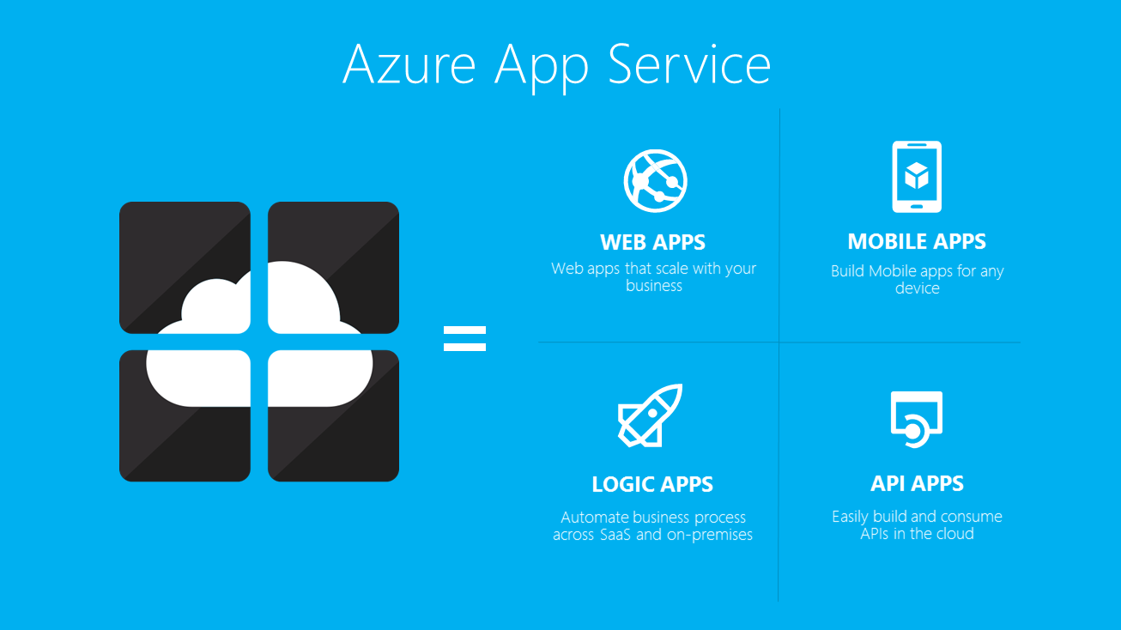
Azure App Service
Full PaaS supports existing or new websites and apps
Quickly build and deploy enterprise-grade apps
Azure framework provides performance and scalability
Web apps
Mobile apps
API apps
Logic apps
Function Apps
Notes:
Like many other Azure products, App Service is a fully functional Platform-As-A-Service. App Service can be used to migrate existing website or applications, such as an ASP.NET web app, or you can leverage App Service to build new apps from scratch. App Service leverages all the capabilities of the Azure framework to provide a quick and easy way to build, deploy, and scale enterprise-grade applications.

Slide 4
Mobile Apps in Azure App Service
Mobile Apps is now a part of Azure App Service
Formerly Azure Mobile Service
Supports migration from Mobile Service
Native apps
Android
iOS
Windows
Cross-platform apps
Cordova
Xamarin
Notes:
Azure combined its support for Mobile Apps inside of Azure App Service. Mobile Apps can be used to develop native apps for the 3 major mobile platforms. It can also be used to develop cross-platform apps. Cordova, sometimes referred to as PhoneGap, offers a hybrid mobile framework based on web technologies. Xamarin, which was recently acquired by Microsoft, may be a better alternative for those well versed in .NET.

Slide 5
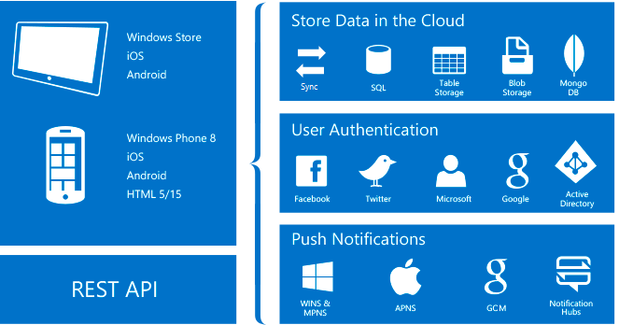
Mobile Apps Features
Authentication and Authorization
OAuth for providers, including Microsoft, Facebook, and Google
Data access
Integrate with Azure SQL Database or on-premise SQL
Support for NoSQL, such as MongoDB
Offline sync
Client SDKs enable easy sync with offline dataset
Push notifications
Azure Notification Hubs integrates for push
notifications on any platform
Client SDKs
Complete set of SDKs for all platforms
Notes:
Mobile Apps for Azure App Service provides key features that make building and deploying mobile apps easier. These features can save developers a lot of time versus building them out from scratch. For example, Azure provides out-of-the-box support for Authentication and Authorization that can be integrated with little code. A lot of options are available for connecting your app to data. Offline support using sync tables can be implemented. Azure Notification Hubs can be used to distribute notifications for all platforms.

Slide 6
Azure App Service Features
Mobile Apps can also leverage other App Service Features
Autoscaling
Supports autoscaling based on load or schedule
Staging environments
Can run multiple versions for testing, staging, etc…
Continuous deployment
Integrate with source control systems for easy deployment
Virtual Networking
Connect to on-premise networks
Notes:
Of course, Mobile Apps can also incorporate all of the other great App Service features. Manually configure and scale as needed, or you use the convenient autoscaling features.

