Slide 1
Network Science
Student: Alice Chang

Slide 2
Agenda
Use case
Dataset
Problems Define
Graph Data Model
Cypher queries
Algorithms application
Cypher actions
Visualization

Slide 3
Use Case
A high school’s chancellor would like to know the population about the students with their different social groups. Additionally, the chancellor wants to improve the student’s performance on exams in order to make the school better.

Slide 4
Dataset
Student Performance In Exams, which includes
Past performance in three subjects, math, reading, and writing
Student’s status about the test preparation course and lunch
Social groups, gender, race, parental level of education

Slide 5
Problems Define
How do these factors affect student’s performance?
Parental level of education
Gender
How effective is the test preparation course?

Slide 6
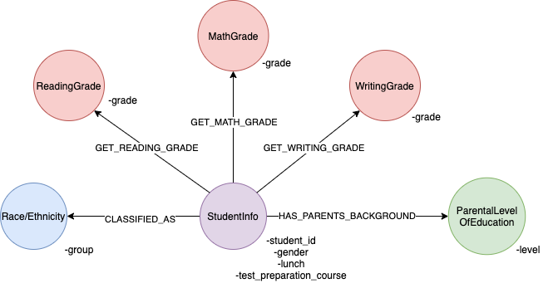
Graph Data Model

Slide 7
Cypher Queries
Overall looks for students who has at least one good grade, which is A or B, in all three subjects
MATCH (s:StudentInfo)
WITH s
MATCH (s)-[:GET_MATH_GRADE]->(m:MathGrade)
MATCH (s)-[:GET_READING_GRADE]->(read:ReadingGrade)
MATCH (s)-[:GET_WRITING_GRADE]->(w:WritingGrade)
MATCH (s)-[:CLASSIFIED_AS]->(race:Race)
MATCH (s)-[:HAS_PARENTS_BACKGROUND]->(p:ParentalLevelOfEducation)
WHERE (m.grade = 'A' or m.grade = 'B') OR (read.grade = 'A' or read.grade = 'B') OR (w.grade = 'A' or w.grade = 'B')
RETURN m.grade AS good_math_grade, read.grade AS good_read_grade, w.grade AS good_writing_grade, s.lunch AS lunch_status, s.test_preparation_course AS test_preparation_course, s.gender AS gender, race.group AS race, p.level AS parental_level_of_edu

Slide 8
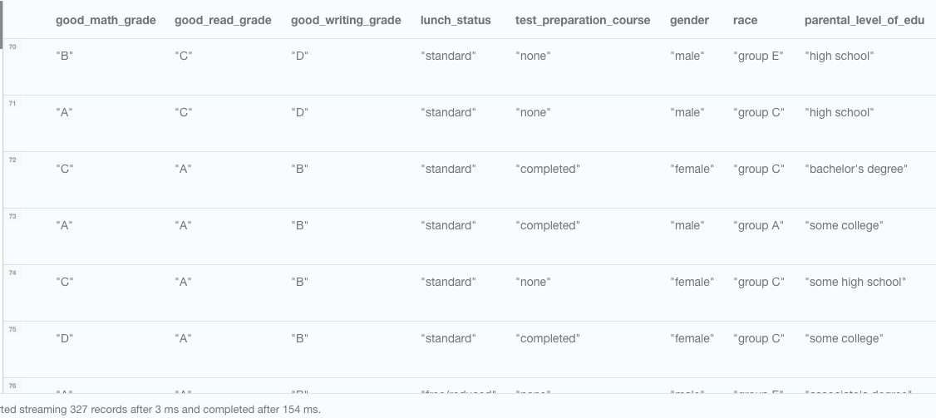
Result table

Slide 9
Cypher Queries
Count how many students who get at least one good grade with ‘standard’ lunch status
MATCH (s:StudentInfo)
WITH s
MATCH (s)-[:GET_MATH_GRADE]->(m:MathGrade)
MATCH (s)-[:GET_READING_GRADE]->(read:ReadingGrade)
MATCH (s)-[:GET_WRITING_GRADE]->(w:WritingGrade)
WHERE (m.grade = 'A' or m.grade = 'B' OR read.grade = 'A' or read.grade = 'B' OR w.grade = 'A' or w.grade = 'B') AND (s.lunch = 'standard')
RETURN count(s.lunch) AS count_lunch_standard_goodgrade

Slide 10
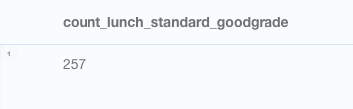
Result table
257/327 students with standard lunch status

Slide 11
Cypher Queries
Count how many students whose parent’s have higher education and get at least one good grade in the exams
MATCH (s:StudentInfo)
WITH s
MATCH (s)-[:GET_MATH_GRADE]->(m:MathGrade)
MATCH (s)-[:GET_READING_GRADE]->(read:ReadingGrade)
MATCH (s)-[:GET_WRITING_GRADE]->(w:WritingGrade)
MATCH (s)-[:HAS_PARENTS_BACKGROUND]->(p:ParentalLevelOfEducation)
WHERE (m.grade = 'A' or m.grade = 'B' OR read.grade = 'A' or read.grade = 'B' OR w.grade = 'A' or w.grade = 'B') AND (p.level = "master's degree" or p.level = "bachelor's degree")
RETURN count(p.level) AS count_higheredu_goodgrade

Slide 12
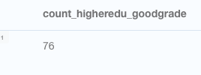
Result table
76/327 students’ parents have higher education

Slide 13
Algorithms
Create a projection of the students who shared same reading and writing grade
CALL gds.graph.create.cypher( 'readwrite’, 'MATCH (s1:StudentInfo) RETURN id(s1) AS id’, 'MATCH (s1:StudentInfo)-[:GET_READING_GRADE | :GET_WRITING_GRADE]->(read_write)<-[:GET_READING_GRADE | :GET_WRITING_GRADE]-(s2:StudentInfo) RETURN id(s1) AS source, id(s2) AS target’ )

Slide 14
Algorithm - Louvain
CALL gds.louvain.stream('readwrite’)
YIELD nodeId, communityId AS community
RETURN community, collect(gds.util.asNode(nodeId).student_id) AS student
ORDER BY size(student) DESC

Slide 15
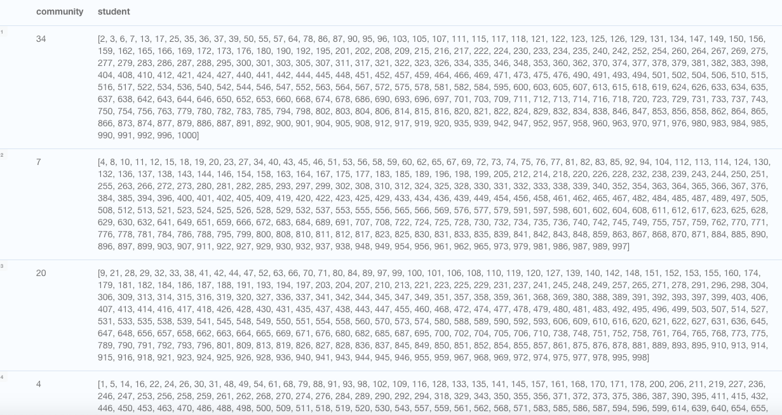
Result table

Slide 16
Algorithm – Label Propagation
CALL gds.labelPropagation.stream('readwrite’)
YIELD nodeId, communityId AS Community
RETURN Community, collect(gds.util.asNode(nodeId).student_id) AS student
ORDER BY size(student) DESC

Slide 17
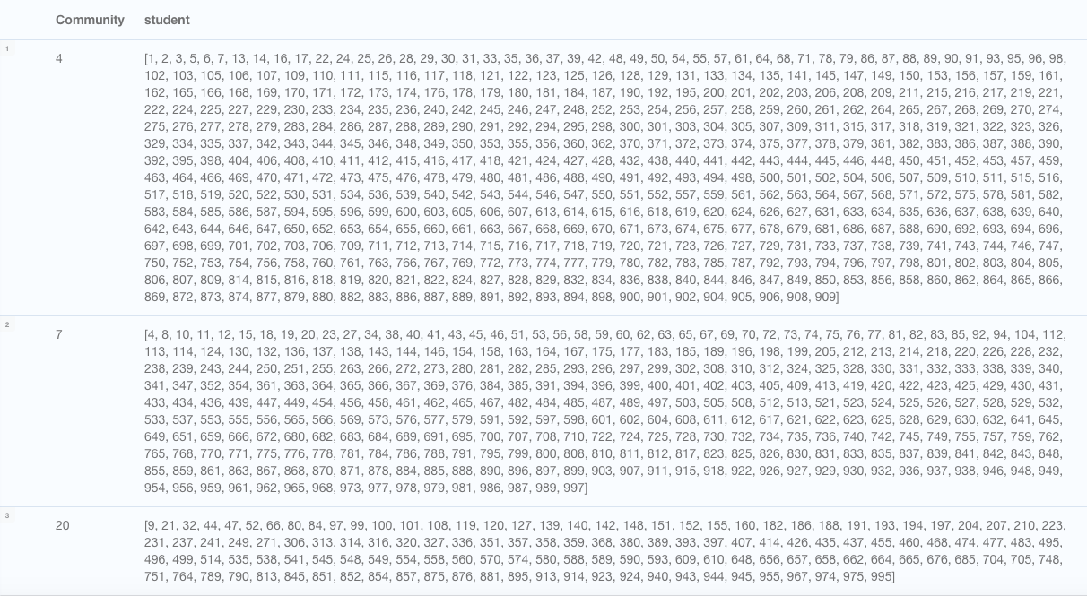
Result table

Slide 18
Cypher Action
Find the student's information by id $student_id
Code:
MATCH (s:StudentInfo{student_id:$student_id})
WITH s
MATCH (s)-[r1: GET_MATH_GRADE]-(m:MathGrade)
MATCH (s)-[r2:GET_READING_GRADE]-(read:ReadingGrade)
MATCH (s)-[r3:GET_WRITING_GRADE]-(w:WritingGrade)
MATCH (s)-[r4:HAS_PARENTS_BACKGROUND]-(p:ParentalLevelOfEducation)
MATCH (s)-[r5:CLASSIFIED_AS]-(race:Race)
RETURN s,m,r1,r2,r3,r4,r5,read,w,p,race

Slide 19
Visualizations
Students who share the same reading grade and writing grade
Students who got all A or all F in three exams

Slide 20
Data Source
Dataset, Student Performance in Exams, https://www.kaggle.com/spscientist/students-performance-in-exams

Slide 21
Q&A

