Slide 1
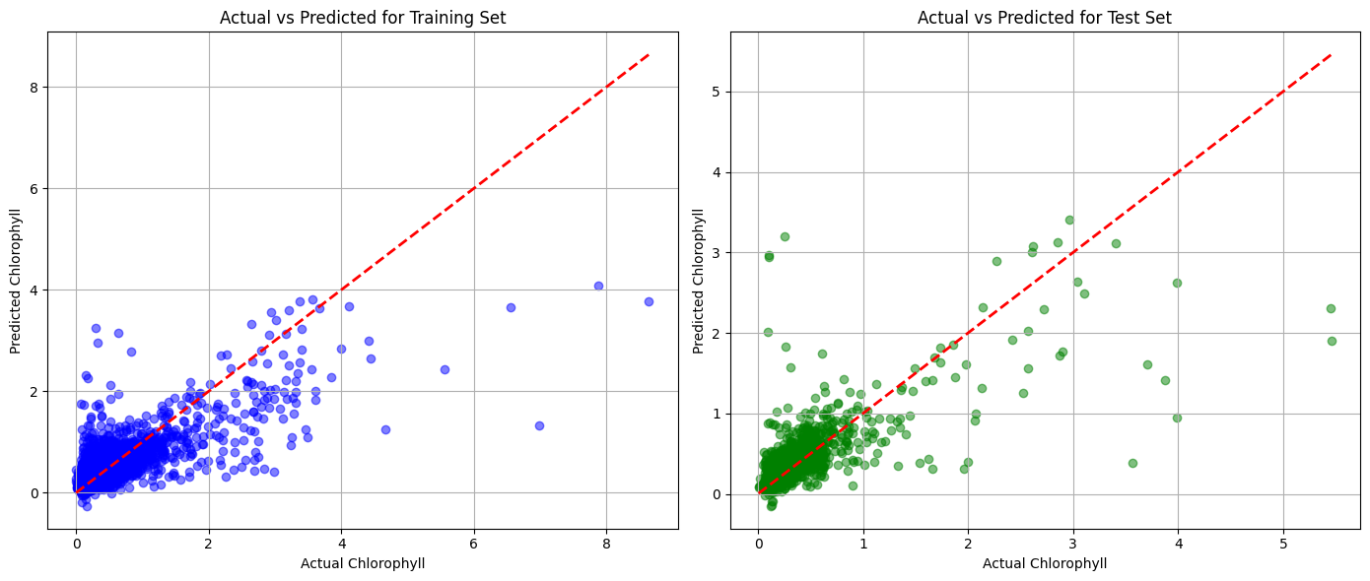
隨機10000筆(0.1%)
MLP best parameters: {'activation': 'relu', 'alpha': 0.0001, 'hidden_layer_sizes': (100,), 'learning_rate_init': 0.1}
Train MAE: 0.11658213167445135
Test MAE: 0.11645429222203847
Train RMSE: 0.25570366880140766
Test RMSE: 0.2744619051569593
Train R2: 0.6362279257787806
Test R2: 0.5622501877909951

Slide 2
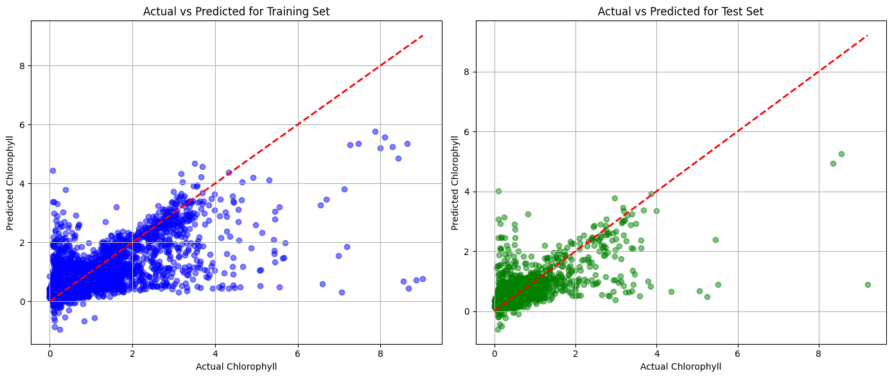
隨機50000筆(0.5%)
MLP best parameters: {'activation': 'relu', 'alpha': 0.0001, 'hidden_layer_sizes': (100,), 'learning_rate_init': 0.1}
Train MAE: 0.1291176388117873
Test MAE: 0.13066090134105612
Train RMSE: 0.2744843571109329
Test RMSE: 0.27701123112997195
Train R2: 0.6016574417545544
Test R2: 0.5316554985508608

Slide 3
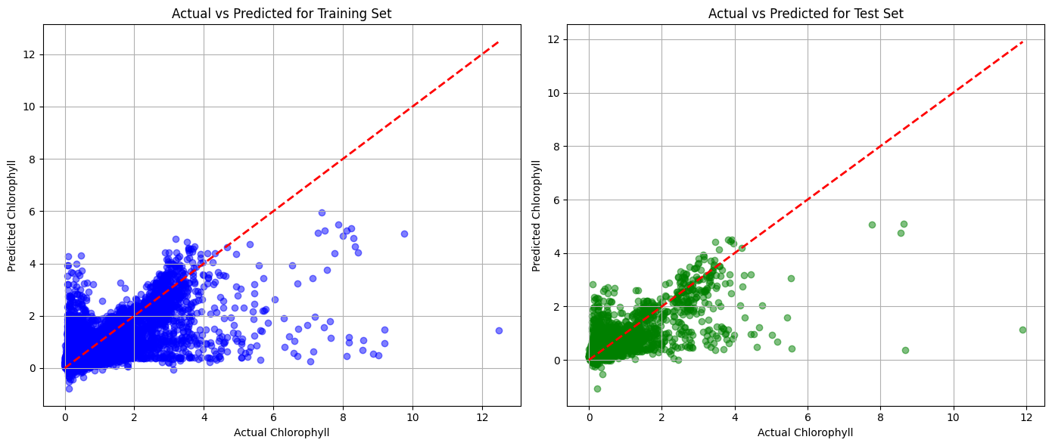
隨機100000筆(1%)
MLP best parameters: {'activation': 'relu', 'alpha': 0.0001, 'hidden_layer_sizes': (100,), 'learning_rate_init': 0.1}
Train MAE: 0.11046505943856089
Test MAE: 0.10924175508131317
Train RMSE: 0.2795218883622827
Test RMSE: 0.2647365526673298
Train R2: 0.5764589146032069
Test R2: 0.6082220493829436

Slide 4
隨機100000筆(1%)
MLP best parameters: {'activation': 'relu', 'alpha': 0.0001, 'hidden_layer_sizes': (100,), 'learning_rate_init': 0.1}
Train MAE: 0.11046505943856089
Test MAE: 0.10924175508131317
Train RMSE: 0.2795218883622827
Test RMSE: 0.2647365526673298
Train R2: 0.5764589146032069
Test R2: 0.6082220493829436

Slide 5
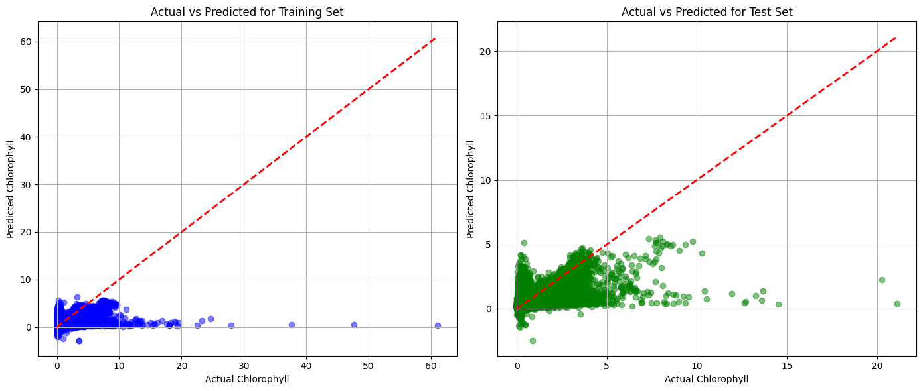
隨機1000000筆(10%)
MLP best parameters: {'activation': 'relu', 'alpha': 0.0001, 'hidden_layer_sizes': (100,), 'learning_rate_init': 0.1}
Train MAE: 0.10917394402577983
Test MAE: 0.10950206925373204
Train RMSE: 0.30180645732185557
Test RMSE: 0.2835361398197471
Train R2: 0.5424893384768417
Test R2: 0.5763236785335777

Slide 6
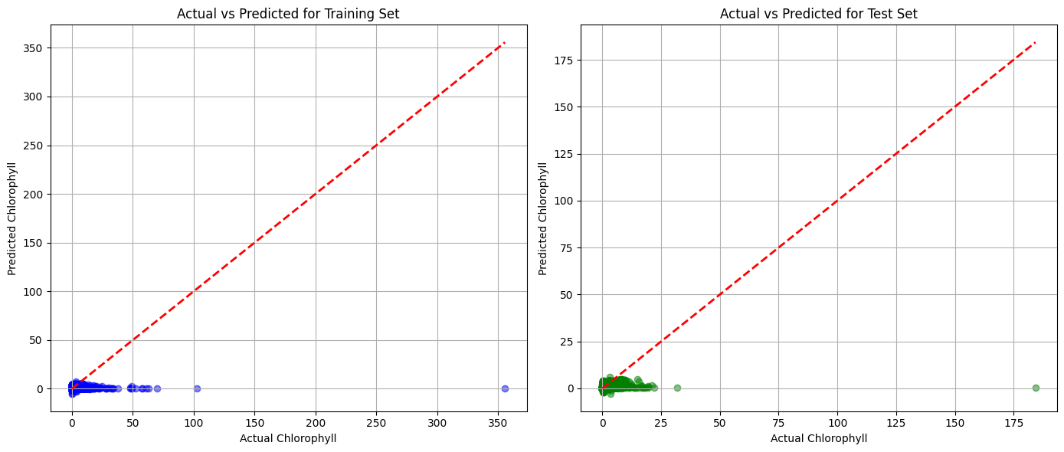
隨機2500000筆(25%)
MLP best parameters: {'activation': 'relu', 'alpha': 0.001, 'hidden_layer_sizes': (100,), 'learning_rate_init': 0.01}
Train MAE: 0.10481935825047542
Test MAE: 0.10475442623668413
Train RMSE: 0.41065950504942983
Test RMSE: 0.3879501673970677
Train R2: 0.3957435231180443
Test R2: 0.4248436821829563

