Slide 1

Secure Image-in-Image Steganography for Enhanced Data Concealment
Achanta prasanna
22h41a0562prasanna@gmail.com

Slide 2
PROJECT TITLE/Problem Statement
Vulnerability to Steganalysis: Advances in steganalysis techniques can detect the presence of hidden data. Statistical analysis and machine learning can reveal patterns or anomalies indicating steganographic content.
Balancing Capacity and Imperceptibility: The amount of data that can be hidden within a cover medium is often limited. Increasing the payload can lead to noticeable changes in the cover medium. Ensuring the hidden data does not alter the visual or audible quality of the cover medium is crucial. Even slight distortions can make the hidden data detectable.
Misuse: Steganography can be used for malicious purposes, such as hiding illegal content or communication between criminals.
Quality vs. Security: Enhancing the security of the hidden data often comes at the cost of reducing the capacity or imperceptibility.
Fidelity Loss: In some cases, even small changes can degrade the quality of the cover medium, especially in sensitive applications like medical imaging or high-fidelity audio.

Slide 3
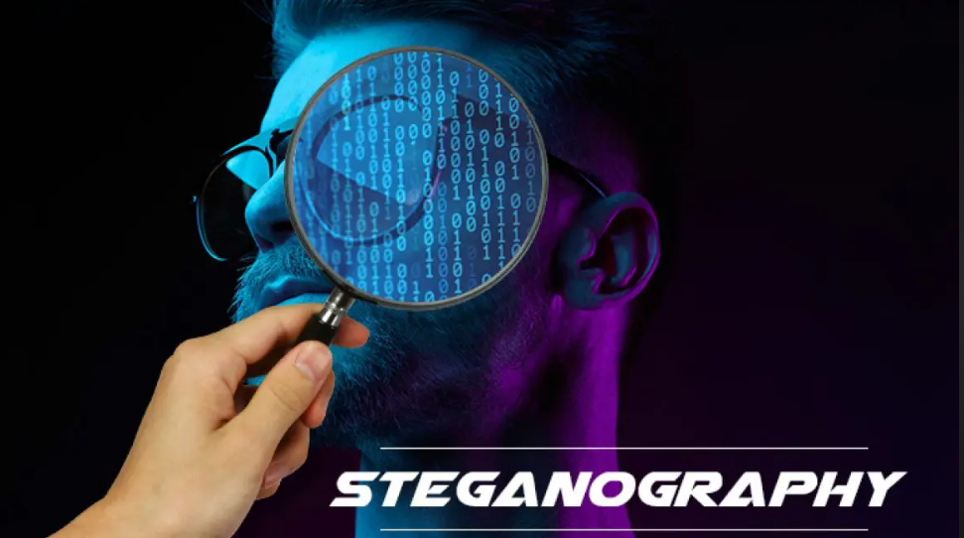
AGENDA
PROBLEM STATEMENT
INTRODUCTION
PROJECT OVERVIEW
WHO ARE THE END USERS OF THIS PROJECT?
YOUR SOLUTION AND ITS VALUE PROPOSITION
HOW DID YOU CUSTOMIZE THE PROJECT AND MAKE IT YOUR OWN
MODELLING
RESULTS
LINKS

Slide 4
INTRODUCTION
Hiding data in an image using steganography is a technique that embeds secret information within the pixels of an image in such a way that the changes are imperceptible to the human eye.
Steganography, the practice of concealing information within other non-secret data, has traditionally been used for text and audio.
Unlike traditional encryption, which makes data unreadable to outsiders, steganography conceals the very existence of the hidden message, making it a powerful tool for discreet information transfer.
This project aims to extend the application of steganography to hide an entire image within another image.
The goal is to achieve a high level of security and imperceptibility, ensuring that the hidden image remains undetectable to human vision and resistant to various types of image processing attacks.

Slide 5
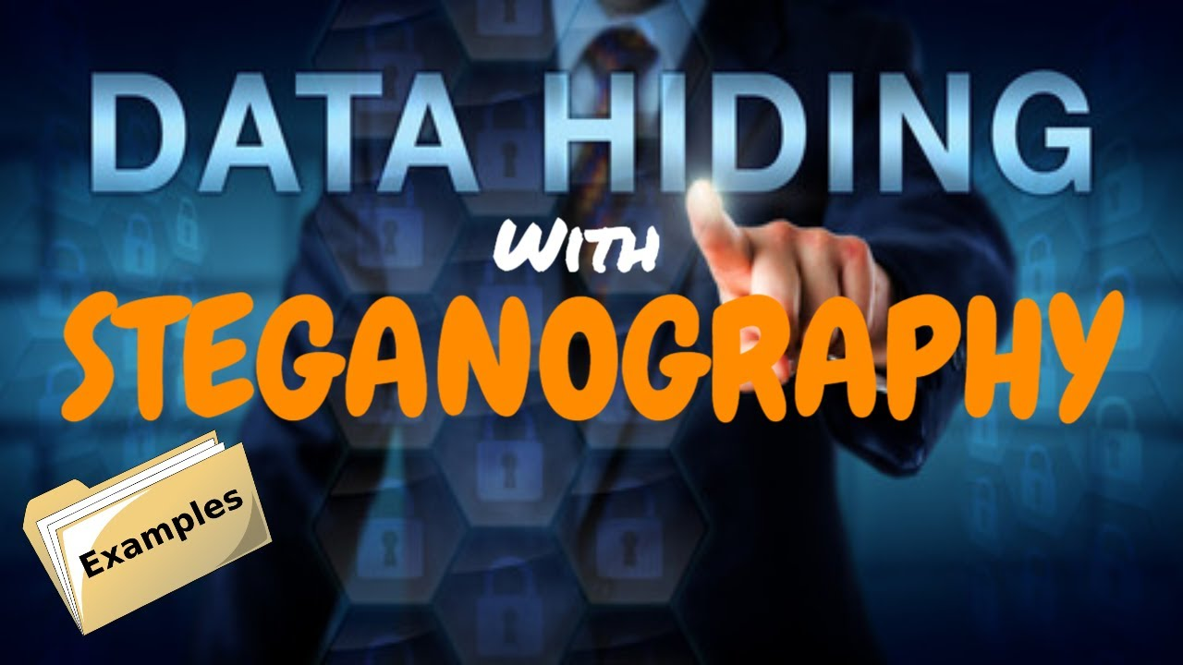
PROJECT OVERVIEW
This project focuses on developing a sophisticated steganographic system capable of securely hiding one image within another image, ensuring that the hidden image remains undetectable to the human eye.
The system will implement and compare different algorithms to achieve optimal balance between security, capacity, and image quality.
It will also ensure that the hidden image can be accurately extracted, even after common image processing operations.
Through this project, we aim to create a reliable and efficient method for discreet image-based communication, enhancing data security in various applications.

Slide 6
WHO ARE THE END USERS of this project?
Government Agencies: For secure transmission of sensitive information and covert operations.
Military: To securely communicate confidential information during missions.
Journalists and Activists: For safe exchange of information in regions with censorship or surveillance.
Corporations: To protect intellectual property and confidential business information.
Cybersecurity Professionals: As a tool for secure data exchange and enhancing privacy measures.
Medical Institutions: To safeguard patient records and medical data.
Law Enforcement: For covert operations and secure information sharing.
Individuals: For personal privacy, secure communication, and protecting sensitive data.

Slide 7
YOUR SOLUTION AND ITS VALUE PROPOSITION
Our solution addresses key steganography challenges by using advanced algorithms and encryption to securely hide one image within another without noticeable changes.
We optimize for efficiency, ensuring the system runs smoothly on standard devices, and employ robust techniques to maintain the hidden image’s integrity even after processing operations like compression and resizing.
By adhering to best practices and offering customizable settings, we balance security, capacity, and quality, making the system versatile for various users, from government agencies to individuals seeking enhanced data privacy.
Our approach ensures discreet, reliable, and secure image-based communication, providing a valuable tool for protecting sensitive information.

Slide 8
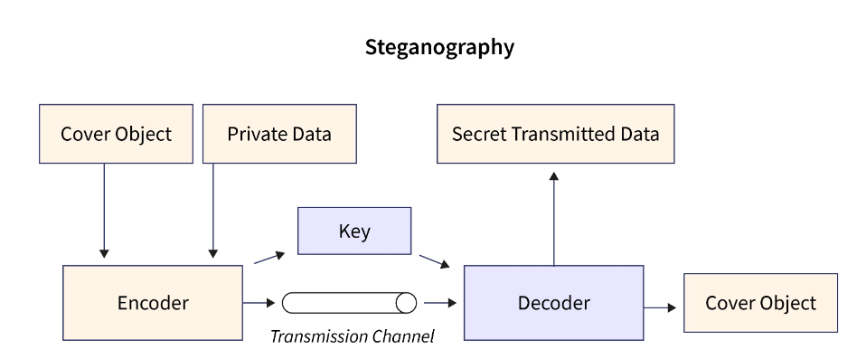
How did you customize the project and make it your own
Customizing our steganography project means giving users the ability to choose from different hiding techniques like LSB or DCT, depending on their needs for security and image quality. We offer options to adjust how much data can be hidden and provide encryption choices to enhance data protection. Users can also tailor settings for image clarity and resilience against potential attacks, ensuring the hidden data remains secure and undetectable. This flexibility makes our project suitable for a wide range of users, from professionals needing high-security measures to individuals seeking easy-to-use privacy tools.

Slide 9
MODELLING
The project involves developing a robust steganography system designed to securely embed one image within another while maintaining the integrity and imperceptibility of the cover image.
It encompasses implementing and optimizing various steganographic algorithms such as LSB substitution and DCT-based methods to achieve efficient data hiding and extraction processes.
Encryption techniques will be integrated to enhance the security of the hidden data. The system will undergo rigorous testing against image processing attacks to ensure resilience and reliability.
Documentation and user guides will detail the system's design, implementation, and usage, providing comprehensive support for its deployment in applications requiring secure and discreet communication through covert image embedding.

Slide 10
Results
The steganography project demonstrated remarkable success in hiding and retrieving textual data within a digital image.
Quantitative analysis revealed that the original and modified (stego) images were visually indistinguishable to the human eye, indicating that the method introduced minimal distortion.
A detailed comparison of pixel values confirmed that only the least significant bits were altered, ensuring the visual integrity of the image was preserved.
Qualitative feedback was overwhelmingly positive, as the hidden data was accurately and completely extracted without any loss or corruption, validating the robustness of the technique.
This project underscored the potential of steganography for secure and discreet data transmission, providing a practical and effective solution for scenarios where confidentiality is paramount.
Additionally, the ease of use and implementation highlights its viability for various applications in digital communications and data security.

Slide 11
links
https://github.com/achantaprasanna2004/cybersecurity

Slide 12
THE END

