Slide 1

Multi-data fusion with transformer
Leichao Cui
2022/5/18

Slide 2
Outline
Background
Related Existing Works
Proposed Methodology
Main Results
Experimental Results
Conclusion and Future Work

Slide 3
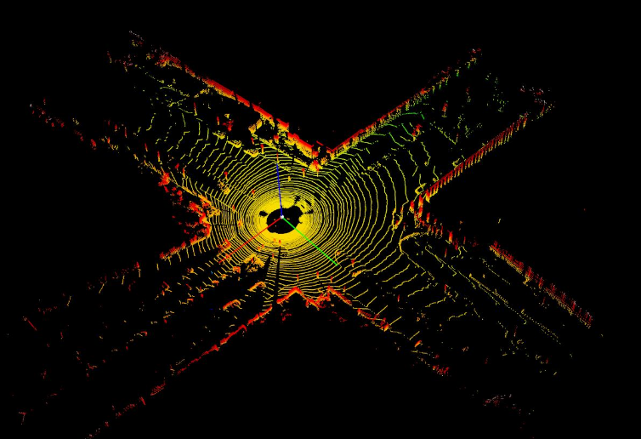
Background
3D object detection
Autonomous driving and domestic robots
The detection of 3D objects with point clouds
The irregular data format
Large search space of 6 Degrees-of-Freedom (DoF) of 3D object

Slide 4
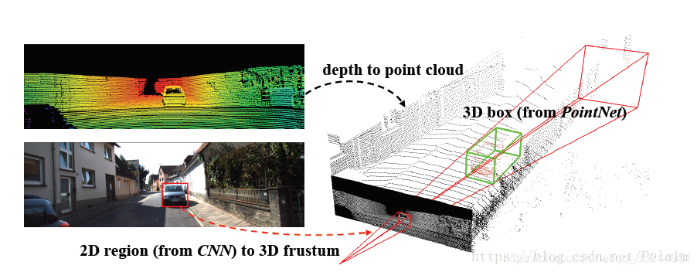
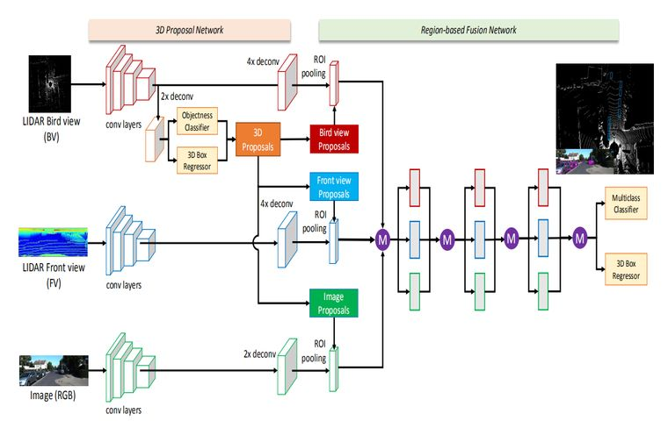
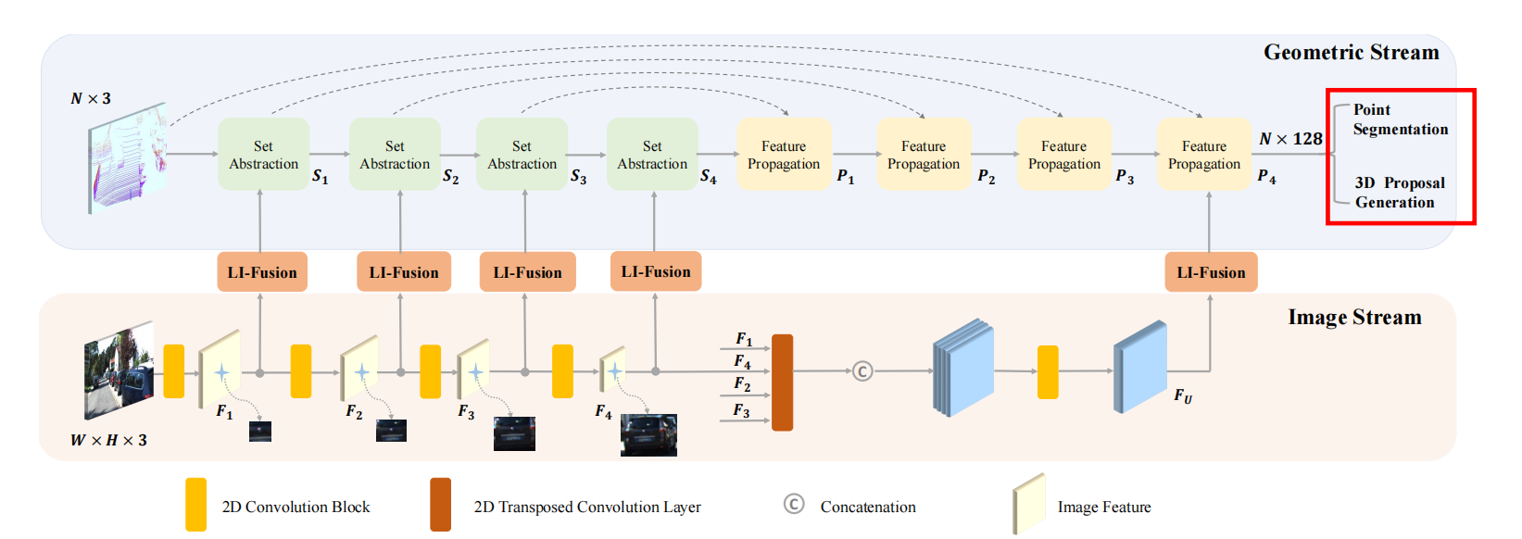
Related Existing Works
LiDAR-camera fusion methods
result-level^{[1]}
use off-the-shelf 2D detectors to seed 3D proposals, followed by a PointNet for object localization.
proposal-level^{[2]}
perform fusion at the region proposal level by applying RoIPool [31]
in each modality for shared proposals.
point-level fusion^{[3]}
first find a hard association between LiDAR points and image pixels
based on calibration matrices,
and then augment LiDAR features with the segmentation scores or CNN features
of the associated pixels through point-wise concatenation.
[1]C. Qi, W. Liu, Chenxia Wu, Hao Su, and L. Guibas. Frustum pointnets for 3d object detection from rgb-d data. CVPR, 2018.
[2]Xiaozhi Chen, Huimin Ma, Jixiang Wan, B. Li, and Tian Xia. Multi-view 3d object detection network for autonomous driving. CVPR, 2017.
[3]Tengteng Huang, Zhe Liu, Xiwu Chen, and X. Bai. EPNet: Enhancing point features with image semantics for 3d object detection. ECCV, 2020.

Slide 5
Related Existing Works
produce the proposals from a kind of data and utilize the multi-data features to refine proposals
extract features efficiently
fuse the multi-data features according to the coordinate projection
the correspondence between different features

Slide 6
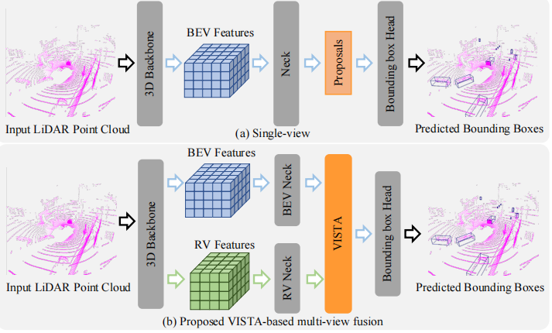
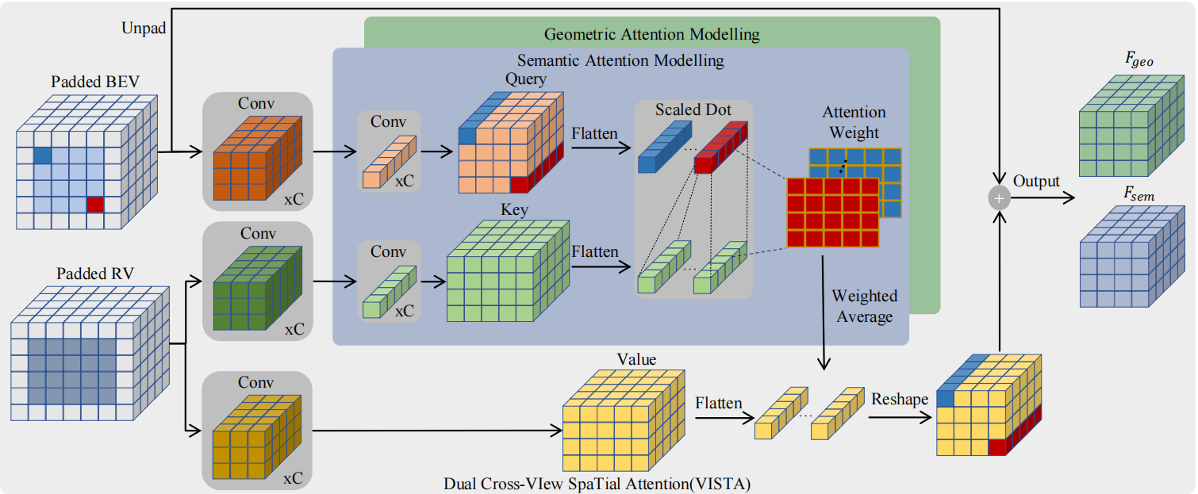
Proposed Methodology
1.multi-view fusion

Slide 7
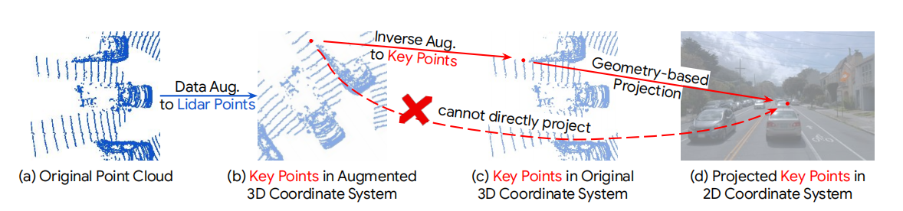
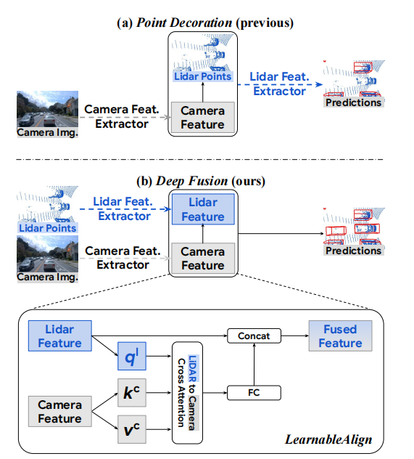
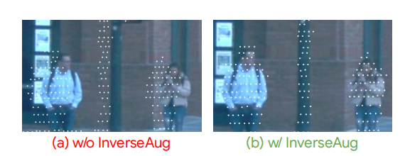
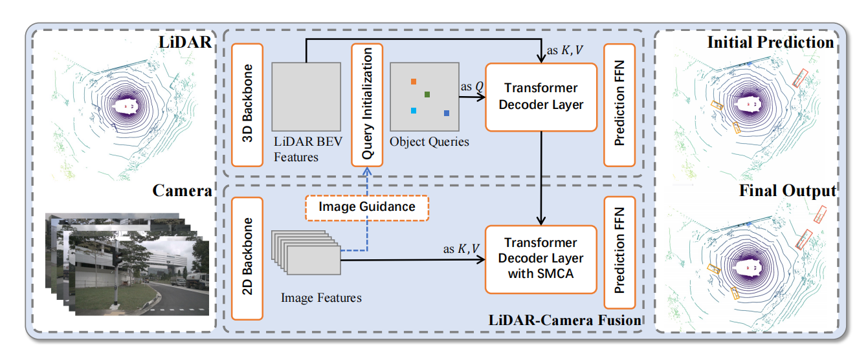
Proposed Methodology
2.multi-data fusion

Slide 8
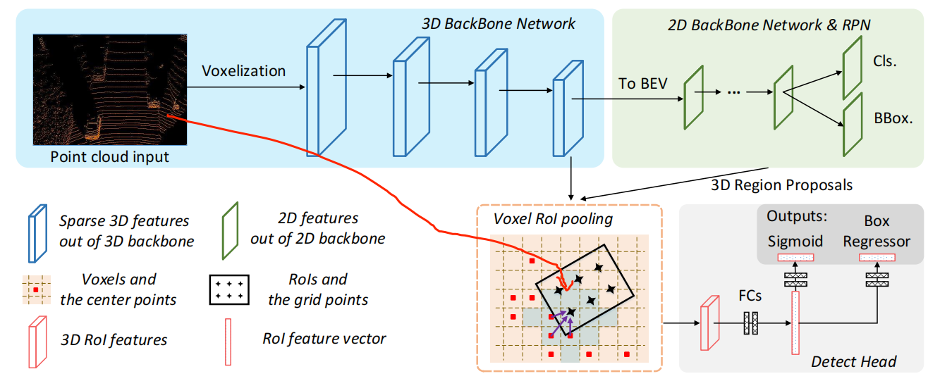
Main Results
3.Feature fusion in front and back stages
Add the original point cloud coordinates in the box using voxel

Slide 9
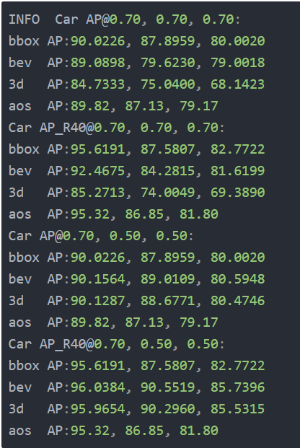
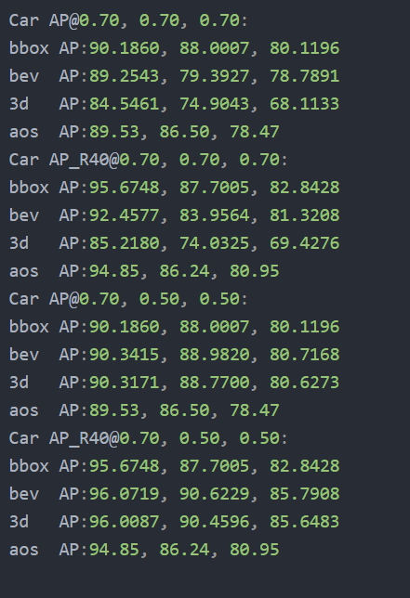
Main Results

Slide 10
Future Work
Combining these three ideas
三个融合，不同视角的融合，其中平面融合可以与图片特征融合，再与俯视图融合，最后二阶段融合

Slide 11
Thank You! Q & A

