Slide 1

Contrastive learning, transformer and multi-data fusion
Leichao Cui
2022/3/30

Slide 2
Outline
Background
Related Existing Works
Proposed Methodology
Main Results
Experimental Results
Conclusion and Future Work

Slide 3
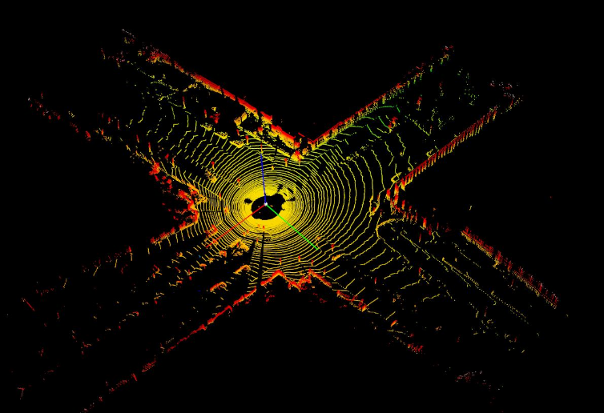
Background
3D object detection
Autonomous driving and domestic robots
The detection of 3D objects with point clouds
The irregular data format
Large search space of 6 Degrees-of-Freedom (DoF) of 3D object

Slide 4
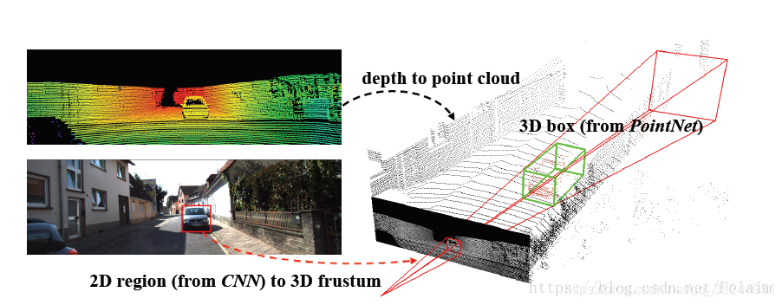
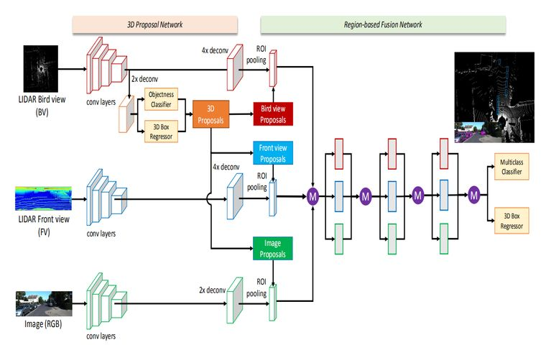
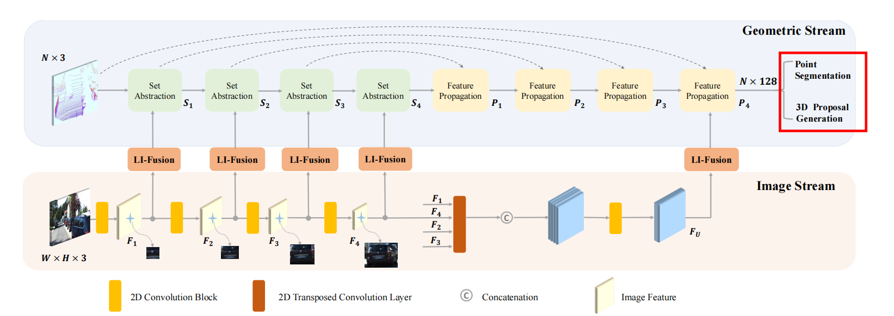
Related Existing Works
LiDAR-camera fusion methods
result-level^{[1]}
use off-the-shelf 2D detectors to seed 3D proposals, followed by a PointNet for object localization.
proposal-level^{[2]}
perform fusion at the region proposal level by applying RoIPool [31]
in each modality for shared proposals.
point-level fusion^{[3]}
first find a hard association between LiDAR points and image pixels
based on calibration matrices,
and then augment LiDAR features with the segmentation scores or CNN features
of the associated pixels through point-wise concatenation.
[1]C. Qi, W. Liu, Chenxia Wu, Hao Su, and L. Guibas. Frustum pointnets for 3d object detection from rgb-d data. CVPR, 2018.
[2]Xiaozhi Chen, Huimin Ma, Jixiang Wan, B. Li, and Tian Xia. Multi-view 3d object detection network for autonomous driving. CVPR, 2017.
[3]Tengteng Huang, Zhe Liu, Xiwu Chen, and X. Bai. EPNet: Enhancing point features with image semantics for 3d object detection. ECCV, 2020.

Slide 5
Related Existing Works
Feature extraction method
3D CNN
Pointnet++
transformer

Slide 6
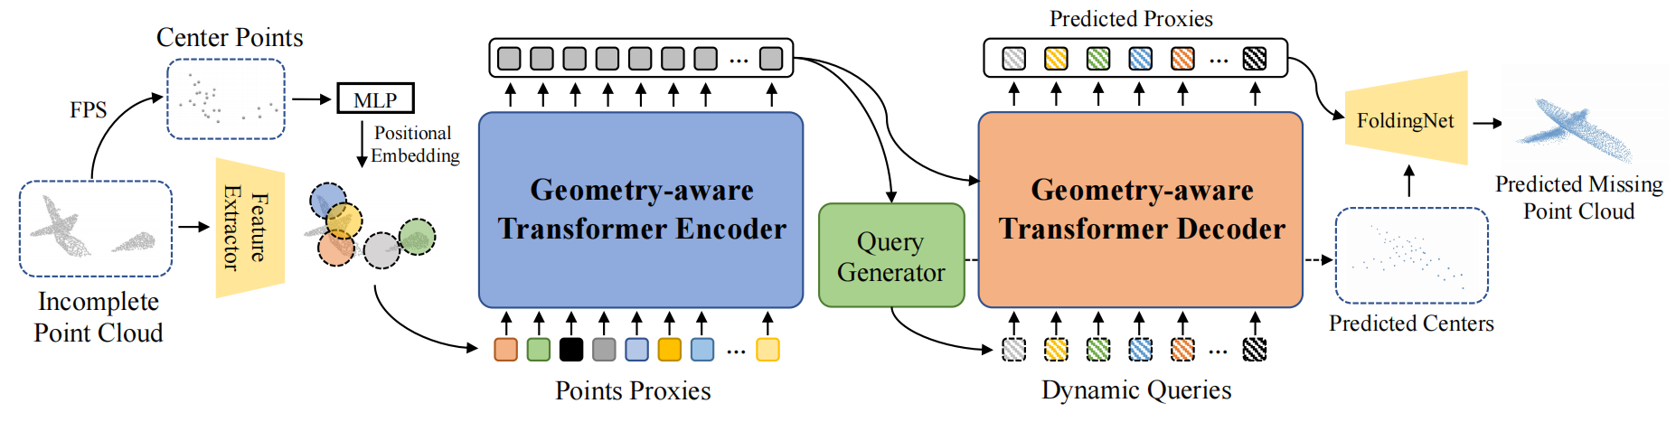
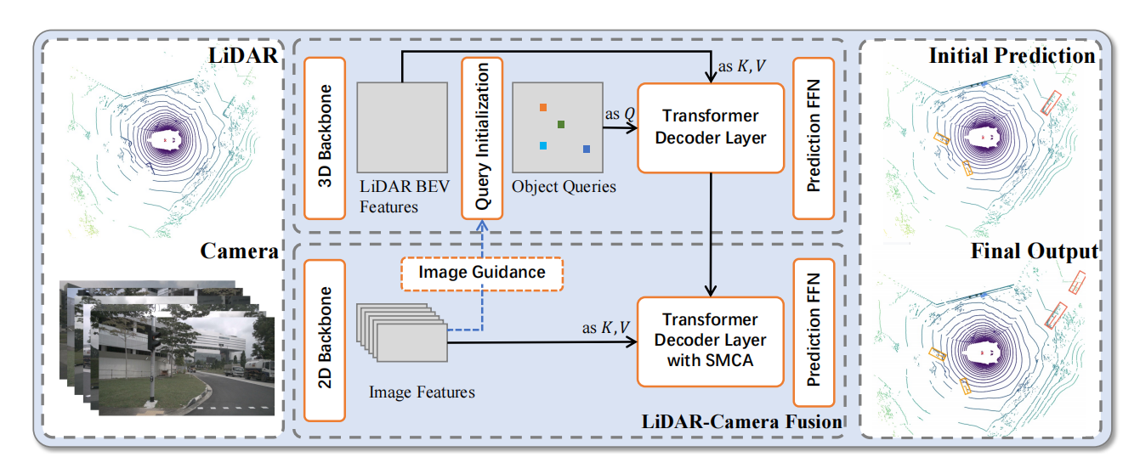
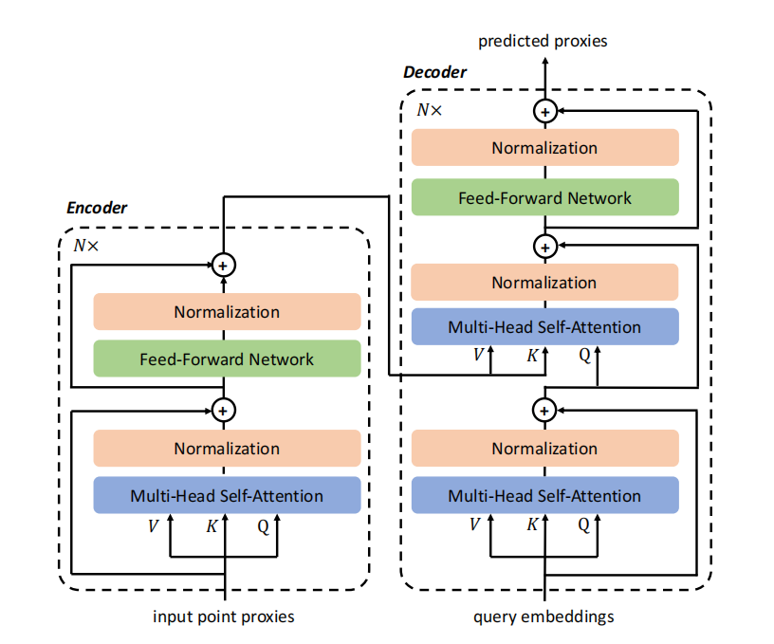
Proposed Methodology

Slide 7
Main Results
transformer
multi-data fusion

Slide 8
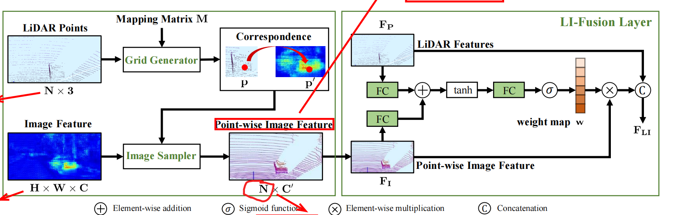
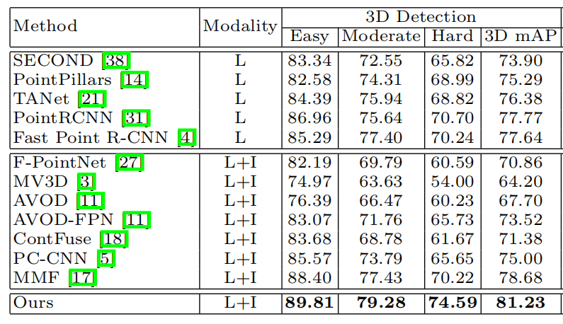
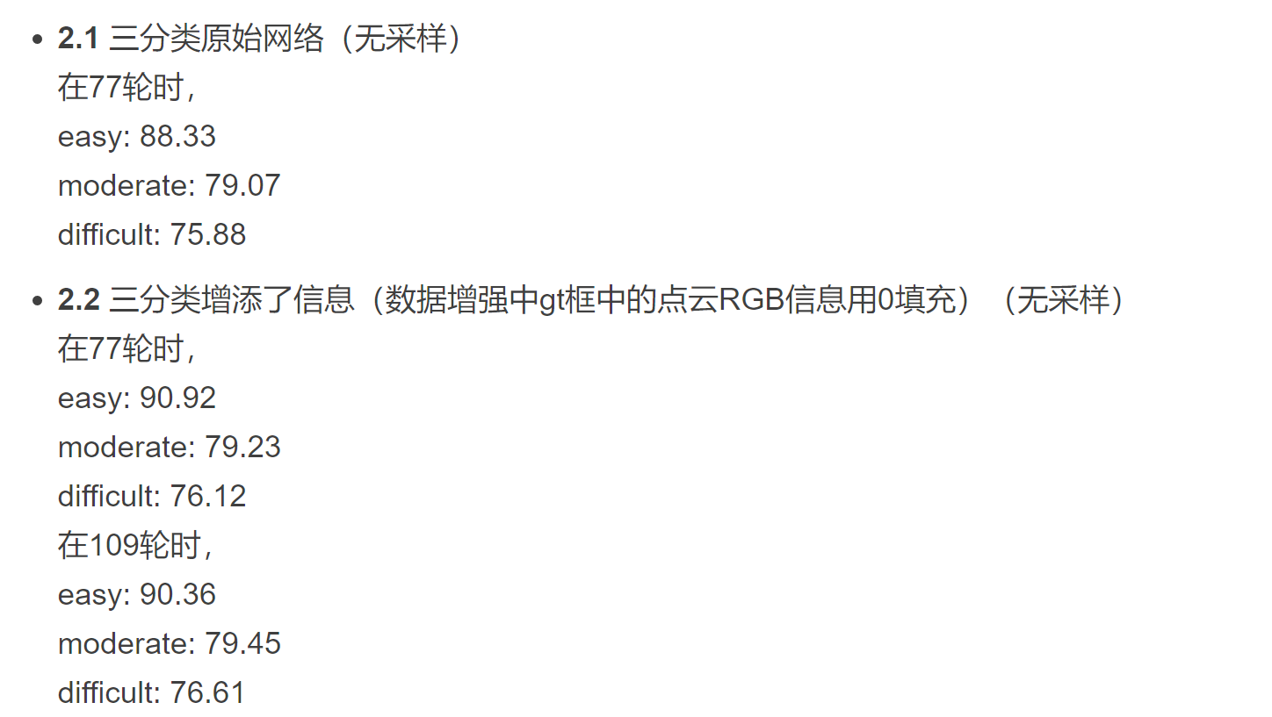
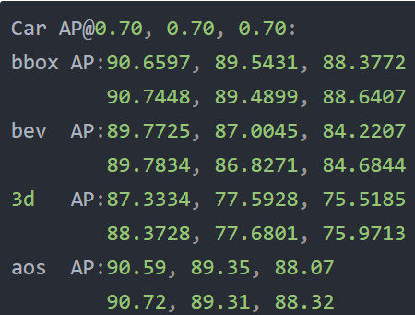
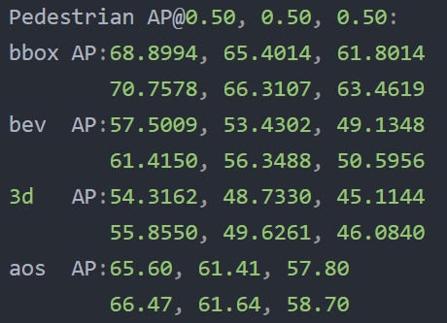
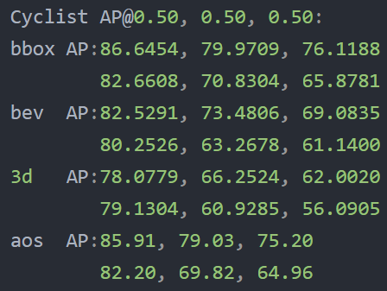
Main Results
1.multi-data fusion
1.1Voxelnet
1.2SECOND

Slide 9
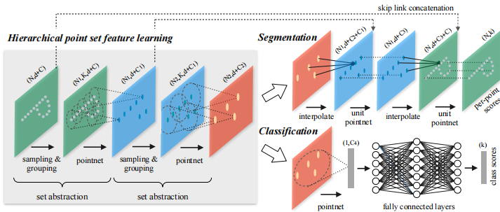
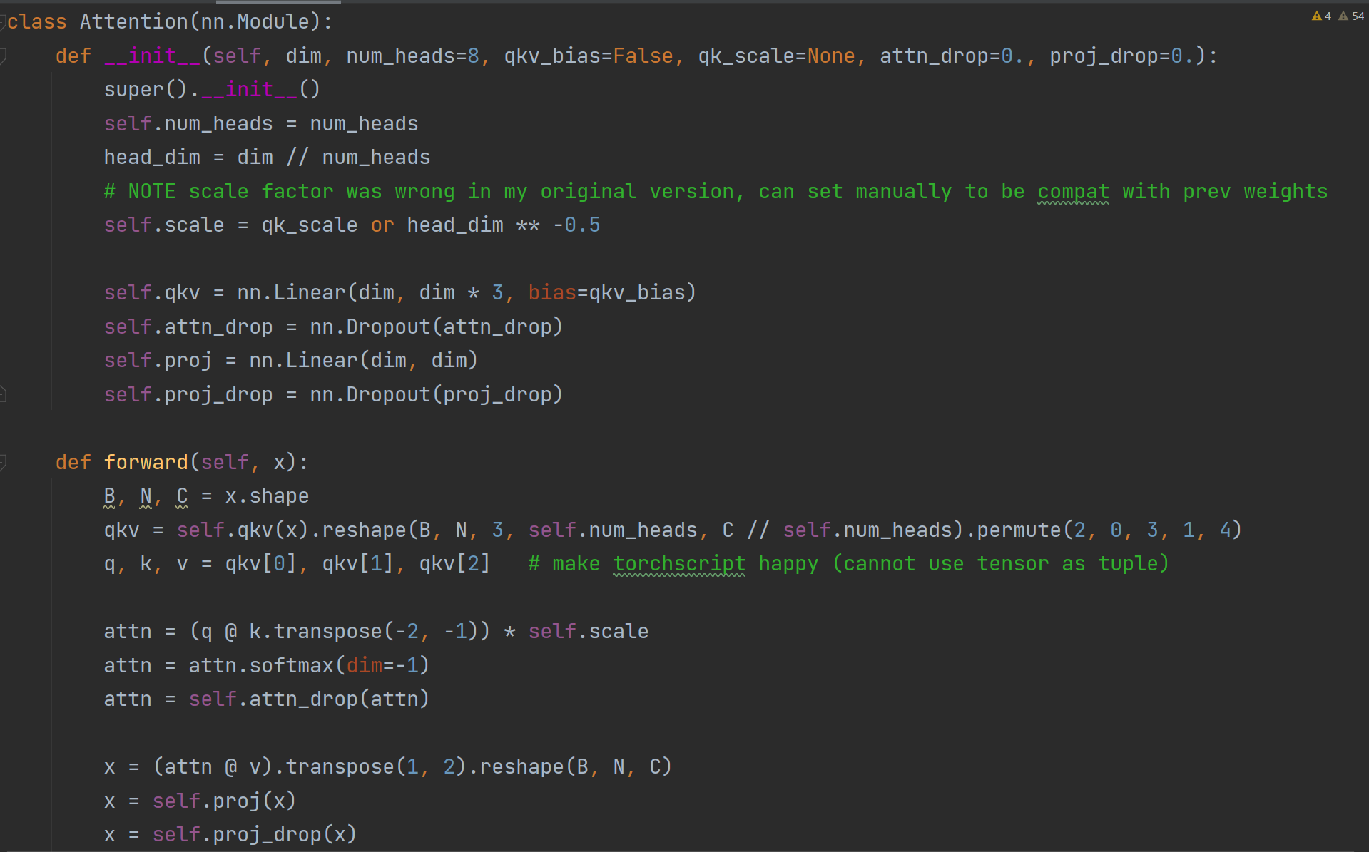
Main Results
2.transformer
1.pointrcnn+self-attention
Same weights but different results each time,
the results are getting worse and worse.
No position information is introduced, and the effect is very poor due to the disorder of the point cloud.
2.pointrcnn+transformer
The effect becomes stable

Slide 10
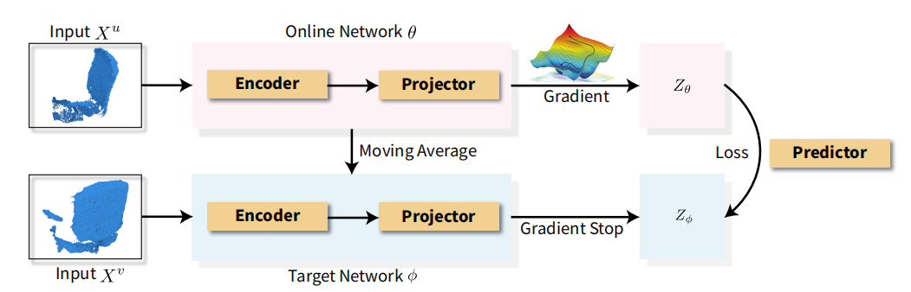
Future Work
Unsupervised Contrastive Learning
How an Query can efficiently pass in location information

Slide 11
Thank You! Q & A

