Slide 1

Multi-data fusion
Leichao Cui
2022/6/22

Slide 2
Outline
Background
Related Existing Works
Proposed Methodology
Main Results
Experimental Results
Conclusion and Future Work

Slide 3
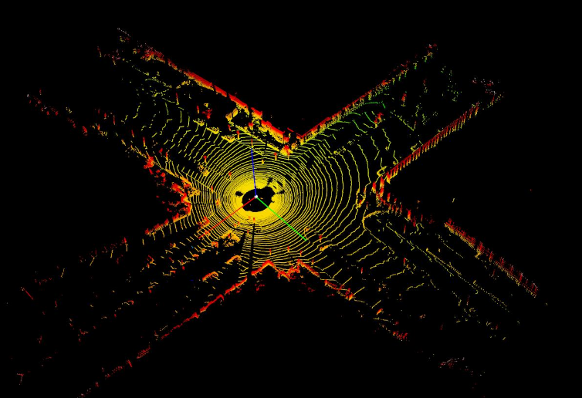
Background
3D object detection
Autonomous driving and domestic robots
The detection of 3D objects with point clouds
The irregular data format
Large search space

Slide 4
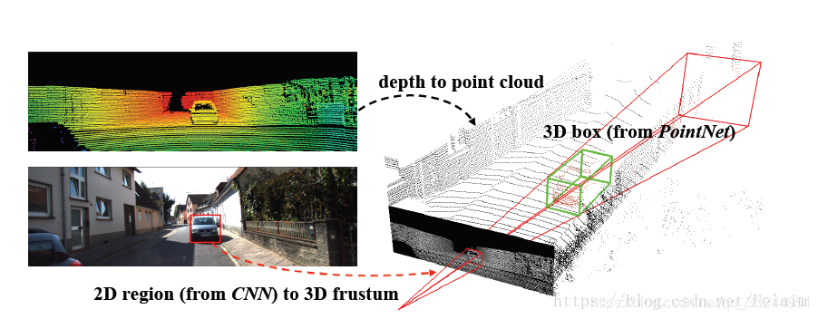
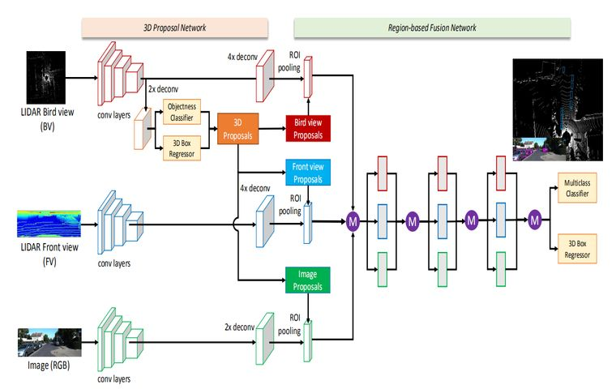
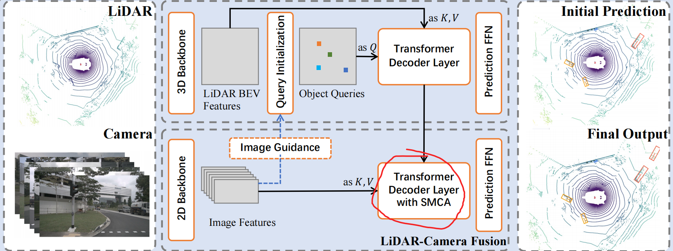
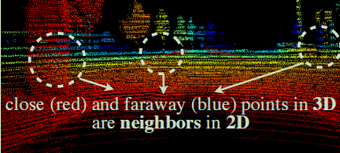
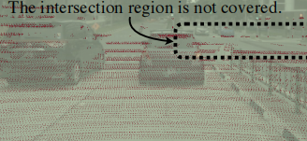
Related Existing Works
LiDAR-camera fusion methods
result-level^{[1]}
Narrow down 3D inspection search using 2D inspection results
proposal-level
perform fusion at the region proposal level
by applying RoIPool^{[2]}, Transformer^{[3]}
point-level
LiDAR-to-camera^{[4]}
Camera-to-lidar^{[5]}
Feature-with-feature^{[6]}
[1] C. Qi, W. Liu, Chenxia Wu, Hao Su, and L. Guibas. Frustum pointnets for 3d object detection from rgb-d data. CVPR, 2018.
[2] Xiaozhi Chen, Huimin Ma, Jixiang Wan, B. Li, and Tian Xia. Multi-view 3d object detection network for autonomous driving. CVPR, 2017.
[3] Xuyang Bai, Zeyu Hu, Xinge Zhu, Qingqiu Huang, Yilun Chen, Hongbo Fu, and Chiew-Lan Tai. TransFusion: Robust LiDAR-Camera Fusion for 3D Object Detection with Transformers. In CVPR, 2022.
[4] Chunwei Wang, Chao Ma, Ming Zhu, and Xiaokang Yang. PointAugmenting: Cross-Modal Augmentation for 3D Object Detection. In CVPR, 2021.
[5] Tengteng Huang, Zhe Liu, Xiwu Chen, and X. Bai. EPNet: Enhancing point features with image semantics for 3d object detection. ECCV, 2020.
[6] Yingwei Li, Adams Wei Yu, Tianjian Meng, Ben Caine, Jiquan Ngiam, Daiyi Peng, Junyang Shen, Bo Wu, Yifeng Lu, Denny Zhou, et al. DeepFusion: Lidar-Camera Deep Fusion for Multi-Modal 3D Object Detection. In CVPR, 2022.

Slide 5
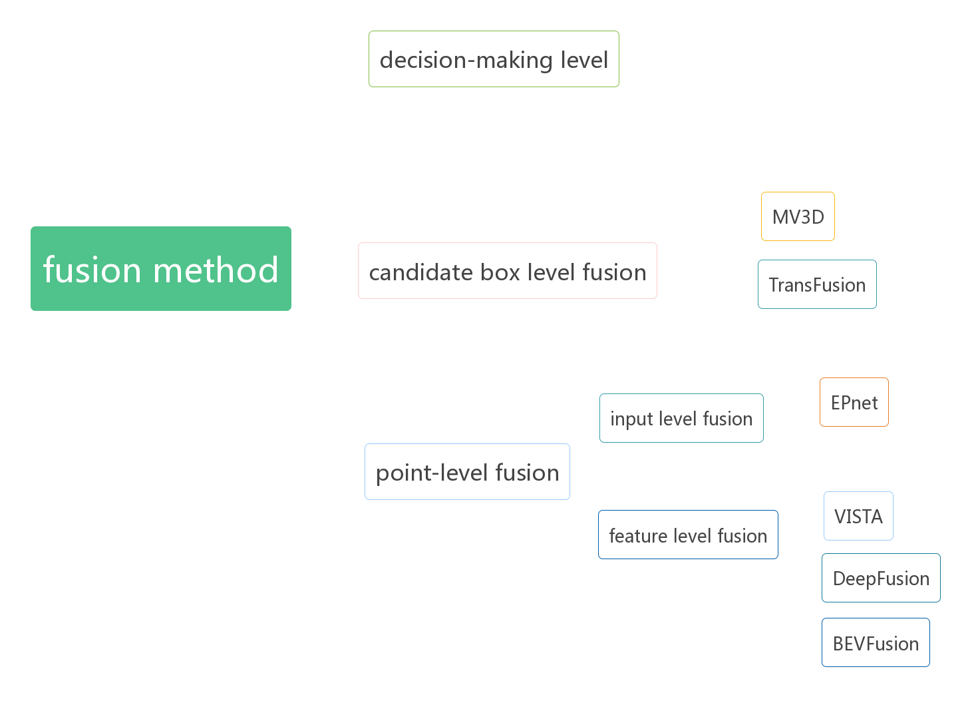
Related Existing Works

Slide 6
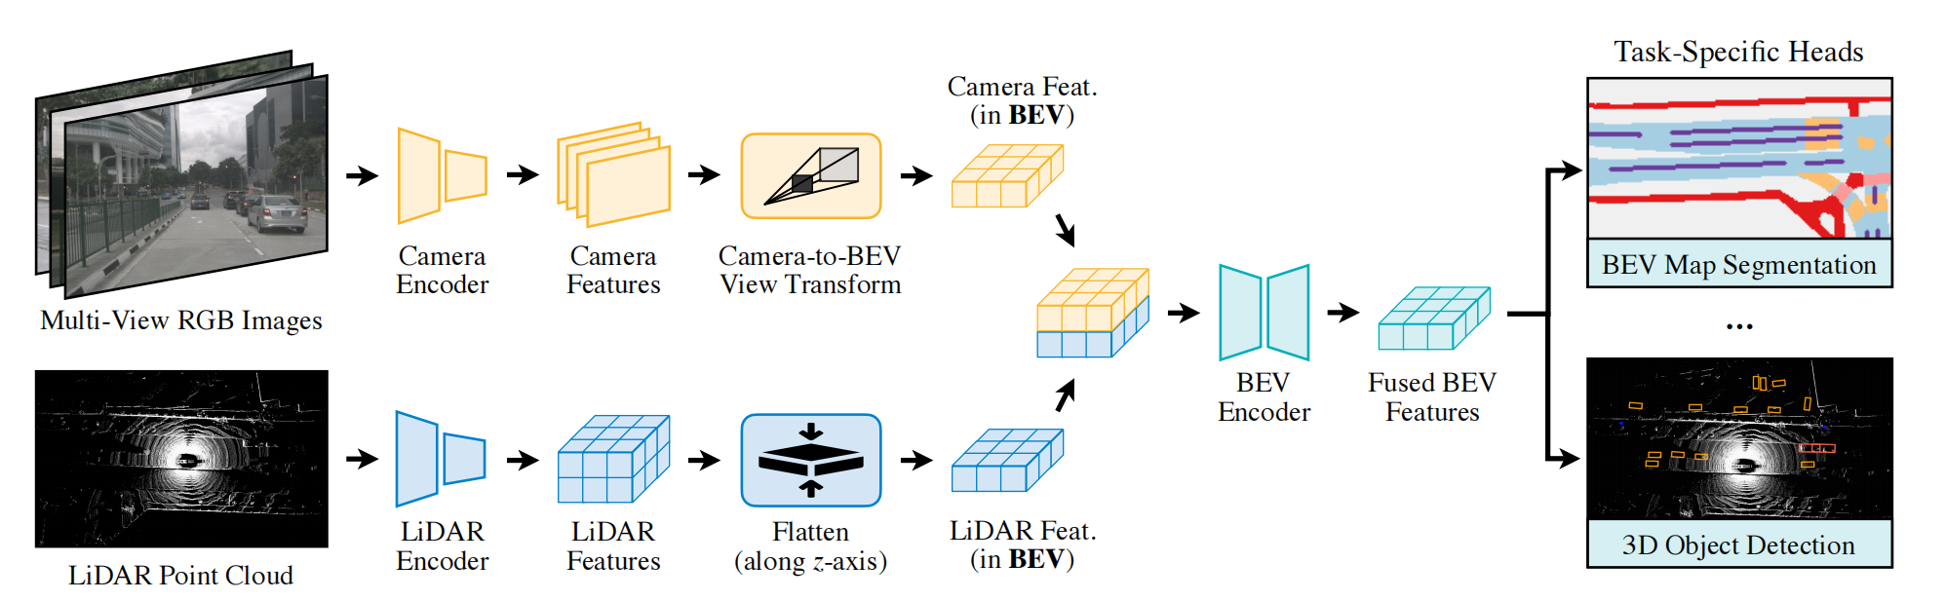
Proposed Methodology
1.point-level fusion
1.1 feature level fusion
[7]
[7] Liu, Zhijian, et al. "BEVFusion: Multi-Task Multi-Sensor Fusion with Unified Bird's-Eye View Representation." arXiv preprint arXiv:2205.13542 (2022).

Slide 7
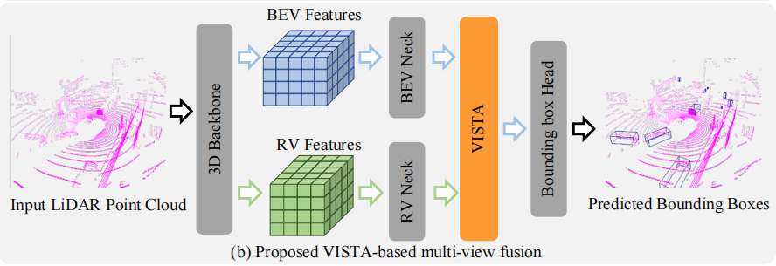
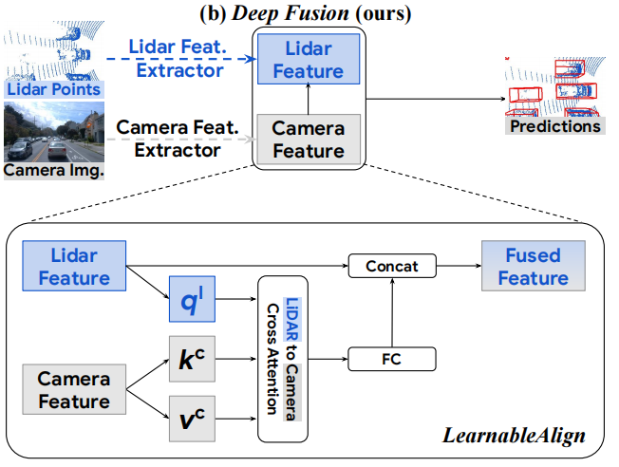
Proposed Methodology
[8]
[9]
[8] Deng, Shengheng, et al. "VISTA: Boosting 3D Object Detection via Dual Cross-VIew SpaTial Attention." Proceedings of the IEEE/CVF Conference on Computer Vision and Pattern Recognition. 2022.
[9] Li, Yingwei, et al. "Deepfusion: Lidar-camera deep fusion for multi-modal 3d object detection." Proceedings of the IEEE/CVF Conference on Computer Vision and Pattern Recognition. 2022.

Slide 8
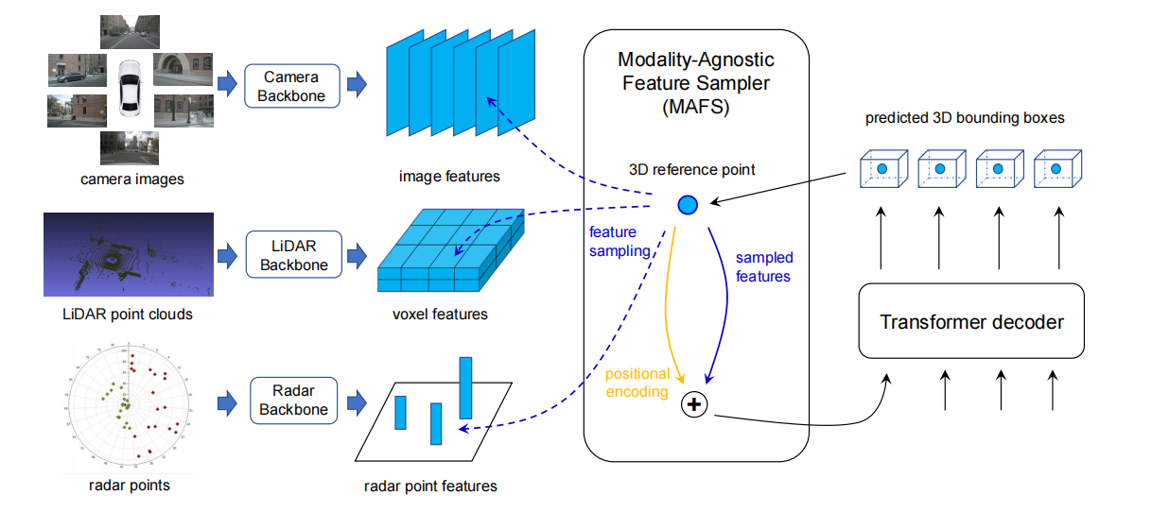
Proposed Methodology
2.proposal-level fusion
[10]
[10] Chen, Xuanyao, et al. "Futr3d: A unified sensor fusion framework for 3d detection." arXiv preprint arXiv:2203.10642 (2022).

Slide 9
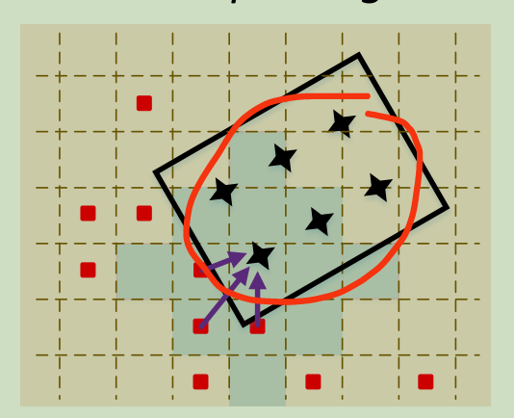
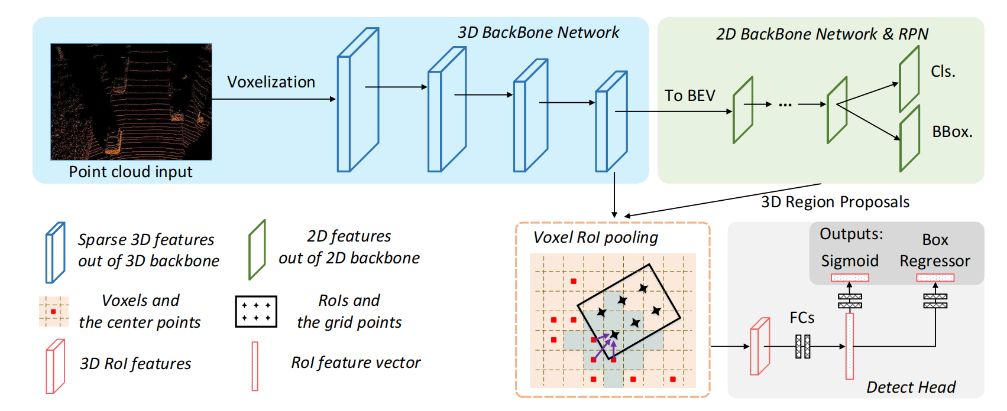
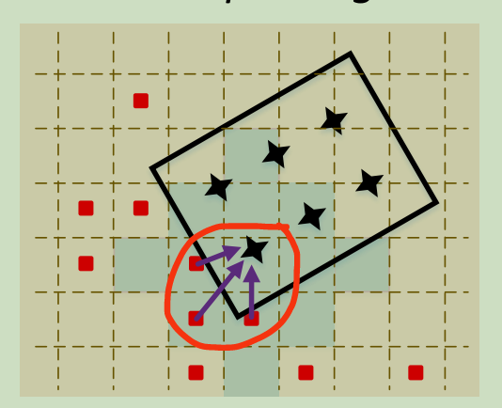
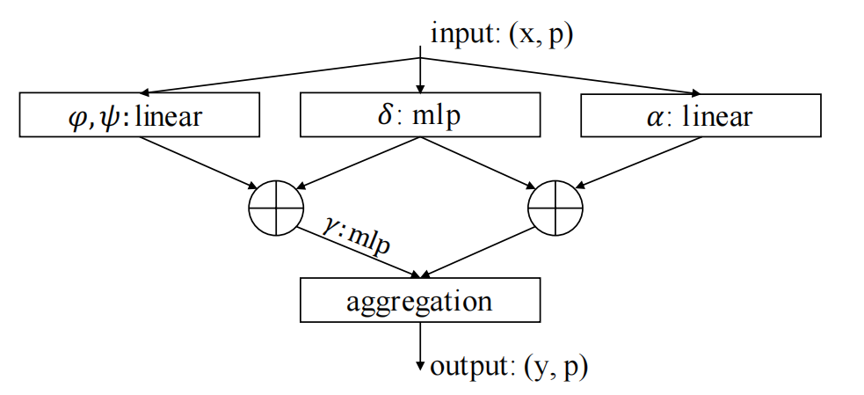
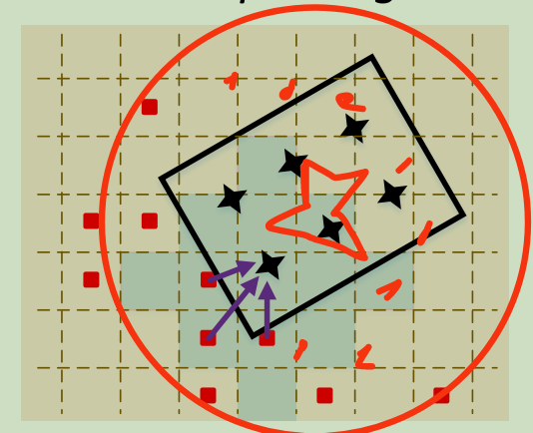
Proposed Methodology
[11]
[12]
[11] Deng, Jiajun, et al. "Voxel r-cnn: Towards high performance voxel-based 3d object detection." Proceedings of the AAAI Conference on Artificial Intelligence. Vol. 35. No. 2. 2021.
[12] Zhao, Hengshuang, et al. "Point transformer." Proceedings of the IEEE/CVF International Conference on Computer Vision. 2021.

Slide 10
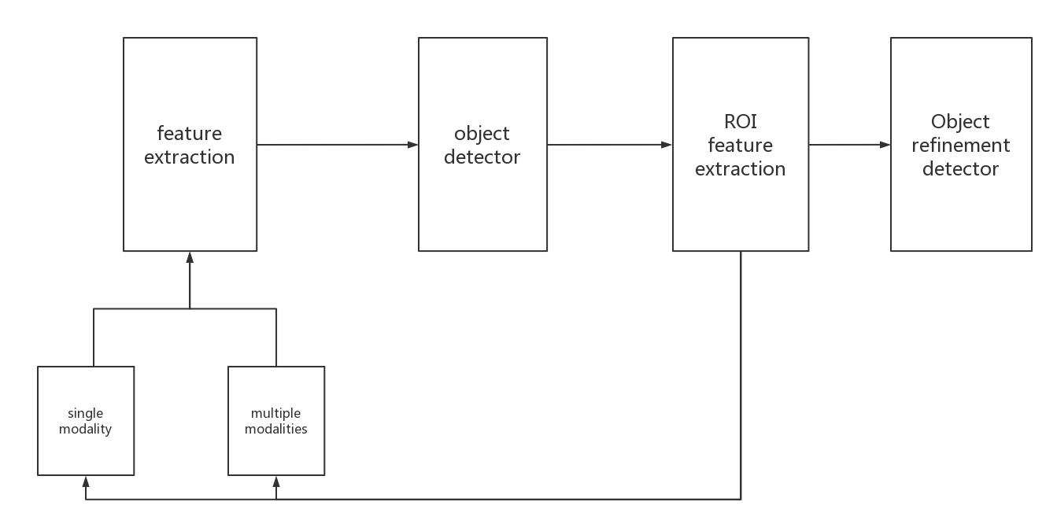
Future Work

Slide 11
Thank You! Q & A

