Slide 1
Eye blindness detection in diabetic patients using CNN
Project Guide:
Dr. Rakhee
-----------------------
Team no:5
Team members:-
A Charan Reddy (15071A05A4)
----------------
J. SaiVignesh
(15071A0576)
------------------
B Prudvi Raj
(15071A05B8)
-------------------
B Manoj
(16075A0524)

Slide 2
Agenda
Abstract
Literature survey
Proposed System
Plan of Action
System Requirements
Modules.
System Architecture.
UML Diagrams
Implementation screenshots
Test cases
Conclusion
Future Scope
References

Slide 3
Abstract
Diabetic retinopathy falls into two main classes:
Non-Proliferative and Proliferative.
The word "proliferative" refers to whether there is neovascularization(abnormal blood vessel growth) in the retina.
Early disease without neovascularization is called non-proliferative diabetic retinopathy (NPDR).
As the disease progresses, it may evolve into proliferative diabetic retinopathy (PDR), which is defined by the presence of the novascularization and has a greater potential for serious visual consequences and may result in Blindness.
So this ocular disease must be identified to ensure treatment for prevention of blindness.

Slide 4
Literacy Survey
Past studies using various high Bias, low variance digital image processing techniques have performed at identifying one specific feature , using top hat algorithm.
Bayesian detection algorithm is used for diagnosing diabetic retinopathy using brightness variation, outliers and segmentation errors. This algorithm has failed to analyze vascular changes in fundus image.(neo-vascularization)
Visual Description of Infected/Damaged areas of Eye is not given.

Slide 5
Proposed System
Our Project aims at better detection of Infected/Damaged areas of Eye using Machine Learning and Deep Learning techniques.
Implement CNN’s to detect abnormalities in the images of Eye accurately than the existing system.
Visual Description : Highlight the Damaged parts of Retina and Optical nerve, for better understanding and diagnosis.

Slide 6
Plan of Action
Literature Survey : 3 weeks.
Design : 5 weeks.
Implementation : 9 weeks.

Slide 7
System Requirements
Hardware Requirement
Ram : 8 GB or Higher.
OS : Windows 7 or Higher.
Hard Disk : 500 Gb or Higher.
Graphic card : 4Gb or Higher .
Fundus Equipment.
Software requirements
Language :
- Python.
Tools :
- Anaconda .
- Pycharm IDE.
Libraries :
- Keras, Scikit – Learn
- Numpy, open CV

Slide 8
System Requirements
Functional requirements
Morphological transformation
Pre-processing
Data Augmentation
Training and Testing Models
Non Functional requirements
Concurrency
Capacity
Maintainability
Usability

Slide 9
Modules
Micro Aneurysms Detection
Severity Level Detection

Slide 10
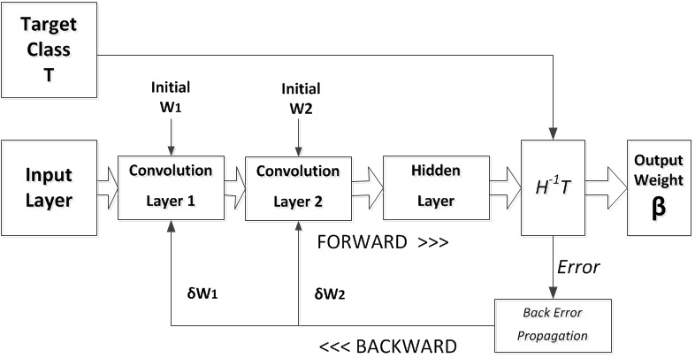
CNN Architecture

Slide 11
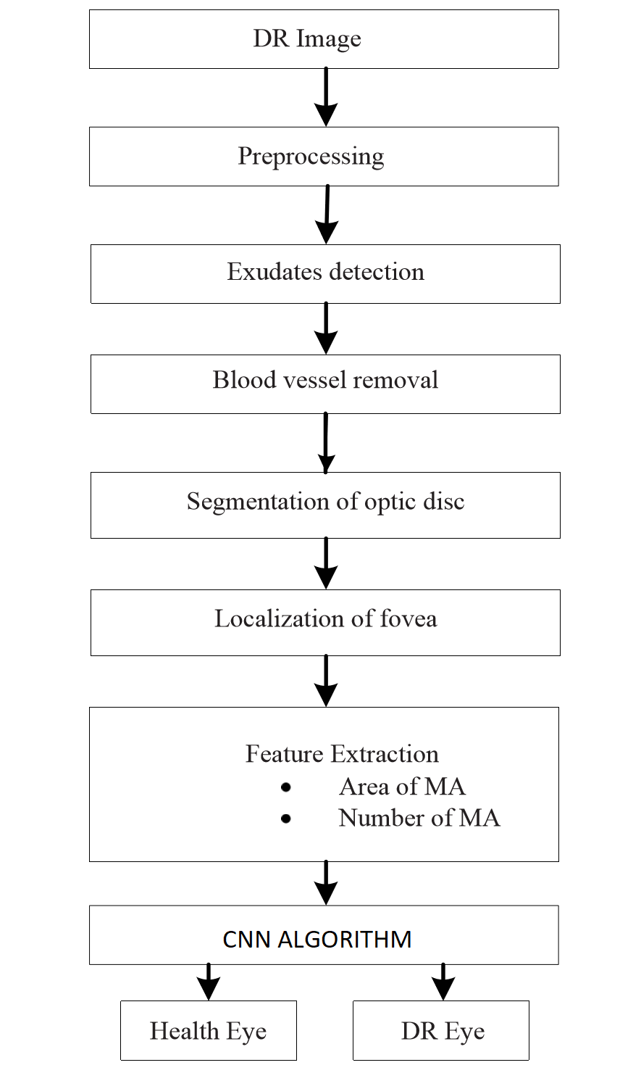
Project Flow Architecture

Slide 12
Design Phases
Collection of Data.
Segmentation of data.
Division of Training and Testing Datasets.
Development of Model.
Training Model.
Testing - Validation.
Results / Features & Functionalities.

Slide 13
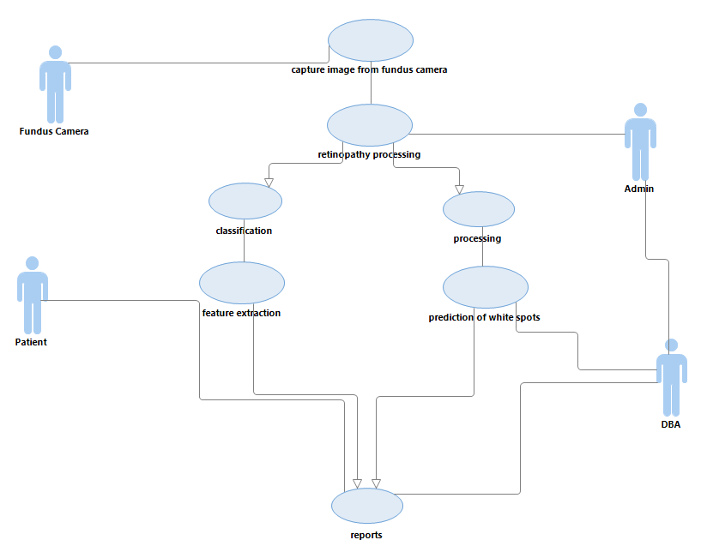
Use Case Diagram

Slide 14
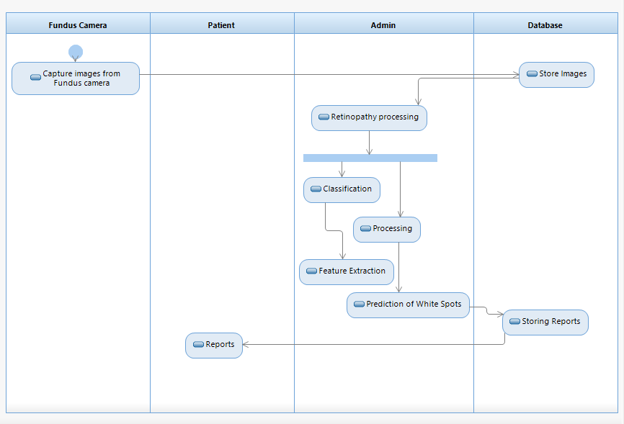
Activity Diagram

Slide 15
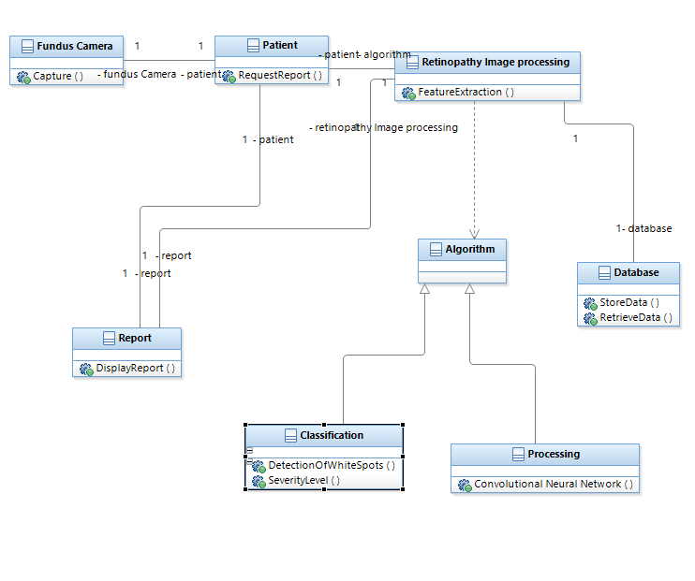
Class Diagram

Slide 16
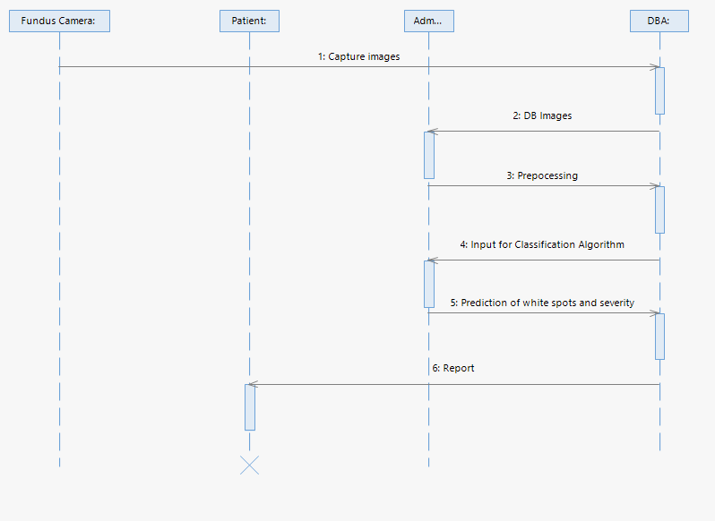
Sequence Diagram

Slide 17
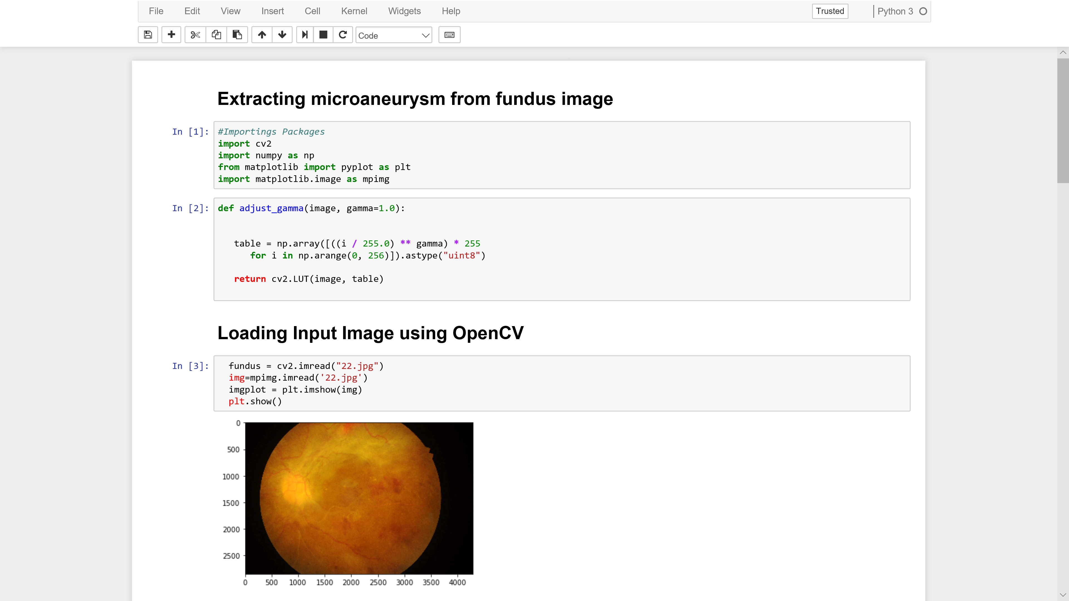
Implementation Screenshots

Slide 18
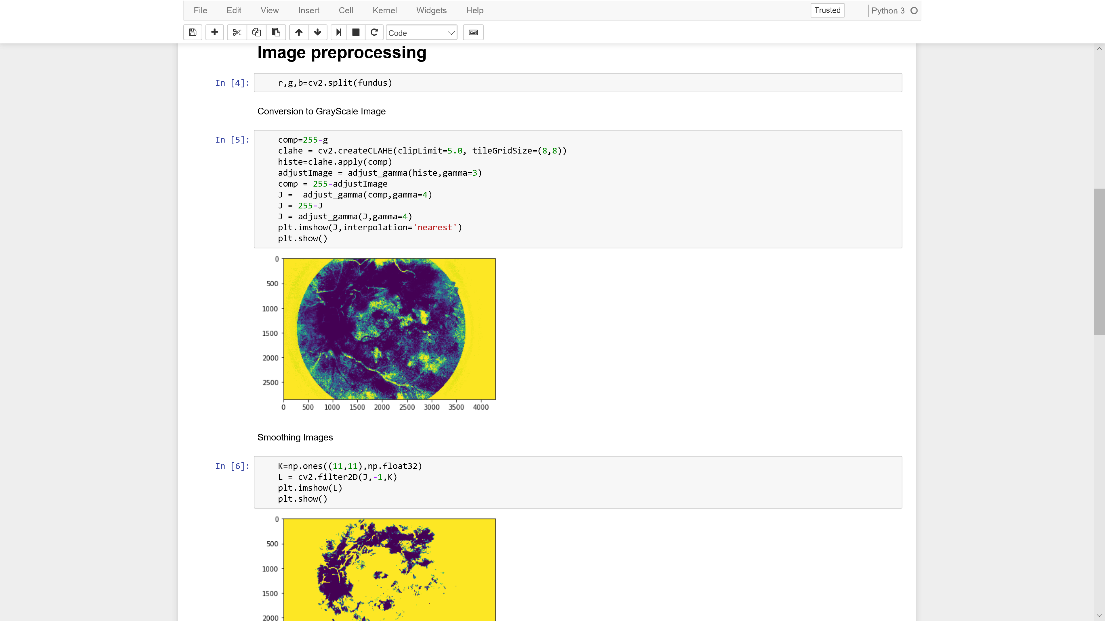
Implementation Screenshots

Slide 19
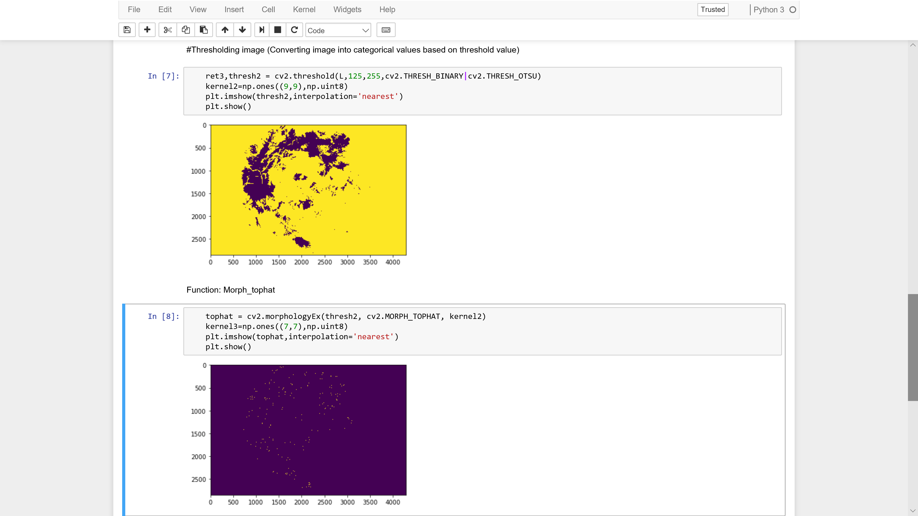
Implementation Screenshots

Slide 20
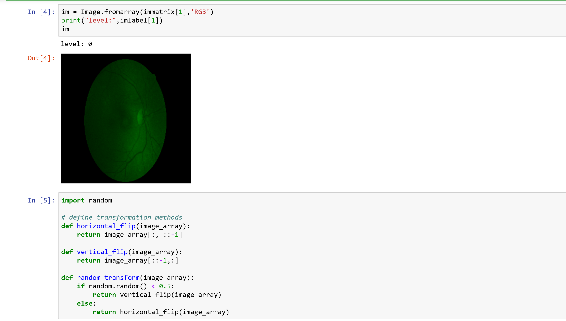
Implementation Screenshots

Slide 21
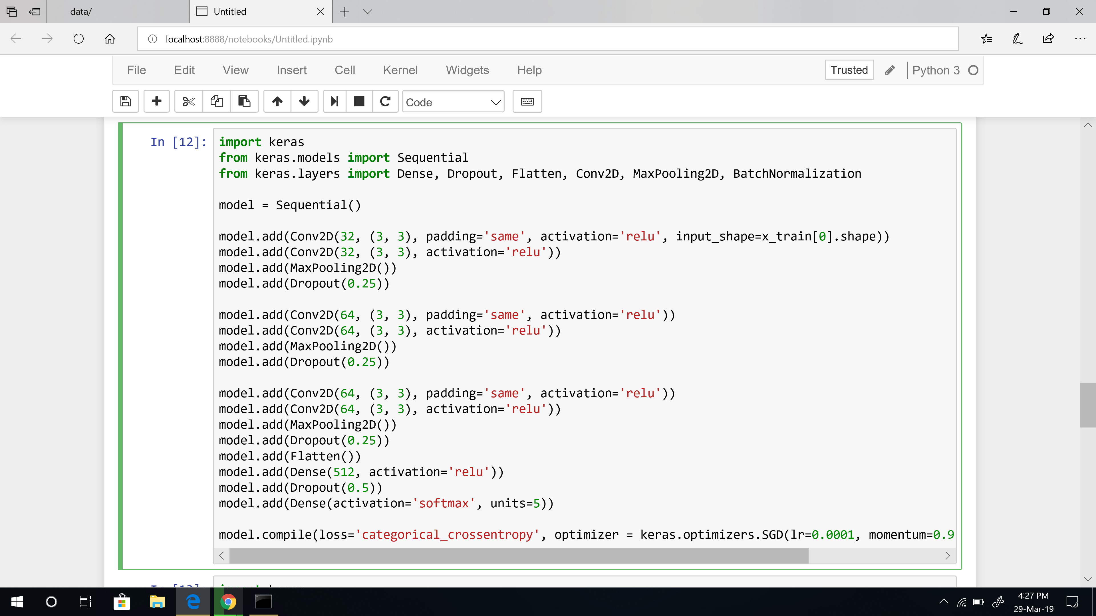
Implementation Screenshots

Slide 22
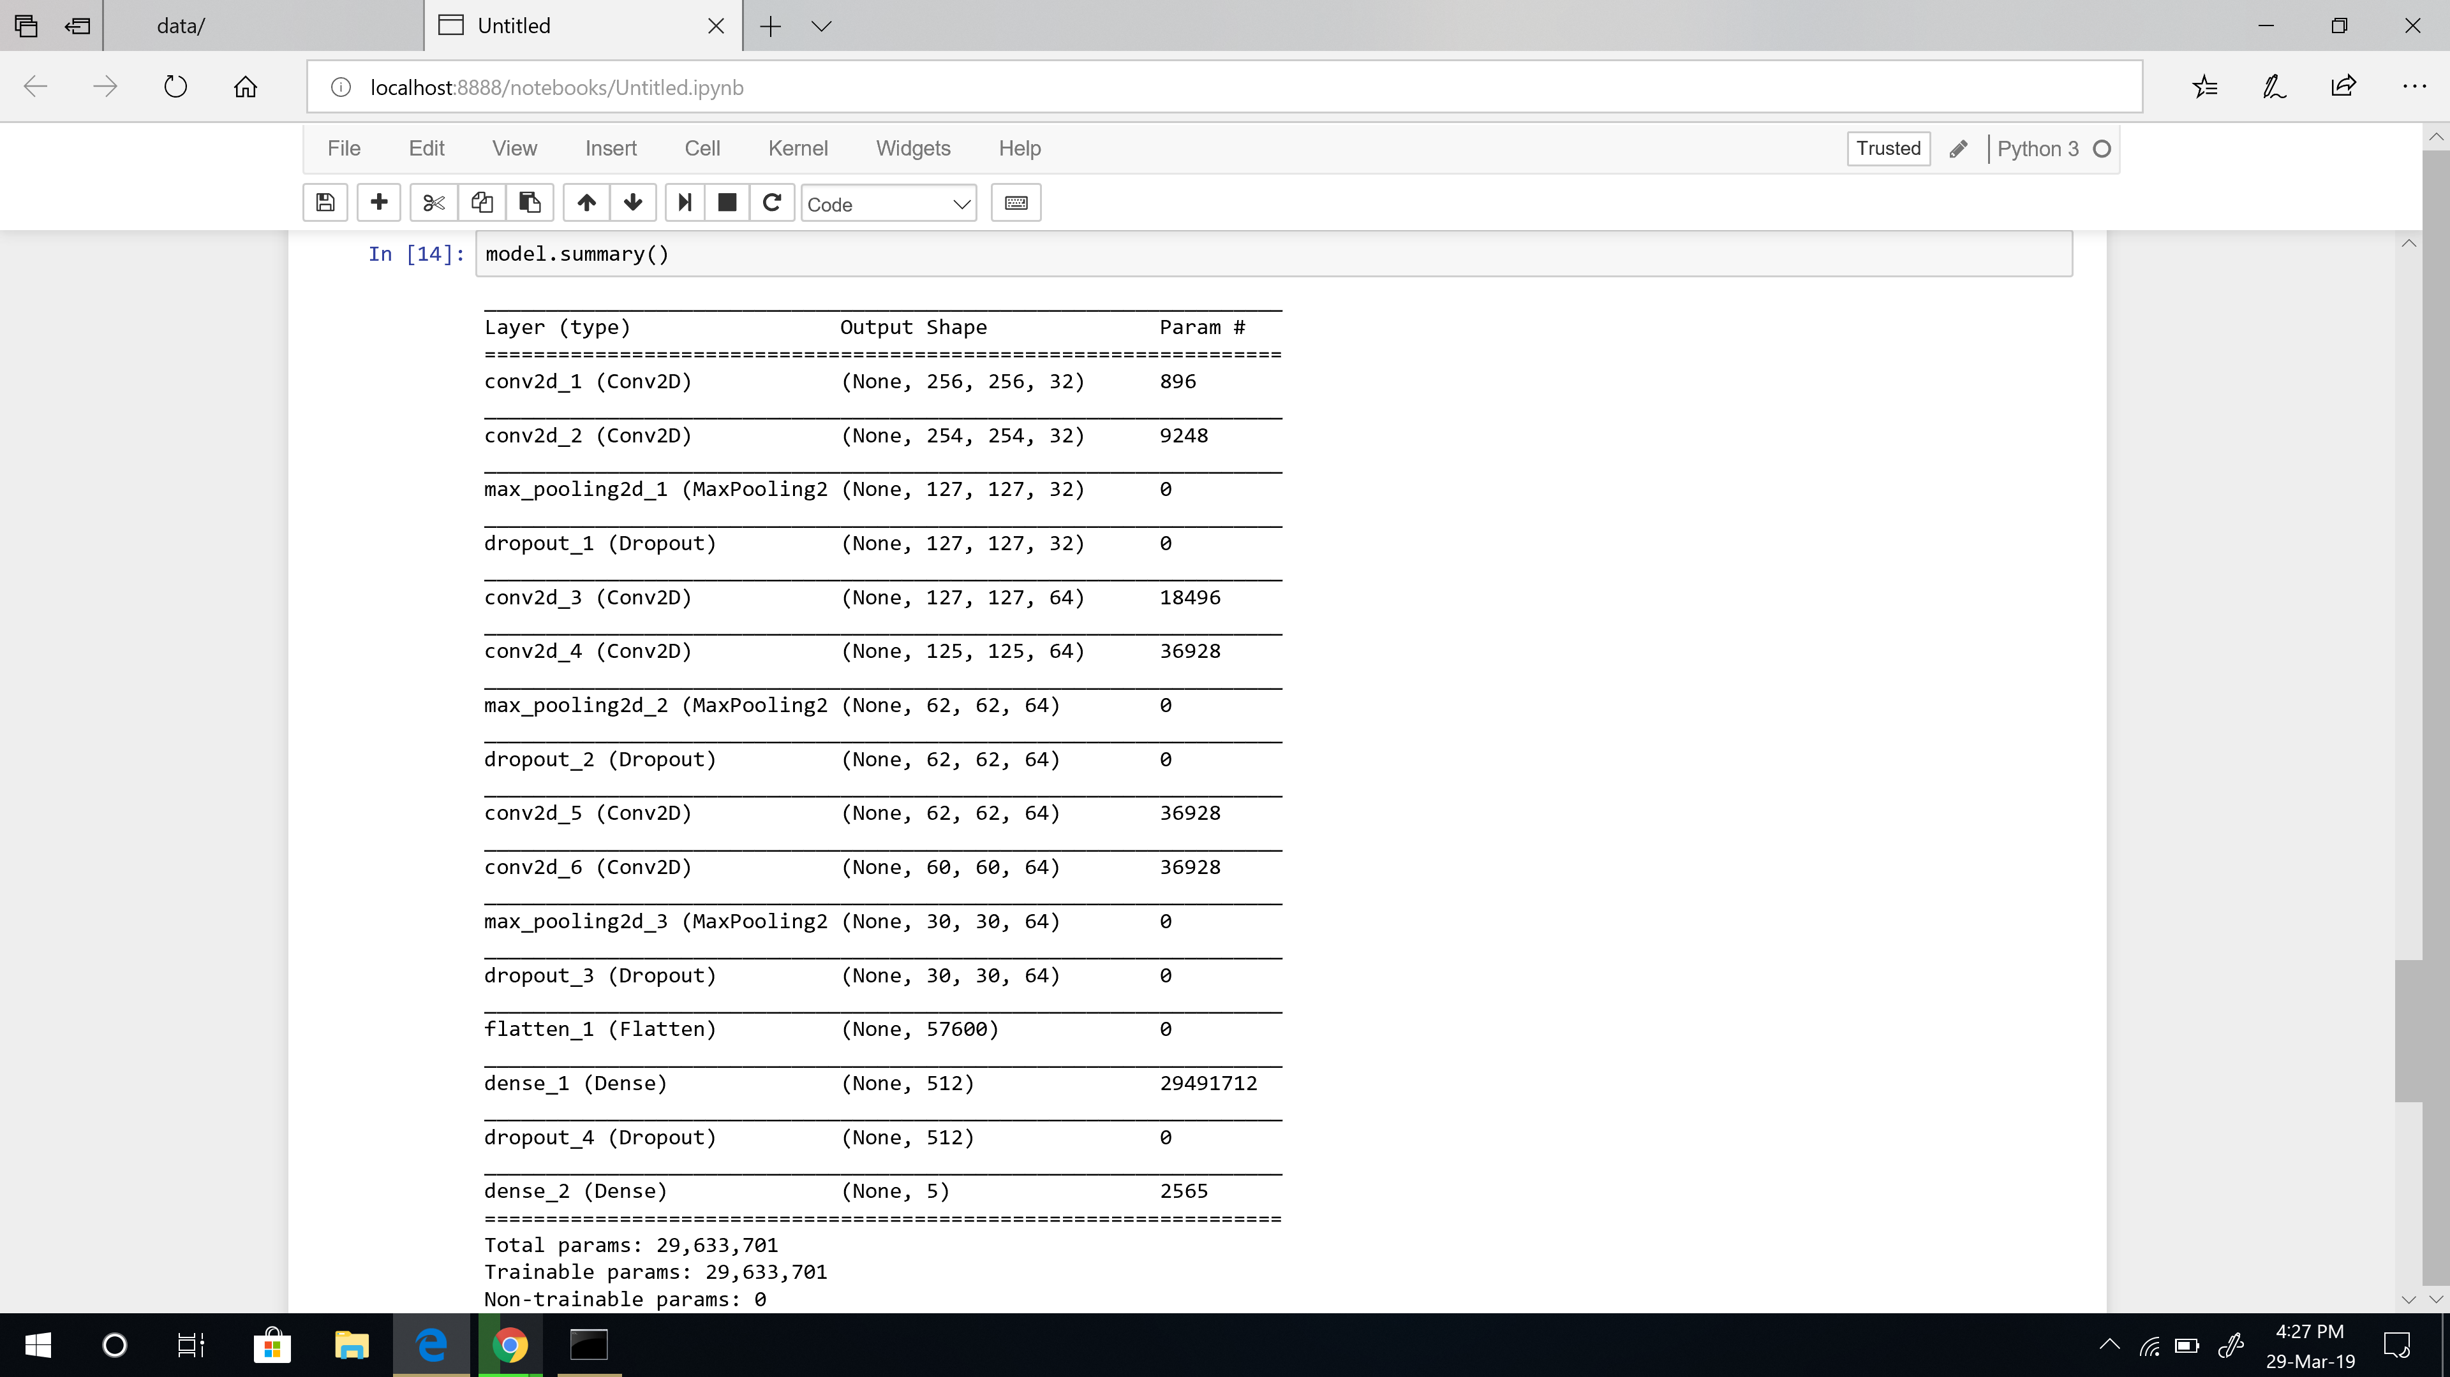
Implementation Screenshots

Slide 23
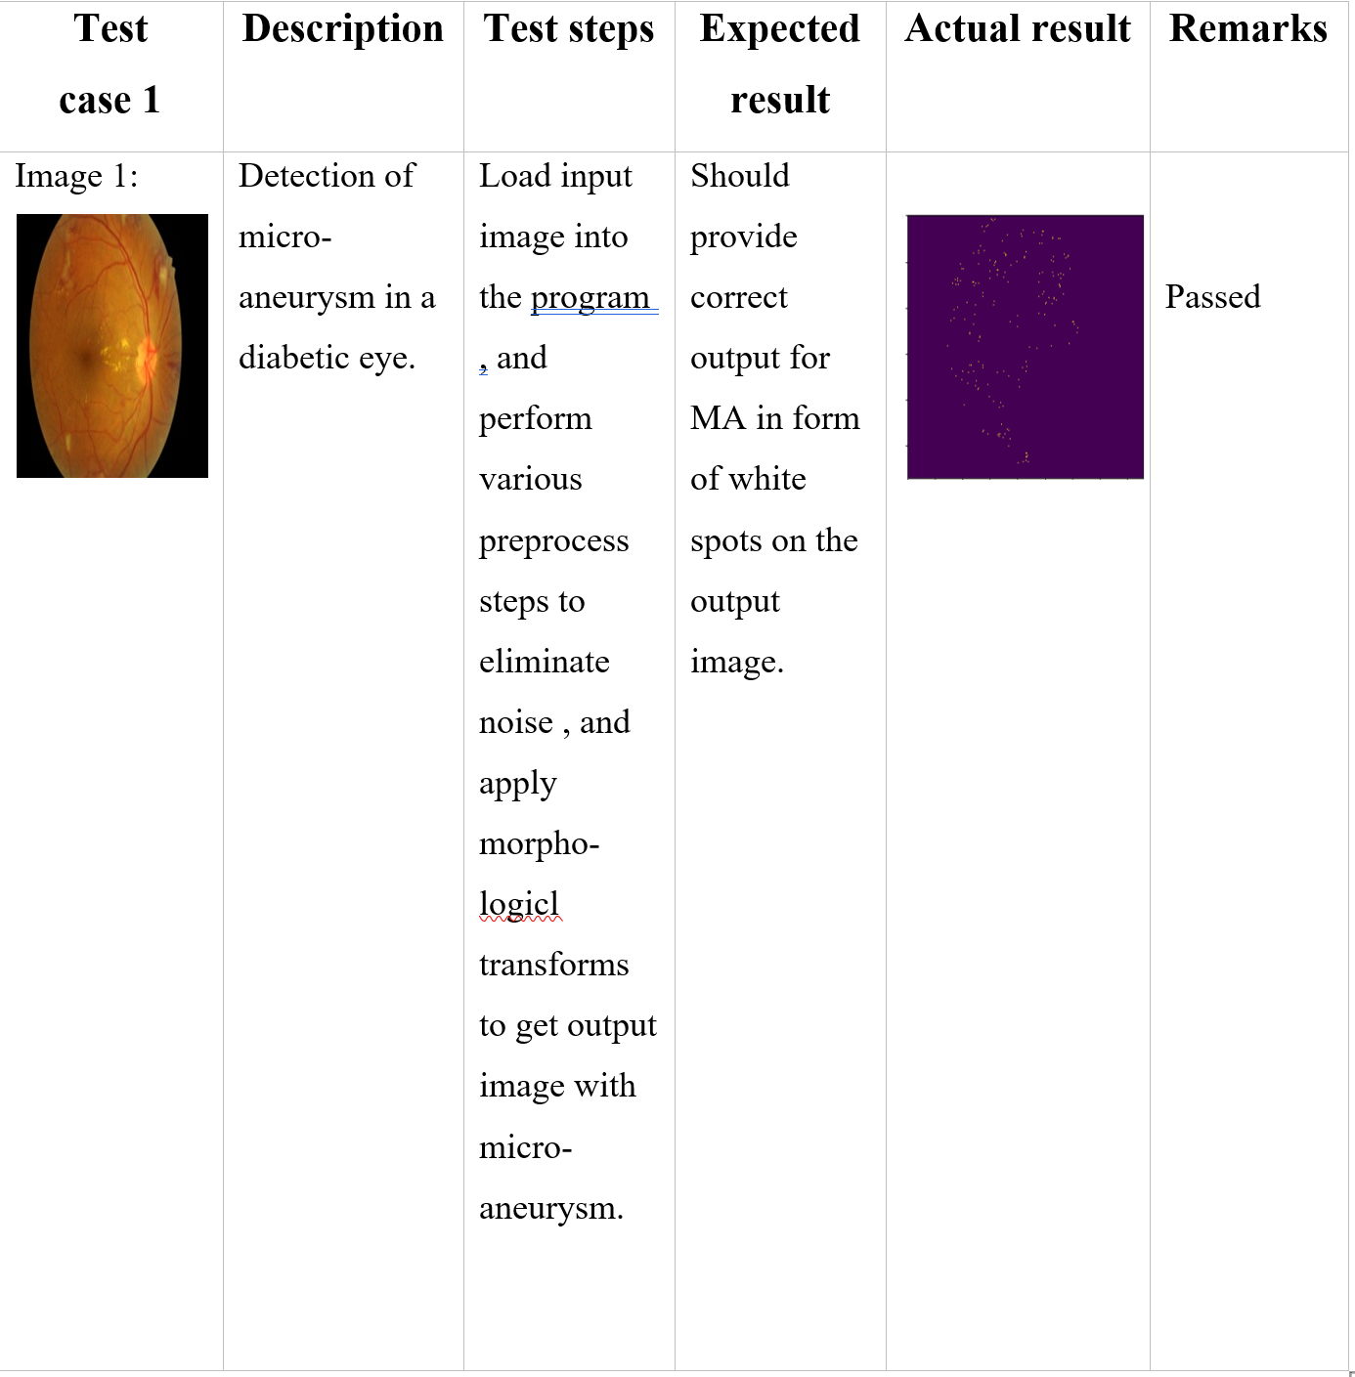
Test case 1
Micro Aneurysm Detection

Slide 24
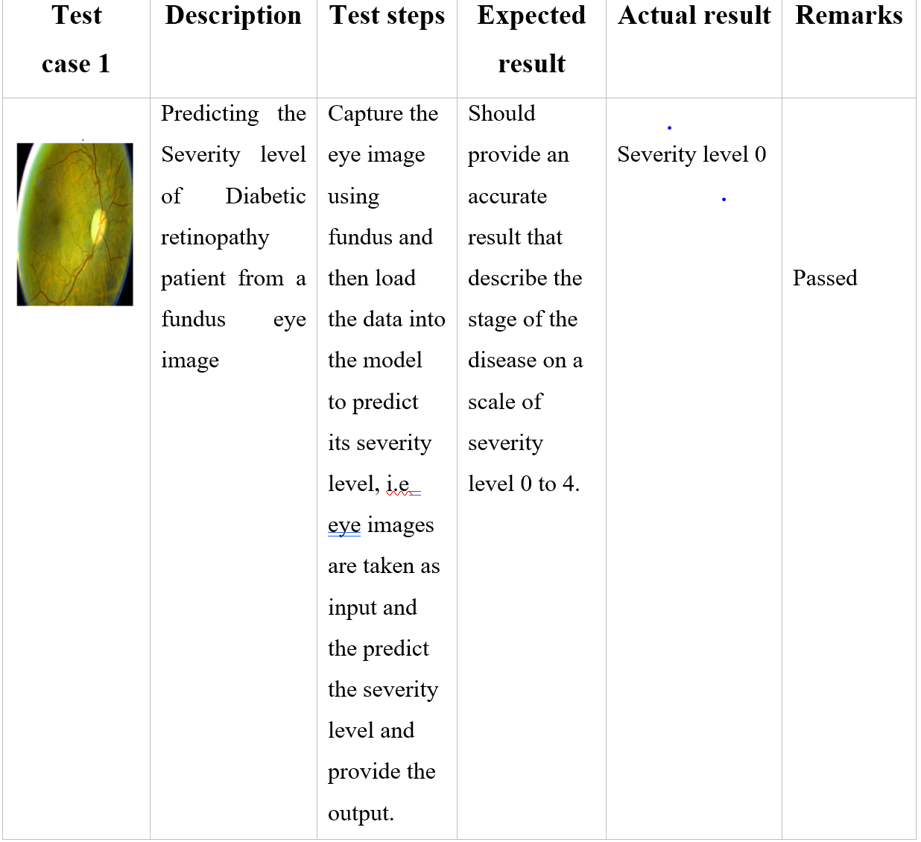
Testcase 2

Slide 25
Conclusion
The parametric measures like sensitivity and accuracy have been predicted for the proposed algorithms and they are presented and discussed with the resultant images.

Slide 26
Future Scope
Future extension of this work may consider the segmentation of other abnormal features like “drusen (Age-related macular degeneration - AMD), cotton wool spot (optic nerve Fiber Damage ) etc.” during the development of an automatic screening system of DR.
In the field of developing automatic screening systems, this work will contribute considerably in evaluation to predict abnormalities in diabetic retinopathy in different modules.
A system can be developed combining all these modules together to assist the physician and patients to suggest and understand proper remedial measures.

Slide 27
References
[1] https://en.wikipedia.org/wiki/Convolutional_neural_network
[2] https://www.mydr.com.au/diabetes/retinopathy-in-diabetes
[3] https://en.wikipedia.org/wiki/Deep_learning
[4] https://blog.keras.io/building-powerful-image-classification-models-using-very-little-data.html

Slide 28
References
[5] https://www.ncbi.nlm.nih.gov/pubmed/17332762
[6] https://www.semanticscholar.org/paper/Diabetic-retinopathy-detection-using-deep-neural-Doshi-Shenoy/938a7a3308b6eb901c2d2b3231ce0c66f9b723f3
[7] https://ieeexplore.ieee.org/abstract/document/8079692
[8] https://idrid.grand-challenge.org/
[9]https://www.researchgate.net/publication/317951200_Automated_detection_o f_diabetic_retinopathy_using_SVM
[10] https://blog.keras.io/building-powerful-image-classification-models-usingvery-little-data.html

Slide 29
THANK YOU
Project Guide:
Dr. Rakhee
Team no:5
Team members:-
J Sai Vignesh (15071A0576)
----------------
A Charan Reddy (15071A05A4)
------------------
B Prudvi Raj
(15071A05B8)
-------------------
B Manoj
(16075A0524)

