Slide 1
Medi-AR
B.Manoj
B.Prudvi raj
A.Charan
J.Vignesh
...medical details re-invented!

Slide 2
IDEA.
Day by day the medical facilities are improving day by day along with new diseases.
This results in development of new drugs daily into the market which has differentuses at different situations .The small change in the dosage misunderstanding leads to lose of life .
So every Doctors/patients/pharma companies/illiterate person/Blind people need to recognize what medicine to be taken in which quantity by simply scanning the drug.

Slide 3
INTRODUCTION
The most advanced technology AR(augmented reality) is best used to this problem.
By taking the images of drugs as the image targets, a detailed pop up of the drug which contains -- usage ,quantity ,precautions, Dosage level,Side Effects.
In the case of blind; illiterate people the voiceover in different regional languages is provided.

Slide 4
DEFINITION
Augmented reality (AR) is a direct or indirect live view of a physical, real-world environment whose elements are "augmented" by computer-generated perceptual information, ideally across multiple sensory modalities, including visual, auditory, haptic, somatosensory, and olfactory.
Augmented reality (AR) adds digital elements to a live view often by using the camera on a smartphone.
Examples of augmented reality experiences include Snapchat lenses and the game Pokemon Go.

Slide 5
DESCRIPTION
Prerequisites -- Smartphone (with camera >3 mp).
TECHNOLOGIES USED :
- UNITY
- VUFORIA ..
--> Appliction takes the images of the medicines as targets &
obtains data from a Database.
--> The result contents and displayed live,on phone screen
with AR elements & animations.

Slide 6
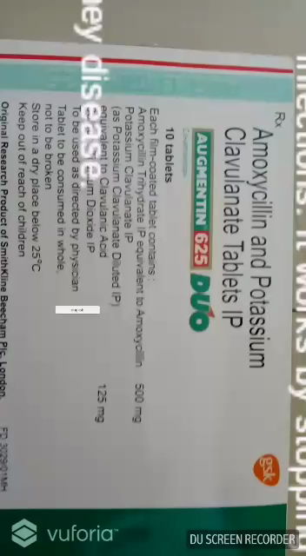
DEMO:
The combination of amoxicillin and clavulanate potassium is used to treat many different infections caused by bacteria, such as sinusitis, pneumonia, ear infections, bronchitis, urinary tract infections, and infections of the skin.

Slide 7
CONCLUSION
By having such features which helps to everyone to have a basic knowledge of all the essential drugs related to various diseases.

Slide 8
THANK YOU!

