Slide 1
welcome to the presentation

Slide 2
Personal Budget monitoring App
Project Presentation
By
Name: Auntor Acharja
Id: 172-15-10047

Slide 3
Contents:
• Introduction to the project
• Project Scope and Goal
• Software Process Model
• Software Tools & Technologies
• Snap Shots

Slide 4
Introduction to the Project:
Now a days we need to manage our regular budget , for monitoring budget we need to use some application.
The main focus of this project is about online services for monitoring our regular budget
This is a best platform for user to maintain and note down their regular expenses and regular income.
According to their regular expenses and income they can easily take decision.
In this System user have an accounts (user-name and passwords ,etc).
User can update everything, edit his profile data and store all income and expenses data.

Slide 5
Project Scope:
• The user can registration by their own email with return a verification mail.
• The user can update their regular expenses and income.
•A regular statement will provide also.
•User can delete their own account.
•They can Update their old password with a strong verification .
• User can view the Profile data and can update it by using his own account.

Slide 6
Project Goal:
Store income expenses data.
Easily decision making.
To save cost for each user.
User friendly

Slide 7
Software Process Model:
After reviewing all the available process models or methodologies, I feel the Waterfall Model matches exactly for my project requirements.
I chooses the waterfall model because it is a sequential design process, often used in software development, in which progress is seen as flowing steadily downwards (like a waterfall) through the phases of Conception, Initiation, Analysis, Design, Construction, Testing, Production/Implementation and Maintenance.

Slide 8
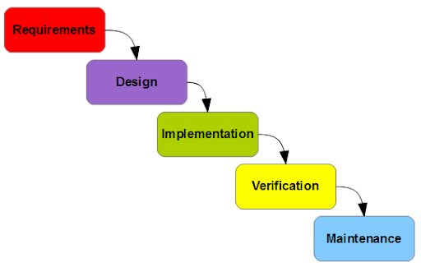
Waterfall Model:

Slide 9
Software Tools & Technologies:
Technologies:
• HTML
• CSS
• JavaScript
• Node js
• React js
Tools:
• mlab Database
•Visual Studio Code

Slide 10
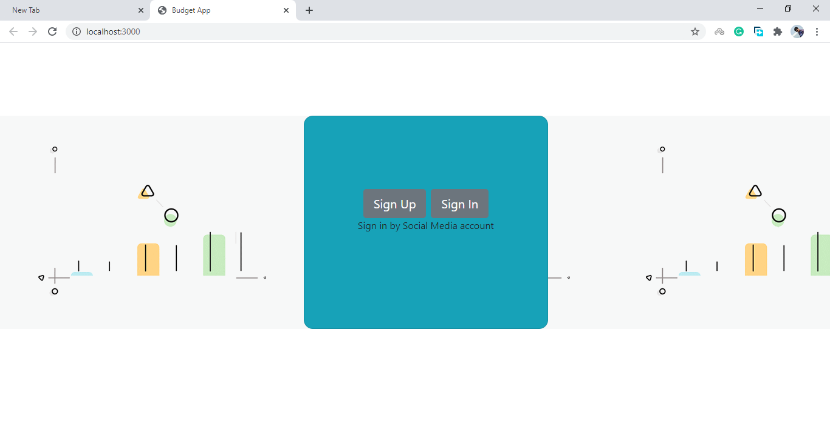
Snap Shots:

Slide 11
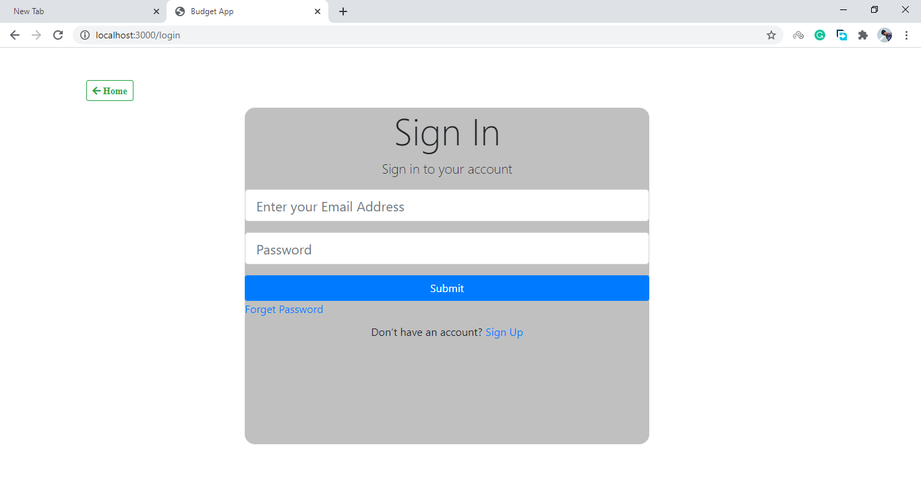
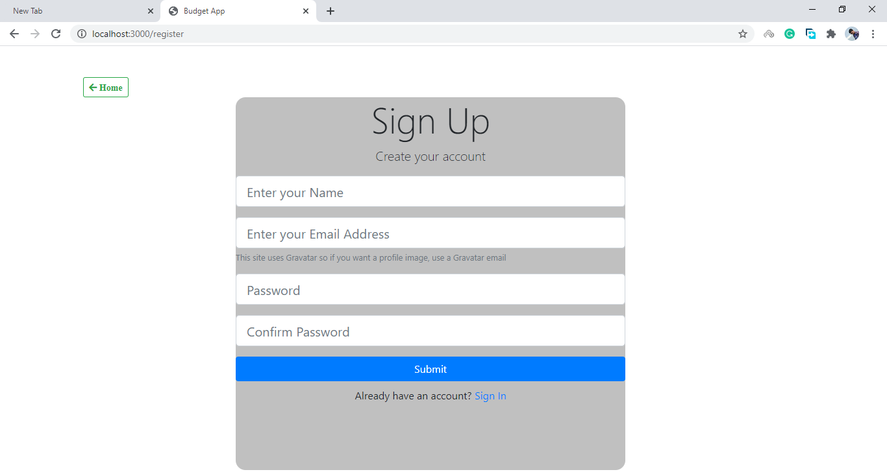

Slide 12
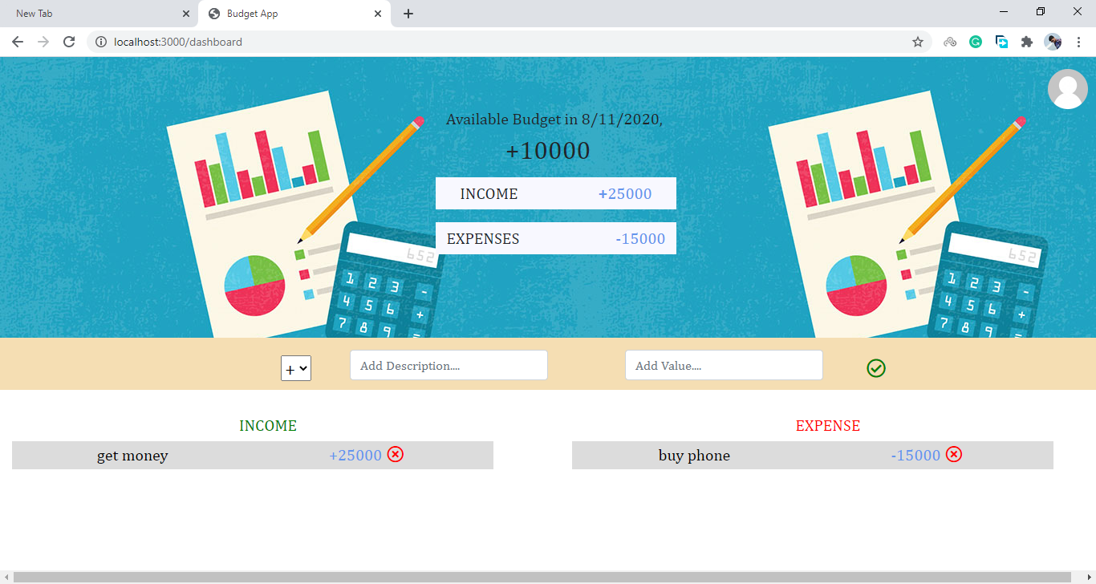

Slide 13
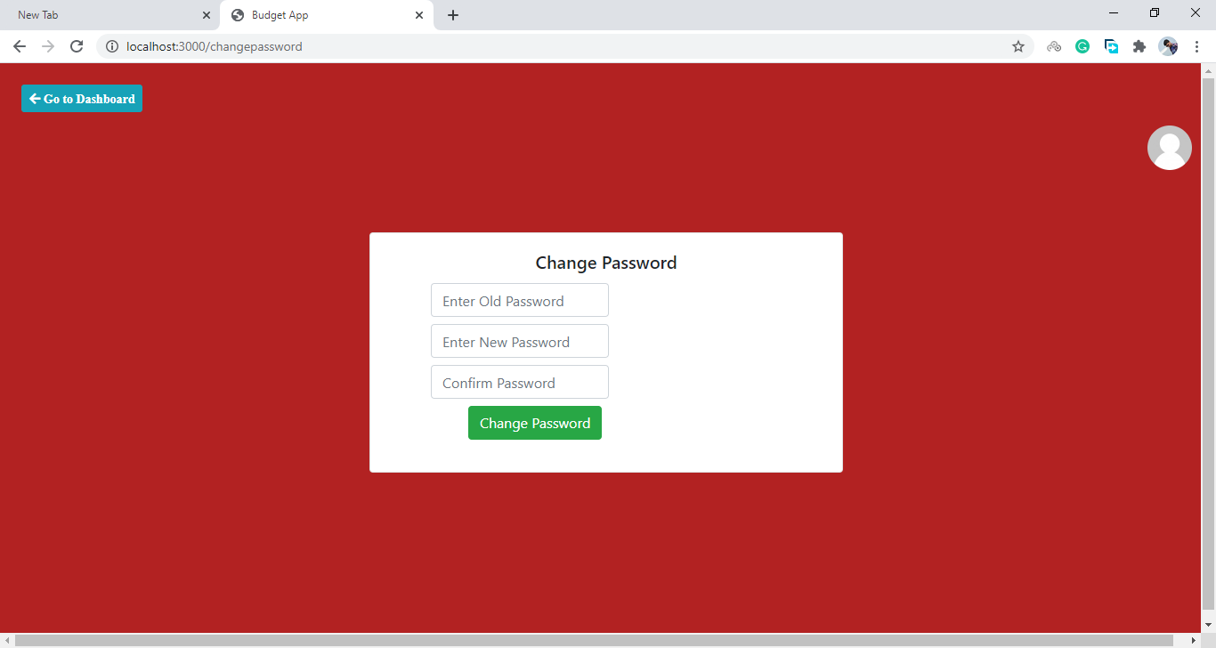
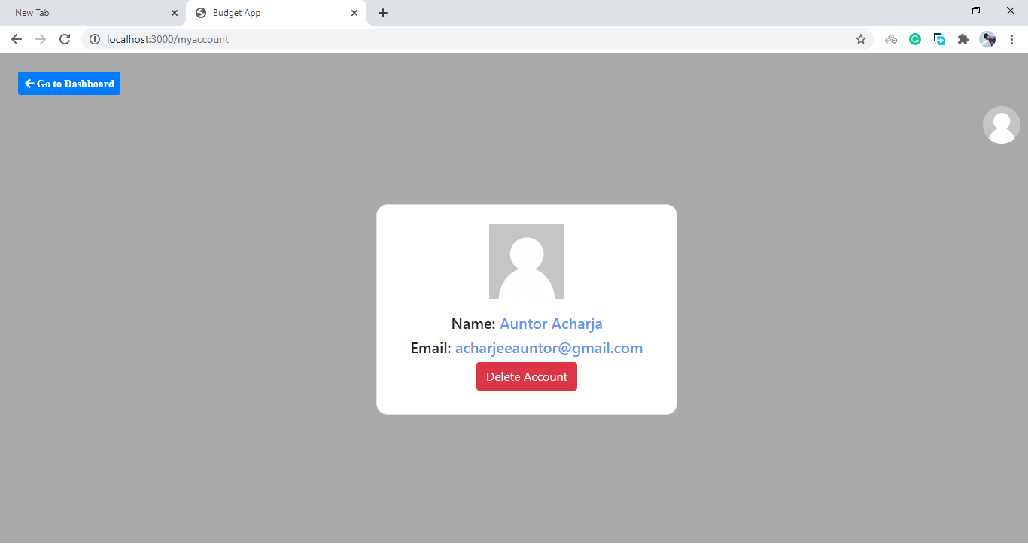

Slide 14
Thank You

