Slide 1



IOE Entrance Preparation and Data Mangement Kit
Department of Electronics and Computer Engineering
Institute of Engineering, Thapathali Campus
Team Members:
Anish Timsina(THA077BEI007)
Bishal Khadka(THA077BEI015)
Nixon Raj Dhakal(THA077BEI028)
Sabin Acharya(THA077BEI035)
Supervisor
Er. Saroj Shakya
October, 2021

Slide 2
Introduction:
“IOE Entrance Preparation and Data Management Kit” is a complete software package that is intended to help the IOE aspirants to practice efficiently for their goal to achieve better marks and position in the IOE Entrance Examination and also help the institutes providing the entrance preparation classes to manage the data of the students enrolled in the institute and conduct error free examinations.

Slide 3
Objectives:
To create a software helpful for entrance aspirant students.
To minimize the trend of the tedious paper based examination.
To help IOE entrance aspirants practice effectively for the entrance examination.
To help the institutes to manage data of the students enrolled in the institutions.
To keep the data of the exams given by the students so that they can evaluate their performance.

Slide 4
Methodology:
based on the block design where each block perform their specific task when a function call is executed.
consists of the 8 main functional block and two other supporting blocks.
first two supporting blocks which shows the project introduction and help in selecting the option for the user i.e.(Introductory block and Option Selector Block).
other 8 blocks helps to enroll the students, take practice test, take full mock test, to see overall score, view the leaderboard of the overall students, help the admin to add or amend question sets and to see and delet data and lastly exit the program.

Slide 5
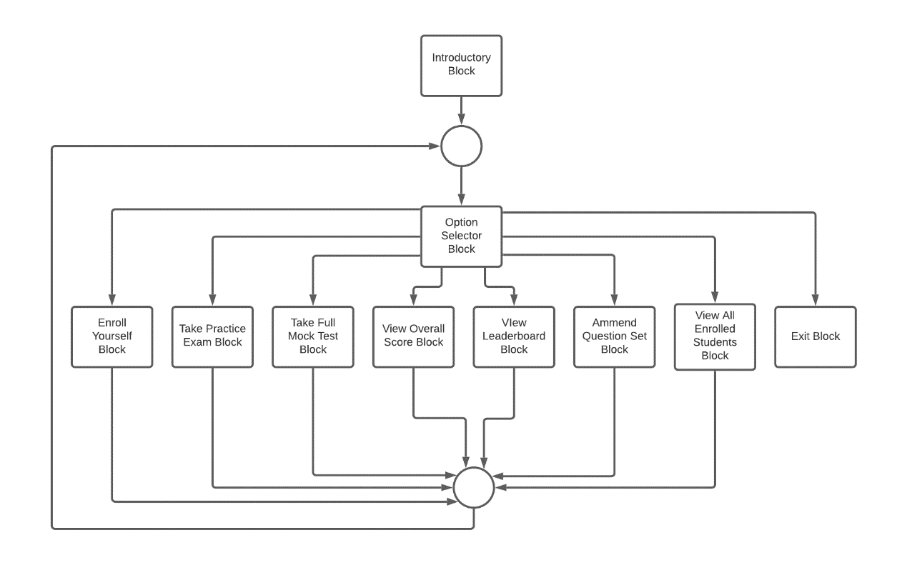
Block Diagram:

Slide 6
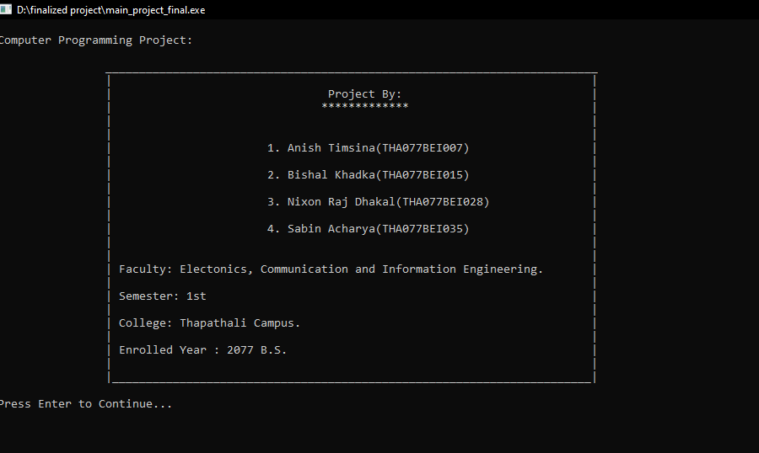
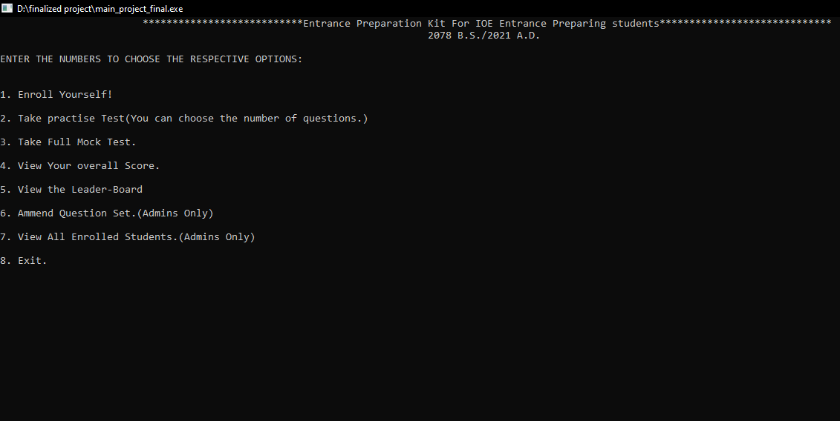
Introduction and Option selector Block
Introduction Block:
Displays the information that include the name of the project the team members, faculty, etc.
Option Selector Block:
Displays the available option to the user and helps to select the desired functions.

Slide 7
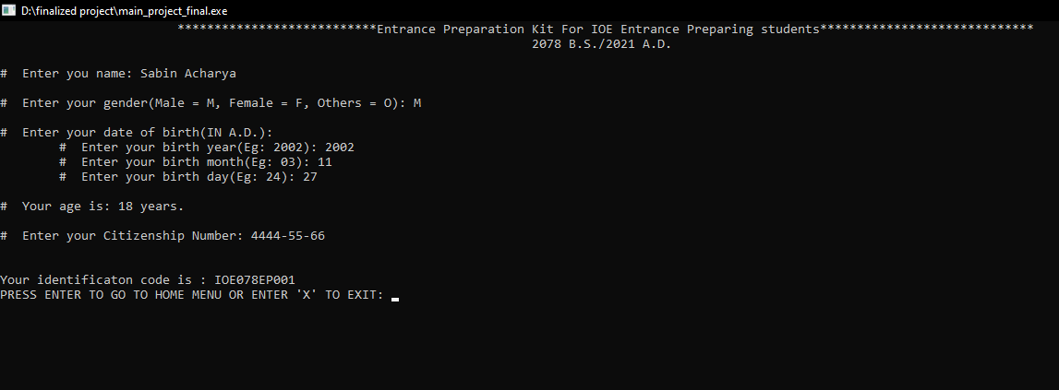
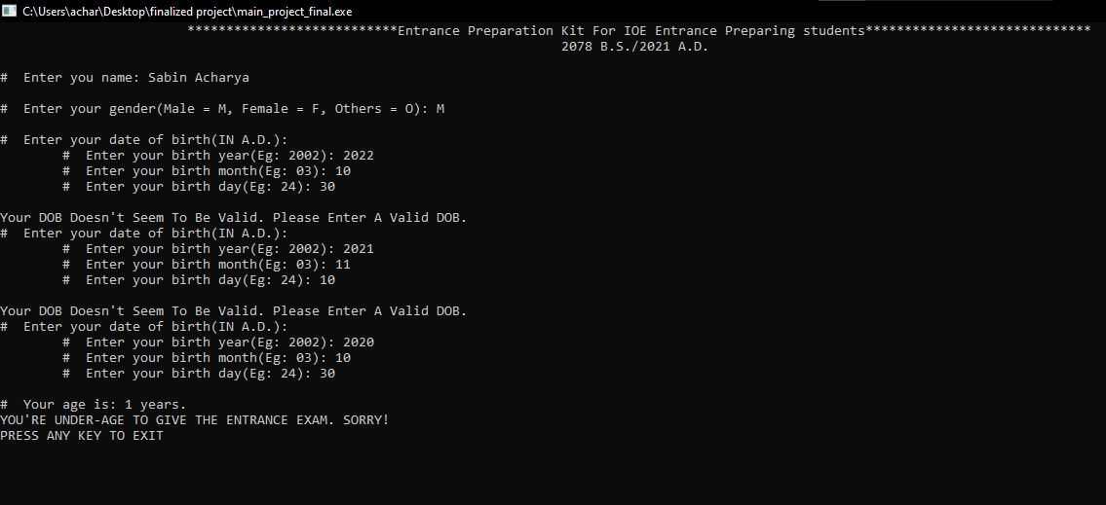
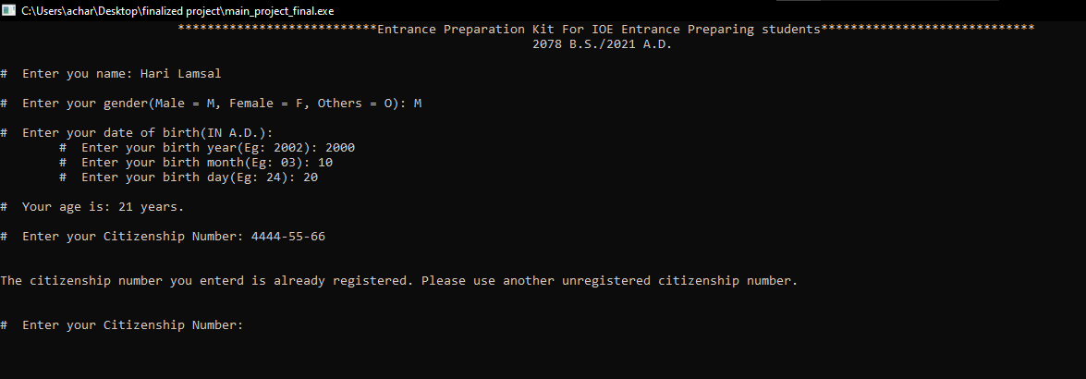
Enroll Yourself Block
Working Block Diagram:
Enroll Yourself
Enter name
Enter Date of Birth
Enter Gender
Enter Citizenship
Generates Unique Identification code and displays it
Takes the personal details of the students validates it and provides the unique identification code to them
If the user provides the wrong data regarding the dates, the program identifies it and tells it to be invalid(fig 1).
It also recognizes the registered citizenship so that two persons cannot have same citizenship number(fig 2).
Fig 1
Fig 2

Slide 8
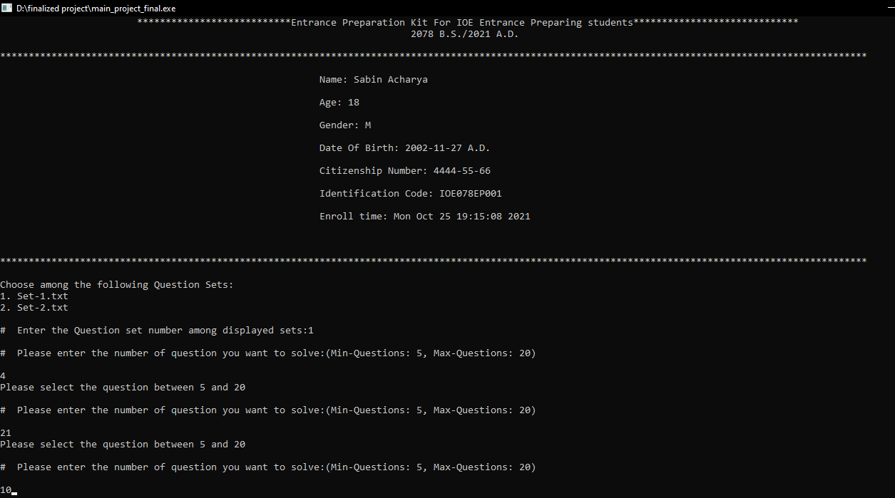
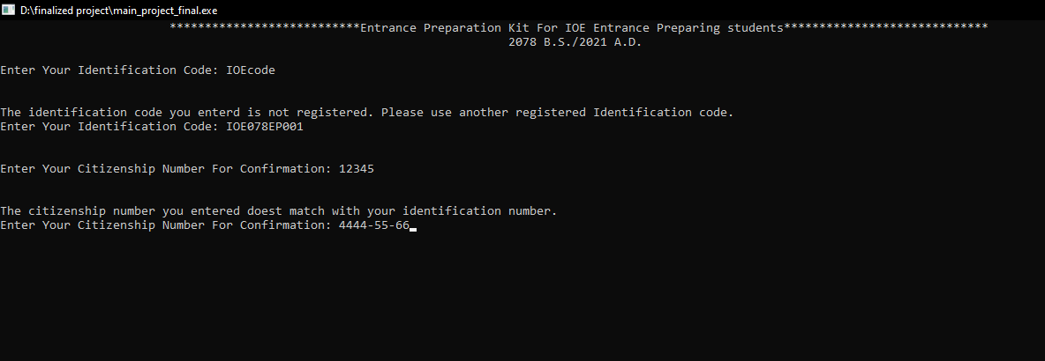
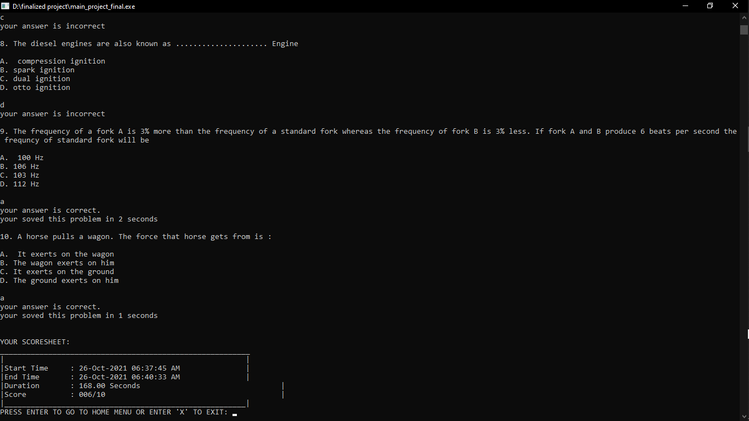
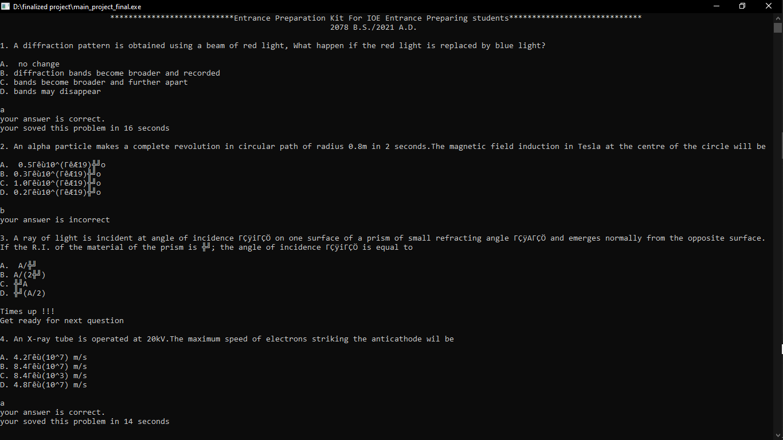
Take Practice Exam Block
2. It shows the available question sets added by the institute and allows user to select the set and select number of question they want to answer between 5 to 20.
1. It checks if the user trying to give the exam is registered or not. The identification code provided by the software is only considered as valid. Also the citizenship number must match with the identification code.
3. Questions are provided and the answer is checked as soon as answered. After 90 seconds the question time gets over.
4. When all questions are answered, the scoresheet is displayed showing the start time, end time, duration and marks.

Slide 9
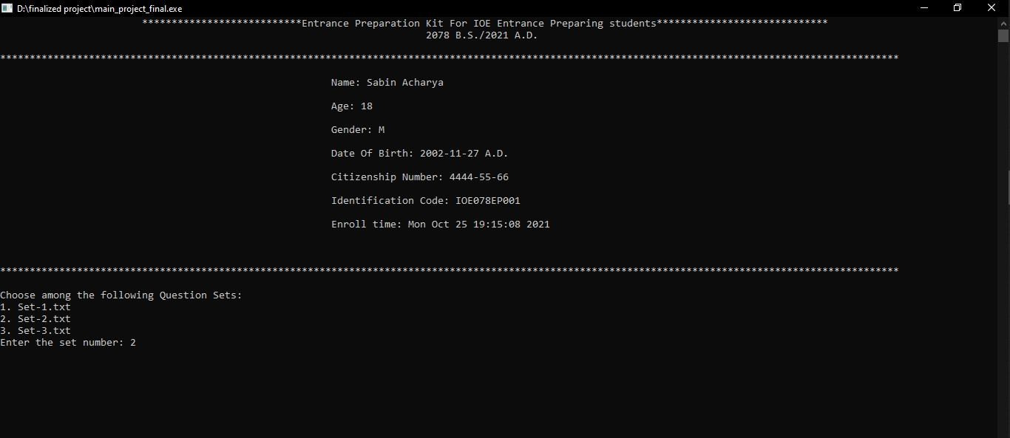
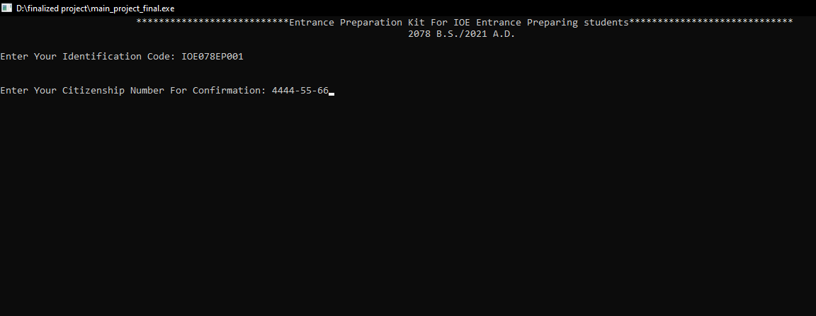
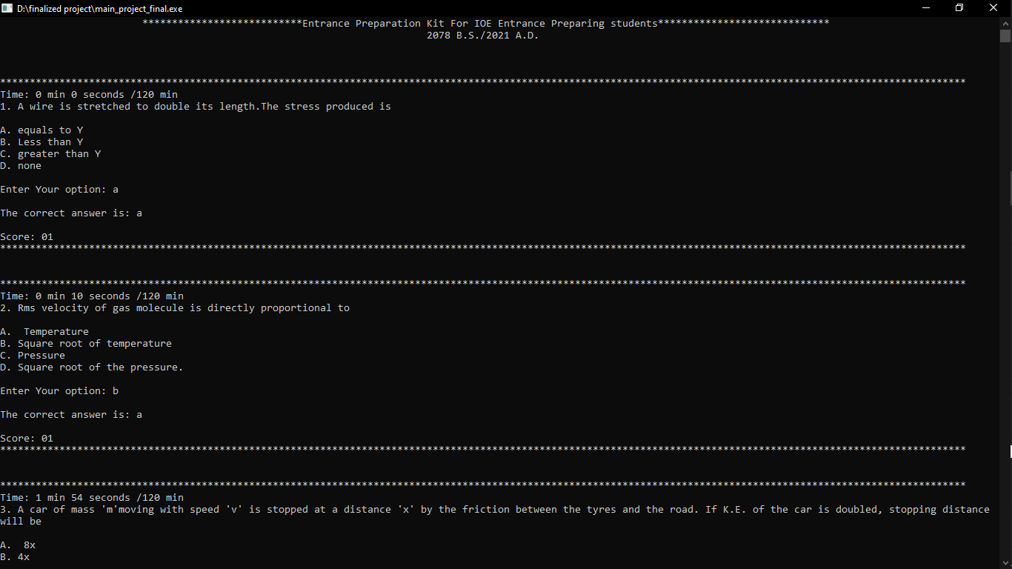
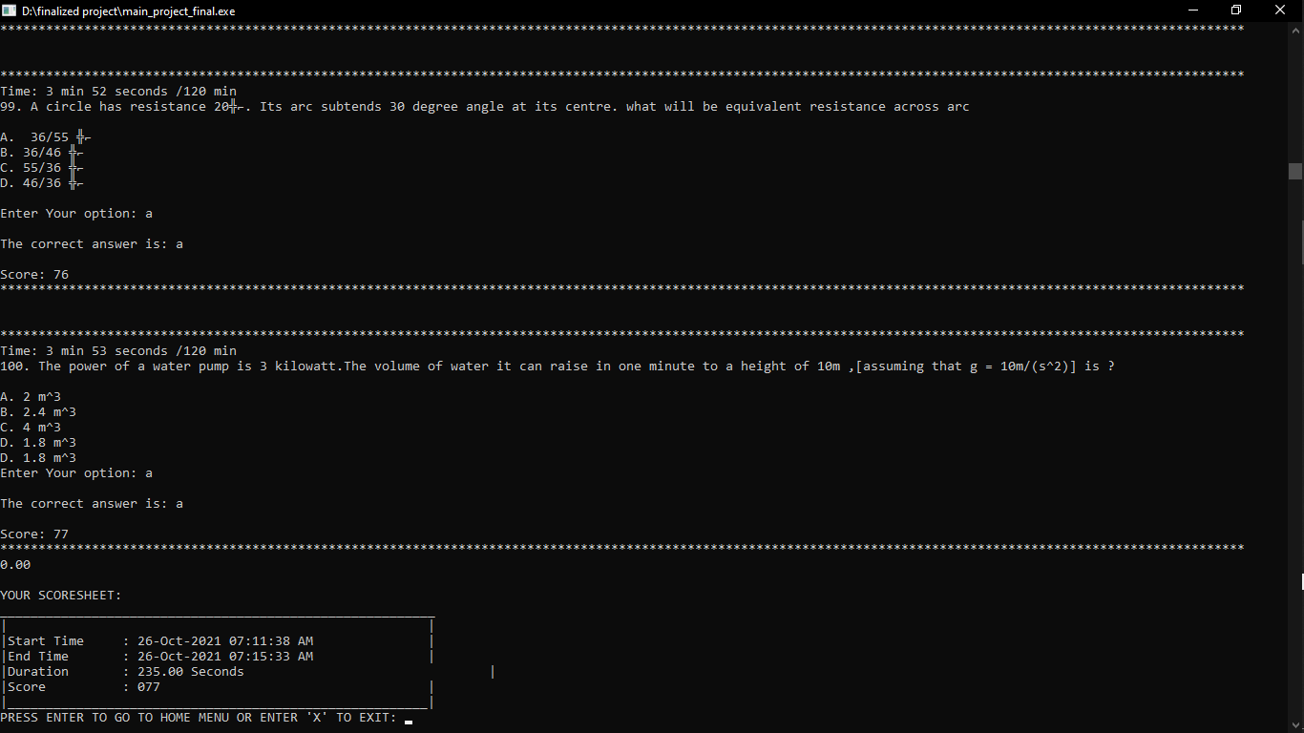
Take Mock Test Block
2. It shows the available question sets added by the institute and allows user to select the set. 100 Questions are compulsory with a time limit of 2 hours in total
1. The user is verified by matching the citizenship number and identification number same as the practice exam block.
3. Questions are provided and the answer is checked as soon as answered by the user.
4. When all questions are answered, the scoresheet is displayed showing the start time, end time, duration and marks.

Slide 10

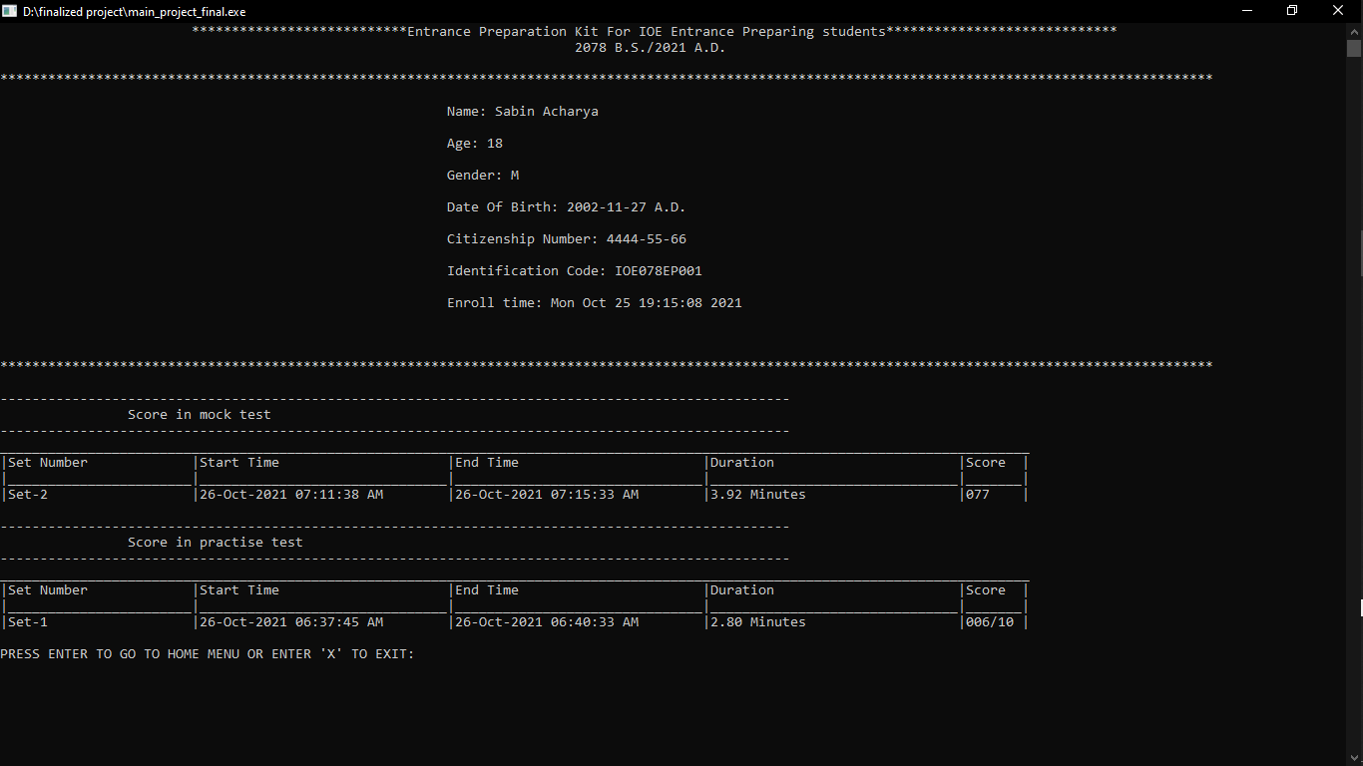
View Overall Score Block
Verifies the user using the identification code and citizenship number check.
Shows the data of the start time, end time, duration, marks, question sets solved by the used since the day he/she is enrolled in the software in tabular format.
The scores in practice test and mock test are displayed separately.

Slide 11
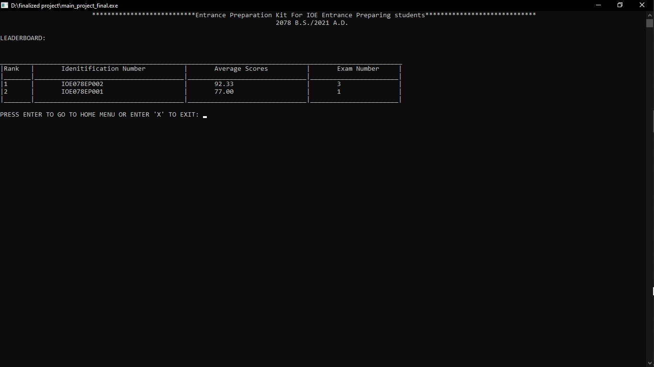
View Leaderboard Block
Shows the ranking of the student based on the average marks obtained by them in all the mock tests exam they gave.
Only consistent students can hold the rank here which shows the real evaluation of the students.

Slide 12
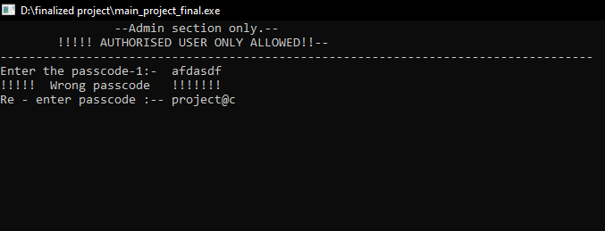
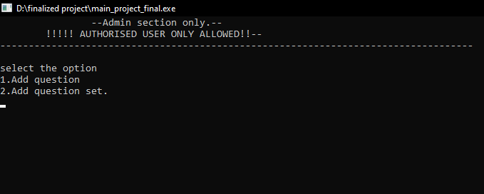
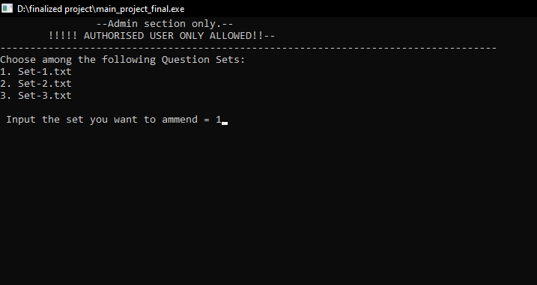
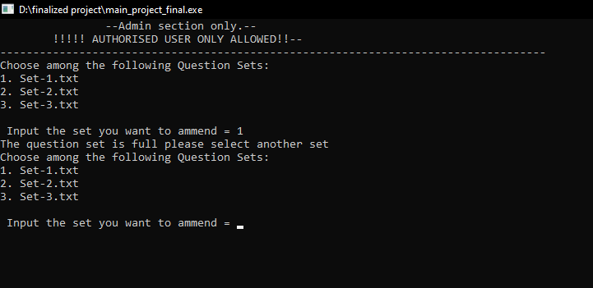
Amend Question Set Block
1. It asks for the user for passcode-1 to access the admin section.
2. It then provides two options, either to add question to existing set or to add a new question set.
3. On selecting add question to existing set option, the existing question sets are displayed. Among them, the desired set can be chosed by the user.
4. If the selected question set has 100 question sets, the message that the set is full is displayed.

Slide 13
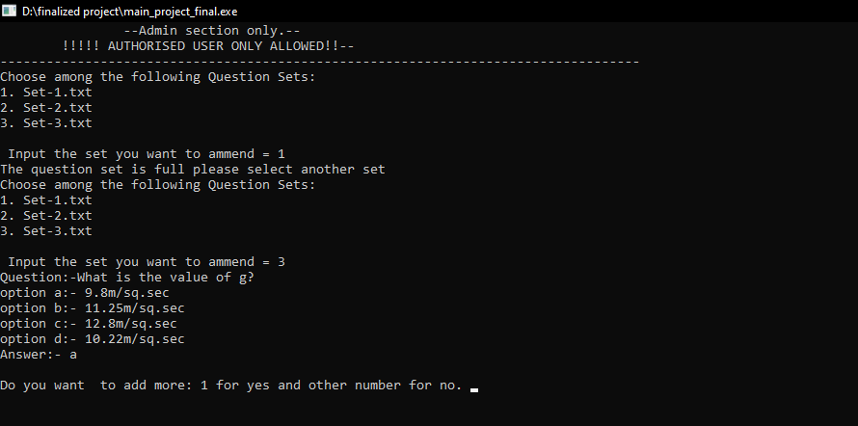
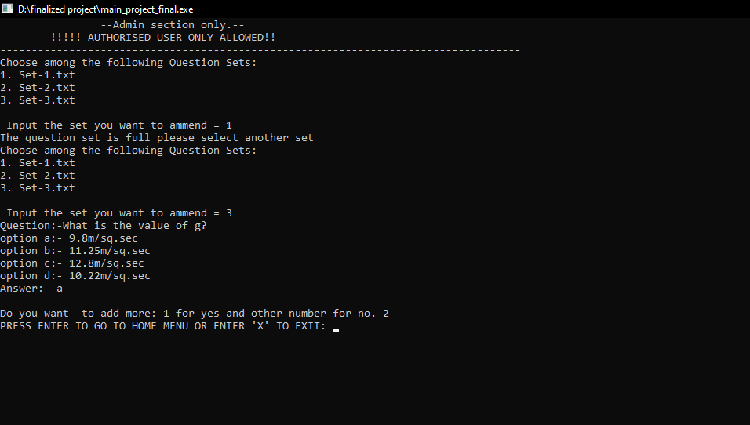
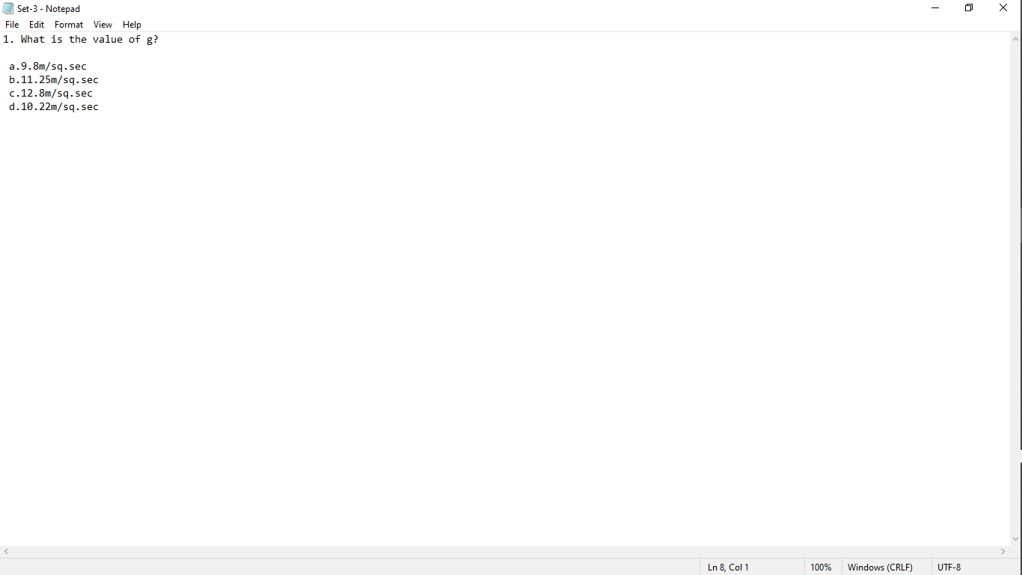
5. On selecting the set which doesn’t have 100 questions, they can add questions and answers easily. On adding each question, it confirms if the user wants more questions to be added.
6. On entering anything other than 1, it asks to press enter to continue to home page and X to exit the program.
7. The question gets added in the selected set serially.

Slide 14
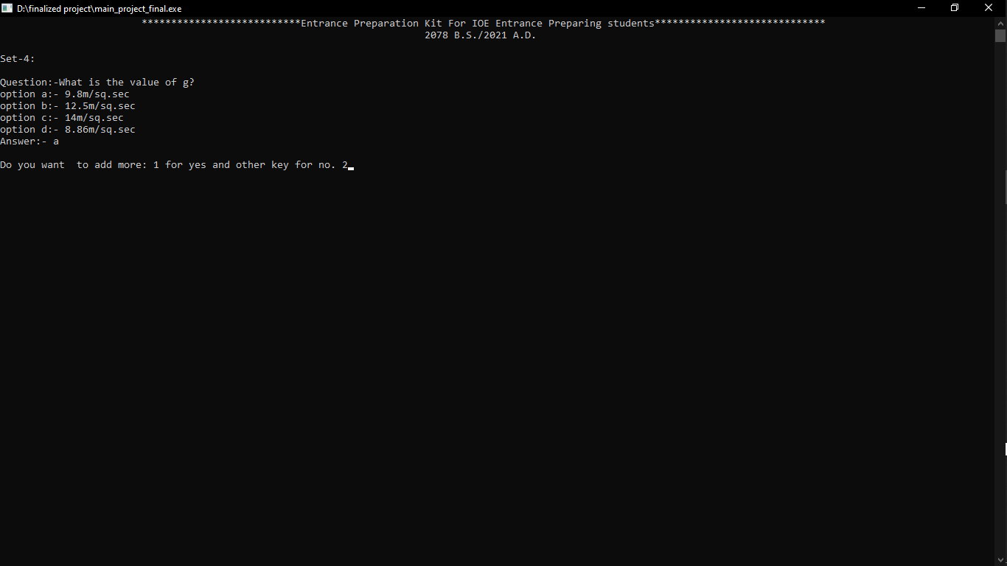

8. On selecting add question set, a new set is formed in serial order in which question is added in same manner as the add question to existing set option.
9. A new set is formed which consists of the questions added from the page. The admin can add some questions now and then add the rest question next time using the add question to existing set feature.

Slide 15
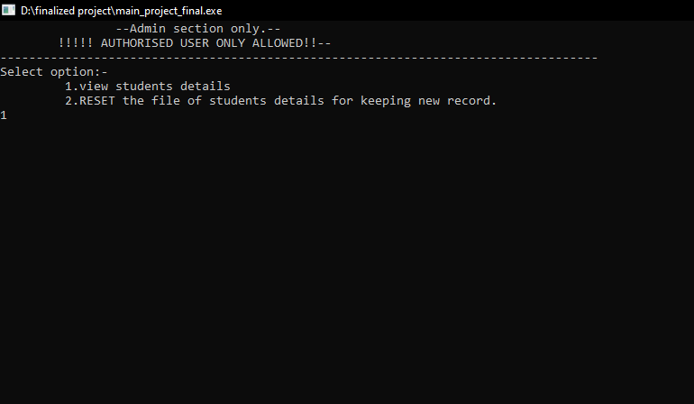
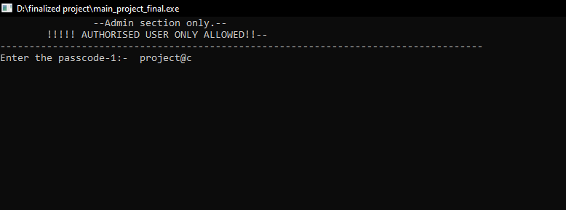
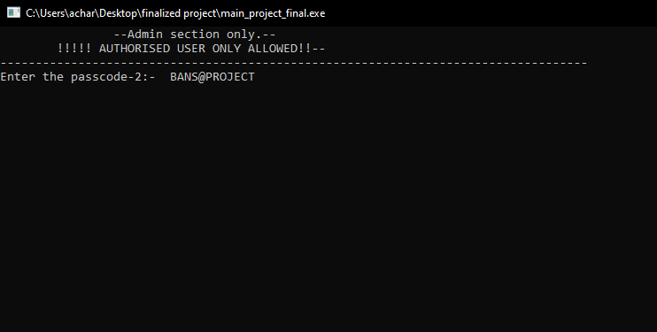
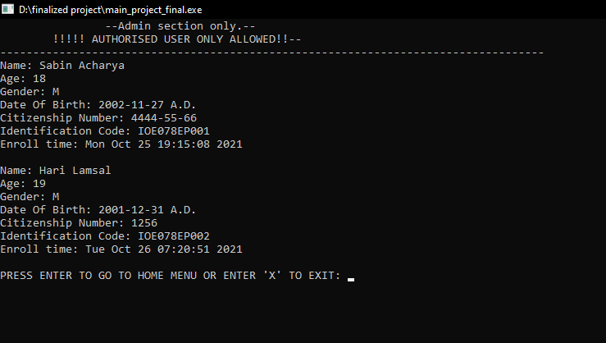
View Enrolled Students
1. It asks for the user for passcode-1 to access the admin section.
2. It then provides two options, either to view student details or to reset the file of students.
3. On selecting view student details option, the passcode-2 is requested which is different than passcode-2. It adds data security to the project.
4. On giving the passcode-2 correctly, all the details of the enrolled students are displayed.

Slide 16
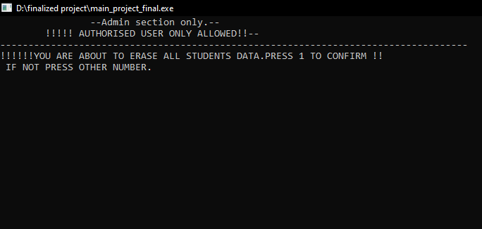
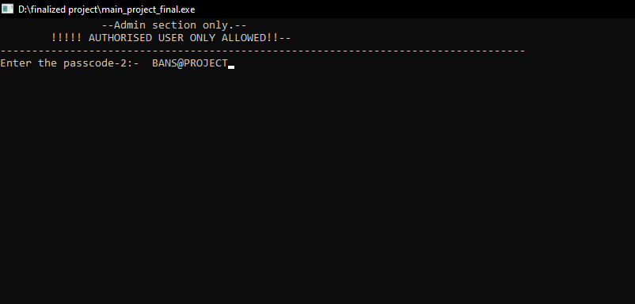
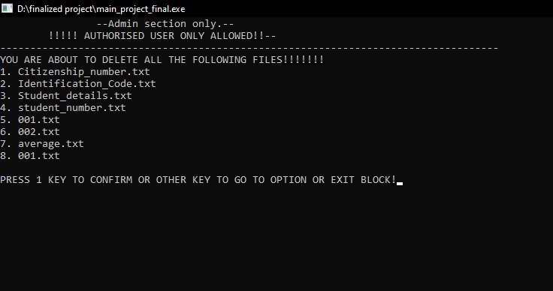
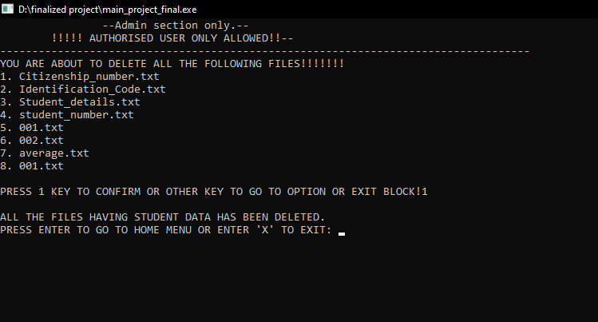
5. It selecting the reset student file option warning appears to proceed.
6. On confirming by pressing 1, the passcode-2 is requested to proceed further.
7. On providing passcode-2 correctly, the files that are going to be deleted is shown and confirmation is asked.
4. On confirming by pressing 1, the data files displayed will be deleted if it is not externally opened by the user.

Slide 17
Exit Block
This block exits the program when selected.
THANK YOU

