Slide 1


Advanced Customer Segmentation Using Unsupervised Learning
Customer Intelligence & Strategic Business Insights
Capstone Project Presentation
Advanced Customer Segmentation | Capstone Project | Slide 1

Slide 2
Organizations lack structured customer segmentation
Difficulty identifying revenue-driving and churn-risk customers
Need for data-driven marketing allocation
Objective: Build scalable unsupervised segmentation framework
Business Context & Objective
Advanced Customer Segmentation | Capstone Project | Slide 2

Slide 3
Online Retail Dataset (5000+ transactions)
Transactional purchase records
Customer-level aggregation performed
RFM behavioral modeling applied
Dataset Overview
Advanced Customer Segmentation | Capstone Project | Slide 3

Slide 4
Removed missing Customer IDs
Eliminated invalid and negative transactions
Outlier treatment using statistical thresholds
Feature scaling via StandardScaler
Data Preprocessing Strategy
Advanced Customer Segmentation | Capstone Project | Slide 4

Slide 5
Recency – Days since last purchase
Frequency – Transaction count
Monetary – Revenue contribution
Derived metrics: Avg order value, product diversity
Feature Engineering Framework
Advanced Customer Segmentation | Capstone Project | Slide 5

Slide 6
KMeans (Partition-based)
Hierarchical (Agglomerative)
DBSCAN (Density-based)
Gaussian Mixture Model (Probabilistic)
Clustering Algorithms Implemented
Advanced Customer Segmentation | Capstone Project | Slide 6

Slide 7
Elbow Method for optimal K detection
Silhouette Score for cluster separation
Davies-Bouldin Index for compactness evaluation
K=3 selected based on balanced metrics
Cluster Optimization Strategy
Advanced Customer Segmentation | Capstone Project | Slide 7

Slide 8
GMM – Highest Silhouette Score (0.3907)
DBSCAN – Lowest Davies-Bouldin Index (0.7535)
KMeans – Strong interpretability
Final approach balances technical strength & business clarity
Model Performance Comparison
Advanced Customer Segmentation | Capstone Project | Slide 8

Slide 9
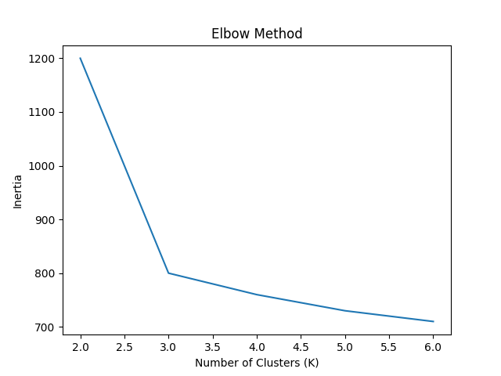
Elbow Method Visualization
Advanced Customer Segmentation | Capstone Project | Slide 9

Slide 10
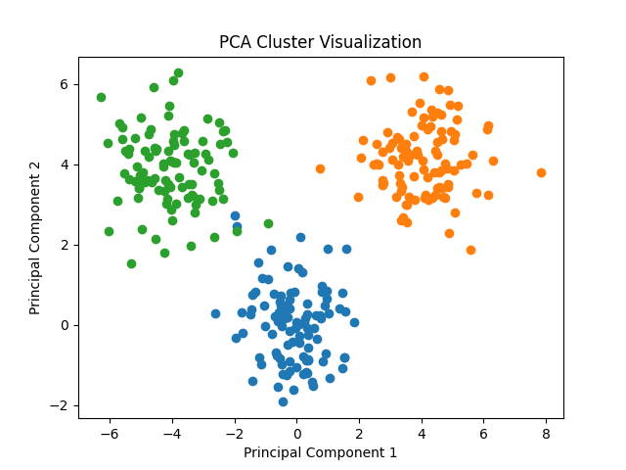
PCA Cluster Visualization
Advanced Customer Segmentation | Capstone Project | Slide 10

Slide 11
High Recency, Low Frequency
Minimal revenue contribution
High churn probability
Strategy: Re-engagement & retention campaigns
Cluster 0 – Dormant / At-Risk Segment
Advanced Customer Segmentation | Capstone Project | Slide 11

Slide 12
Low Recency, High Frequency
Highest revenue contribution
Core customer base
Strategy: Loyalty programs & exclusive offers
Cluster 1 – Premium Loyal Segment
Advanced Customer Segmentation | Capstone Project | Slide 12

Slide 13
Moderate purchasing behavior
Stable revenue contribution
Upselling opportunity
Strategy: Cross-sell & personalization
Cluster 2 – Mid-Tier Growth Segment
Advanced Customer Segmentation | Capstone Project | Slide 13

Slide 14
Premium segment drives majority revenue
Dormant segment represents retention opportunity
Targeted segmentation improves marketing ROI
Scalable enterprise-ready analytics pipeline
Strategic Business Impact
Advanced Customer Segmentation | Capstone Project | Slide 14

Slide 15
3 distinct behavioral customer segments identified
Scientific validation through multiple clustering metrics
Actionable marketing strategies developed
Framework ready for real-world deployment
Conclusion
Advanced Customer Segmentation | Capstone Project | Slide 15

