Slide 1
Data analytics with python
Name : Karthikeya K
Designation : Software Engineer at Tech Mahindra Ltd
Current location : Electronic city, Bengaluru
Domain : Social Media
Project : Facebook Data

Slide 2
Introduction :
Social media is an interactive platform where information, ideas and data can be created, shared through virtual communities and networks.
We will try to understand the details of a person through his Facebook profile details and find some relationship between the different attributes.

Slide 3
Data set description :
Our data set contains collective information about the Facebook social media platform. It has several attributes regarding a person’s Facebook account like DOB, number of friends, total number of likes, gender of the person etc.

Slide 4
Pandas profiling :
We will be reading the data from a tsv file and converting them into a data frame.
With the help of pandas profiling we will be able to get an overview about the data collected.
We can basically speed up EDA with the help of pandas profiling which is very powerful.
We can get quick information like the number of columns and rows in the data frame, the type of data in each column, what are the missing values, how many rows are duplicated, the correlation between the columns, sample of the first and last few rows of the data frame.

Slide 5
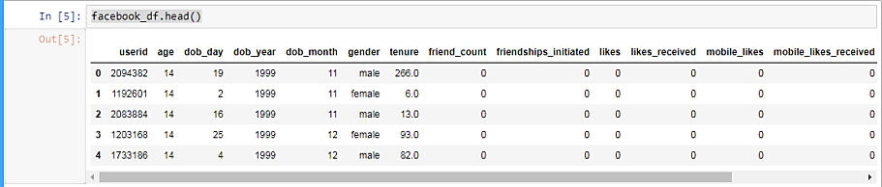
Summary of the data
We will be naming our data frame as “facebook_df” .
Summary can be obtained by looking into the head and tail of the data set.
Eg: facebook_df.head()

Slide 6
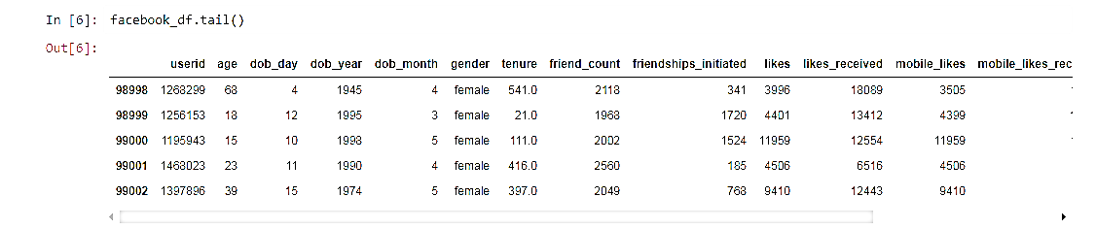
Eg : facebook_df.tail()

Slide 7
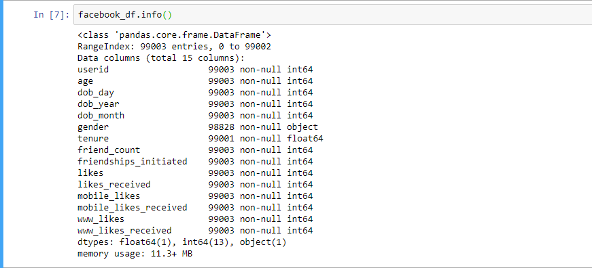
Basic info of the date frame:
Gives information about the number of rows and columns and the type of elements in each column of the data frame.

Slide 8
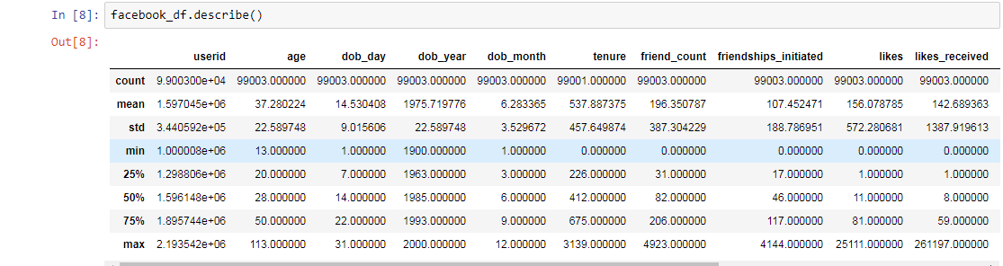
Descriptive statistics :
We can understand the Q1, Q2, Q3, mean, std deviation, min, max and count data from this command.

Slide 9
Missing values :
Note : Columns with high co relation are dropped from the data frame.
As we can see there are 2 columns with some missing row values. i.e gender and tenure column.
We use the isnull() python method of the pandas package to find the missing values present in the above 2 columns.
We list out the indices of all the missing values.

Slide 10
Continued . . .
Since gender column contains the categorical data (not numerical) we will be using the mode of the gender column to fill the missing values in it.
If we observe carefully we can see that in the tenure column the difference between the min and 25% & difference b/w the max and 75% is drastic.
In tenure column the standard deviation is high compared to mean. This indicates that the mean is drawn towards the outliers and it’s not a normal distribution.
Hence we fill its missing values with median instead of mean.

Slide 11
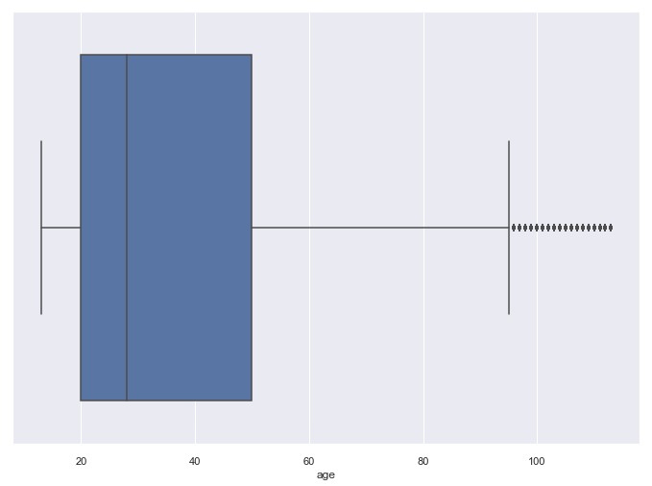
Detect the outliers :
Outliers can be detected with the help of box plots. Its evident that outliers are present in many columns in our data frame.
Eg :
sns.boxplot(x='age', data=facebook_df)

Slide 12
Zscore to eliminate outliers :
In our example we use the tenure and the age column to find the outliers. Our method to find the outliers here will be the “zscore” method.
First we detect the zscore of these columns and keep the threshold as 3.
So in our case if the zscore > 3 we drop such values from the data frame.
Hence in this way we drop some of the outliers in the data to make it more of a normal distribution.

Slide 13
Data transformation :
We can convert the categorical gender column into numerical data for easy analysis.
Eg : convert male as 1 and female as 0.
We can also create a new column. We will create a new column named Facebook_Usertype for easy categorization of the gender column.
Eg : If age < 20 we call them “Teenager” else male or female.

Slide 14
Feature Engineering :
We usually convert categorical data to numerical data for easy statistical analysis and to create models using machine learning.
Hence we convert Facebook_Usertype column to numerical values .
Eg : Teenager as 2
Male as 1
Female as 0

Slide 15
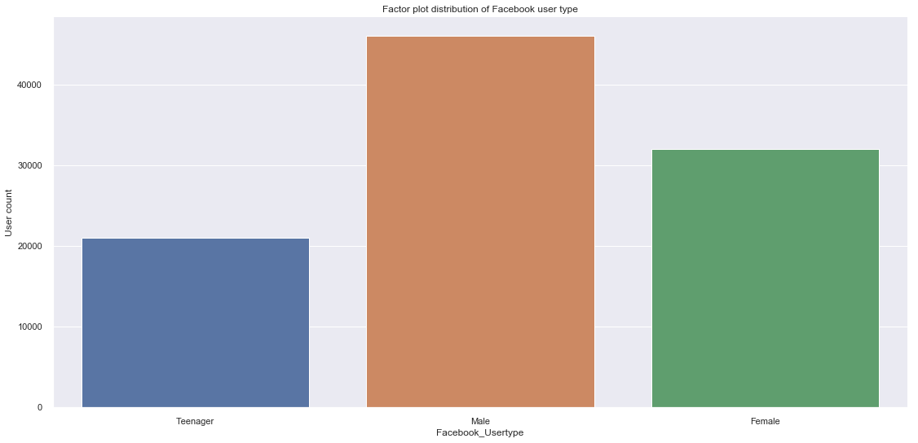
Data visualization
Factor plot :
To analyse the Facebook_Usertype column. i.e the different types of facebook users :
Eg : (More male fb users compared to female/teenager)
factor_visual = sns.factorplot(x='Facebook_Usertype', data=facebook_df, kind='count', size=8, aspect=2.0)

Slide 16
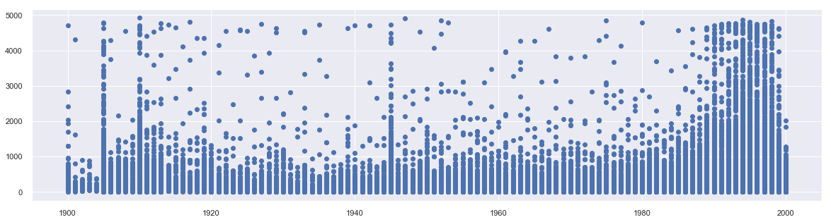
Scatter plot :
Lets try to find the relationship b/w the date of birth of a person vs the number of friends he/she has.
Eg:
plt.scatter(facebook_df['dob_year'], facebook_df['friend_count'] )
DOB analysis : It can be seen that people who are born after 1980 have more friend count in their facebook profile.

Slide 17
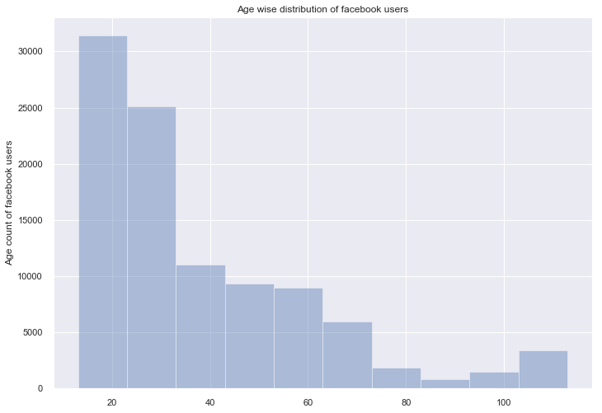
Distribution plot :
Eg :
sns.distplot(facebook_df.age.values, bins=10, kde=False)
Plot suggests that there are more number of young people who use fb social media. Older people engage very less with the social media platform.

Slide 18
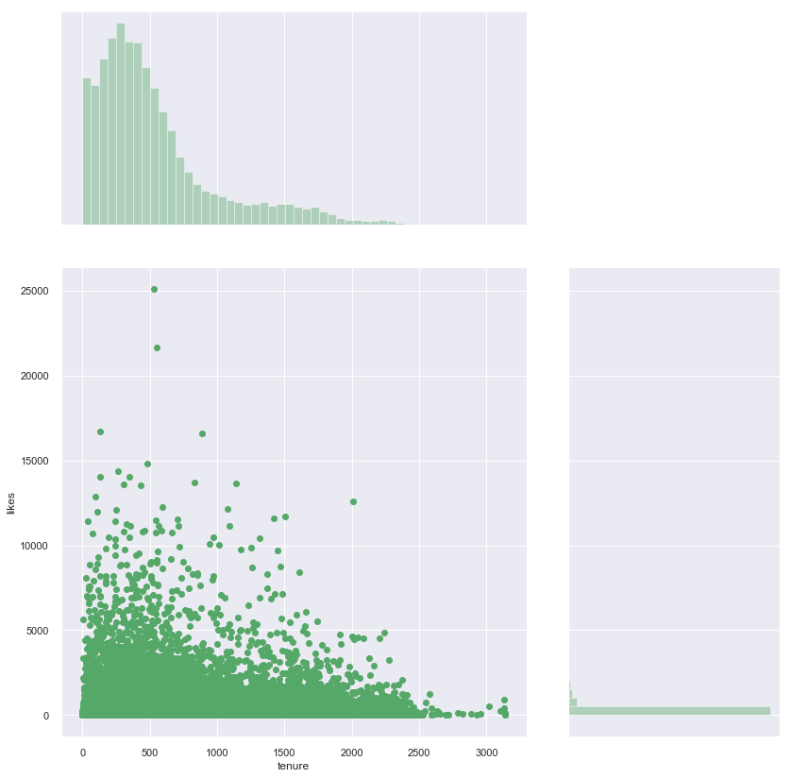
Joint plot :
Eg : Tenure analysis – Bulk of users spend time b/w 0-1000 mins with the likes being less than 5000.
sns.jointplot(x='tenure', y='likes', data=facebook_df, height=12, ratio=2, color='g')

Slide 19
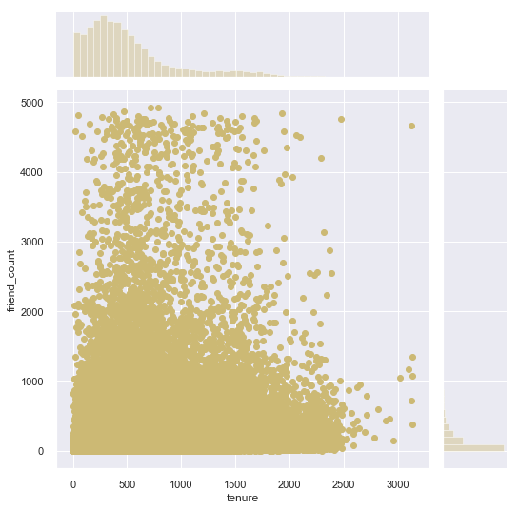
Friend count analysis :
When friend count is less than 1000 people spend around 500-1000 mins online. As friend count increases the tenure decreases. This says that fb usage reaches saturation with increase in friends and the engagement with virtual reality decreases.

Slide 20
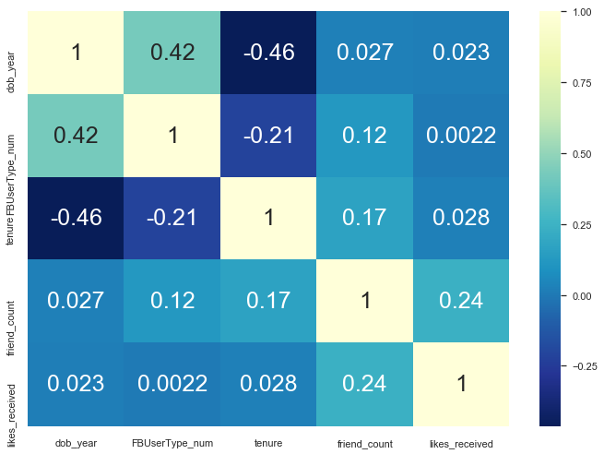
Heatmap : Visual representation of correlation between columns using heatmap.

Slide 21
Eg:
sns.heatmap(facebook_df[['dob_year', 'FBUserType_num', 'tenure', 'friend_count', 'likes_received']].corr(), cmap='YlGnBu_r', annot=True)
Some observations :
No. of likes received is positively correlated with the number of friends in a person’s social media account.
Tenure is highly negatively correlated with the DOB of a person.
User type has negligible effect on the number of likes received by a person.

Slide 22
THANK YOU
End of slideshow

