Slide 1
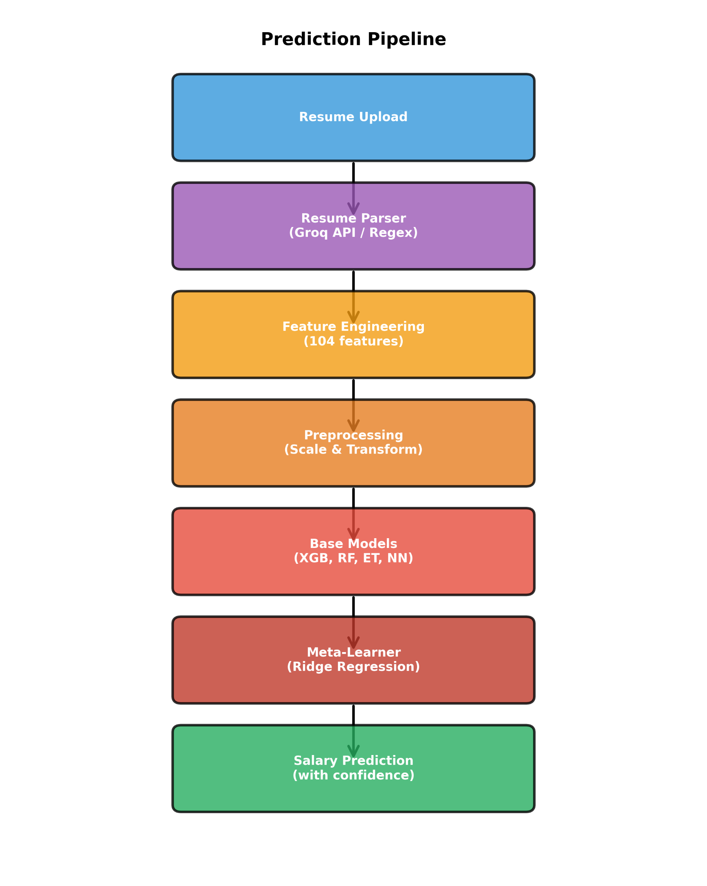
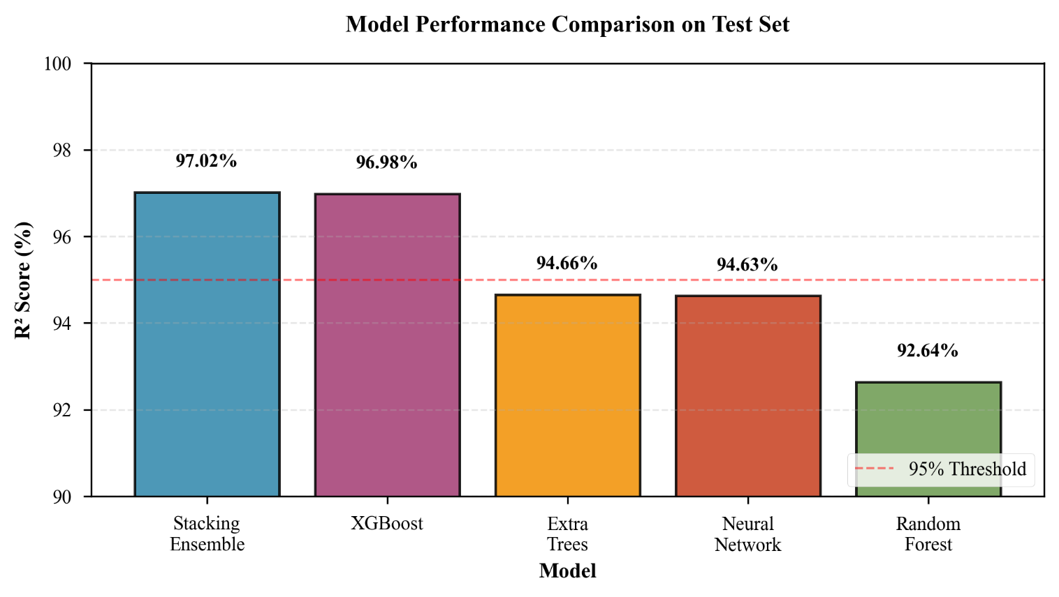
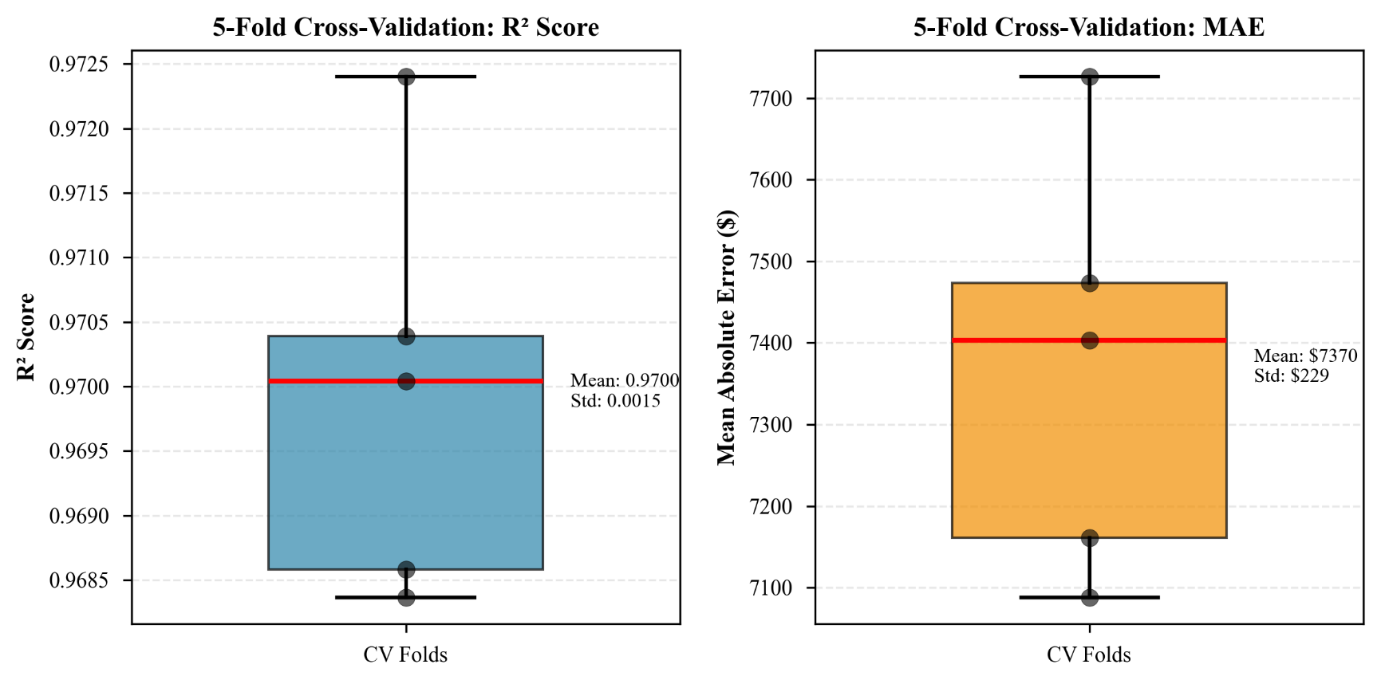
Department of Computer Science and Engineering
INVATI-2026
SALARYLENS: AN INTELLIGENT RESUME-BASED SALARY PREDICTION SYSTEM USING STACKING ENSEMBLE LEARNING
ABSTRACT
SalaryLens is an intelligent web-based system predicting annual salaries from resume data using advanced ML. It addresses salary information asymmetry for job seekers, employers, and HR professionals. A stacking ensemble of XGBoost, Random Forest, Extra Trees, and Neural Networks with Ridge regression as meta-learner achieves 97.02% R² score and 91.29% accuracy (±10% margin) on 29,850 resumes. 104 engineered features, LLM-based parsing (85%), and a Streamlit web app with what-if analysis deliver a production-ready career planning tool with MAE of $7,071 and sub-second predictions.
KEYWORDS :
Salary Prediction | Machine Learning | Stacking Ensemble | Resume Parsing | Feature Engineering | Career Analytics | Explainable AI
OBJECTIVES AND PROBLEM STATEMENT
PROPOSED METHODOLGY
1. Develop high-accuracy prediction model achieving >95% R² across diverse job roles and experience levels
2. Engineer 100+ features from raw resume data through 10 systematic transformation categories
3. Integrate LLM-based resume parsing (Groq + Llama 3.1 70B) with >80% extraction accuracy
4. Implement SHAP explainability for transparent, interpretable salary predictions
5. Deploy interactive what-if tools and production-ready web app on Streamlit Cloud
Problem Statement: Develop an accurate, transparent system predicting annual salaries from resume analysis, providing actionable career insights and addressing information asymmetry in salary negotiation.
Pipeline: Resume Upload → LLM Parsing (Groq/Llama 3.1 70B, 85%) → Feature Eng. (15→104 features, 10 categories) → Stacking Ensemble → Real-time Prediction
Base Learners:
• XGBoost: 1000 estimators, lr=0.02, R²=96.98%
• Random Forest: 400 estimators, max depth 20, R²=92.64%
• Extra Trees: 400 estimators, extreme randomness, R²=94.66%
• Neural Network: 256-128-64 layers, ReLU activation, R²=94.63%
Meta-Learner: Ridge Regression (α=5.0), 3-fold CV → Final R²: 97.02%
Feature Engineering: 10 categories: Ordinal (4), Binning (1), Polynomial (2), Interaction (12), Ratio (3), Achievement (4), Location (3), Target Encoding (6), Frequency (4), TF-IDF Skills (60) = 104 total features
Data: 29,850 records (from 30,000 after outlier removal), 85% train / 15% test split
Resume Parsing: Primary: Groq API + Llama 3.1 70B (85%, 2-3s) | Fallback: Regex-based (70%, <1s) | Formats: PDF, DOCX, TXT
NOVELTY & CONTRIBUTION
[S1] State-of-the-Art: 97.02% R², advanced from prior best 94.5% using novel 4-model + Ridge meta-learner
[S2] Feature Pipeline: 7.79% R² boost over raw features; ablation study validates each of 10 categories
[T1] Hybrid Parsing: Groq/Llama 3.1 70B (85%, 2-3s) + regex fallback (70%, <1s) for reliability
[T2] What-If Analysis: 5 career scenarios: skill upgrades, relocation, promotion, education, growth
[P1] Societal Impact: Reduces information asymmetry; promotes fair, transparent compensation for all
IMPACT
RESULTS
CONCLUSION & FUTURE WORK
APPLICATIONS
Model Performance:
Achievements:
✓ 97.02% R² surpassing prior best of 94.5%
✓ End-to-end: resume upload → career planning
✓ Production-deployed on Streamlit Cloud
✓ Rigorous ablation study and cross-validation
Future Work:
→ Real-world validation on live job platforms
→ Geographic expansion + international currency
→ Temporal modeling for salary trend analysis
→ Fairness audit and demographic bias mitigation
→ Mobile app + multi-task learning
Job Seekers: Data-driven salary benchmarking before negotiation
Recruiters/HR: Competitive compensation benchmarking and pay equity analysis
Career Planners: Simulate career decisions via what-if scenarios
Students: Career path planning based on earning potential and skill value
Research: Open-source ML pipeline for labor economics and salary modeling research
Real-Time Speed: Sub-1-second predictions end-to-end
Superior Accuracy: 8% improvement over prior SOTA systems
Transparency: SHAP feature importance reveals true salary drivers
Workplace Equity: Tools to identify and address pay disparities
Accessibility: WCAG AA compliant, responsive desktop and mobile
Key Metrics:
R² Score: 97.02% | Accuracy (±10%): 91.29%
MAE: $7,071 | RMSE: $8,846 | Speed: <1 sec
Model Comparison (R²):
★ SalaryLens: 97.02% | XGBoost: 96.98%
Extra Trees: 94.66% | Neural Net: 94.63%
Random Forest: 92.64% | Prior SOTA: 94.50%
5-Fold Cross-Validation:
Seniority Rank (12.3%) | Yrs Experience (10.8%)
Job Title Encoding (9.5%) | Seniority×Exp (8.7%)
Education Rank (7.2%) | Industry Encoding (6.9%)
Skills×Exp (6.1%) | Achievement Score (5.4%)
High Paying City (4.8%) | Company Rank (4.3%)
Field of Study Encoding (3.9%) | Num Skills (3.6%)
GPA×Edu (3.2%) | Exp² (2.8%)
Skills per Year (2.4%
Guided By:
Dr. Saroja Devi H.
Presentation By:
Mohan Acharya (1NT22CS116)
Prince Chaudhary (1NT22CS143)
Pradeep Badu (1NT22CS133)
AY 2025-26

