Slide 1
Exploratory Data Analysis
Energy Dataset
Submitted By:
Peter Vayda
Rupesh Acharya
Niyati Maheshwari

Slide 2
Data Analysis
Data - https://github.com/LuisM78/Appliances-energy-prediction-data
Data can be found in ‘csv’ file. It has data of temperature details and humidity details of 8 rooms inside the house. It also consist data like windspeed , visibility , temperature outside and pressure. Data has to be analyzed before proceeding for performing predictions with algorithms.

Slide 3
Exploratory Data Analysis Plan
Exploratory Data Analysis consists of following major tasks:
Form hypotheses/develop investigation themes to explore
Wrangle data
Assess quality of data
Profile data
Explore each individual variable in the dataset
Assess the relationship between each variable and the target
Assess interactions between variables
Explore data across many dimensions

Slide 4
Libraries
Plotting Libraries
Matplotlib
Seaborn
Wrangling Libraries
Numpy
Pandas
EDA Tools
Pandas_profiling

Slide 5

Analysis
We can see that the dataset contains 29 columns and 19,735 rows.

Slide 6
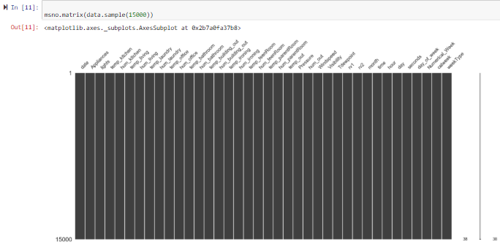
No Missing Values

Slide 7
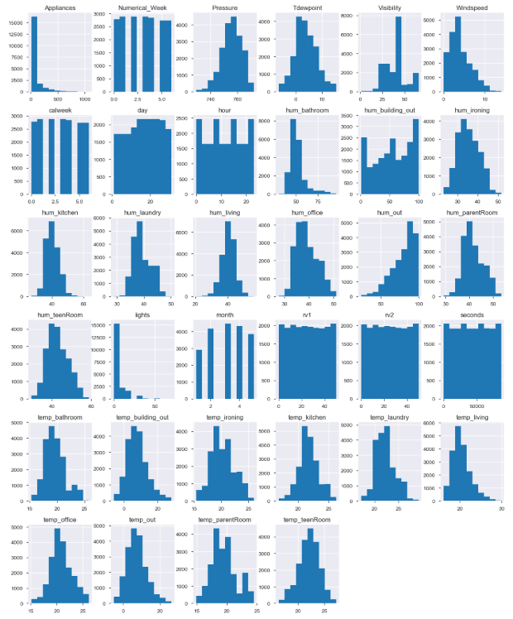
Histogram for Numerical Features

Slide 8
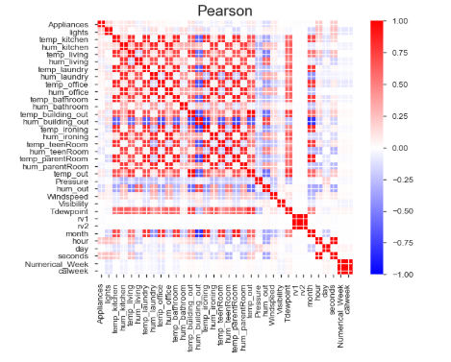
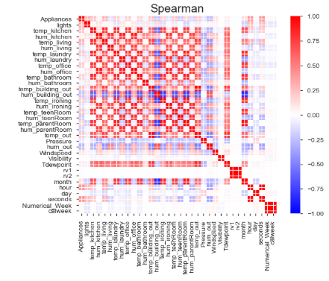
Correlations

Slide 9
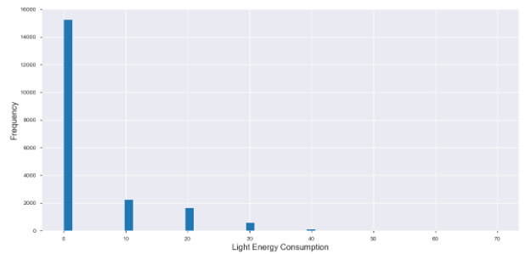
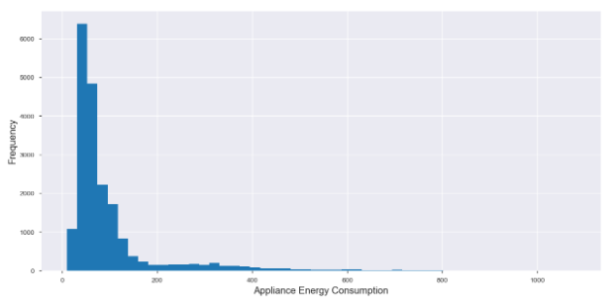
OVERALL ANALYSIS OF LIGHTS AND APPLIANCES

Slide 10
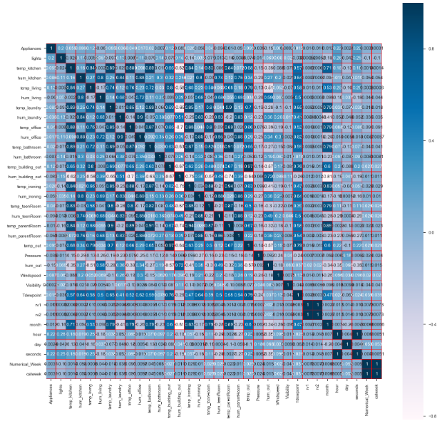
This is a heatmap which shows the correlation of all the variables. Here , values >0.05 is considered as factors that influence other variables. Anything less that that will be represented with blank spaces.

Slide 11
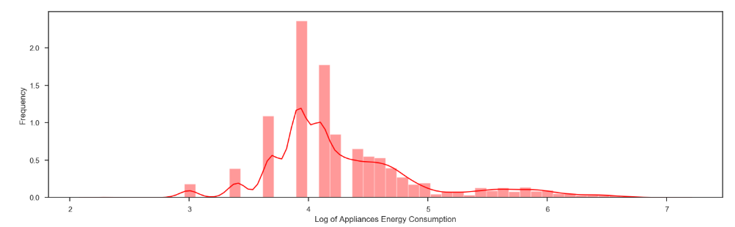
Distribution Curve of Appliances

Slide 12
Conclusion
When we see the above graphs of data, we can understand the pattern. Also, we get a view of how the data is varying and which features would be important to be selected to run selected algorithms to get the desired data.

