Slide 1

Water Quality of Barton Creek Watershed, Austin-Texas
DSCI_605: Final Project
Fall 2021
Smrita Acharya
Department of Environment, Geology and Natural Resource, Ball State University

Slide 2
Water Quality
Water quality is the measure of physical, chemical and biological characteristics of different water sources
Parameters
pH (Standard Units)
Conductivity (uS/cm)
Turbidity (NTU)
Ammonia as N (mg/L)
Water Temperature (Deg. Celsius)
Flow (Cubic feet per second)
Data source: https://data.austintexas.gov)
Project Objectives
To visualize the time series, change in water quality parameters in Barton Creek
To develop ShinyApp to visualize spatial sampling points, selected water quality parameters and data summaries

Slide 3
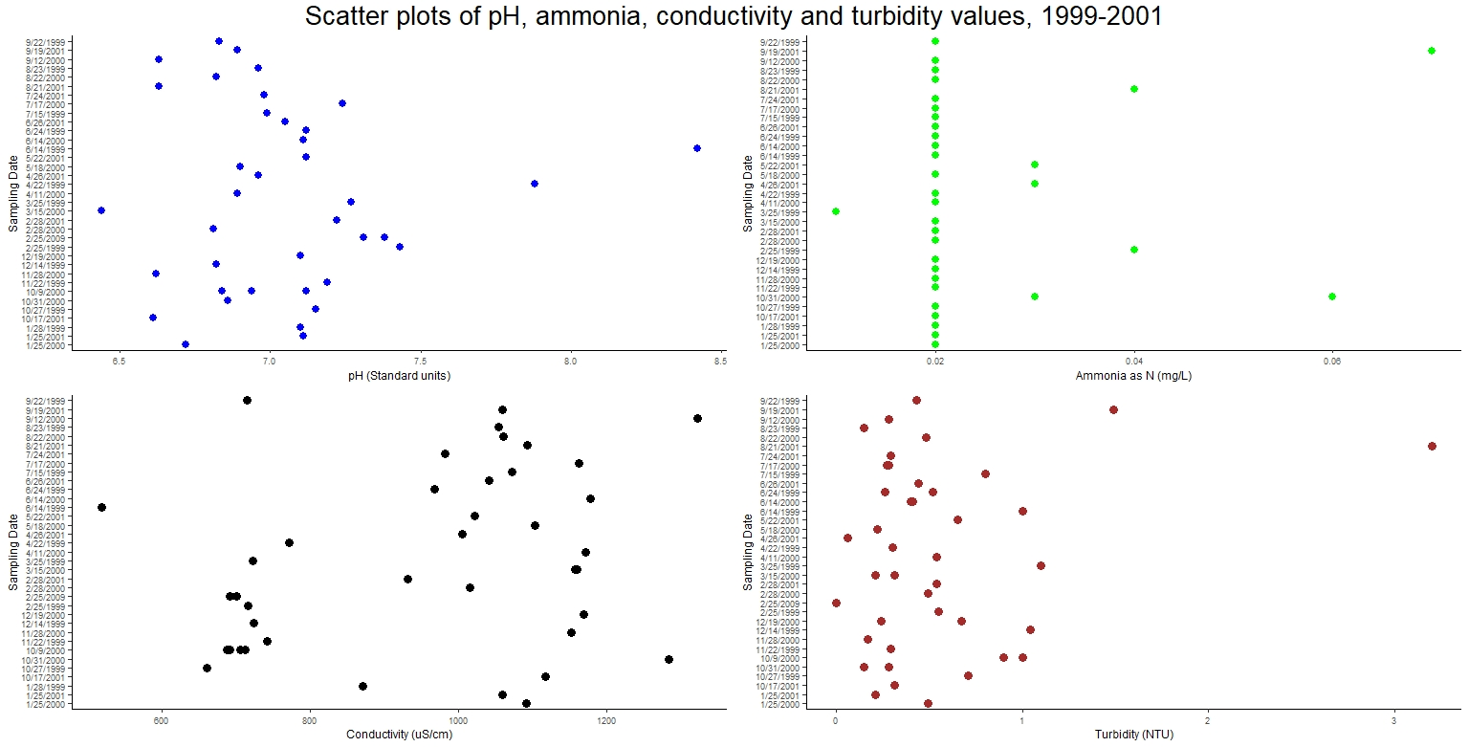
Deliverables
Figure 1: Time series plots of pH, conductivity and turbidity (1999-2001)

Slide 4
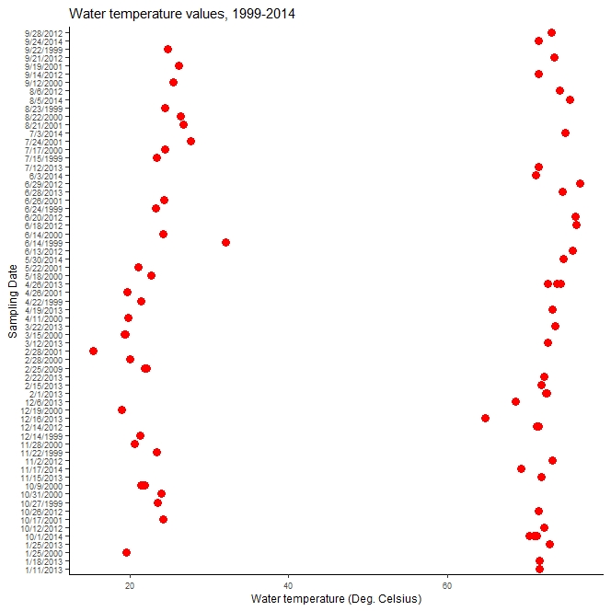
Figure 2: Time series plot of water temperature (1999-2014)

Slide 5
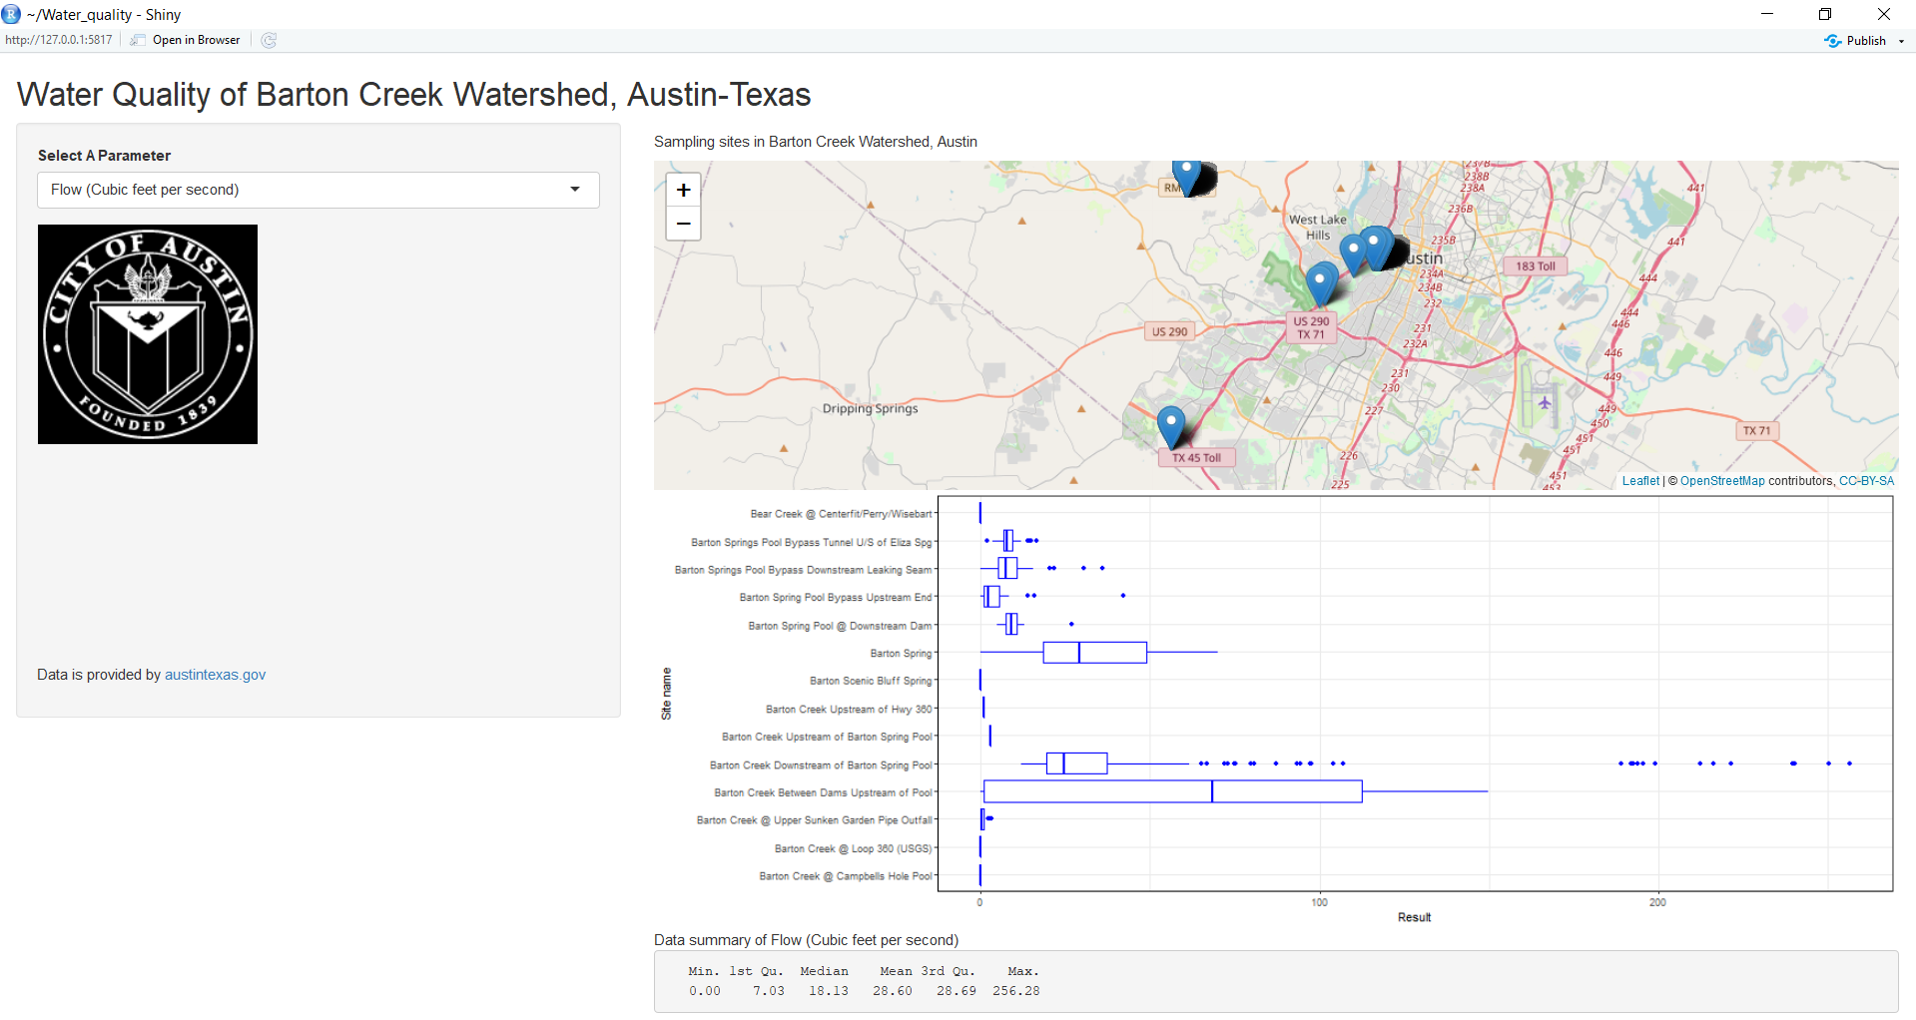
ShinyApp for Barton Creek Watershed

Slide 6
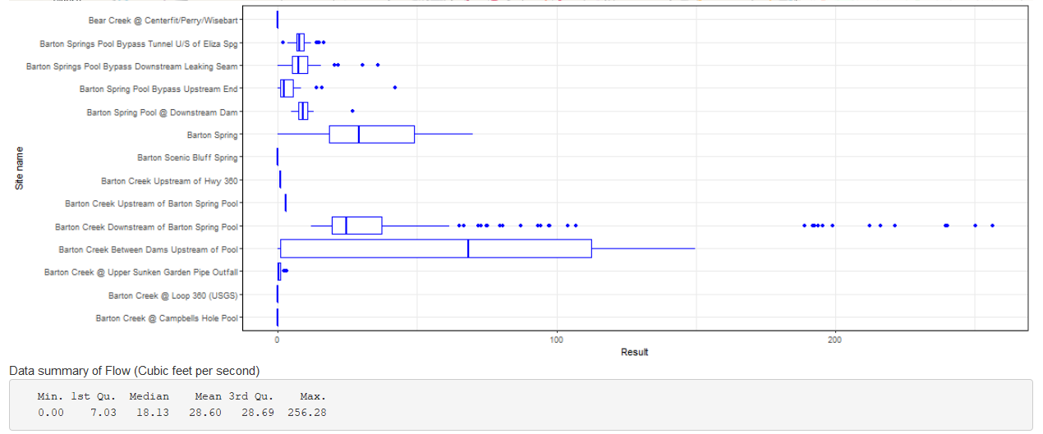
Figure 3: Box plot of flow rate (cubic feet per second) in water sampling locations

Slide 7
Summary and Limitations
The water quality parameters pH, turbidity, conductivity and TDS did not quite vary when plotted across sampling dates.
In months of September-October 2000-2001, water had higher turbidity
Springs samples had lowest water temperature values (<30 Deg. Celsius) and stream samples had higher water temperature values (>60 Deg. Celsius). The plot was distinctively clustered in scatter plot
Limitations: Statistical analysis of the dataset could not be done due to inconsistency in the parameters or sample size/date
THANK YOU!

