Slide 1
Honeywell Project - 3
Virtual Assistant for on-prem deployment
Faculty Mentors: Dr Pavithra H, Dr Smriti Srivastava
Student Team:
Tejash Pathak, Hruthikesh, Disha G N, Vaibhav Acharya, Pratham G Bhat

Slide 2
Problems
Problem | Fallback
The vision model significantly increasing the latency and the docker container startup time. | Vision model is currently not implemented.
The parser and extractor service is failing on multiple document upload. | Currently supports single document parsing and extracting.
The 7B parameter model container is failing to run on a CPU. | Currently moved to Llamma:3.2 3b parameter model.

Slide 3
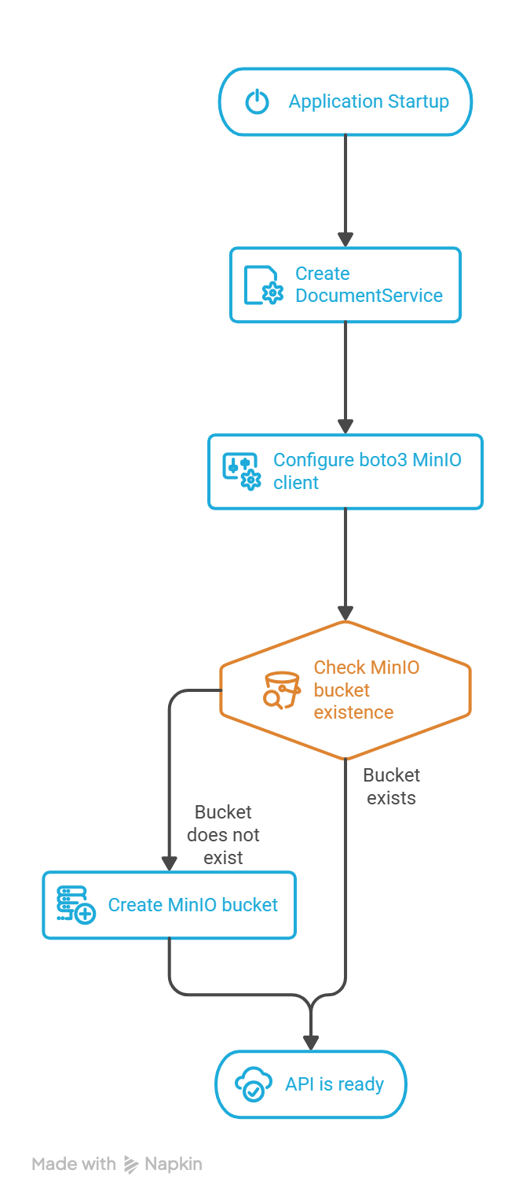
Document Upload

